Slide 1
CA Board of Pharmacy’s Communication Journey: Patient-Centered Labels
Virginia Herold, Executive Officer
California State Board of Pharmacy
www.pharmacy.ca.gov

Slide 2
California Patient Medication Safety Act (Chapter 470, Statutes 2007)
Required CA Board to Promulgate Regulations
Required CA Board to Report to the Legislature

Slide 3
CA Board Public Protection Mandate
Protection of the public shall be the highest priority for the California State Board of Pharmacy in exercising its licensing, regulatory, and disciplinary functions. Whenever the protection of the public is inconsistent with other interests sought to be promoted, the protection of the public shall be paramount.
California Business and Professions Code 4001.1

Slide 4
What information on the prescription label is most important?
Directions for use (224 of 1,207 responses = 18.6%)
Name of drug; if generic, state generic name AND brand name (222 of 1,207 responses = 18.4%)
Dosage prescribed (213 of 1,207 responses = 17.6%)
Side effects/warnings/interactions/contraindications (122 of 1,207 responses = 10.1%)
Purpose of drug – state what condition medication is prescribed to treat (84 of 1,207 responses = 7%)

Slide 5
What to change on the prescription label?
Print should be larger or darker (170 of 568 responses = 30%)
Nothing needs to be changed on the label (139 of 568 responses = 24.5%)
Include purpose of drug – state what condition medication is intended to treat (69 of 568 responses = 12.1%)

Slide 6
What would make prescription labels easier to read?
Larger or bolder print (314 of 522 responses = 60%)
When asked for other suggestions, the top responses were:
Easy-open lids/packages should be used; no child-proof caps for seniors (20 of 134 responses = 14.9%)
Include purpose of drug - state what condition medication is intended to treat (17 of 134 responses = 12.7%)

Slide 7
1st Iteration of Labels
18 months of public discussion at forums, hearings, committees and board meetings
Noticed: Nov. 20, 2009
Effective Date: Jan. 1, 2011

Slide 8
1st Iteration of Labels
Required Elements of Drug Containers Dispensed in CA:
Clustered in one area comprising at least 50% of label in at least 10-point sans serif font (12-point typeface, if requested) and listed in the following order in bold typeface or color, or blank space to set off:
Name of patient
Name of drug and strength (either trade or generic)
Directions for use
Condition or purpose as indicated on prescription

Slide 9
1st Iteration of Labels
Established standardized directions for use when applicable
e.g., Take 1 [insert appropriate dosage form] at bedtime;
Take 1 [insert appropriate dosage form] in the morning, and Take 1 [insert appropriate dosage form] at bedtime;
Take 1 [insert appropriate dosage form] in the morning, 1 [insert appropriate dosage form] at noon, and 1 [insert appropriate dosage form] in the evening;
If you have pain, take __ [insert appropriate dosage form] at a time. Wait at least __ hours before taking again. Do not take more than __ [appropriate dosage form] in one day.

Slide 10
1st Iteration of Labels
Required directions for use to be published on CA Board’s website in at least 5 languages.
Required sample labels to be published on CA Board’s website.
Required pharmacies to have policies and procedures in place to help patients with limited or no English proficiency to understand information on the label.
Defined “appropriate dosage form” as including pill, caplet, capsule or tablet.

Slide 11
2nd Iteration of Labels
Noticed: May 27, 2014
Effective Date: April 1, 2015

Slide 12
2nd Iteration of Labels
Changes from the 1st Iteration of Labels
Required ONLY these 4 items to Clustered in one area comprising at least 50% of label in at least 10-point sans serif font (12-point sans serif font, if requested) and listed in the following order in bold typeface or color, or blank space to set off:
Name of patient,
Name of drug and strength (either trade or generic)
Directions for use
Condition or purpose as indicated on prescription

Slide 13
2nd Iteration of Labels
Changes from the 1st Iteration of Labels
Required 12-point sans serif typeface on all labels.
Removes 10-point sans serif font as an option for the labels.

Slide 14
AB 1073 (Ting, Chapter 784, Statutes of 2015)
Effective Jan. 1, 2016
Law recognizes many dispensers use translations and allows the practice to continue.
Introduces 3 new requirements for translation

Slide 15
AB 1073 (Ting, Chapter 784, Statutes of 2015)
Requirement #1
A pharmacist shall use professional judgment when selecting the wording of directions that appear on a prescription container label in any language.

Slide 16
AB 1073 (Ting, Chapter 784, Statutes of 2015)
Requirement #2
A dispenser shall provide translated directions for use on a prescription container when requested by the patient or a patient’s representative, provided:
a)The appropriate direction is among the 15 standardized directions for use that have been translated and made available on the board’s website in Spanish, Vietnamese, Korean, Russian and Chinese, and the pharmacist believes the direction for use is appropriate. Translations into additional languages or translations of additional directions are not required;
b)The dispenser may provide its own translations in place of the translations available from the board; and,
c)The dispenser is responsible for the accuracy of the English directions provided to the patient.

Slide 17
AB 1073 (Ting, Chapter 784, Statutes of 2015)
Requirement #3
The translated direction should, whenever possible, appear in the patient-centered area of the prescription container label. When this occurs, the English version should appear whenever possible on the prescription container label outside the patient-centered area. When the English translation cannot be printed on the prescription container, the English translation may be provided on a supplemental sheet.
Note: A translated direction may be provided on a supplemental sheet when it cannot be added to the prescription container label. In this case, the patient-centered area of the label shall contain the English version of the direction.

Slide 18
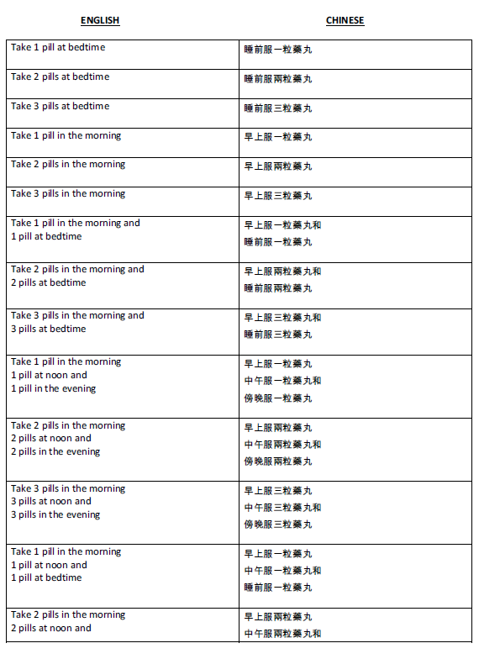
AB 1073 (Ting, Chapter 784, Statutes of 2015)
Samples of Translations Available on the CA Board’s Website Available in:
Chinese
Korean
Russian
Spanish
Vietnamese

Slide 19
3rd Iteration of Labels
Noticed: Oct. 23, 2015
Effective Date: July 1, 2017

Slide 20
3rd Iteration of Labels
Changes from the 2nd Iteration of Labels
Adds requirement of adding “generic for _____” where the brand name is inserted.
Allows for only the generic name if the brand name is no longer widely used.
Allows for the manufacturer’s name be listed outside the patient-centered area - 50% defined area.

Slide 21
3rd Iteration of Labels
Changes from the 2nd Iteration of Labels
Requires policies and procedures of pharmacies to help patients with limited or no English proficiency to include a selected means to provide interpretive services and now translation services in the patient’s language.

Slide 22
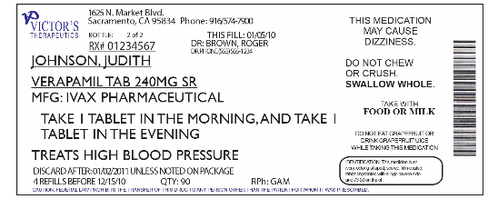
3rd Iteration of Labels
Sample Label BEFORE July 1, 2017

Slide 23
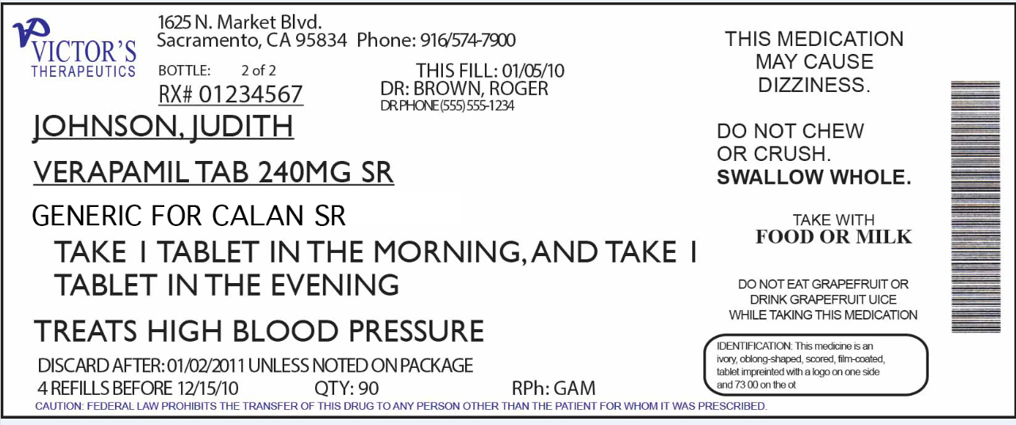
3rd Iteration of Labels
Sample Label AFTER July 1, 2017

Slide 24
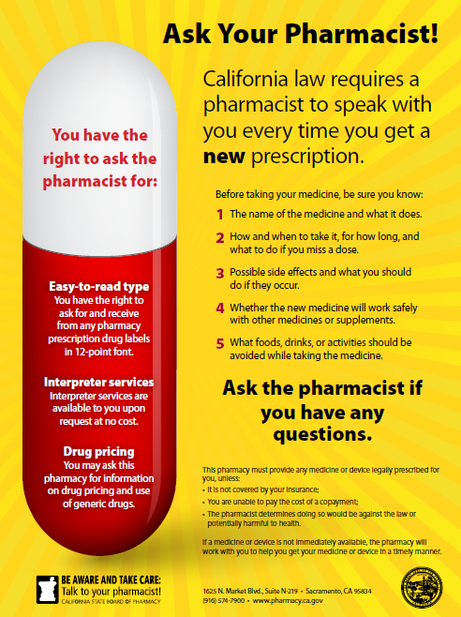
Notice to
Consumers

Slide 25
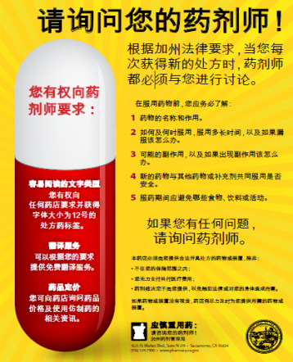
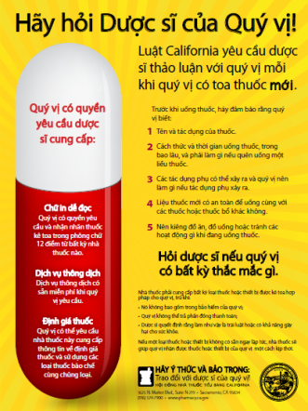
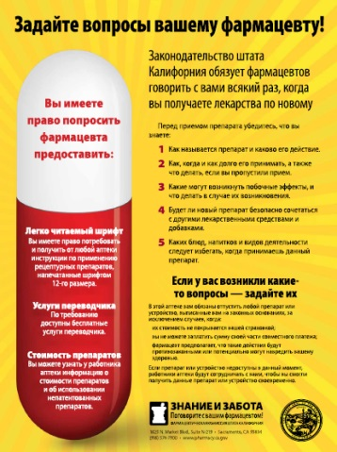
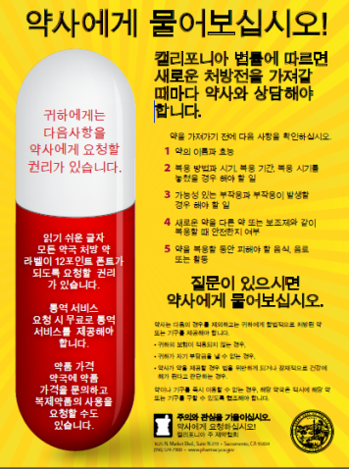
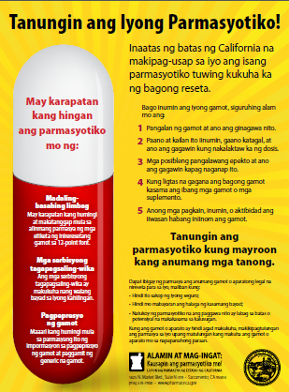
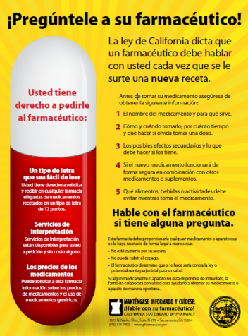
Notice to
Consumers

Slide 26
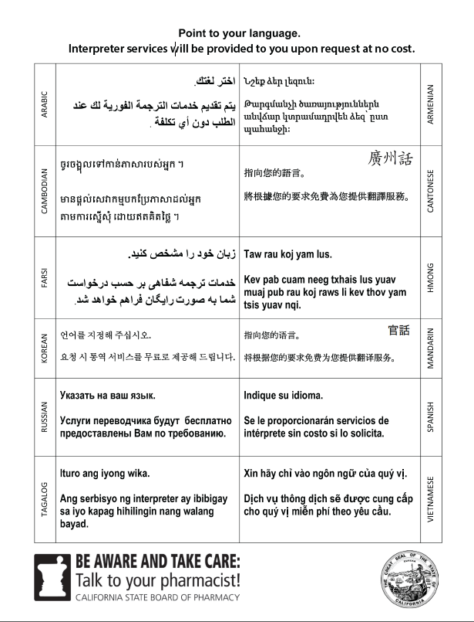
Notice of Interpreter Availability

Slide 27
CA Board of Pharmacy
Lessons Learned
Questions
Contact Information: Virginia.Herold@dca.ca.gov
(916) 574-7900

