Slide 2
Share in the chat
Your organization
Your favorite fall beverage:
Apple cider
Pumpkin spice latte
Still drinking my summer lemonade ;)
Moving on to eggnog!

Slide 3
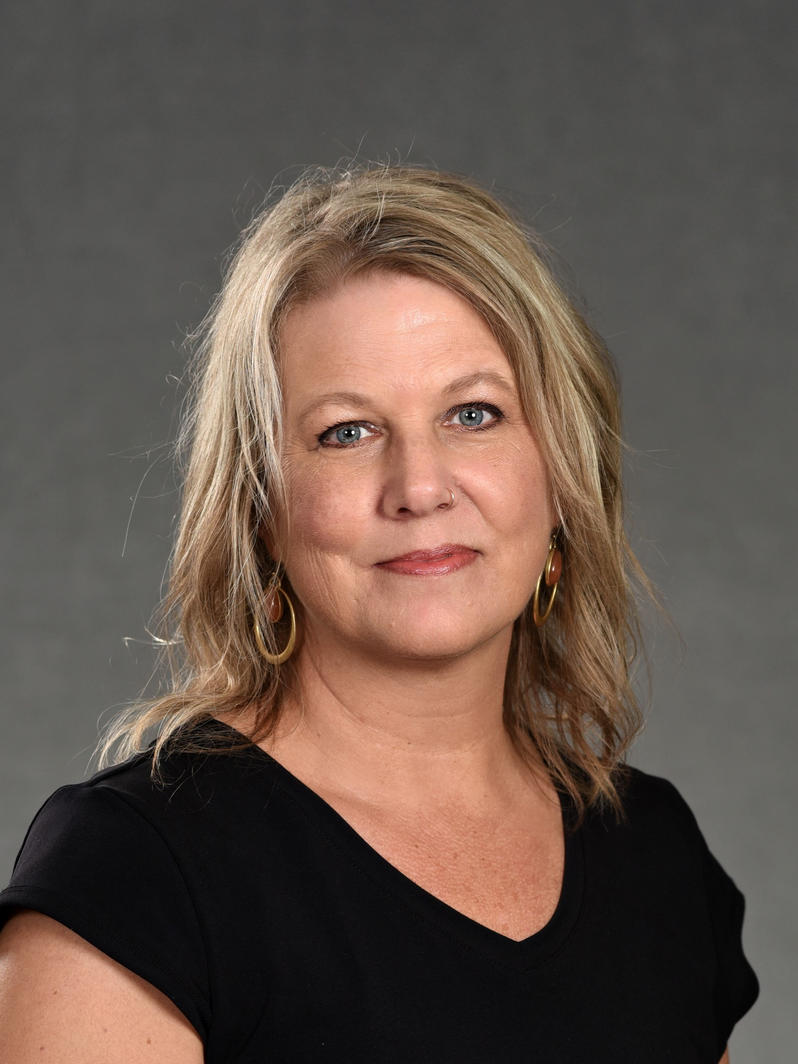
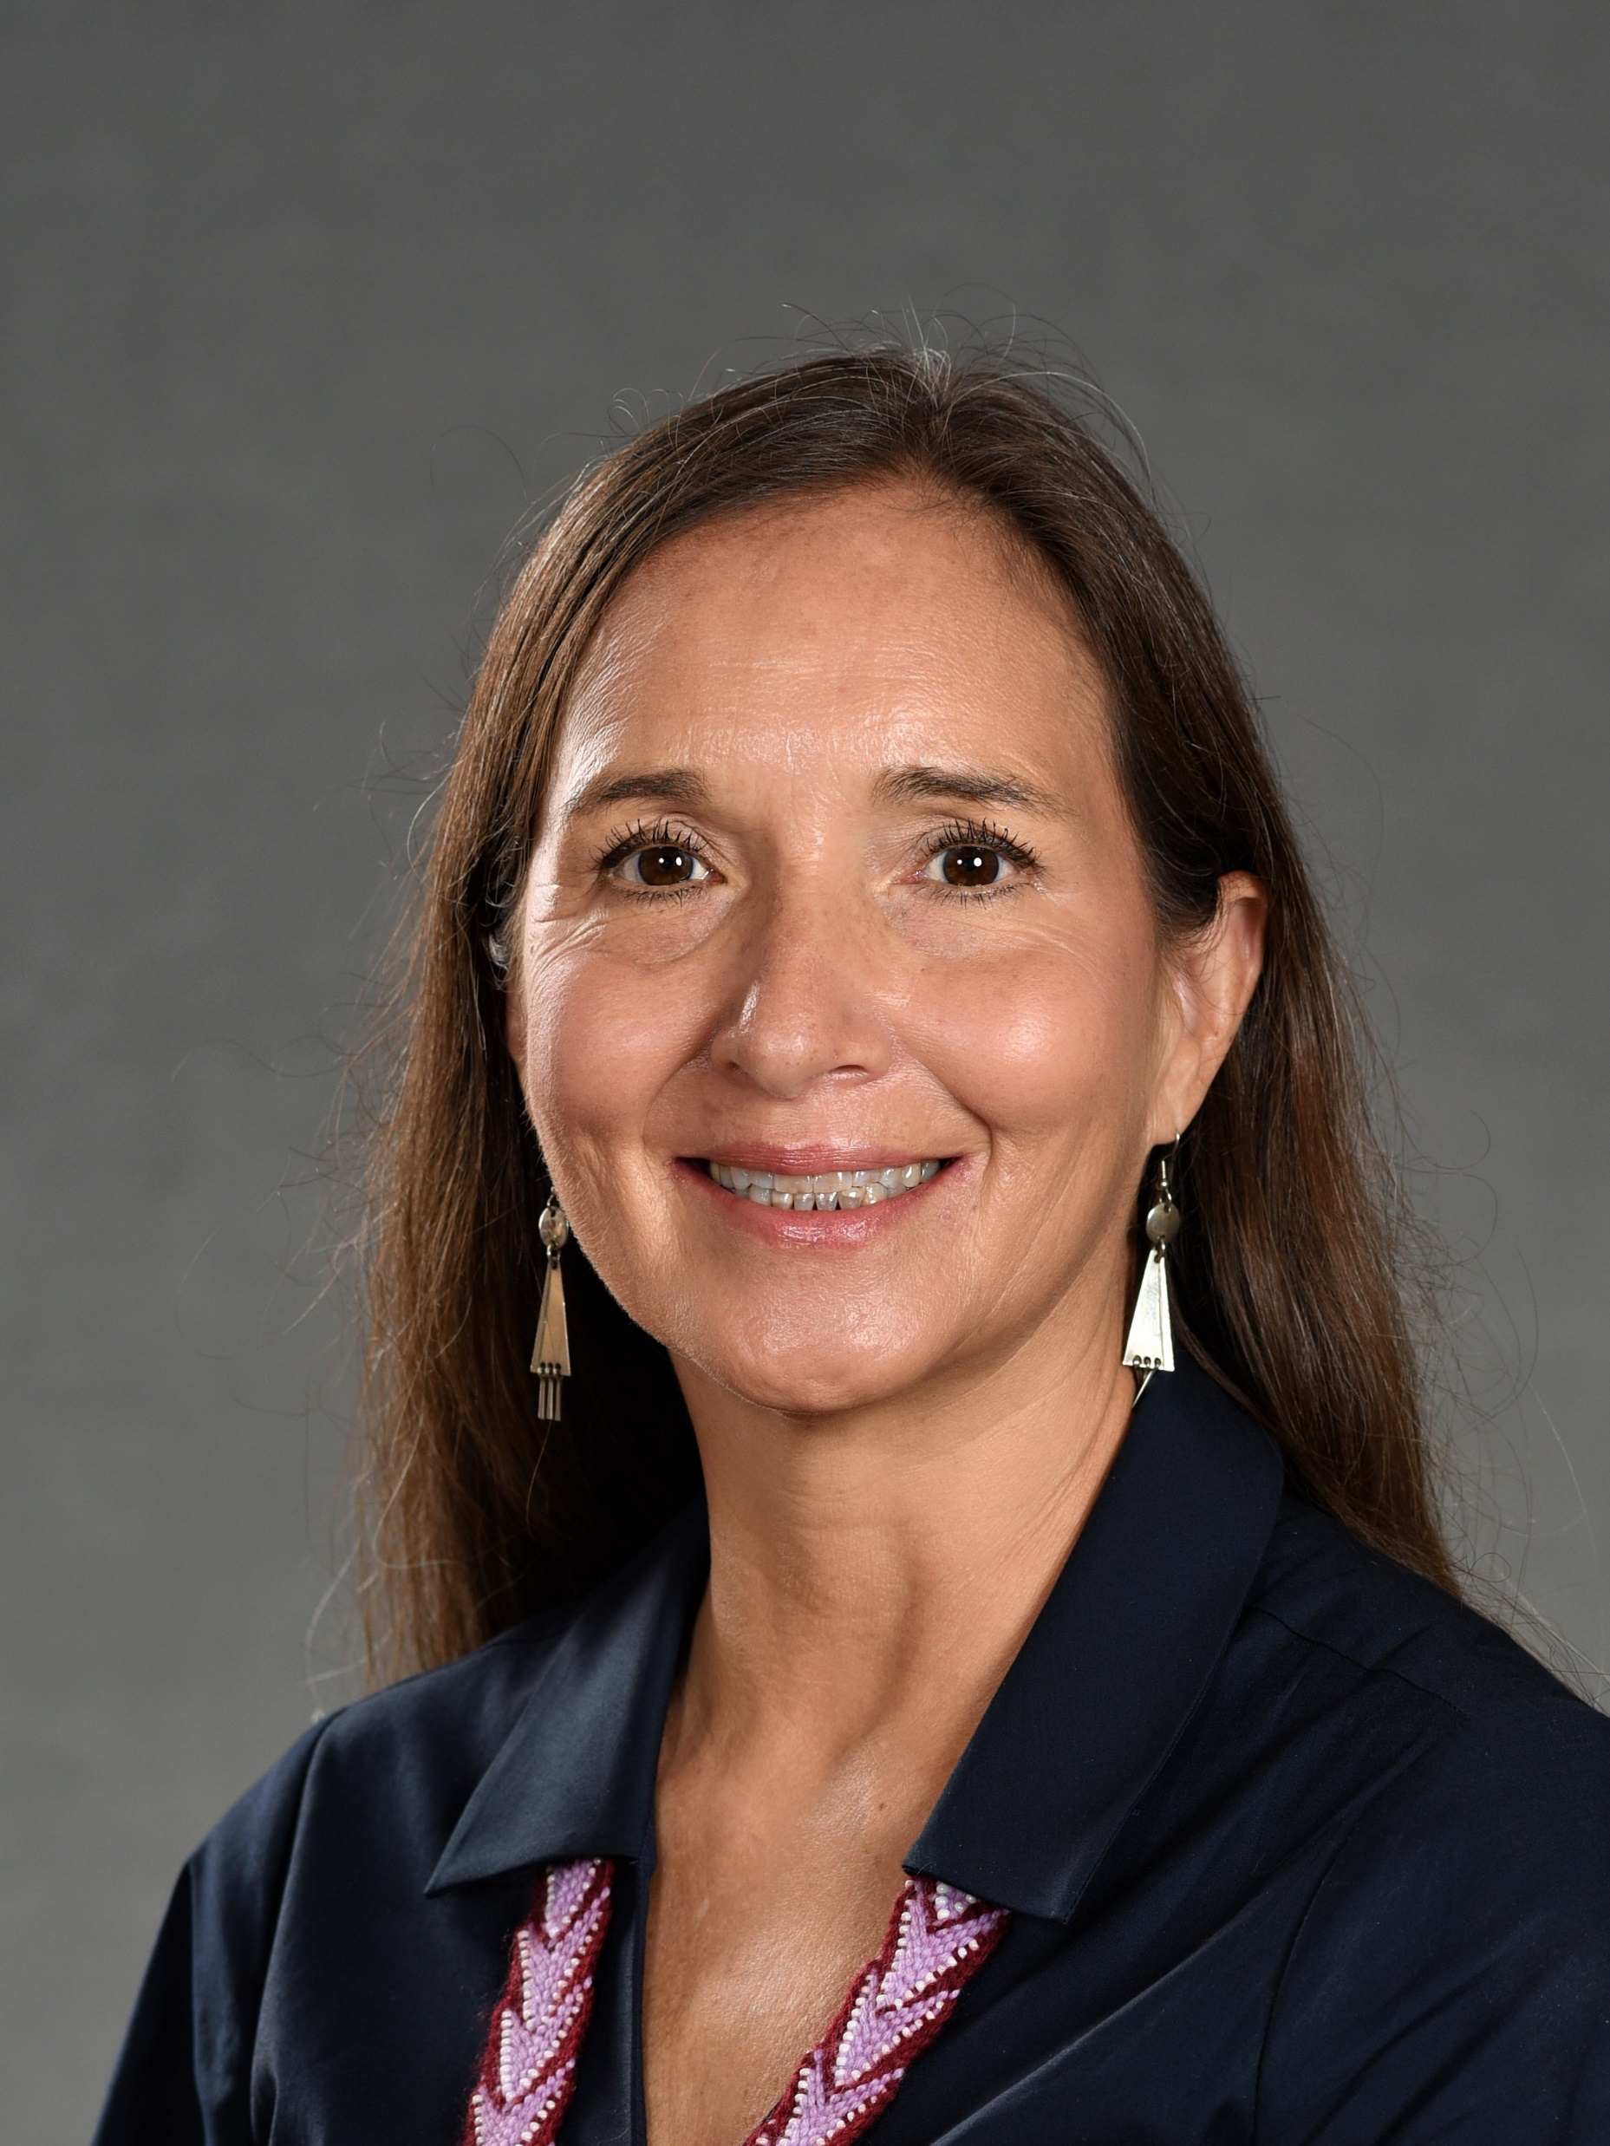
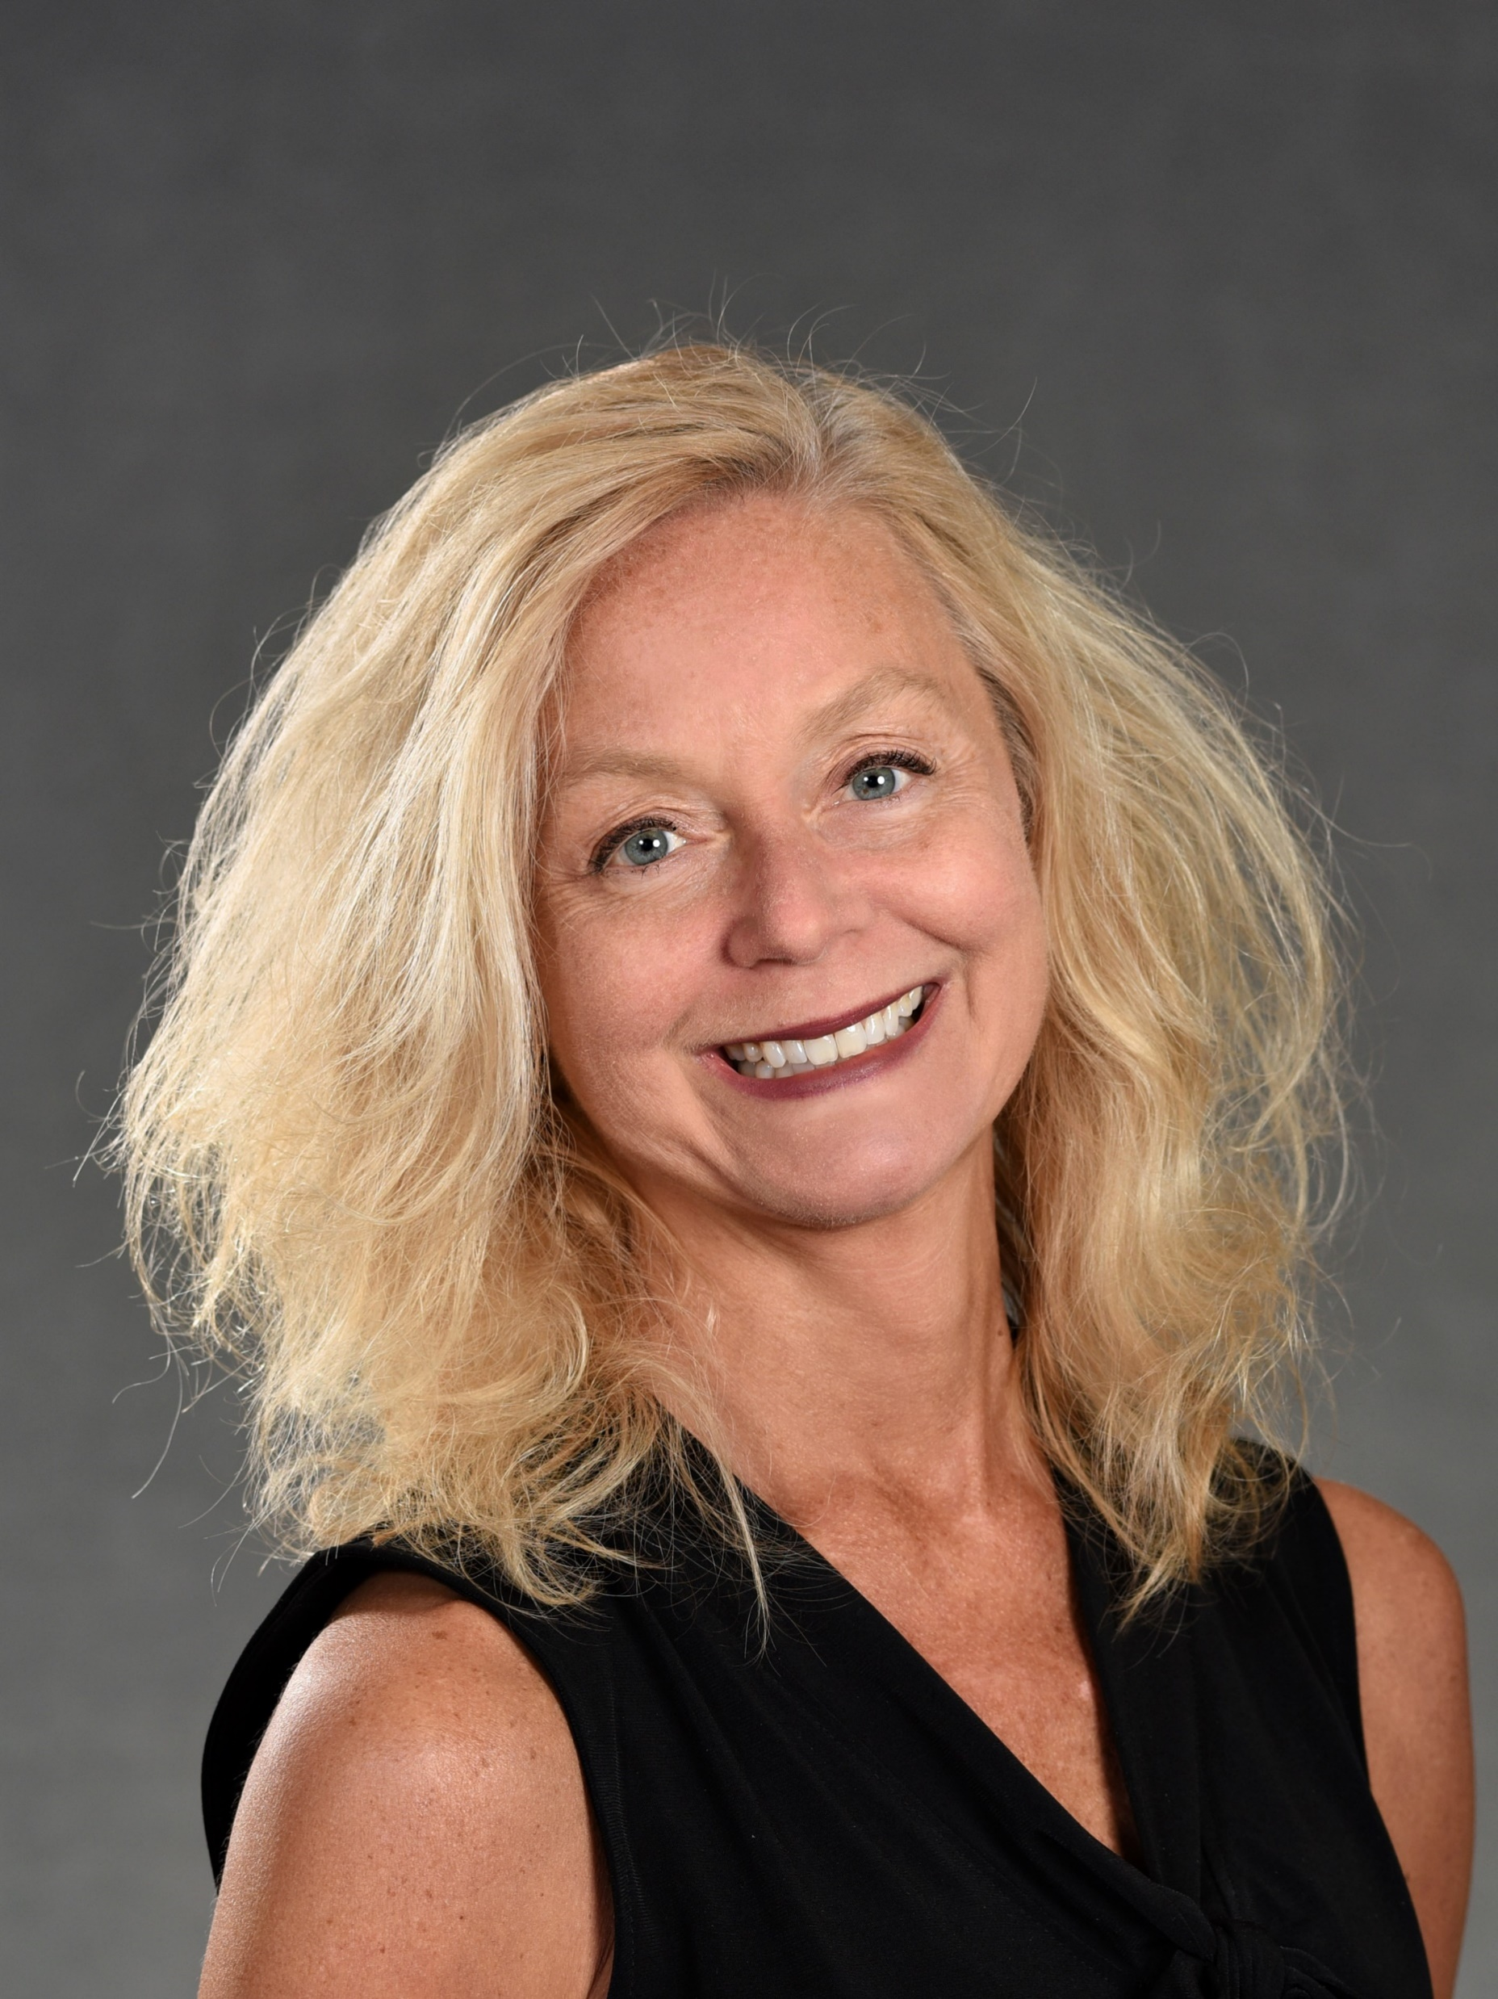
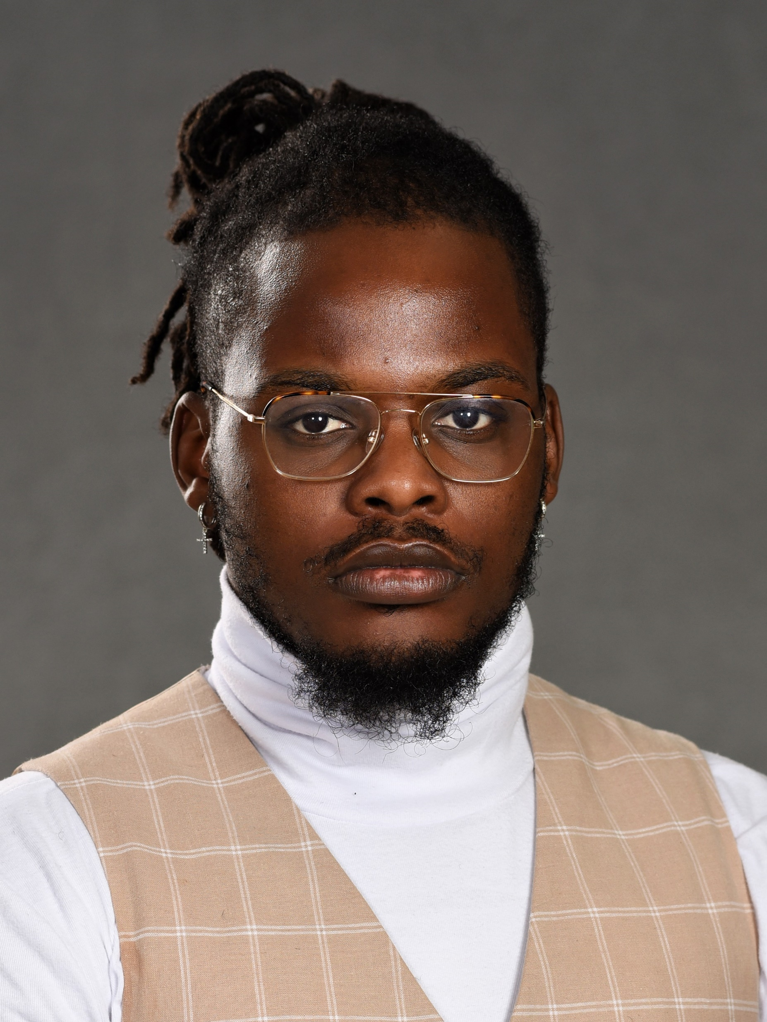
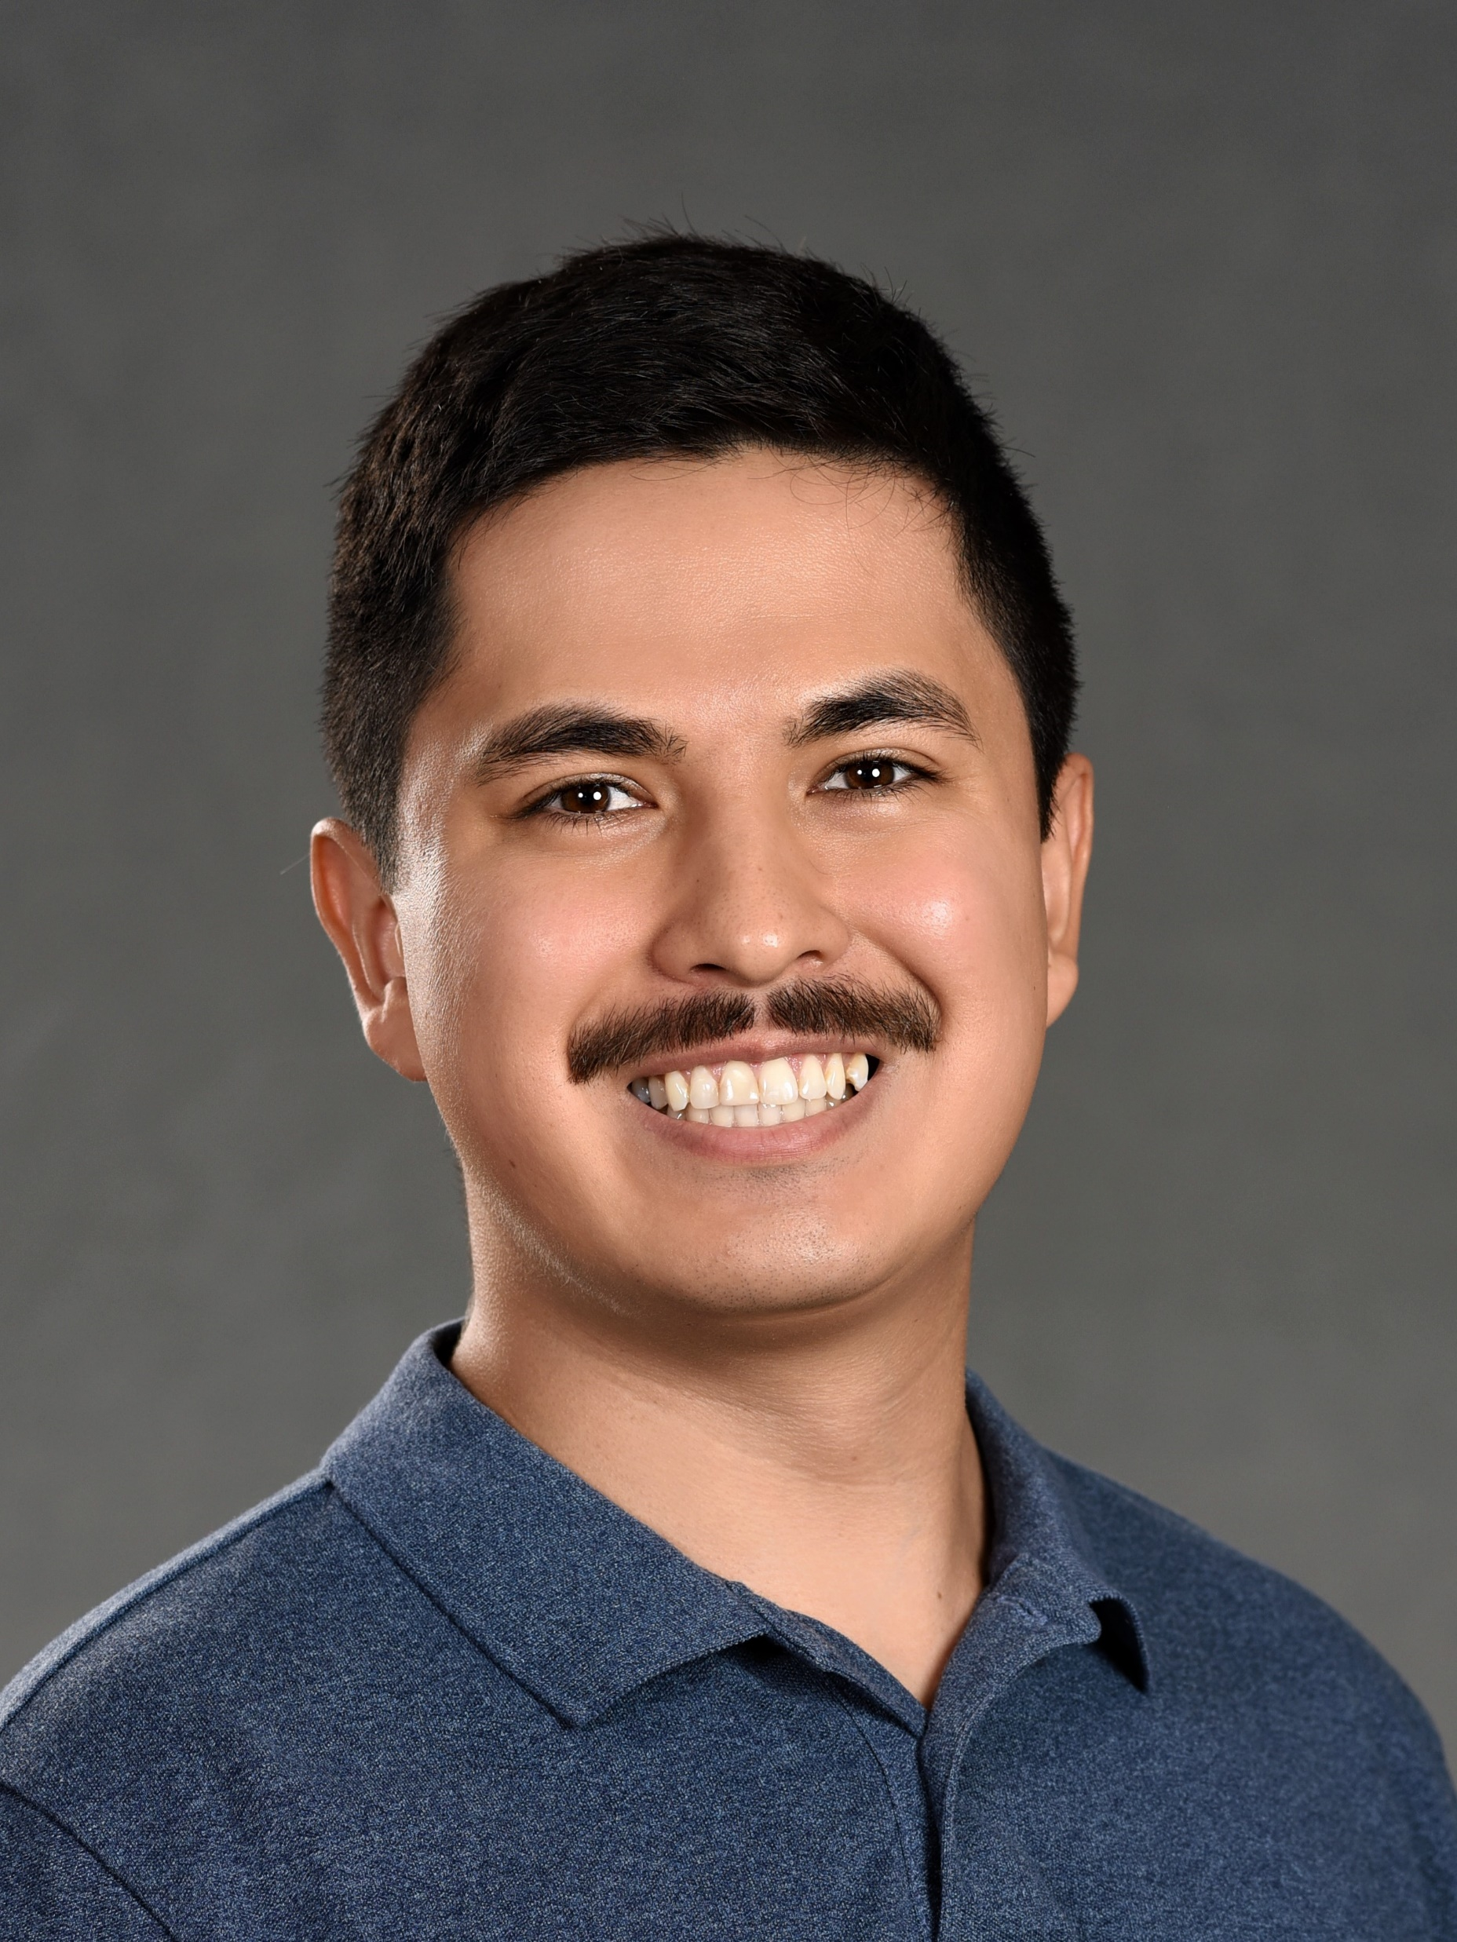
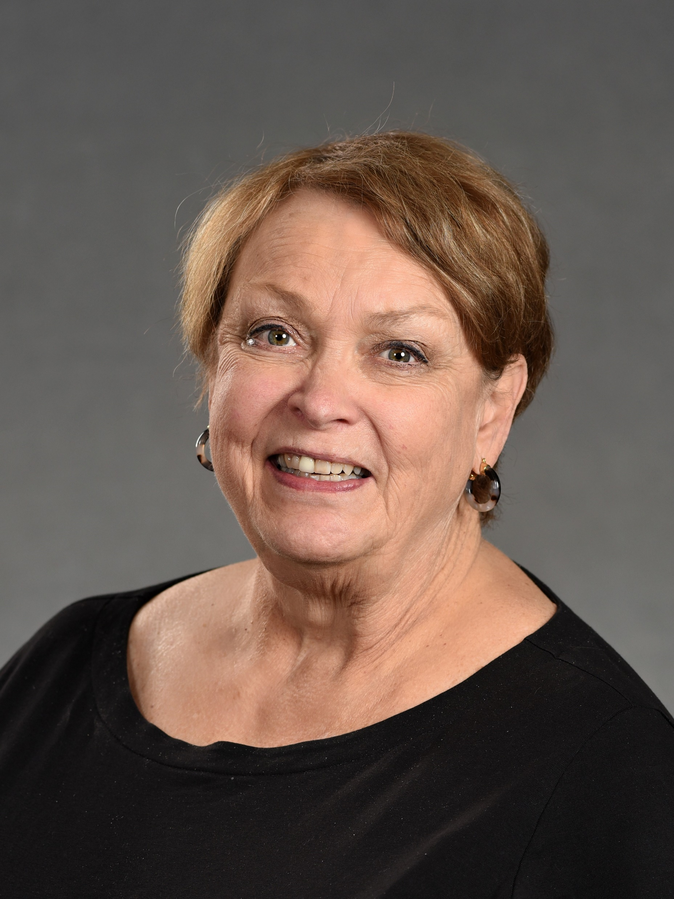
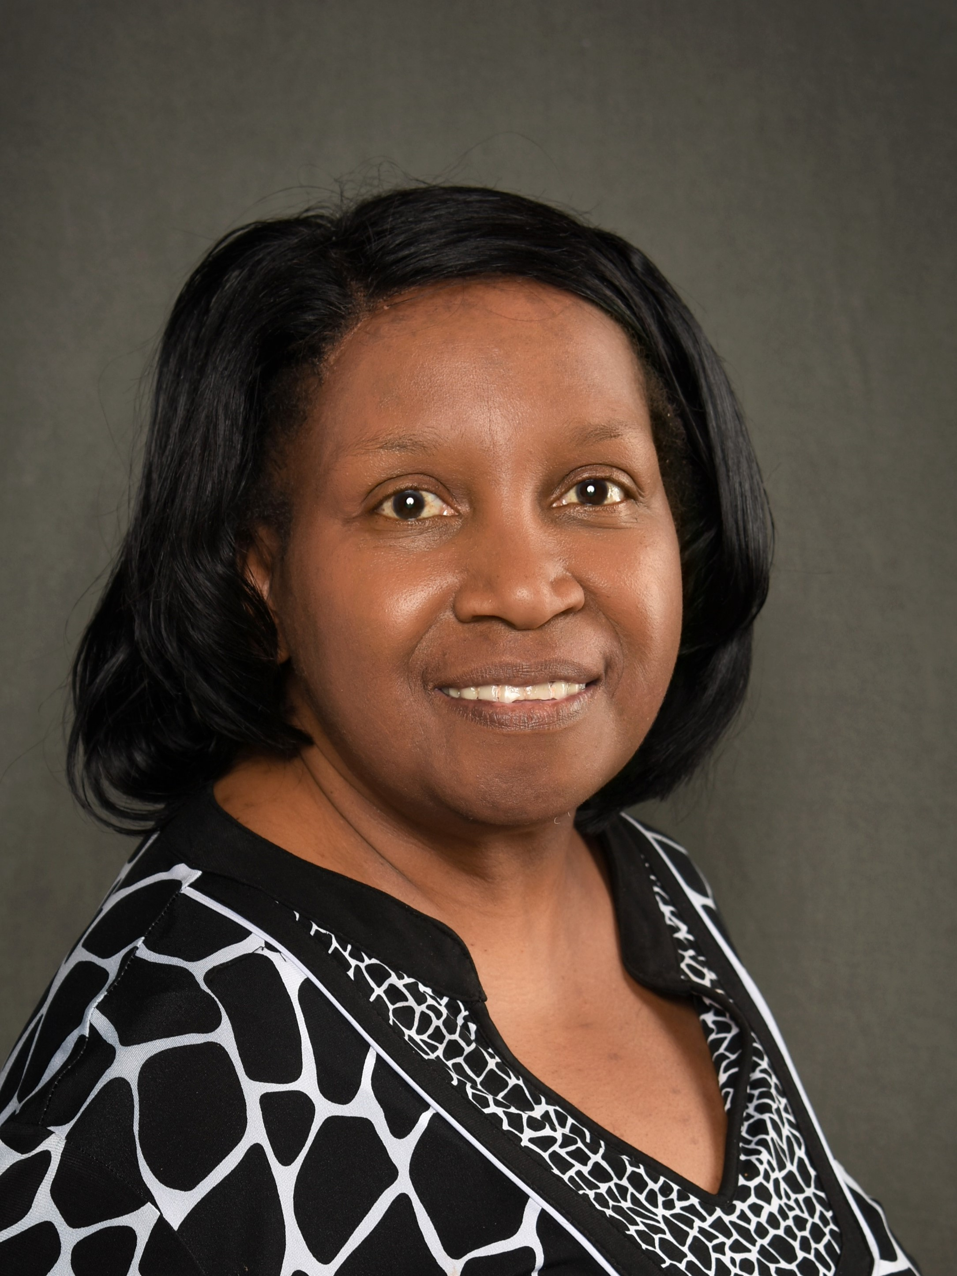
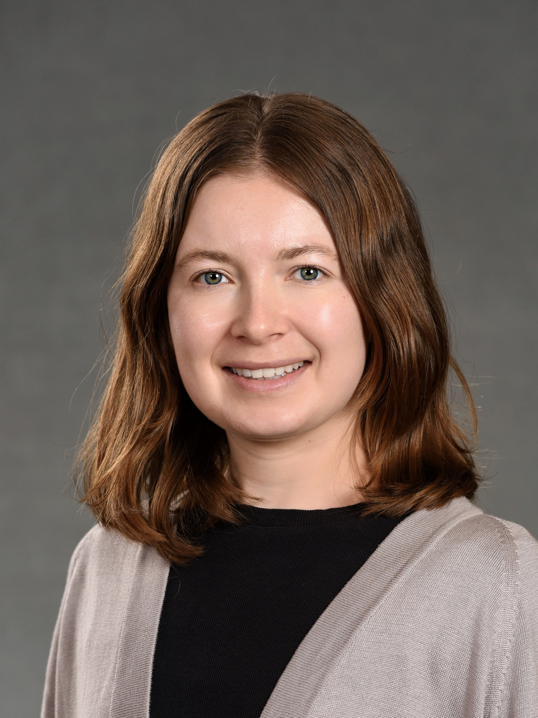
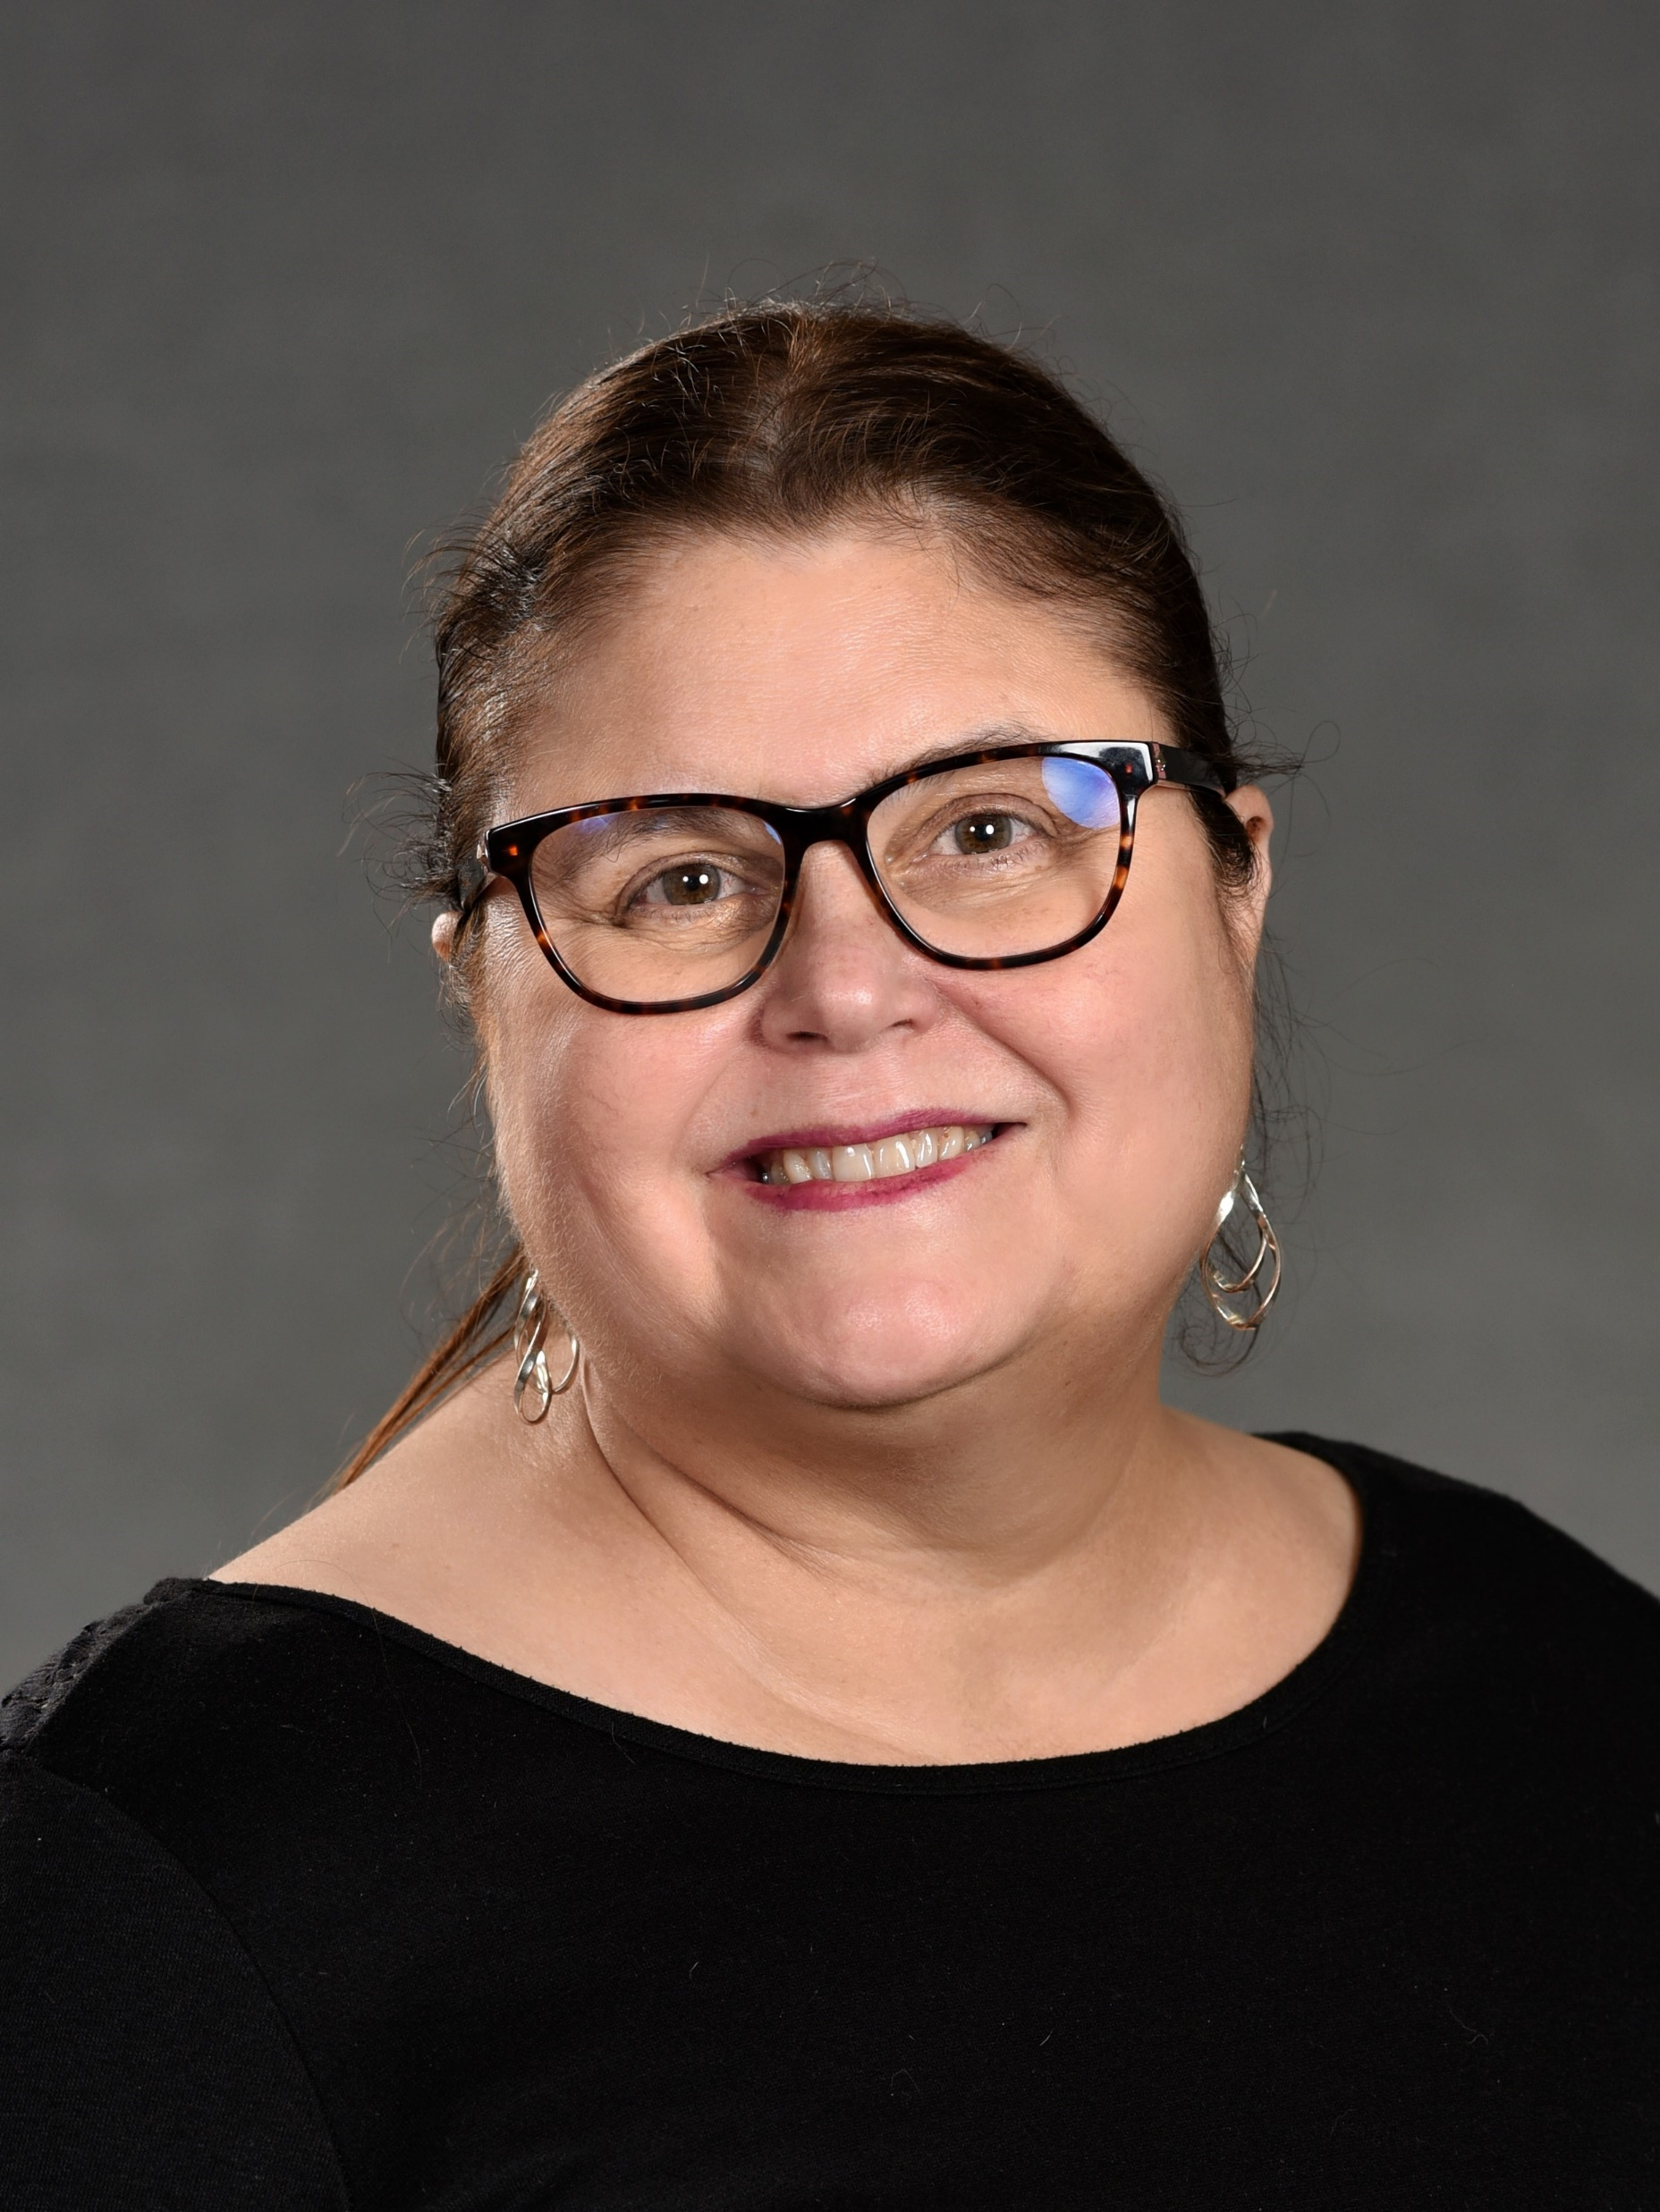
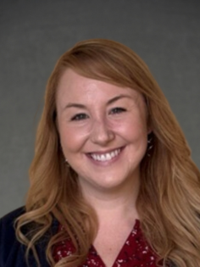
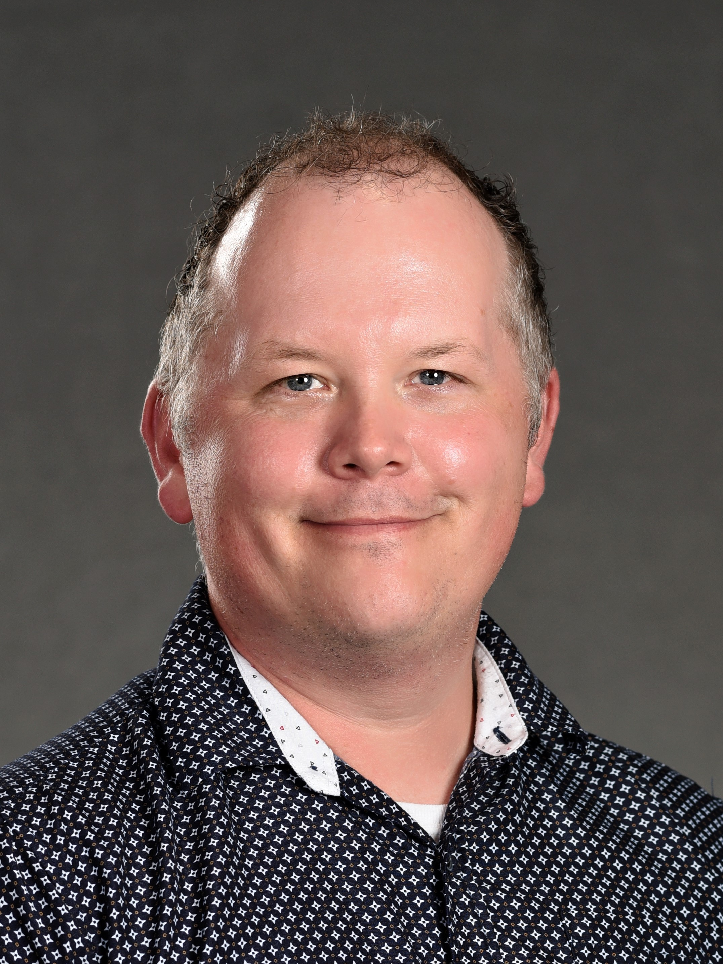
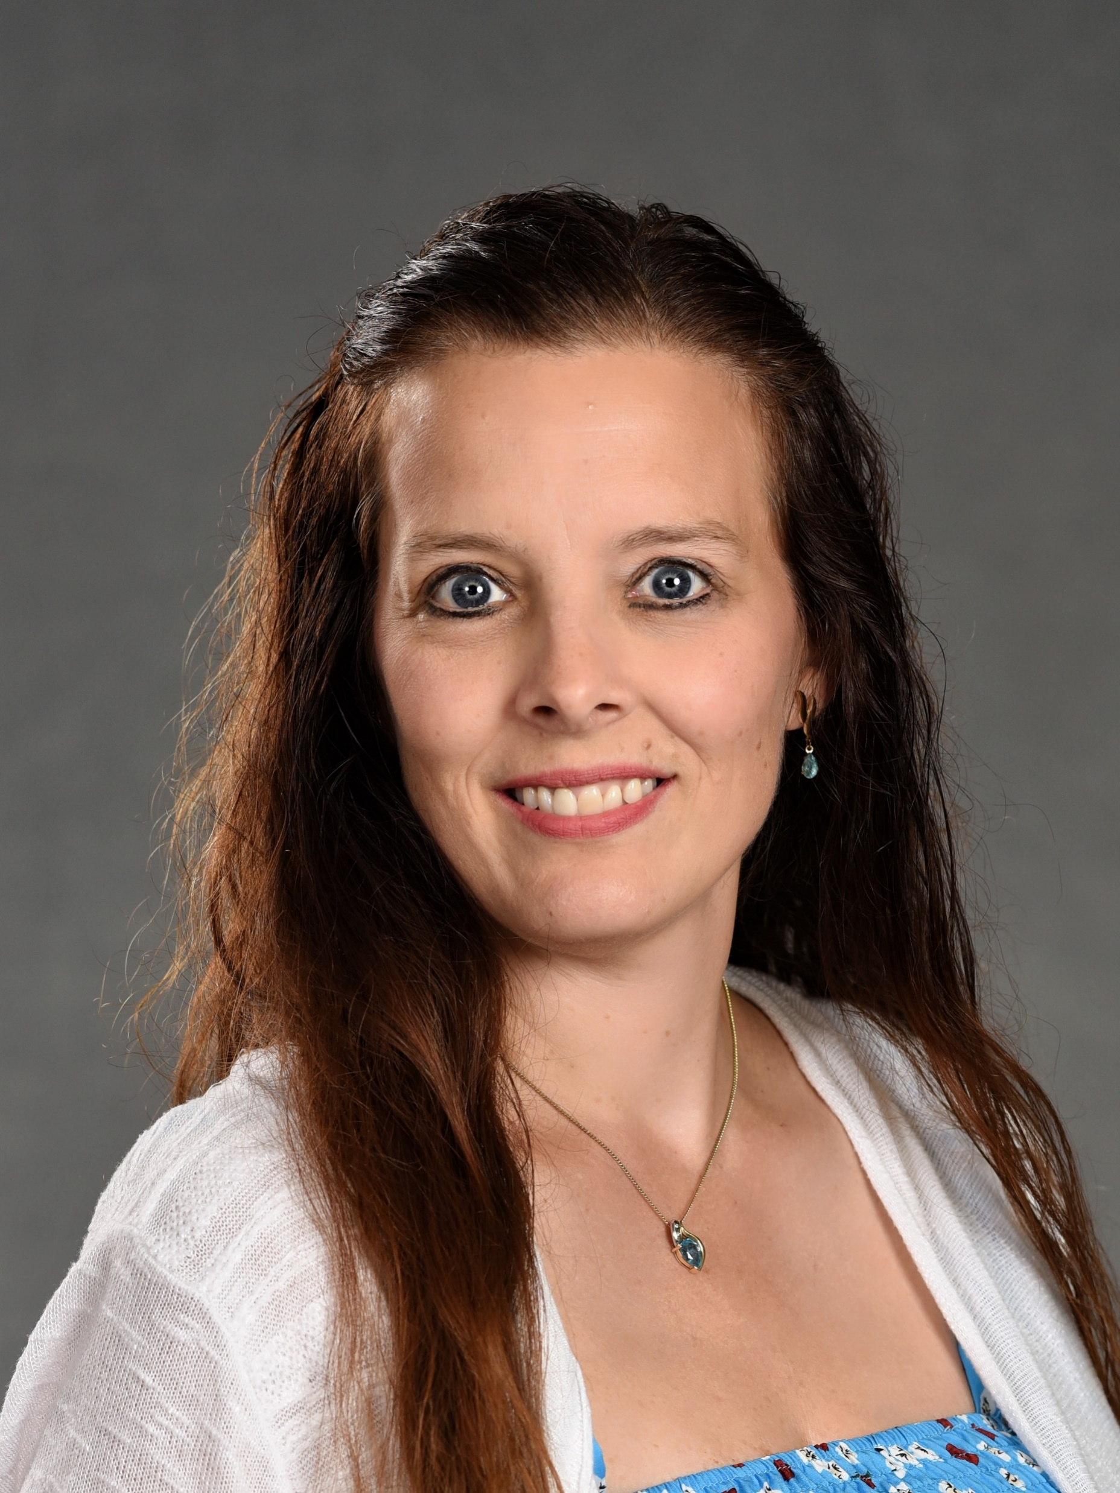
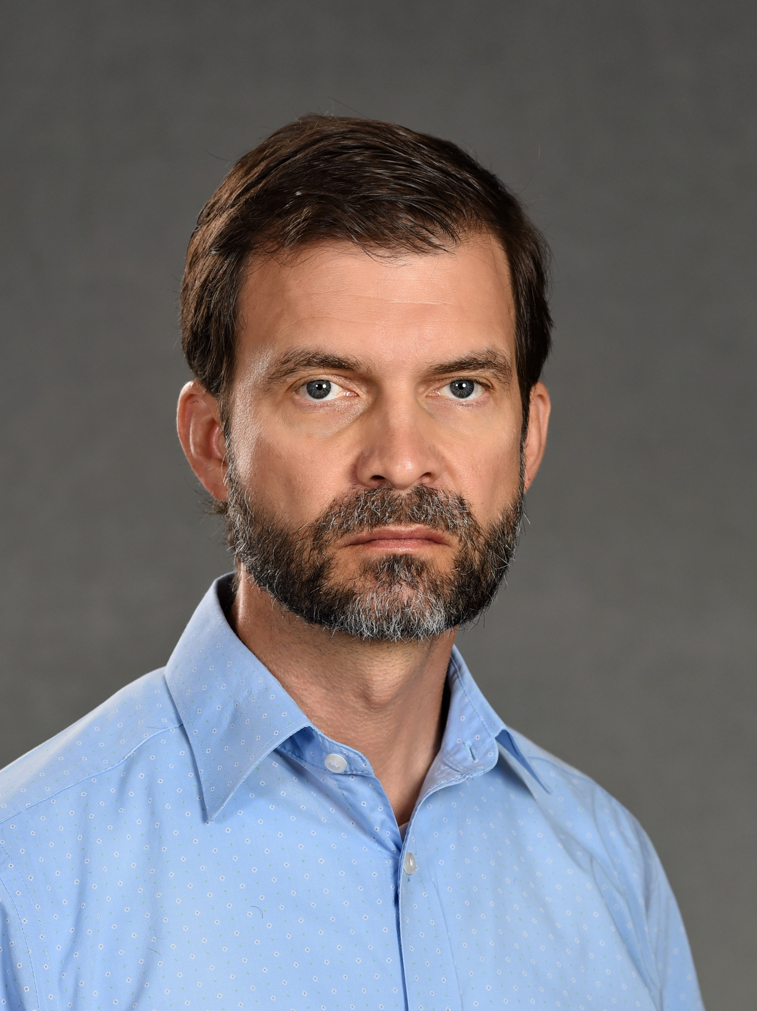
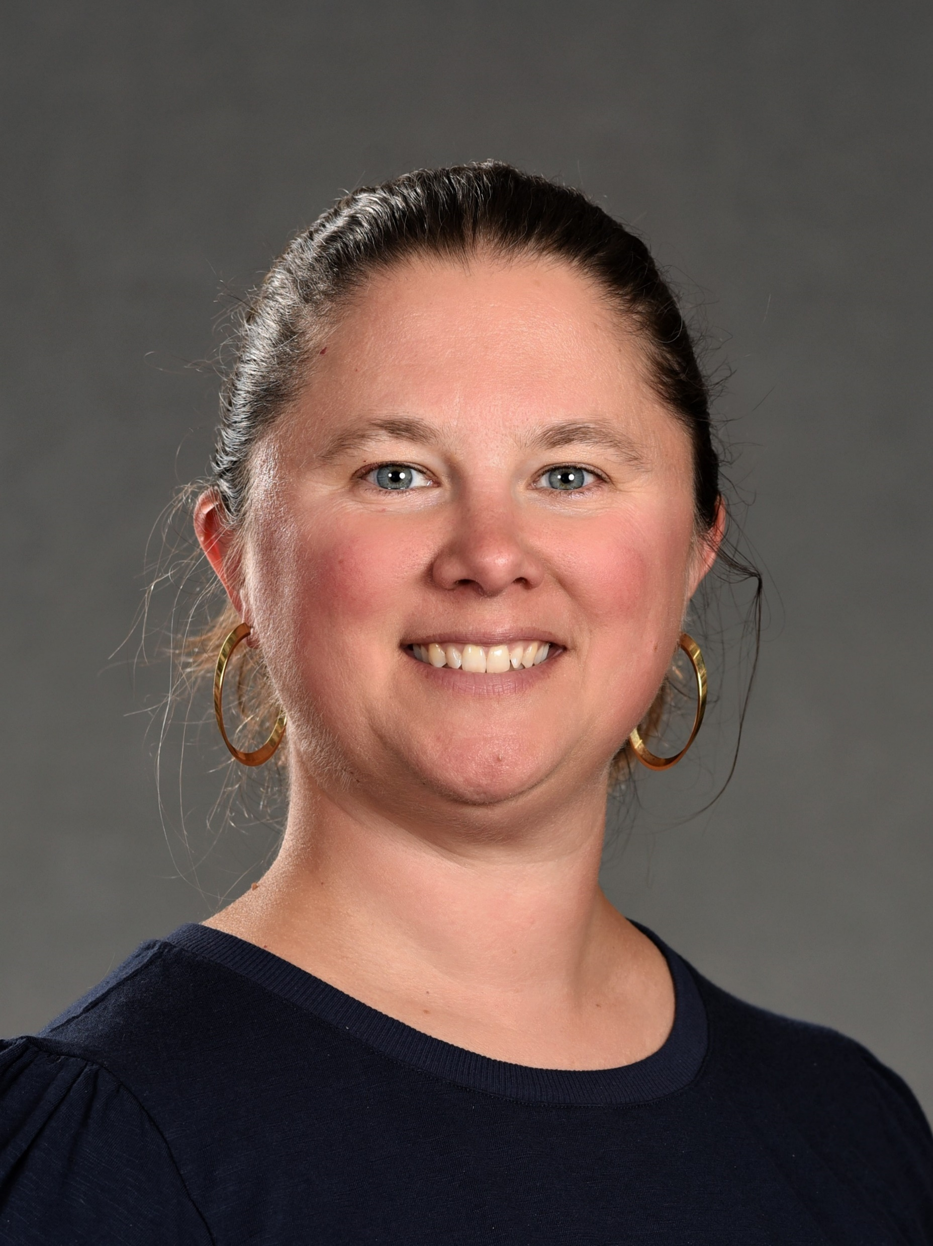
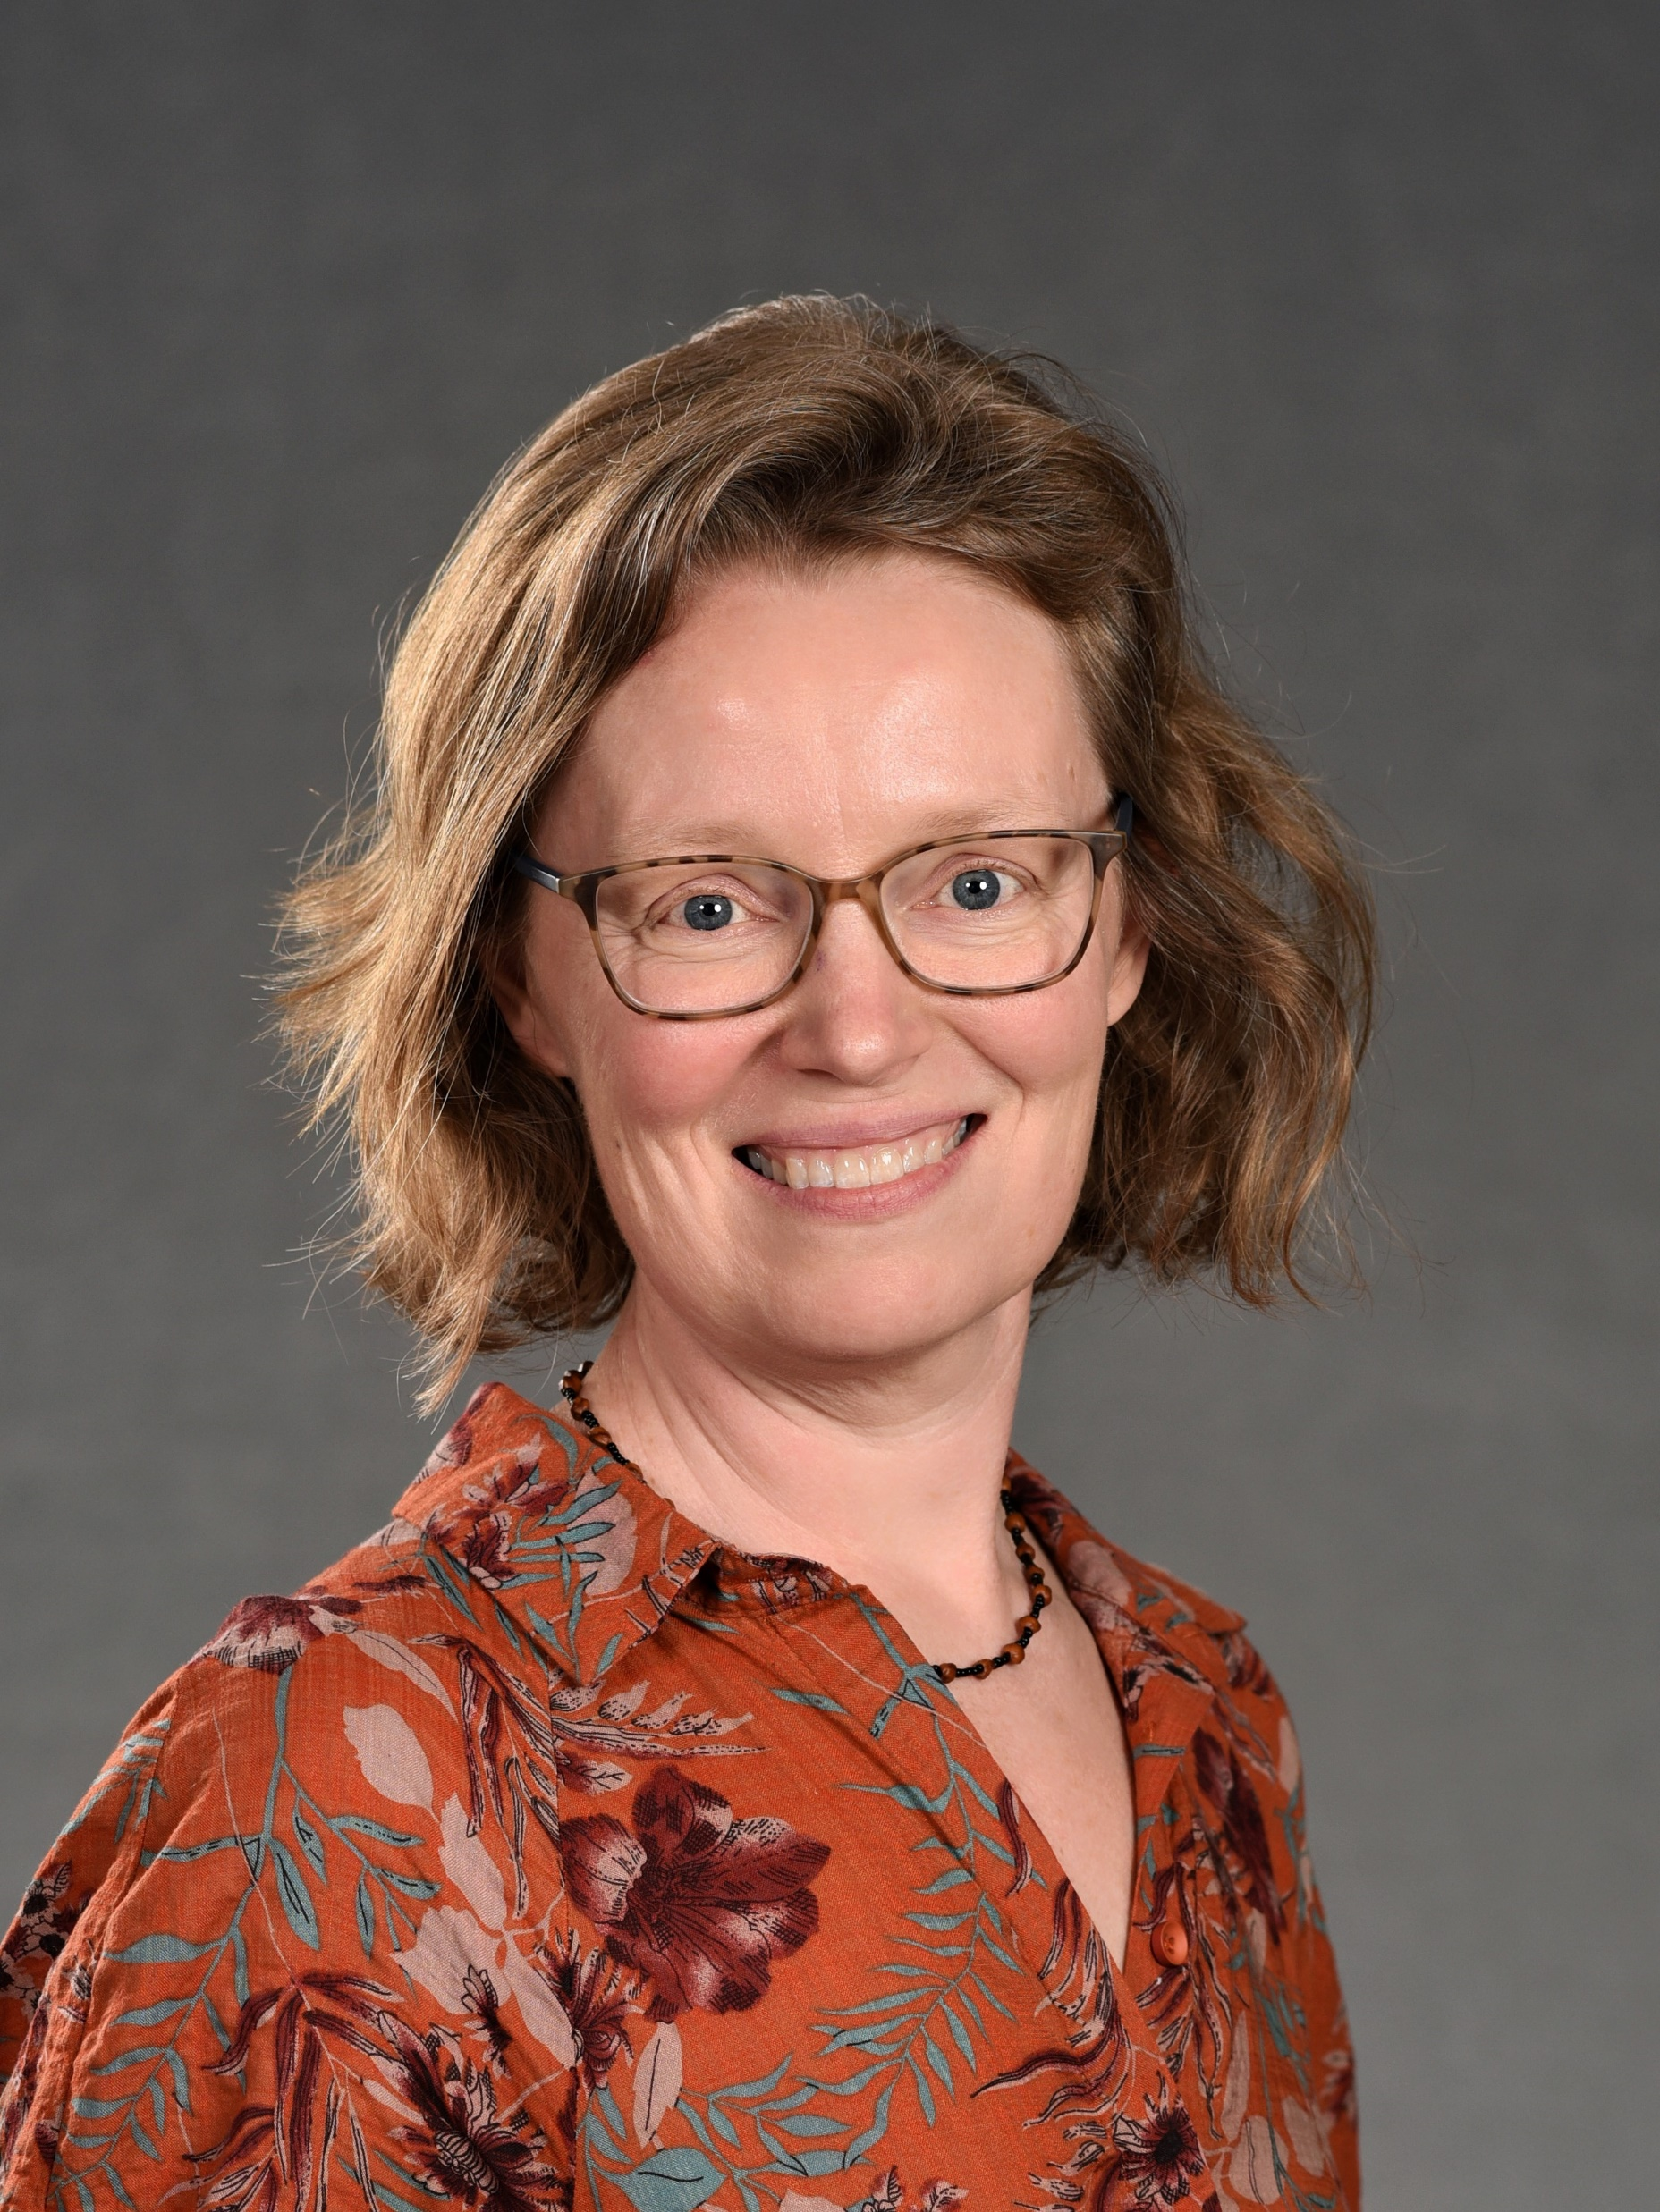
Staff Introductions
https://wisconsinliteracy.org/about/staff-board.html

Slide 4
Wisconsin Literacy's Best Kept Secrets: Maximize Your Member Benefits
Fall Conference
October 16, 2024

Slide 6
Why?
We don't mean to keep secrets!
Maybe we need to toot our own horn more...?
And be clearer about our services!
Maybe Wisconsin Literacy could...

Slide 7
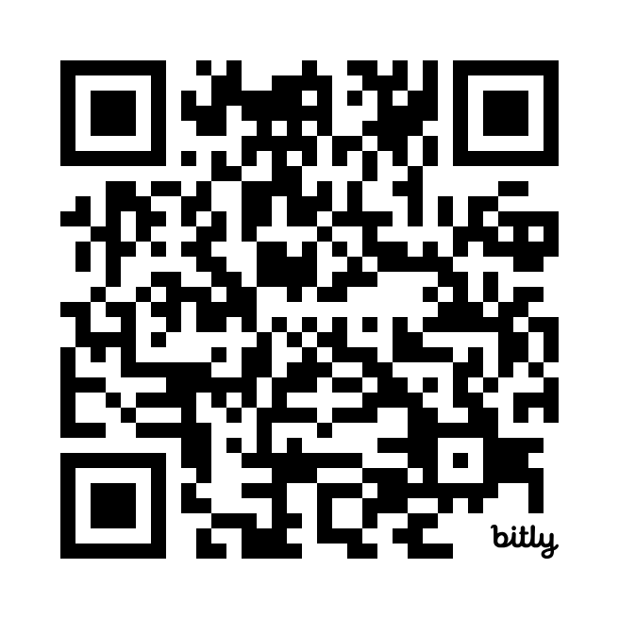
Website Scavenger Hunt
Find the 5 images hidden on our website.

Slide 8
Website Scavenger Hunt
 | Page | How to get there | Image
1 | Homepage | Wisconsinliteracy.org
2 | Tutor Training Page | Menu/Trainings/Tutor Trainings
3 | Volunteer Support Resources | Menu/Resources/General Nonprofit Resources/Volunteer Support
4 | Literacy Programming Resources | Menu/Resources/General Nonprofit Resources/Literacy Programming
5 | Events Calendar | Menu/News & Events/Events

Slide 9
Answers: Website Scavenger Hunt
 | Page | How to get there | Image
1 | Homepage | Wisconsinliteracy.org
2 | Tutor Training Page | Menu/Trainings/Tutor Trainings
3 | Volunteer Support Resources | Menu/Resources/General Nonprofit Resources/Volunteer Support
4 | Literacy Programming Resources | Menu/Resources/General Nonprofit Resources/Literacy Programming
5 | Events Calendar | Menu/News & Events/Events

Slide 10
Professional Development in FY24
110 sessions offered
1951 attendees

Slide 11
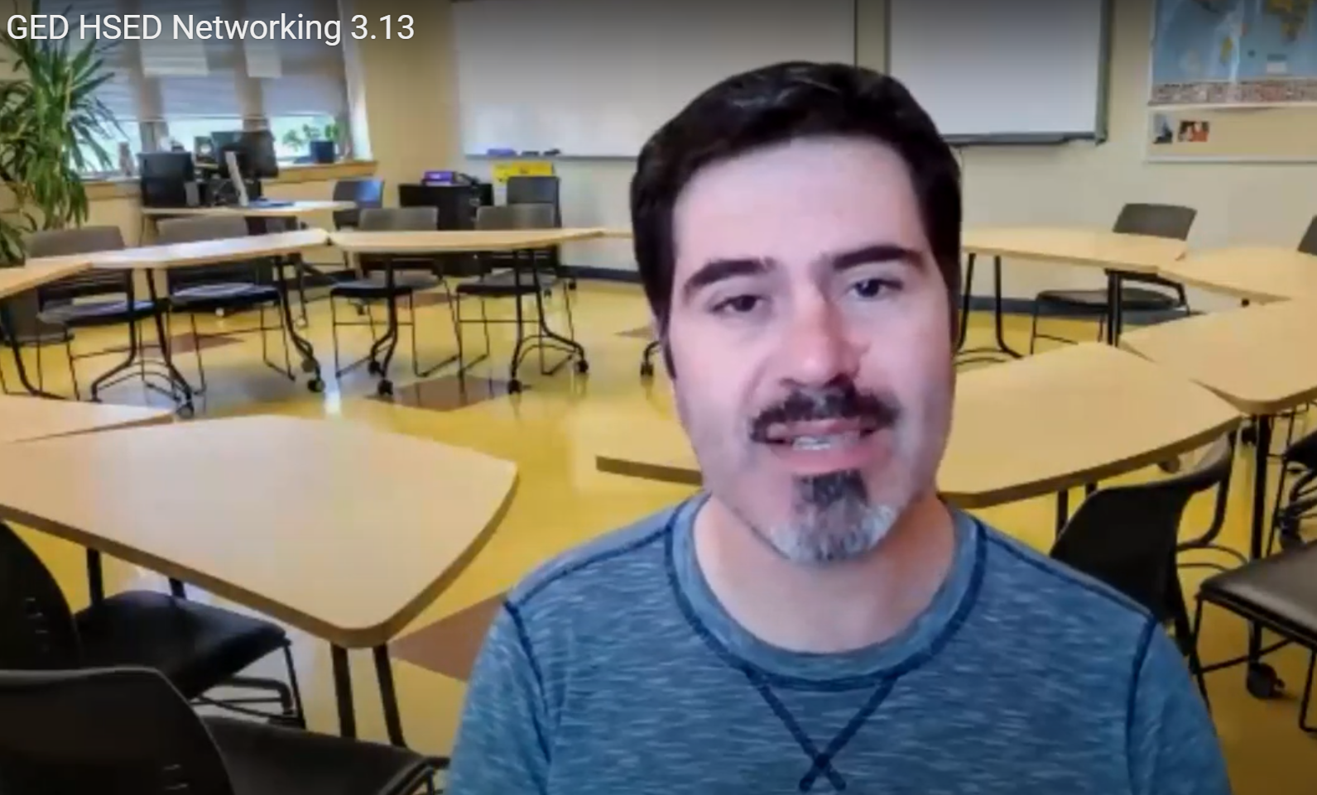
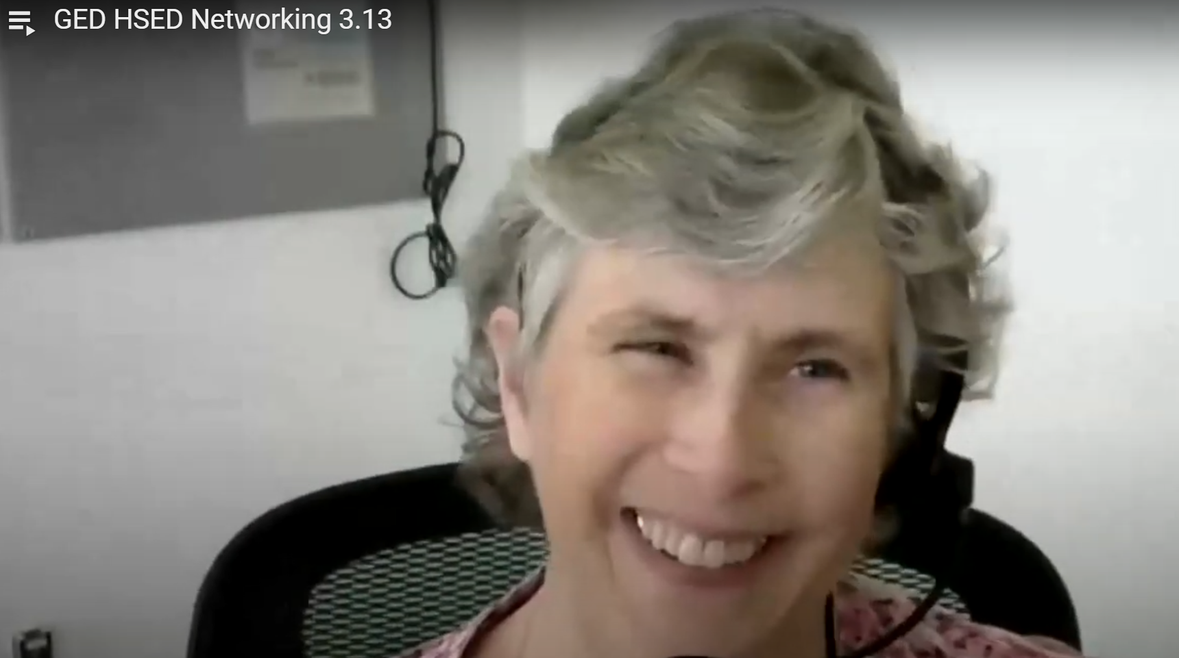
Networking Opportunities
Library Networking
Tutor Coordinators
Small Programs
Corrections Networking Call
Executive Director/Large Program
GED/HSED Program Coordinators
Medium Programs
Northstar Digital Literacy Users
Regional Programs

Slide 12
Tutor Training
Online tutor training
Live tutor training
Access videos and interactive courses on our website
Register for Zoom sessions
Website event calendar
Monthly e-newsletter
Monthly email from Regional Literacy Consultants
Request customized, in-person sessions

Slide 13
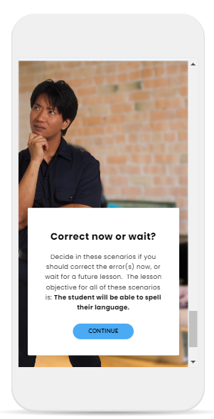
Tutor Training
ELL Introductory Tutor Training Series
Adult Literacy/ABE: Introductory Tutor Training Series
Ongoing Tutor Training

Slide 14
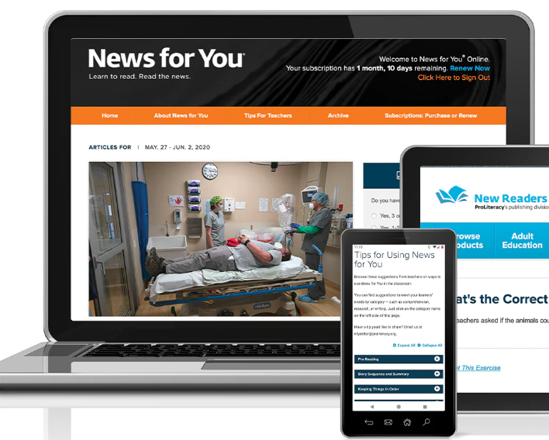
Subscriptions & Memberships
News for You: Online and paper
GED Online Learning
DCS GED Prep Online
Northstar Digital Literacy
Literacy Minnesota
Intercambio
ProLiteracy
COABE

Slide 15
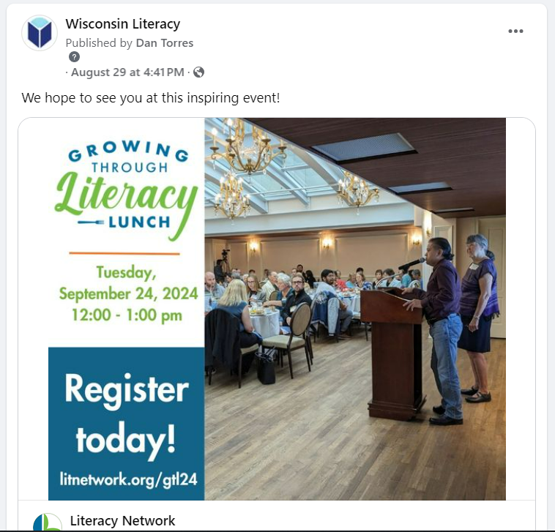
Social Media
Advertise your program’s:
Events
Job postings
Achievements
( )

Slide 16
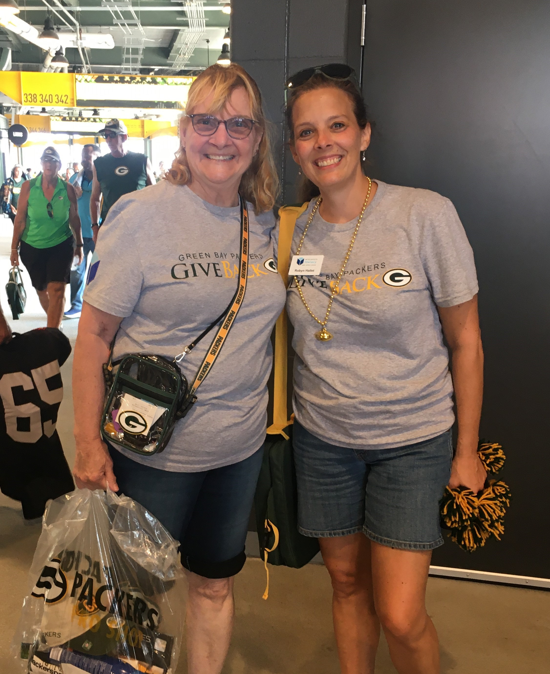
Consulting
Nonprofit management
Board development
Volunteer recruitment and retention
Literacy programming
Curricula and assessments
Data management

Slide 17
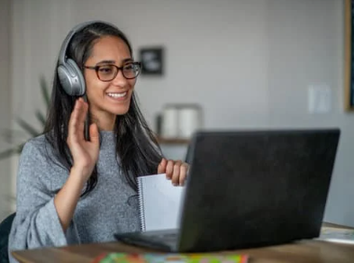
Reflection
What secret will you explore first?

Slide 18
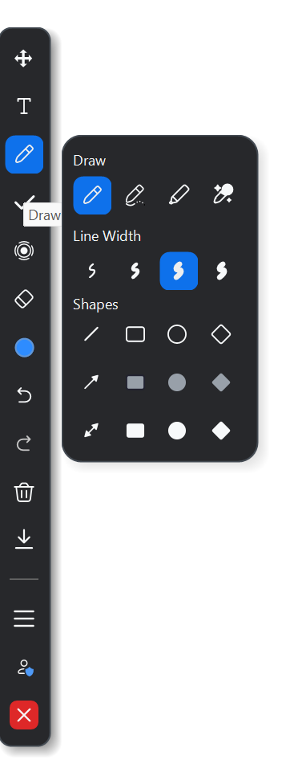
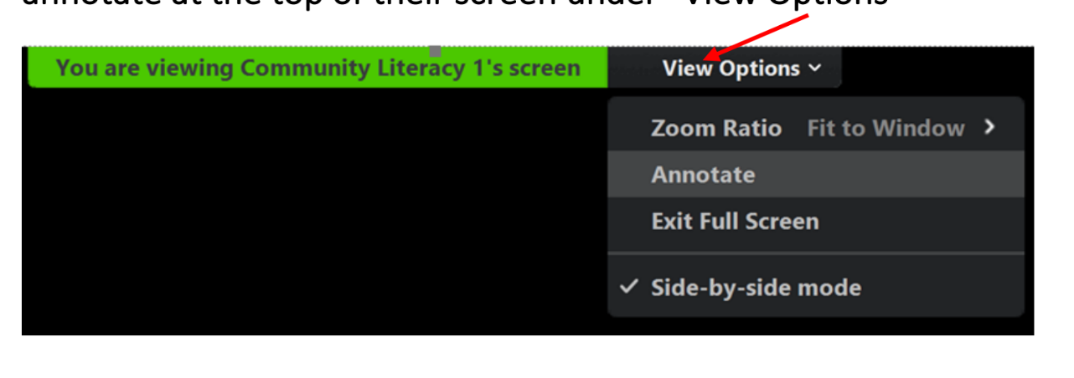
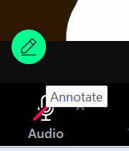
Jamie Kobs (she/her)

Slide 19
