Slide 1

Implicit Bias: You are What People Hear
Health Literacy Wisconsin
Winston F. Wong, MD, MS
Medical Director, Community Benefit
Director, Disparities Improvement and Quality Initiatives
Kaiser Permanente
April 7, 2017

Slide 2
Disclosure
I have no reportable disclosures and no relevant financial relationships

Slide 3
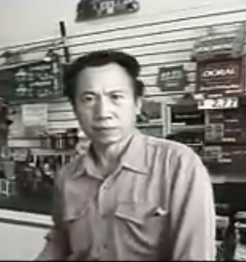
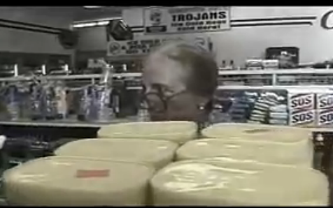
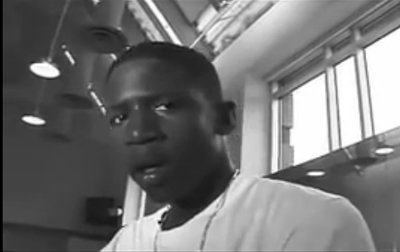
Unconscious Bias: Recognizing It
“Silent Beats” video – shows us how unconscious bias influences our perception of the individuals we encounter
https://www.youtube.com/watch?v=Nnr41dvsDvY

Slide 4
Less insidious but just as harmful
https://www.youtube.com/watch?v=DWynJkN5HbQ

Slide 7

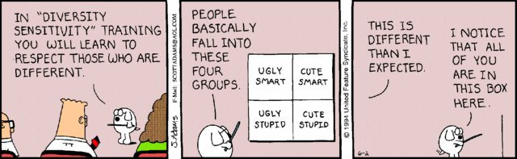
Implicit Bias: A Way to navigate the world/a way to bias
What Is It?
Deep-seated
Ubiquitous
Resides in our core “flight or flight” mechanism
If ignored, may give rise to “confirmation bias”
What Is It Not?
The same forever
To be ignored

Slide 8
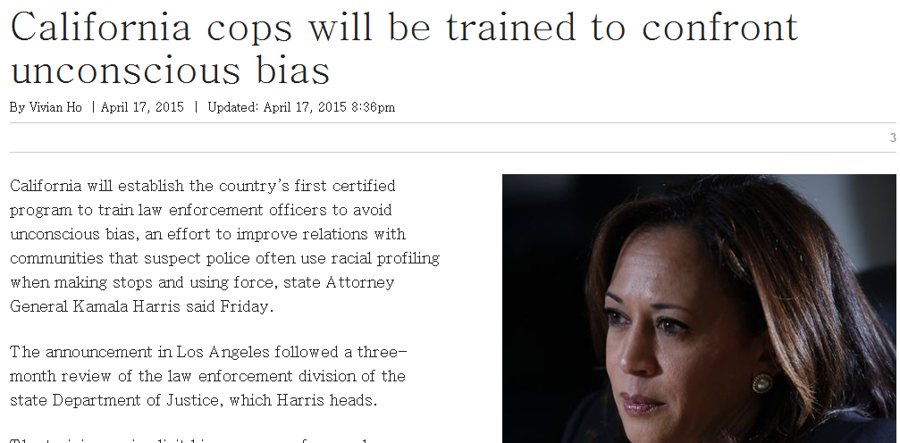
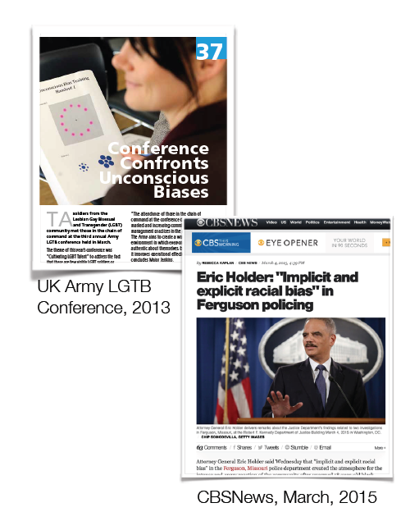
Unconscious Bias Is In the News These Days …

Slide 9
Functional Forms of Bias
Confirmation bias: The tendency to search for, interpret, focus on and remember information in a way that confirms one's preconceptions.
Micro-inequities: Subtle actions that reflect our unconscious biases. May be difficult for both parties to recognize.

Slide 10
What is Health Literacy?
The Institute of Medicine 2004
“The degree to which individuals have the capacity to obtain, process, and understand basic information and services needed to make appropriate decisions regarding their health.”

Slide 11
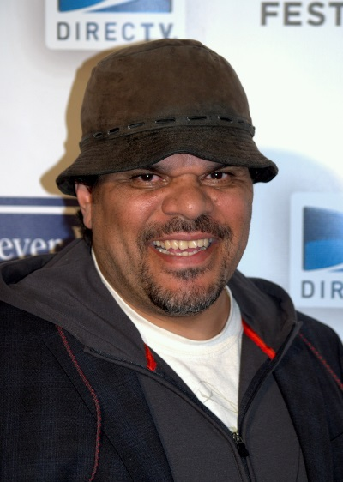
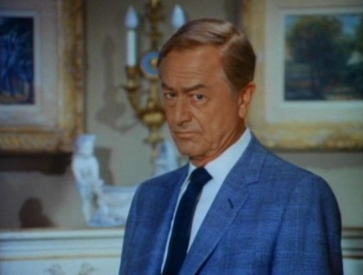
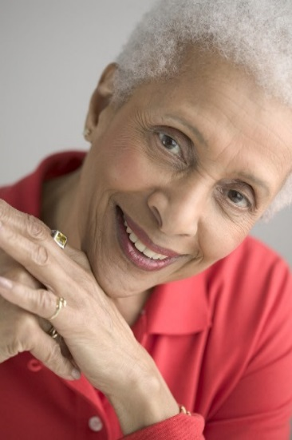
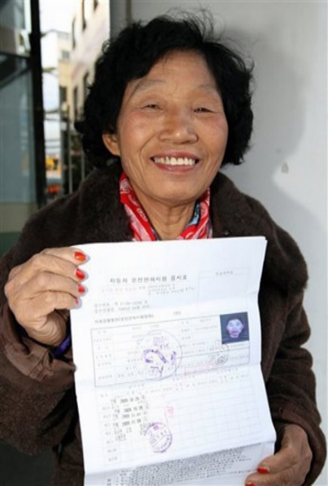
Does Implicit Bias play a role in effective health literacy?
“I want to talk to you about your diabetes…”

Slide 12
Does Implicit Bias operate in speech only interactions?
Some examples:
Volunteers?

Slide 13
Implicit Bias: Does it Affect How we listen?
No studies on Implicit Attitudes on isolated audio interaction
In human interaction, face to face, audio (hearing) plays a significant role in establishing basis for interaction
Many interactions in health care are not person
How much persona do we attribute to a person based on voice interaction alone or in combination with visual bias?

Slide 14
Possible interactions
Speaking more loudly
Skipping details in explanations
Assumptions about intellectual capacity
Dismissiveness
Frustration
Anger

Slide 15
Potential Strategies
Pause and question assumption
Challenge your auto-pilot reaction
Familiarize yourself with the other individual to counteract stereotypes associated with voice interaction
Be aware of cadence, vocabulary, accent, vernacular

Slide 16
Examples
Use of vernacular
Volume of voice
Accents
  - Regional (Southern vs Northeastern
  - Country of Origin (English vs Vietnamese)
  Race
  Gender
  Sexual orientation
  Age
  Social class

Slide 17
Health Literacy and Confronting Implicit Bias in Speech
https://www.youtube.com/watch?v=2iSw0plmKGs

