Slide 1
Implementation and Evaluation of a “Teach-back and Plain Language” Method Competency Program
David Hager, PharmD, BCPS
Kate Hartkopf, PharmD, BCACP

Slide 2
Dave Hager and Kate Hartkopf have no relevant financial disclosures to report

Slide 3
Learning Objectives
Identify the use of universal communication principles in pharmacy practice
Summarize the process UW Health used to incorporate teach-back and plain language principles into patient education
Evaluate the effectiveness of a competency and training program for teach-back and plain language

Slide 4
Traditional Communication Strategies:
The Challenge
Research shows that patients remember and understand less than half of what clinicians explain to them
Patients with limited health literacy have trouble with both written and oral communication in the clinical setting
The more involved we are in learning, the more we learn
How much we learn if we…

Slide 5
Traditional Communication Strategies:
The Challenge
46% of patients misunderstand prescription instructions
Other sources of information fail:
  Auxiliary labels
  Consumer sheets
  Medication guides
Wolf et al. Patient Educ Couns. 2007.
Notes:
46% misunderstood one or more dose instructions
Less than 10% of patients examine any auxilliary label, in patients with >5meds <2% looked at all labels
Only 23% of patients report looking at medication guides; pts with low health literacy 16.7%
From Wolf et al. To err is human: patient misinterpretations of prescription drug label instructions.Patient Educ Couns. 2007 Aug;67(3):293-300.
Several studies have assessed patients’ understanding of their medications.
In these studies, researchers found that individuals with limited health literacy demonstrated…
• 12 to 18 times the odds of being unable to identify their own medications and distinguish one from the other
• Common difficulty understanding simple instructions such as taking a medication every 6 hours or on an empty stomach
• Worse understanding of common drug mechanisms and side effects, such as how warfarin works (despite being on warfarin and having attended educational classes on its use)
• Greater misinterpretation of drug warning labels
Kripalani et al 2006.
Gazmararian et al 1999.
Fang et al 2006.
Davis et al 2006.
Other research studies have found that patients with low health literacy had…
• Greater difficulty understanding numerical information, such as INR levels for monitoring warfarin use.
• Lower medication adherence, though not all studies have shown this. One study showed that the majority of patients were non-adherent because they didn’t understand their medication regimens.
• Anecdotal evidence of making mistakes with their medications and experiencing more adverse drug events (though this, too, is not consistently supported in research).
• Higher health care costs, due in part to greater use of Emergency Departments and higher hospitalization rates.
Fang et al 2006.
Gazmararian et al 2006.
Howard et al 2005.

Slide 6

Solution:
Use Universal Communication Principles
Slow down, position yourself to engage the learner, and speak in shorter sentences.
Use plain language (common non-medical words).
Actively listen, encourage questions, and address concerns.
Share practical information and provide specific instructions. Use relevant examples and analogies.
Focus on the 3-5 most important concepts, highlighting key behaviors.
Ensure that content of information is age and culture appropriate.
Incorporate the use of simple pictures into explanations when possible.
Check for understanding using teach-back.
Notes:
Because we can’t tell by looking who is affected by low health literacy, we advocate using a Universal Precautions approach - that is, simplify information for everyone, independent of their perceived health literacy abilities. By simplifying information for all and assuming that most patients may have difficulty in understanding the information, we are paving the way for improved communications and, hopefully, improved adherence and health outcomes.
• Keep it short and simple. Only tell patients what they need to know, not what is nice to know.
Using plain language is not easy for us as clinicians. Make a conscious effort to avoid medical jargon and vague instructions.
• Most pharmacists probably feel that they give patients a chance to ask questions, but some simple techniques can enhance patients’ comfort level in asking questions.
• Because everyone has different learning styles, verbal messages should be reinforced with written information and pictures whenever possible. Everyone learns better if information is reinforced in multiple ways. Provide easy-to-understand information for ALL patients.
• There is a growing body of research suggesting that asking patients to “teach back” what they have learned improves medical outcomes. This was listed as one of the top 11 patient safety practices for reducing medical errors (National Quality Forum 2003, Shojania et al 2001).
Together, these strategies and others will help ensure the environment is patient-friendly and shame-free for ALL patients.

Slide 7
Universal Communication Principles
Behavior | Example
Used plain language | Use of common, non-medical words (Ask Me 3 Words to Watch - Fact Sheet)
Introduced self | “Hi. My name is Jamie. I am a pharmacist and I am going to talk with you about your medicines today.”
Identified primary learner | “Who takes care of your medicines?” “Who helps you understand your medicines?” “Who helps you take your meds at home?”
Addressed primary concern first | “Before we get started, what questions or concerns do you have for me?”
Ask Me 3 Words to Watch Fact Sheet
National Patient Safety Foundation (July 2014)
http://www.npsf.org/?page=askme3

Slide 8
Universal Communication Principles
Behavior | Example
Used “chunk and check” (Divided and organized key points) | Teach 2-3 main points about the first concept/skill Check for understanding using teach-back (“To make sure I did a good job teaching…”) Does not introduce new points until the learner has mastered the first ones
Used open-ended questions | “Now that we have talked through the process for [giving yourself injections], let’s have you try so you can do this when you get home.”
Provides a summary | Closes conversation by reviewing key take home point of each teaching “chunk” If did not chunk and check, summarizes key items of whole consult

Slide 9
Universal Communication Principles
Behavior | Example
Asked what questions do you have? | Offers patient an opportunity to bring up questions at the end of counseling (open- or closed-ended method)
Checked for understanding | “We’ve gone over a lot of information today. In your own words, please review what we talked about. How will you make it work at home?”
Used empathy | Relates to the affective state of the patient when showing empathy Engages learner by reflecting back what is heard

Slide 10
Let’s Put it to Practice!
In this section, we will observe a pharmacy consultation
In your role as the observer, we want you to pay close attention for universal communication principles
  What behaviors are used during the consultation?
  What behaviors were missed?
Keep notes on your observation form

Slide 11
Let’s Meet Our Patient
ME is a 26 year old male
Patient has had persistent sinus symptoms for the past 2 weeks
  Symptoms include:
    Colored, purulent drainage from the nose
    Swelling, warmth, and tenderness over the sinus areas
    Toothaches
  He has been using saline nasal spray, OTC pain relievers and pseudoephedrine at home without much relief
He saw his provider today; diagnosis: sinus infection
Two medicines have been prescribed and sent to the pharmacy
  Amoxicillin-clavulanate 875-125mg tablets. One tab 2x/day x 10 days.
  Fluticasone Nasal Spray. Two sprays in each nostril once daily.

Slide 12
Patient Case
http://youtu.be/c1Ze4RCTQbE

Slide 13
Video Discussion
Overall, what was your impression?
Which behaviors did you see applied?
Which behaviors were missed?

Slide 14
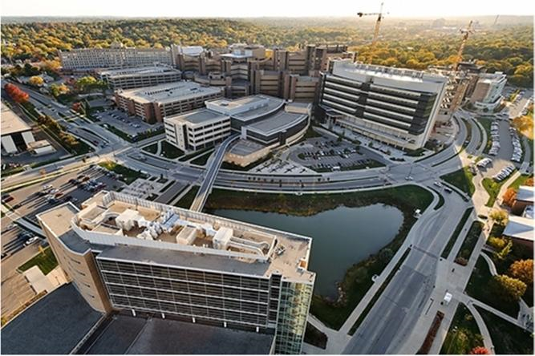
Organization Background
UW Hospital and Clinics (UWHC)
  592-bed academic, level 1 trauma center
  Organization-wide electronic medical record
Inpatient Pharmacist Roles at UWHC
  Medication admission histories
  Drug therapy management
  Medication reconciliation through transitions of care
  Medication discharge teaching
“Discharge Express” medication
delivery to patient rooms
Notes:
Daytime: 28 inpatient pharmacists broken into teams by services and 2 ambulatory pharmcists in main hospital; ambulatory pharmacy fills 270 rx/day and captures 53% of discharge orders

Slide 15
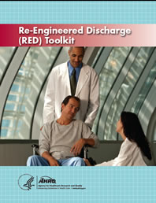
Project Impetus
Enhancing transitions in care became a focus for UW Health in 2012
UW Health Transitions of Care Team identified teach-back and plain language as a key strategy to reduce readmissions
Based on Project RED and Ask Me 3:
  12 components including patient centered
  teaching and assessing the patient’s
  understanding of the discharge plan
  “Plain-Language” and “Teach Back Method”
http://www.ahrq.gov/professionals/systems/hospital/red/index.html
http://www.npsf.org/for-healthcare-professionals/programs/ask-me-3/ask-me-3-resources/
Notes:
Project Re-Engineered Discharge or Project RED, implemented at Boston Medical Center and last revised in 2013.
Ask Me 3 sponsored by the National Patient Safety Foundation
Ascertain need for and obtain language assistance.
Make appointments for followup care (e.g., medical appointments, postdischarge tests/labs).
Plan for the followup of results from tests or labs that are pending at discharge.
Organize postdischarge outpatient services and medical equipment.
Identify the correct medicines and a plan for the patient to obtain them.
Reconcile the discharge plan with national guidelines.
Teach a written discharge plan the patient can understand.
Educate the patient about his or her diagnosis and medicines.
Review with the patient what to do if a problem arises.
Assess the degree of the patient's understanding of the discharge plan.
Expedite transmission of the discharge summary to clinicians accepting care of the patient.
Provide telephone reinforcement of the discharge plan.

Slide 16
Project Partnership
Pharmacy Patient Ed Cmte
UW School of Pharmacy
UWHC Transitions Team
Notes:
Expectation from the transition team was for a CBT and discipline specific hands on training; Department of Pharmacy had an existing Patient Education Committee that needed repurposing; relationship with faculty at SOP -= brought two valuable components. – first an understanding of adult education theory and qualitative research experience. Continuing Ed has been criticized for not impacting practice or changing patient outcomes as they often don’t include role-play, case discussion or hands on opportunities that change the confidence level of the practitioner and percieved self efficacy. When you are talking about changing the way pharmacists structure their discharge education after years of practicing with the current model – we realized quickly that a different approach was needed. Also wanted to demonstrate change so needed direct observation of behaviors.

Slide 17
Purpose
To evaluate whether active learning-based training in teach-back and plain language (TBPL) techniques can lead to observable changes to patient-centered practices in pharmacist-patient education

Slide 18
Methods: Population
Adult patients (>18 yo) with two or more new medications being seen at UWHC were included in the study (inpatient and ambulatory)
IRB exemption was obtained

Slide 19
Methods
Baseline: Communication Assessment and Observations
(July 19 - Aug 14, 2012)
Intervention: Training
CBT & Workshop or Webinar or Team
(Aug 14 – Oct 19, 2012)
Post-Intervention: Communication Assessment and Observations
(Oct 19 - Dec 14, 2012)
8/14: Workshop
9/20: Webinar

Slide 20
Methods: Communication Assessment
100 patient surveys pre- and post- implementation
Makoul G et al. Patient Educ Couns. 2007
Notes:
IRB exemption was obtained
Tool was intended for physicians, adapted for our project to pharmacists, but could be used with any care provider

Slide 21
Methods: Training
Institution provided Computer Based Training was required for all pharmacists
  Basic information about health literacy, universal communication strategy, plain language and teach-back method
Train-the-trainer approach used for application based competency assessment
  Concepts included:
    Identifying the primary learner
    Physical positioning
    Agenda setting
    Assessing baseline knowledge
    Adapting to misunderstandings
    Four categories of “Words to Watch” from Ask Me 3
    Chunk and check
    Teach-back method of checking for understanding
Notes:
Patient case with non-adherent patient receiving new warfarin and low-molecular weight heparin
Each session was interactive and designed around adult active learning principles including: clear learning objectives, model examples, problem solving, and group cases with feedback
Delivered in a variety of formats over a 3 month period to all pharmacists who have patient interactions. Included at standing Pharmacy Grand Rounds and Ambulatory Pharmacy Grand Rounds. Eight members of the patient education committee met with pharmacists who were unable to attend either of the grand round sessions at team meetings or individually until all pharmacists were trained

Slide 22
Methods: Training
16 item session evaluation form:
  Confidence (5)
  Plain language and teach back ability pre- and post (2)
  Skill in new methods (9)
Ability: 1-5 scale (poor to excellent)
Confidence: 1-5 scale (not at all to extremely confident)

Slide 23
Methods: Direct Observation
Student pharmacists were trained and validated to complete direct observation of pharmacist discharge counseling with a standardized rubric
  Two 1 hour training sessions and validation with a recorded example
  Provided rater training document
  Evaluated on 0-2 scale (0 – Not Done, 2 – Done Completely)
Consented patient prior to entering room
After consult provided Communication Assessment Tool, pencil and envelope

Slide 24
Methods: Direct Observation
Thirty elements were evaluated during each observation in 6 domains:
  Setting the stage
  Assessment of current knowledge
  Strategies used to overcome barriers
  Teaching materials utilized
  Teaching strategies used
  Closure
Nine process related elements were also evaluated
Notes:
Setting the Stage: Introducing self and purpose, positioning, identifying the primary learner, agenda setting
Assessment: Indication, purpose, ADEs
Strategies: Addressing primary concerns first, caregiver involvement, varying teaching / positioning, emotional support
Materials: Show and tell, written materials, applied use of med chart
Strategies: Setting expectations, chunk and check, open-ended questions (had to have at least 5), practice
Closure: Summarizes, open ended ask for questions, teach back
Process: Audible, plain language, positive statements, style, respect, eye contact, empathy, pace

Slide 25
Results: Communication Assessment
Communication Assessment Tool scores were high at baseline and did not change post-intervention:
  Mean for all 14 items 4.71 ± 0.52
  Highest in “Treated me with respect”, “Gave me all the information I wanted”, and “Spent the right amount of time with me”
Notes:
1 = poor and 5 = excellent
Lowest in “Showed interest in my ideas about my health”, “Discussed next steps, including any follow-up plans”, and “Involved me in decisions as much as I wanted”

Slide 26
Results: Training
118 pharmacists completed the training program
  25 Ambulatory
  93 Inpatient
Training was completed within 2 months
  37 Workshop
  22 Webinar
  59 Team-based Training
All participants recommended the program to colleagues
Notes:
25 outpatient and 93 inpatient

Slide 27
Results: Training n=59
Self-rated level of skill | Mean (sd)
Identifying the key learner for the medication consult | 4.24 (0.59)
Using a conversational style and engaging the learner | 4.27 (0.58)
Assessing the learner’s baseline knowledge about the medicines | 3.93 (0.69)
Using plain language throughout the consult | 4.20 (0.58)
Organizing the consult using the “chunk and check” method | 3.76 (0.75)
Applying the teach-back method to tailor the consult | 3.79 (0.74)
Adapting the information to the patient’s lifestyle and daily routines | 4.02 (0.75)
Summarizing the key points for the consult | 4.22 (0.69)
Addressing the learner’s misunderstandings in a respectful way | 4.17 (0.62)
Notes:
25 outpatient and 93 inpatient

Slide 28
Results: Training n=59
Self-rated confidence | Mean (SD)
Are able to provide adequate counseling when time is limited? | 3.85 (0.66)
Can help learners to overcome learning barriers? | 3.97 (0.59)
Can engage learner’s who seem uninterested in receiving a medication consult? | 3.69 (0.70)
Can provide motivation to learner’s who are struggling with changes (such as medicines, conditions, lifestyle)? | 3.97 (0.59)
Know the appropriate methods to “chunk and check” the medication information you provide (divide and organize key points)? | 3.97 (0.57)
Notes:
25 outpatient and 93 inpatient

Slide 29
Results: Training
55 of 57 pharmacists committed to making changes to patient counseling based on the session
  On 1-5 scale, 4.37 ± 0.56 commitment to making the change
“Rate your overall ability to counsel patients using plain-language and teach-back techniques”
p<0.001
Notes:
Cronbach alpha estimate of internal consistency of 0.88, and the confidence scale exhibited an alpha of 0.78

Slide 30
Results: Direct Observation n= 84 (40 Pre / 44 Post)
Notes:
Did not keep any patient or pharmacist identifiers
0=not done, 1= done some and 2 = done completely

Slide 31
Results: Training Program Feasibility
Trained 24 student pharmacists for direct observations
  30 min student preparation
  4 x 1 hour training sessions by 3 investigators
  Total of 48 hours
Trained 118 pharmacists in patient education techniques
  1 hour competency (workshop or webinar)
  20 min computer based training
  Total of 153 hours
Notes:
Change in confidence

Slide 32
Results: Pharmacist Testimonials
“Using the teach-back method gives me confidence that my patients will take their medications correctly and get the most benefit.”
  Eddu – Surgery Pharmacist
“I was working with an elderly couple…prior to this training I would have consulted them without determining the primary learner, which could have led to a poor outcome. Instead I waited until the caregiver arrived and I knew the patient would succeed at home.”
  Judy – Cardiology Pharmacist

Slide 33
Barriers
Reaching all pharmacists
  Across each inpatient team and 12 ambulatory pharmacies
Patient acceptance
Role clarity
Consult duration
Notes:
Tracking all pharmacists progress, providing multiple modalities to complete training, analysis shows impact was the same from webinar as a live session, using front line staff to lead the change.
Moving relationships from friend to provider
Set the stage
Acknowledge awkwardness
Accept responsibility
Who does it, how do you reduce duplication in the process
6.84 min pre and 8.79 min post (p=0.087) not significatnt

Slide 34
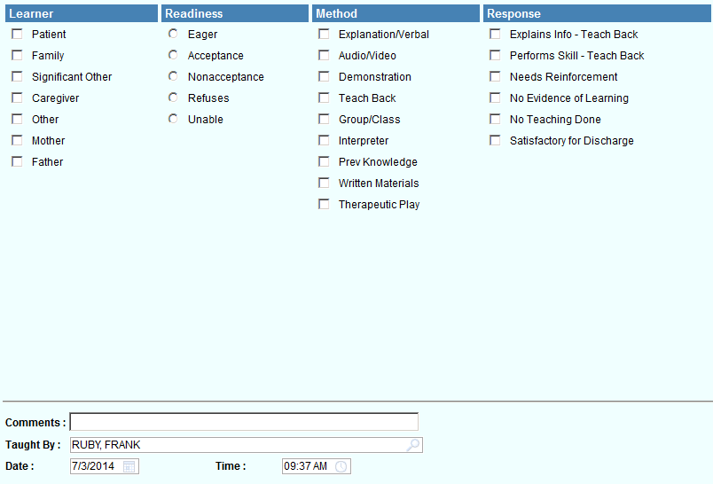
Next Steps
Integrate into onboarding
Optimize interaction with new technology:
  Recording discharge instructions
  Providing 24/7 access to plans via phone, mobile device or computer
Hardwire into documentation

Slide 35
Conclusions and Application
Implementing a plain language and teach back training program improved observable pharmacist-patient communication skills
Use of adult learning principles can encourage practice change – regardless of modality
Partnership with “academia” creates more impactful training and allows for measurement of change
Utilization of students created exposure to research principles and health literacy concepts while being a valuable data collection resource

Slide 36
Acknowledgements
Kate Hartkopf, PharmD
Beth Martin, RPh, MS, PhD
Amanda Margolis, PharmD, MS, BCACP
Trevor Schmidt, PharmD

Slide 37
Implementation and Evaluation of a “Teach-back and Plain Language” Method Competency Program
David Hager, PharmD, BCPS
dhager@uwhealth.org
Kate Hartkopf, PharmD, BCACP
khartkopf@uwhealth.org

