Slide 1
“So, what does health literacy mean to you?”: Asking Culturally Proficient Questions to Implement Health Literacy Initiatives
Virginia Brown, DrPH University of Maryland Vbrown12@umd.edu 410-386-2760 | R.V. Rikard, Ph.D. Michigan State University rvrikard@msu.edu 919-995-2721

Slide 2
We have no relevant financial interest

Slide 3
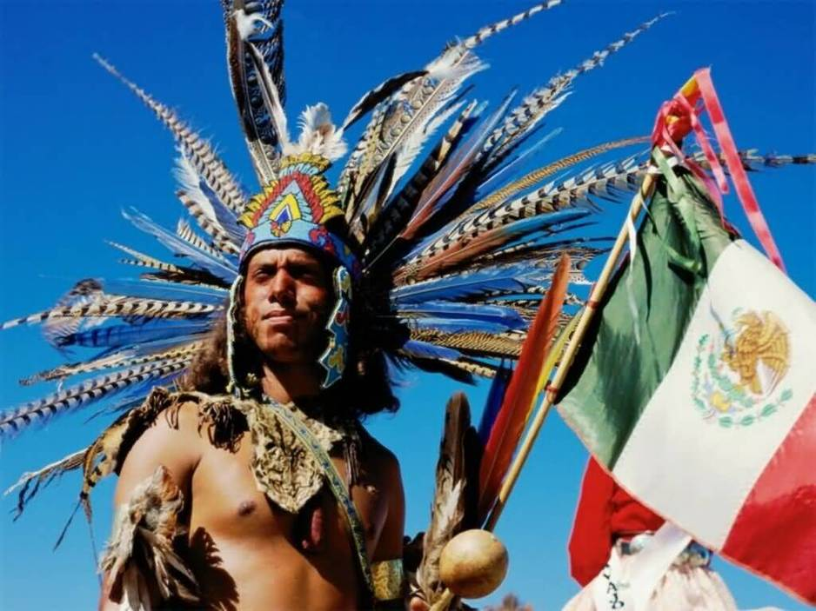
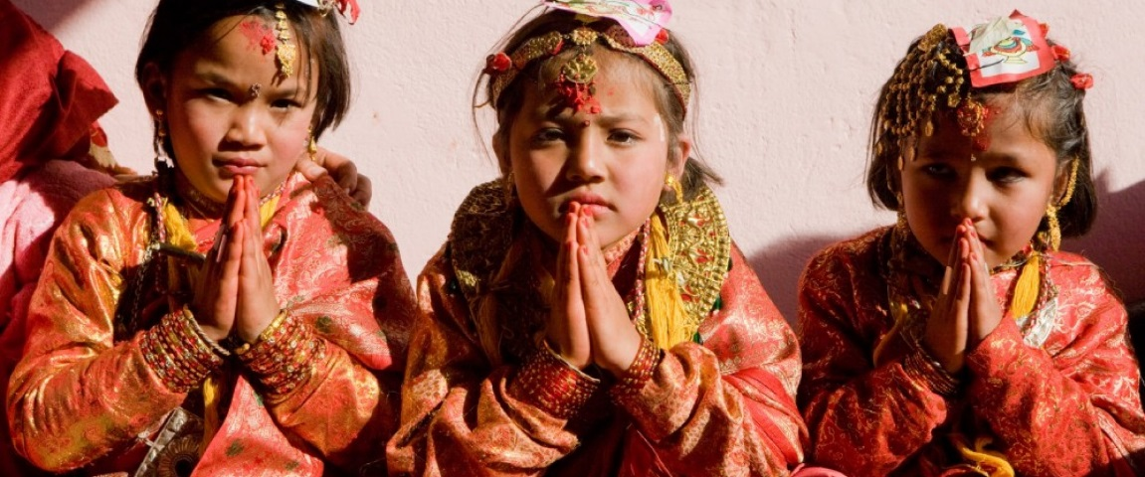
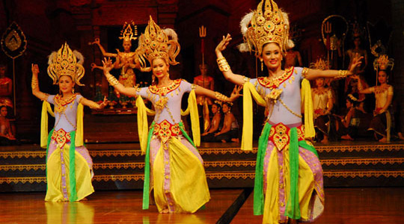
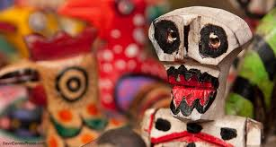
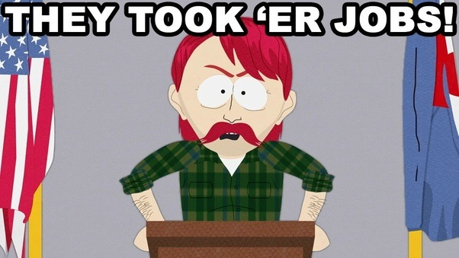
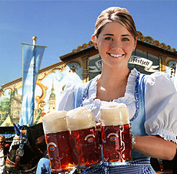
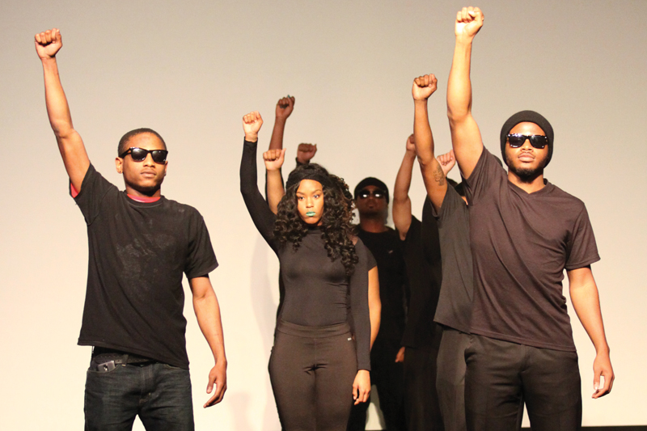
Culture?

Slide 4
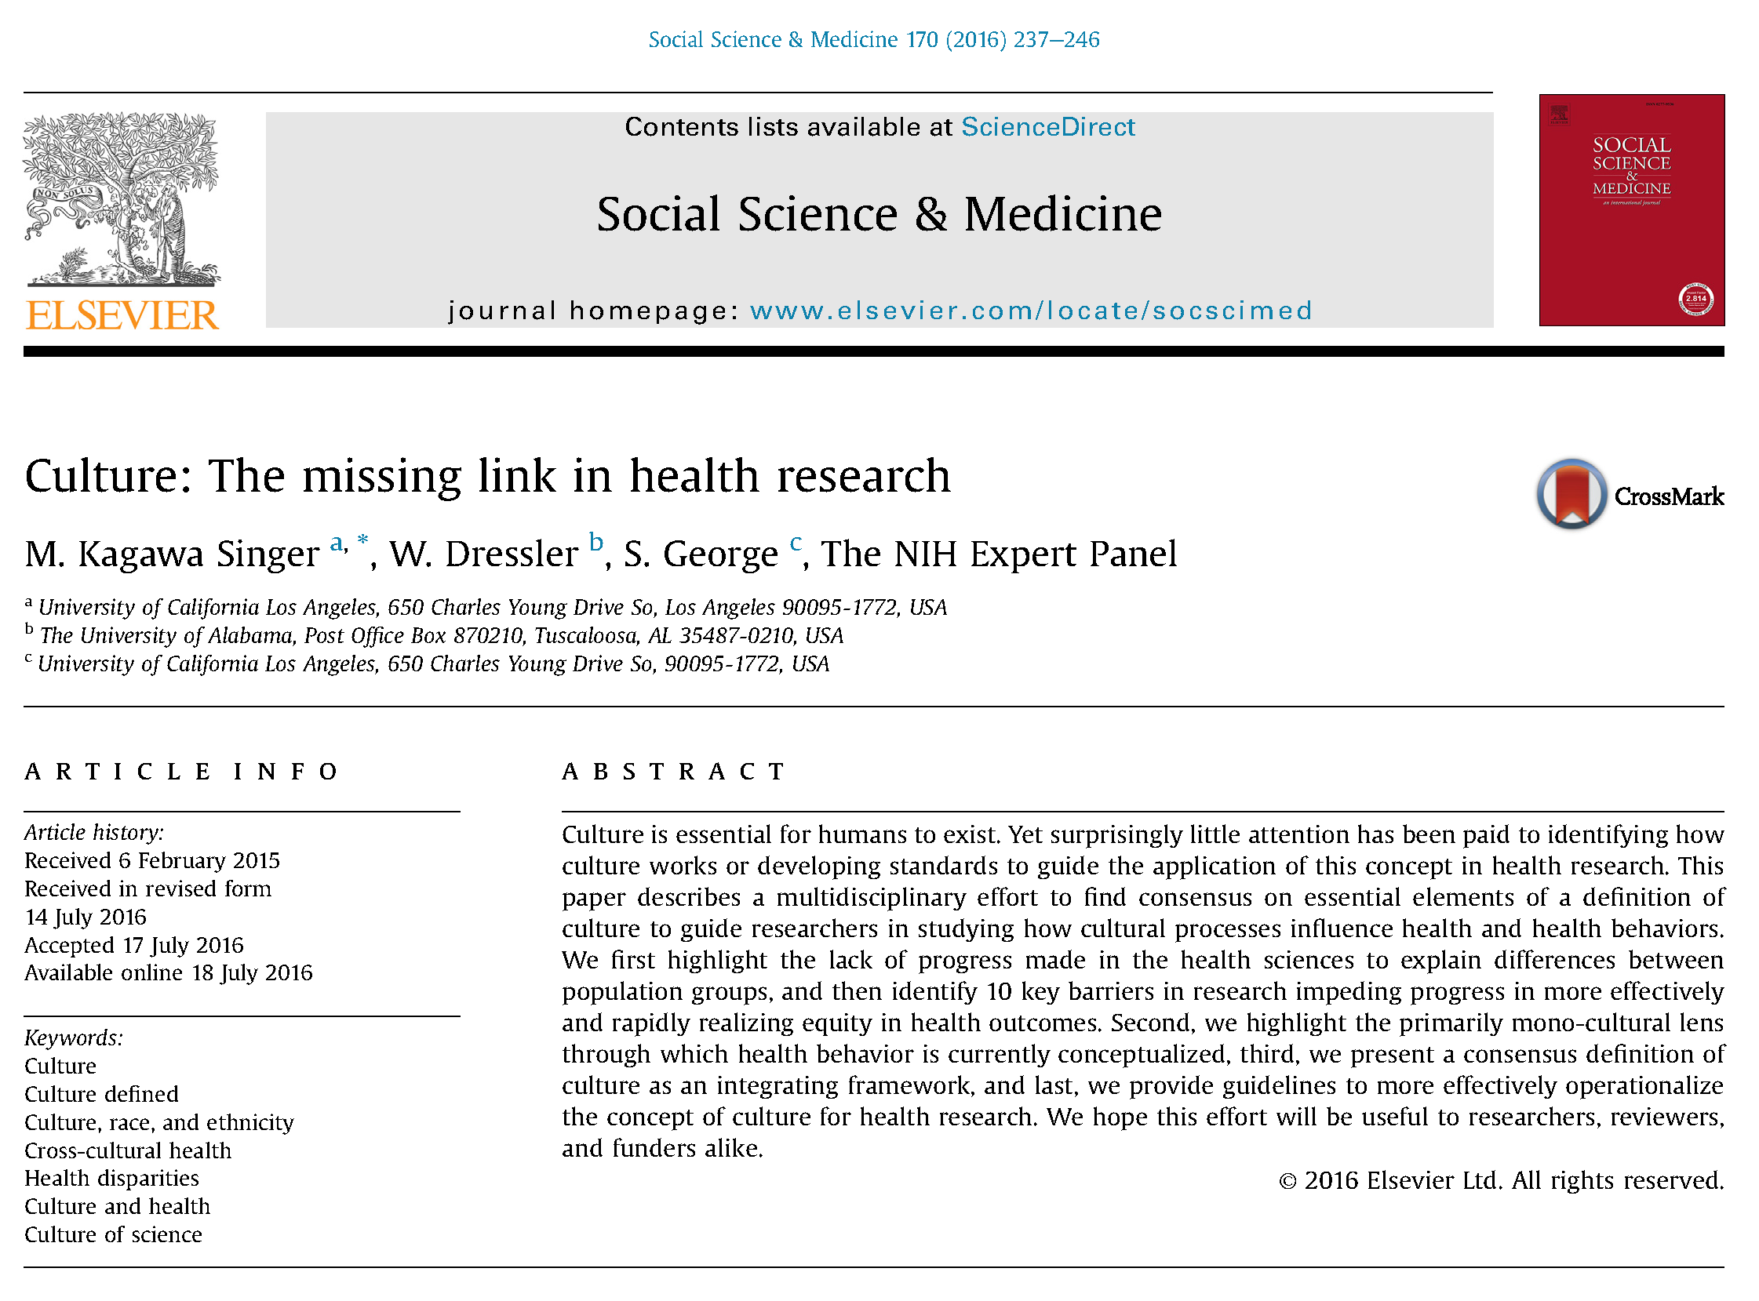
Culture?
Culture is an internalized and shared schema or framework that is used by group (or subgroup) members as a refracted lens to “see” reality, and in which both the individual and the collective experience the world.
Culture is not an immutable “thing”, but a constantly evolving, multidimensional, multi-level process that encompasses all aspects of the human condition.

Slide 5
Cultural Continuum
Brown and Rikard (n.d.)

Slide 6
Cultural Proficiency
Definitions and practices of cultural proficiency are simplified versions of cultural competency that require the adoption of some but not all elements of a non-dominant culture; and
Cultural proficiency, as operationalized, represents an individual and/or organizational approach to serve diverse cultures and establishes tangible benchmarks of action to respond to an ever-evolving entity.

Slide 7
So…..what’s the connection?
Health Literacy

Slide 8
Notes:
Just before the Barriers slide – the video relates to Systems of oppression-That racism, sexism, heterosexism, ableism, and classism

Slide 9
Barriers to Cultural Proficiency
Systems of oppression - racism, sexism, heterosexism, ableism, and classism
A sense of privilege and entitlement
Unawareness of the need to adapt
Notes:
Systems of oppression-That racism, sexism, heterosexism, ableism, and classism exist is without refute, historically and currently. Data are on the side of documenting and describing the ill effects of such systems. Being able to understand oppression as a systemic issue apart from personal behavior is important.
A sense of privilege and entitlement-Systems of oppression have two effects-on those who are harmed and on those who benefit. Those harmed from systemic oppression respond from an emotional connection, as well as from being well informed of practices that impact them negatively. On the other hand, many of those who benefit from historical and current practices are oblivious to the negative effects of systemic oppression, because they can choose not to see.
Unawareness of the need to adapt-Many educators and schools often struggle with change that involves issues of culture. For those who are resistant, change often is experienced as an outside force that judges current practices as deficient or defective. Whether accurate or not, an adversarial relationship exists between those forcing the change and other members of the school community.

Slide 10
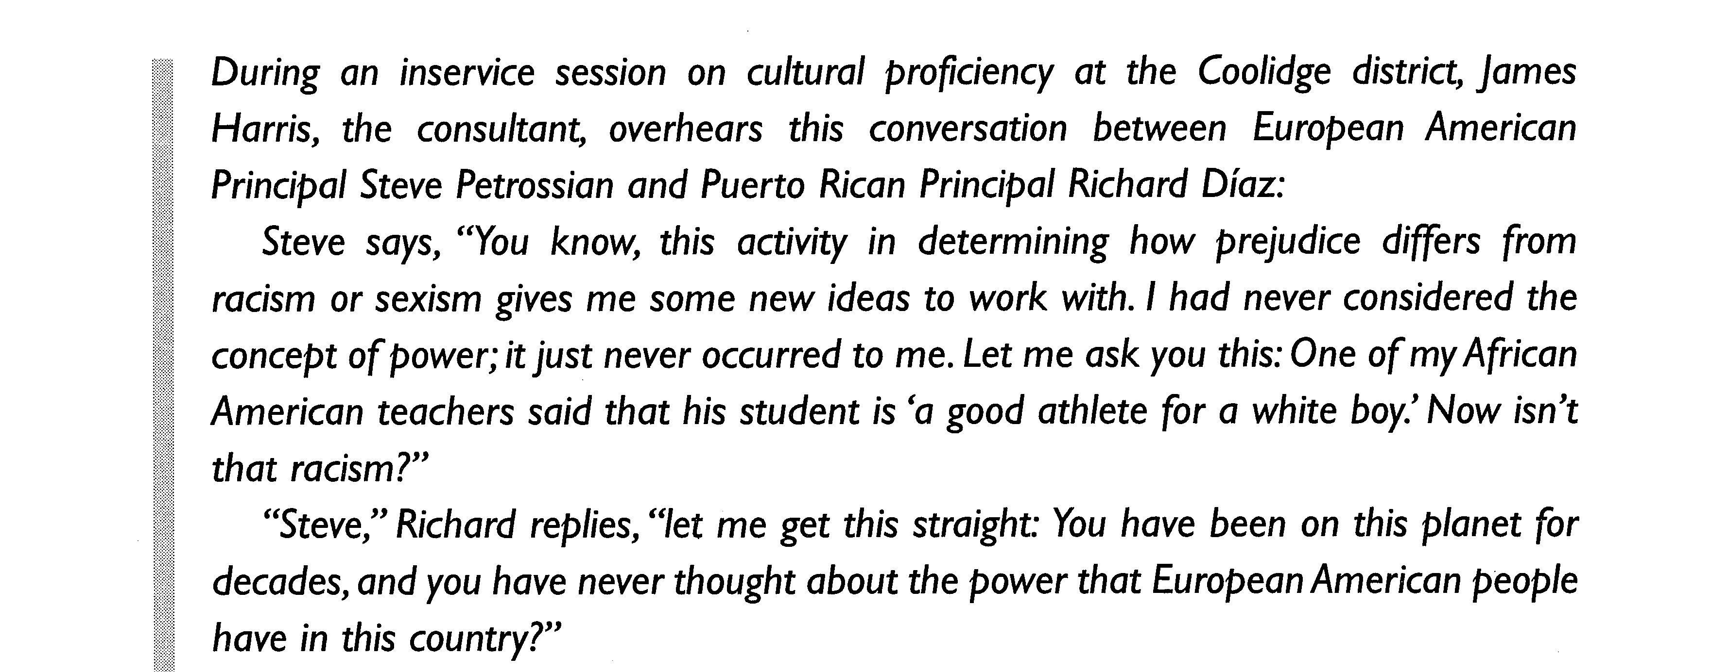
Case Study
Notes:
Ok, everyone gather in groups of 2 to 3 and read the case study.

Slide 11
Digestion Questions
Is there an example of oppression in the case study? How do you know?
Who benefits from privilege and entitlement in the case study? Provide some examples…
What are peoples reactions when they become aware?
What would be your recommendation to begin moving the needle toward cultural proficiency?

Slide 12
How to ask culturally proficient questions
DO | DO NOT
Assume nothing | Tell others about their culture
Inquire with respect | React visually to responses
Acknowledge different perspectives | Say that one point of view is best
Create a safe and respectful place | Power differential
LISTEN! | Judge
Notes:
*Acknowledge that people are sensitive when their point of view is challenged.

Slide 13
3 Guiding principles for creating health literate questions:
Acknowledge the status quo - change is seldom easy and is often unwanted, especially when a commitment to cultural proficiency means having to do more work.
The plan is not to fix something that is broken; it is to genuinely understand health experiences and grow as a community.
Golden Rule – work with a member(s) of the community to develop questions.

Slide 14
Best Practices:
Set ground rules –
respect, every voice is important, no wrong answers, no laughter after an answer
Open with a conversation question
Example: “I’d like to go around the room and have everyone tell us your first name and what is your favorite food.”
Example: “What do you like about living in _____________?”
Open ended questions
Example: “What does healthy eating mean to you?”
PROBES!
Example: “How much important is it to you to eat healthy food?”
Always end on a positive note
Example: “If you were given a blank check to improve the health of your community, what would you do?”

Slide 15
Your Turn!

Slide 16
Now what?
Goal: design appropriate health information and implement tailored health literacy initiatives
What needs to be created?
What can be modified to meet needs?
What is already in place to meet needs?

Slide 17
Questions? Comments? Accolades?

Slide 18
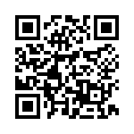
“So, what does health literacy mean to you?”: Asking Culturally Proficient Questions to Implement Health Literacy Initiatives
Virginia Brown, DrPH University of Maryland Vbrown12@umd.edu 410-386-2760 | R.V. Rikard, Ph.D. Michigan State University rvrikard@msu.edu 919-995-2721

