Slide 1
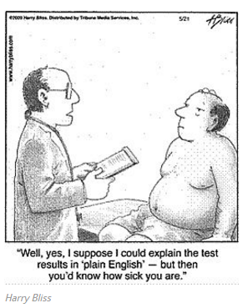
Clarify, Don’t Terrify!
Utilizing National Library of Medicine Resources for Health Literacy
Elizabeth Kiscaden, MLIS, AHIP
Carolyn Martin, MLS, AHIP
National Network of Libraries of Medicine

Slide 2
Disclosure
Personnel involved in this presentation have no relevant financial interest

Slide 3
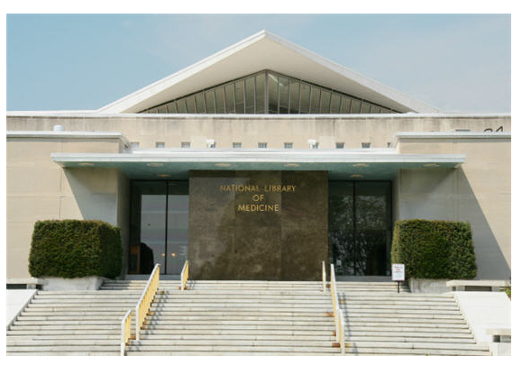
Who are we?
Notes:
Introduce the National Network of Libraries of Medicine and relationship b/w NNLM and NLM
Introduce ourselves individually and which region we’re from

Slide 4
Why libraries?
In 2015, 73% of people who visit a public library in America go looking for answers about their health (“Libraries at the Crossroads,” 2015)
In a 2017 report, 66.8% of local government officials believe that libraries should support provision of public health service (“The role of libraries in advancing community goals,” 2017)
NNLM mission, “improve the public’s access to information to enable them to make informed decisions about their health.”
Notes:
Pew research study recently in the news: http://www.pewinternet.org/2015/09/15/libraries-at-the-crossroads/
Horrigan, J. B. (2017). The role of libraries in advancing community goals. The Aspen Institute. Washington, D.C.

Slide 5
MedlinePlus
Written at 5-8th grade reading level
Available in Spanish!
Notes:
Learn how to write your own “easy to read” materials
Bring samples to distribute to participants

Slide 6
MedlinePlus
Utilizes web accessibility best practices
Look fantastic as printouts!
Notes:
Many records have an audio format

Slide 7
Understanding Medical Words: A Tutorial from the National Library of Medicine
Learn about word roots, beginnings, endings and abbreviations
Notes:
Free! Fun! What’s not to love?

Slide 8
HealthReach
What if everyone… shared the culturally competent patient education materials they created?
Notes:
HealthReach is a national collaborative partnership
All submissions must: be in the public domain, be licensed by creative commons, or comes with the author’s permission

Slide 9
HealthReach
Intended for patients with limited English proficiency
Culturally appropriate
Must have undergone a medical review
No ads, all free!

Slide 10
HealthReach
Growing collection of provider information (cultural information, best practices)
Notes:
In Carolyn’s region, EthnoMed submitted resources
Looking for more submissions for patients with developmental disabilities

Slide 11
NIH Senior Health
Health information for older adults
Partnership of National Institute on Aging and National Library of Medicine
Information comes from National Institutes of Health
Senior-friendly features (large text, sound, contrast)
Information in bite-sized pieces
Health videos
Trainer Toolkit

Slide 12
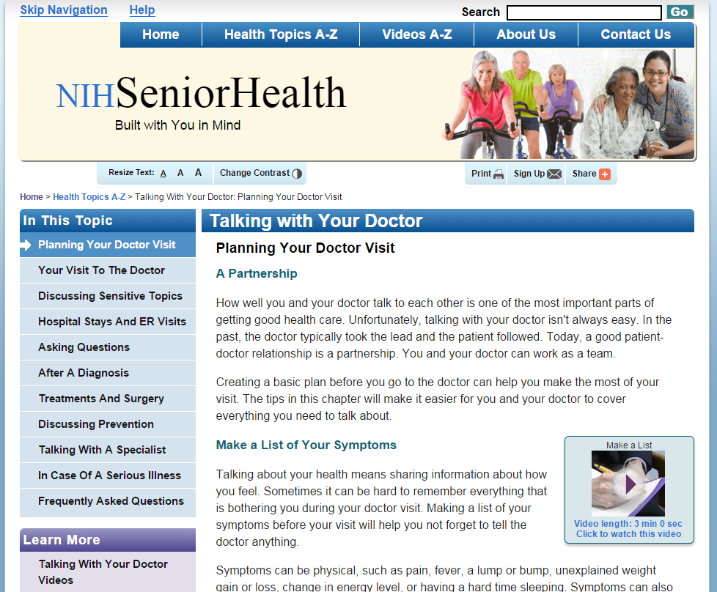
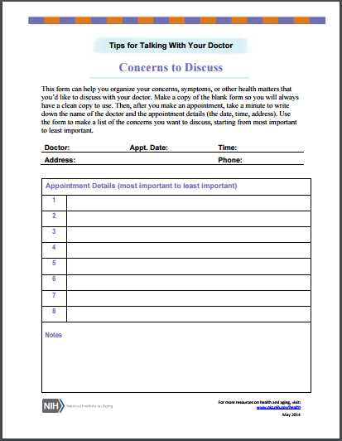
NIH Senior Health
NIH Senior Health

Slide 13
NIH National Institute on Aging

Slide 14
NIH National Institute on Aging

Slide 15
American Indian Health

Slide 16
Genetics Home Reference
Health conditions
Genes
Chromosomes and DNA
Resources
Genetic handbook

Slide 17
Genetics Home Reference

Slide 18
PubMed Health

Slide 19
PubMed Health

Slide 20
NLM SIS Outreach Resources

Slide 21
Health literacy projects funded through NNLM
Training on health literacy to staff at the Wilkes-Barre General Hospital
Integrate health literacy into the curriculum at Touro College of Osteopathic Medicine
Hold a health literacy symposium at Saint Peter’s University Hospital
Make low literacy health education materials available to patients and families at the Children’s Hospital of Wisconsin (CHW)

Slide 22
NN/LM PNR funded projects
“CAM Health Literacy and Older Rural Adults”
Express Outreach Award
Montana State University
“Somali Mammogram Screening Education Project”
Health Disparities Information Outreach Award
EthnoMed / Harborview Medical Center
"Equal Access to Health Information"
Technology Improvement Award
Open Doors for Multicultural Families
“Equipping Peer Language Navigators for Outreach in Anchorage, Alaska Communities”
Express Outreach Award
The Anchorage Health Literacy Collaborative

Slide 23
Thank you!
For more resources and contact information, please visit us at nnlm.gov.

