Slide 1

Local Strategies for
Vaccine Community Outreach

Slide 2
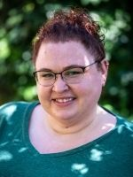
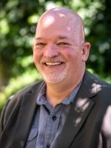
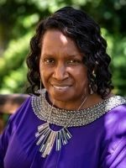
Vaccine Community Outreach Specialists
Will Housley
will@wisconsinliteracy.org
Patricia Wilson
patricia@wisconsinliteracy.org
Laura Cunningham
laura@wisconsinliteracy.org
Notes:
Hello, my name is Laura Cunningham (she/her) , and I am a Vaccine Community Outreach Specialist with Wisconsin Health Literacy. I am one of 3 of the VCOs in Wisconsin, along with Will Housley and Patricia Wilson. We work with our sub-awardee organizations providing support that they need through our DHS grant.
Our primary rolls are to support them through any financial reporting, community outreach, and other important health information they might need in their work, as well as being their biggest cheerleaders in all that they do for their communities.
We are lucky to have 3 of our groups we’ve been working with here to showcase their organizations some of the amazing work that they have been doing over the past year. During their presentations feel free to ask questions, but we will leave time at the very end of this portion to let anyone ask questions of all 3 presenters. And with that, Will I will let you introduce the first speaker.

Slide 3
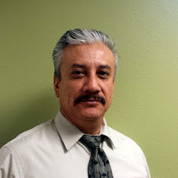
Hector Portillo
Padres E Hijos En Acción

Slide 4
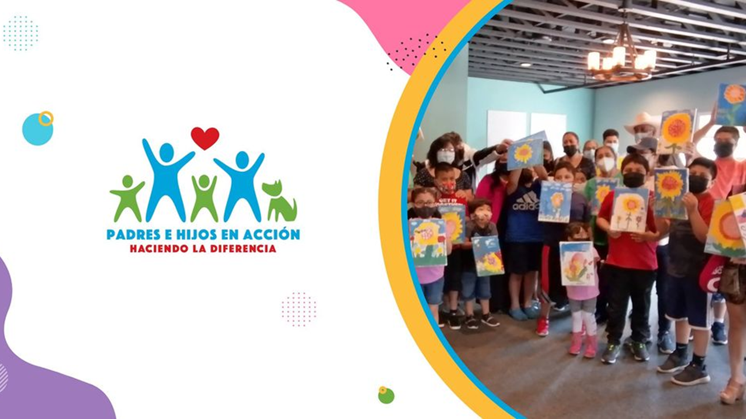

Slide 5
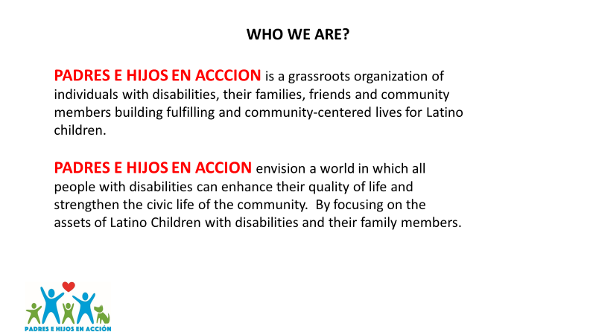

Slide 6
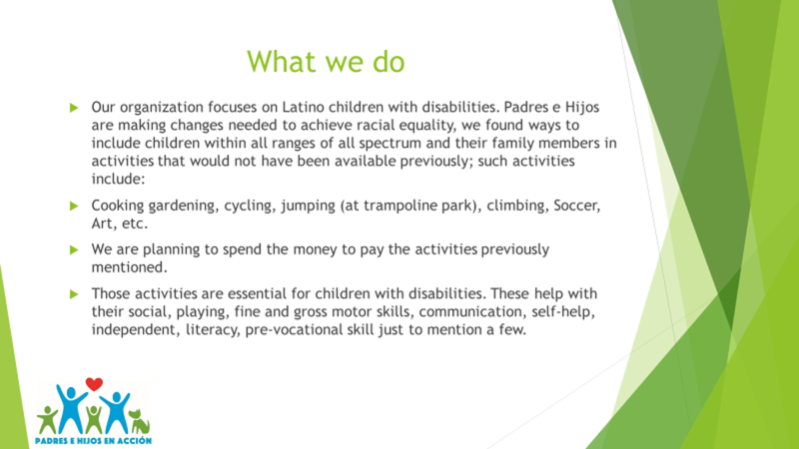

Slide 7

COVID-19 Community Outreach Grant

Slide 8
ACTIVITIES
We provide Face masks, hand sanitizer, Covid-19 literacy, attended different events to promote and distribute information.
Facebook has been an avenue to talk about the vaccine, COVID, hesitancy. What else was needed? Access, priority at first. Last pocket is those who want vaccine but may still not know how to navigate the system or who may encounter language barriers.
We posted in the front of every restaurant, apartments, and store that were willing to participate.
We met with storeowners to orient them and provide them with resources and connections so they can talk to their employees and clients. Hector, Isabel, and Alejandra worked on these conversations.

Slide 9



Slide 10

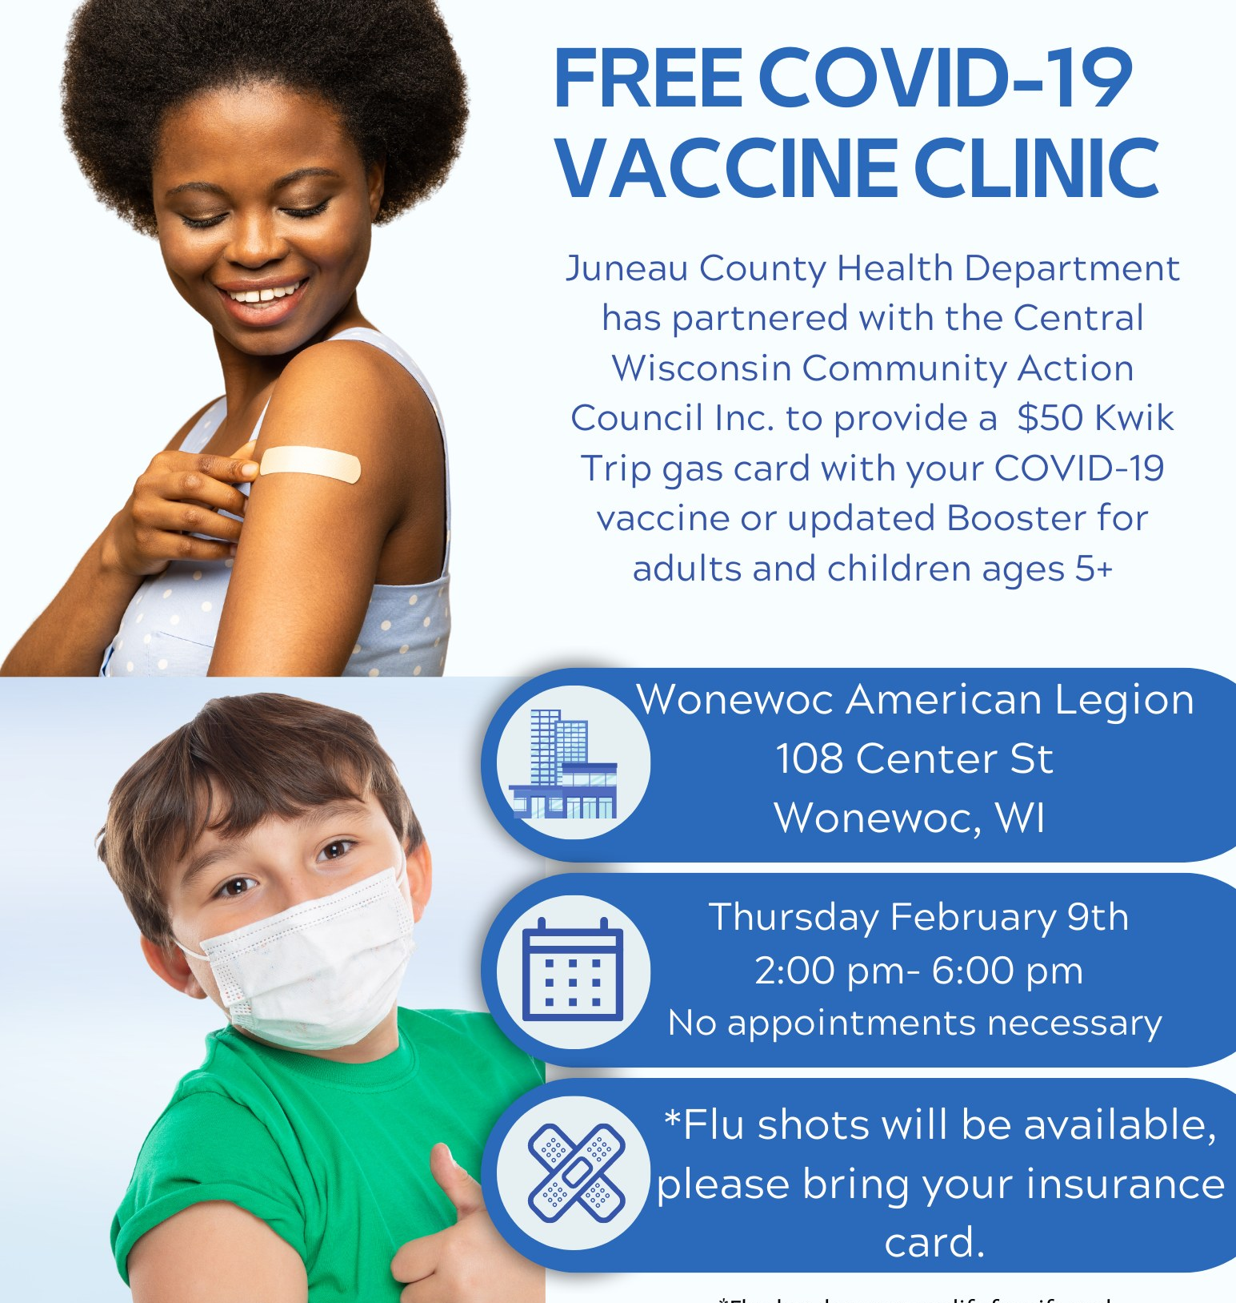


Slide 11
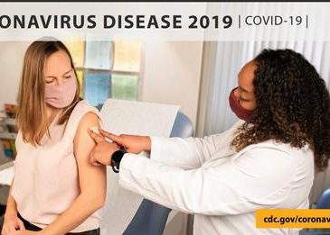
Facebook has been an avenue to talk about the vaccine, COVID, hesitancy. What else was needed? Access, priority at first. Last pocket is those who want vaccine but may still not know how to navigate the system or who may encounter language barriers.
Cuándo darse su 2.ª dosis: hable con su proveedor de atención médica sobre cuándo debe recibir la 2.ª dosis de su esquema principal.
Las personas de 6 meses a 64 años, especialmente varones de 12 a 39 años, pueden considerar recibir una 2.ª dosis principal de una vacuna de Pfizer-BioNTech, Moderna o Novavax 8 semanas después de la 1.ª dosis.
Dejar transcurrir un periodo más prolongado entre la 1.ª y la 2.ª dosis puede aumentar el nivel de protección que ofrecen las vacunas

Slide 12
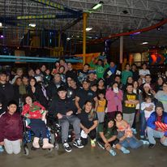

Slide 13
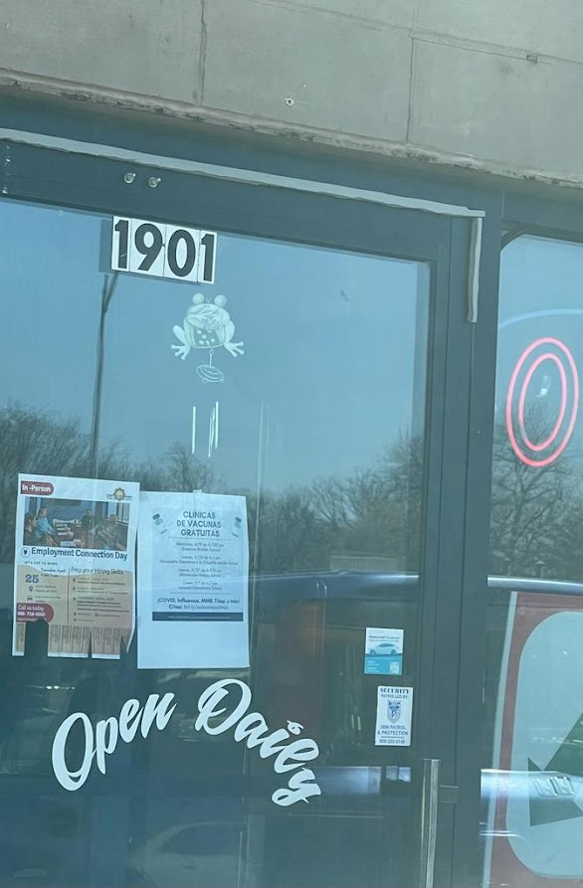
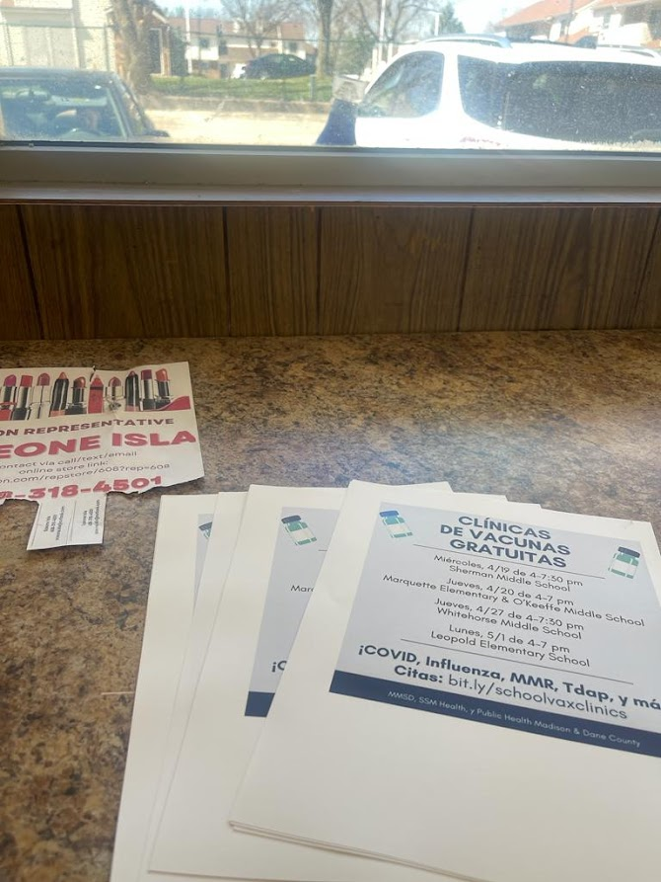


Slide 14

PHONE CALLS

Slide 15
FACEBOOK/WEBSITE PAGES

Slide 16
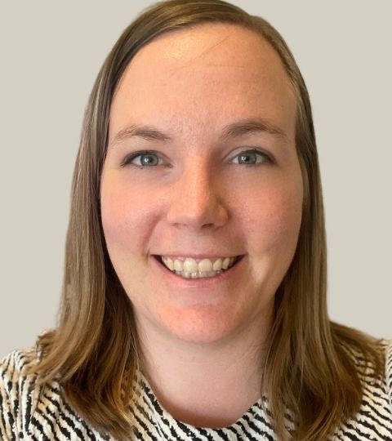
Caitlyn Lewis
Community Center for Immigrants
(CCI)

Slide 17

Community Center for Immigrants
Vaccine Community Outreach Educational Summit

Slide 18
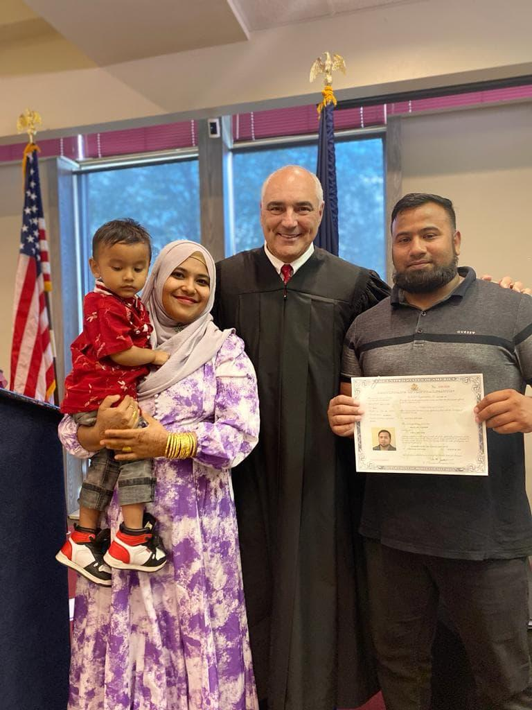
Overview
Most of our participants are refugees from Southeast Asia and Africa
We provide:
  Virtual civics and literacy education to refugees and immigrants
  In house immigration legal services (DOJ recognized)
  Experiential learning field trips
In addition to this, we had been helping people get relief from struggles caused by COVID-19 :
  Applying for state benefits, unemployment, access to food banks
  Scheduling vaccinations
  Helping to find local clinics/information about COVID-19 questions

Slide 19
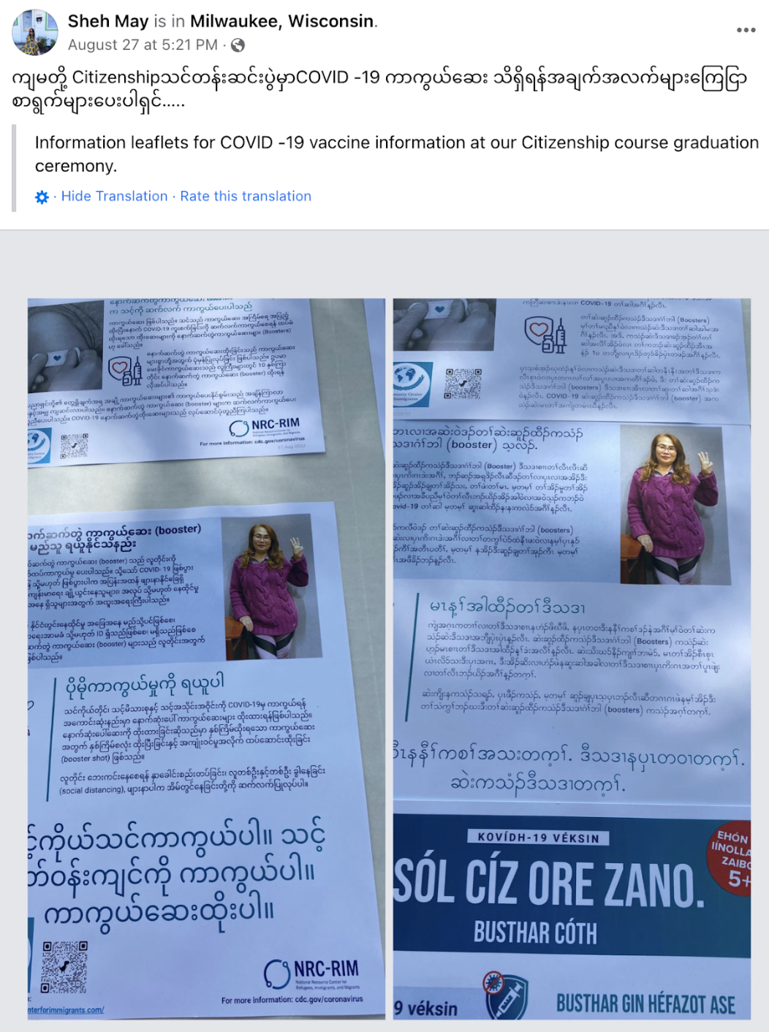
Successes
Amplifying current participant stories about why they chose to get vaccinated.
Hosting virtual access sessions & including COVID-19 educational programming with all of our events.
One-on-one conversations with the families we serve.

Slide 20

Stumbling Blocks
Social media posts not gaining as much attention and traction as we first had hoped.
COVID-19 fatigue - people believing they didn’t have to worry about the pandemic anymore.
Language barriers and creating video content to pair with written content.
  https://www.youtube.com/watch?v=TMi32x53KYc

Slide 21
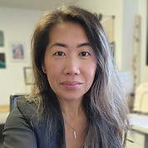
Pa Thao
Black and Brown Womyn Power Coalition
(BBWPC)
Notes:
Pa Thao is the co-founder and executive director of the Black and Brown Womyn Power Coalition in Eau Claire Wisconsin. She is a community organizer and an advocate for ending the violence against women, queer, trans and young folx, and has received many awards for her work including recognition in 2021 from the Wisconsin Senate for her courage, resilience and being a champion for all. Pa is a proud mother of 5 and likes to spend free time helping on the family farm and working with her consulting business.

Slide 22

BLACK & BROWN WOMYN POWER COALITION, INC. | 2023
COVID-19 VACCINE OUTREACH
WI Health Literacy Presentation | June, 8th, 2023

Slide 23



Mission & Vison
Mission
Building the capacities of Black and Brown advocates and their communities to end violence against womyn, queer and trans folx, and young people.
Vision
A bold healthy community lead by liberated and powerful Black, Brown, womyn, queer and trans folx, and young people.
www.bbwpcoalition.org/

Slide 24




2012- Gap identified for services- training & technical assistances for culturally specific advocates and providers.
2016- Wisconsin Women's Training Institute Created as an LLC
  Culturally specific domestic violence training for advocates & providers
  Hmong WI Family Strengthening Helpline provider
2019- BBWPC Non-profit Statues approved June
  funded Power Up Eau Claire
  1st state grant contract for training as a nonprofit
  physical office Jan 2020
2023- Continuing Development & Capacity Building
  Power Up Eau Claire
  WI Hmong Family Strengthening Helpline
  WWTI
  Hmong DV/SA TA & Training

Slide 25


  Engage
    Voter registration
    Get Out the Vote
  Inform
    campaign education
  Build Community Power
    civic participation
    issue campaign
    base building

Slide 26

Hmong Vaccination Literacy Outreach
  Focused on Community
    Trusted Messenger
    Monthly Partners Meeting
  Monthly Vaccination Reminder
    Sept-Nov, SPOKE text
  Mutual Aid & Base Building Events
    Thanksgiving Care Packages
    Hmong Hertiage Month Gala

Slide 27
Community Partnership
  Monthly Meetings- focused on COVID-19
    Eau Claire City-County Health Dept
    ECAHMAA
    JONAH
    Eau Claire Area School District
    Power of Perception
  COVID-19 Health Information Updates & Messenger
  Direct impact on of health information
  Culture consideration/relevancy

Slide 28
SPOKE Text
  Booster (Sept)
  Testing Kits (Oct)
  Safe Holiday Reminder (Nov)
  List of 1800 in Eau Claire County

Slide 29
https://fb.watch/kSoebY0zt-/
Notes:
Over 200 people in attendance
150 care packages with information on COVID-19 vaccine & testing
Vaccine clinic on with Wausau Family Pharmacy

Slide 30
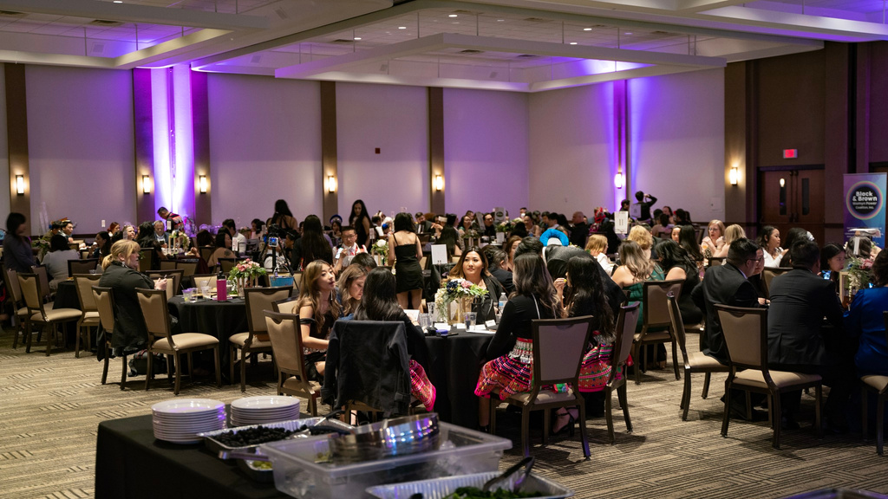
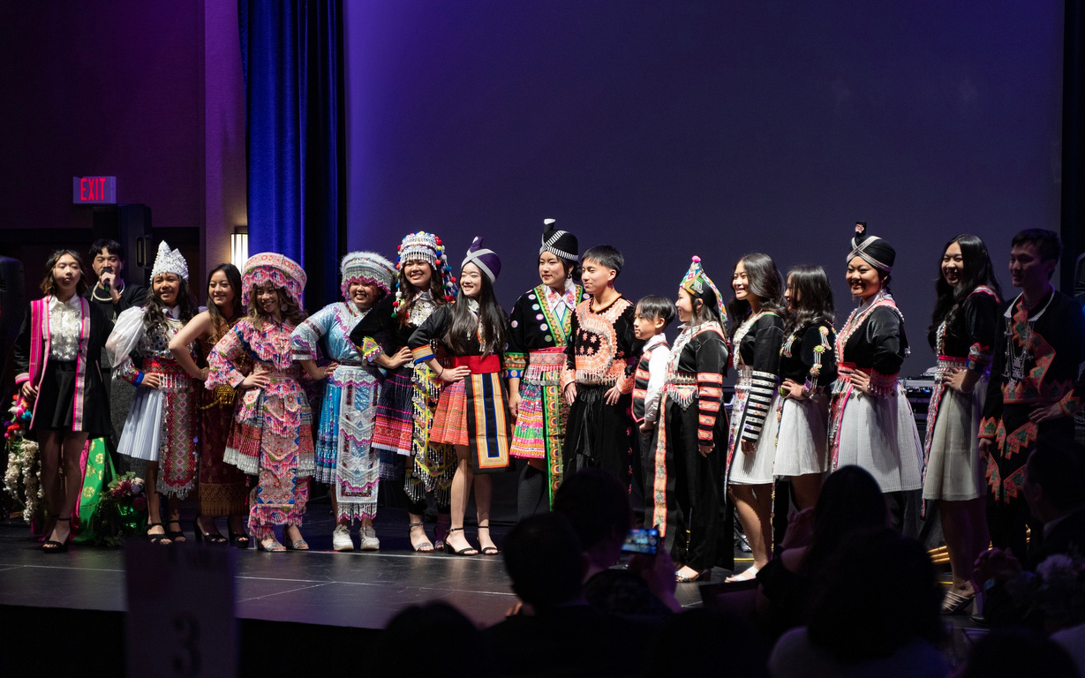
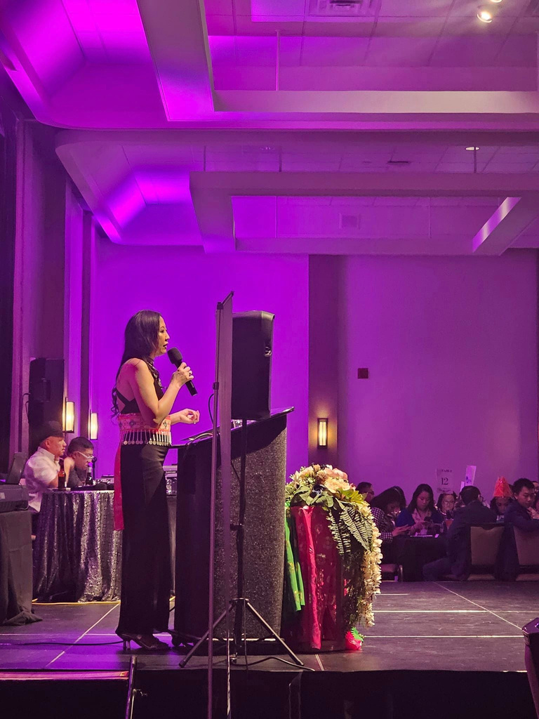
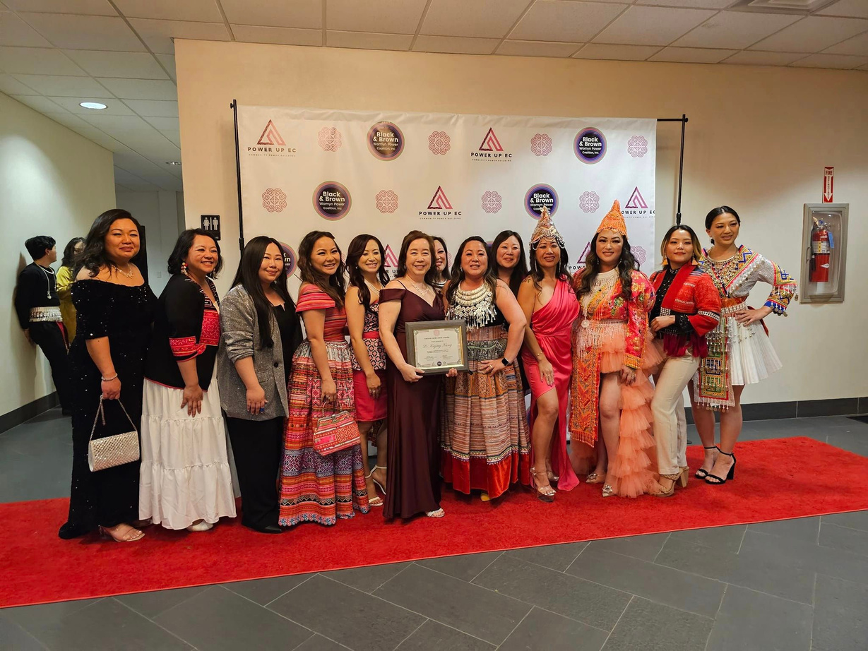

Slide 31
BLACK & BROWN WOMYN POWER COALITION, INC. | 2023
CONTACT US:
eMail: admin@bbwpcoalition.org | pa@bbwpcoalition.org
Call/Text: (800) 343-9337
WI Health Literacy Presentation | June, 8th, 2023

Slide 32
Q & A Time

