Slide 2
Special thanks to Wisconsin Department of Public Instruction
Notes:
Thanks to DPI for offering the grant to bring health literacy curriculum and resources to high schools in Wisconsin.
Special thanks for Christina Patrin for being a big supporter of our work and guiding us through this process.

Slide 3
Wisconsin Health Literacy
Statewide nonprofit organization offering education and training on Health Literacy
Community projects
Division of Wisconsin Literacy (over 70 members)
Health Literacy Summit (every other year)
WisconsinHealthLiteracy.org

Slide 4
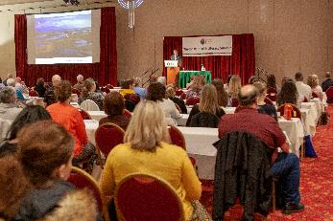
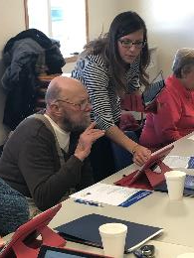
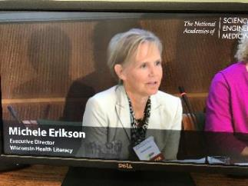
Wisconsin Health Literacy
Notes:
Overview of WHL:
In addition to trainings like today we do…
Community-based workshops on topics such as: LTAPM/Opioid Education, Digital Health Literacy
Health Literacy Advocacy with Legislatures
National partnerships and collaborations
Hosting national Summit every other year
Prescription Med-label project – making labels easier to read and improving medical adherence
Review of materials

Slide 5
Which of the following is the single strongest predictor of an individual’s health status?
8
1. Age
2. Income
3. Literacy Skills
4. Employment status
5. Education Level
6. Racial or ethnic group
Notes:
Another reason why we do what we do….

Slide 6
What is Health Literacy?
“The degree to which an individual has the capacity to obtain, communicate, process, and understand basic health information and services to make appropriate health decisions.”
-The Affordable Care Act of 2010

Slide 7
Why health literacy in high school?
Can affect anyone at anytime
Strategies need to be in place to see improved health outcomes
It’s a 2-way street – patients and providers need to work together
Notes:
There is no written rule on when low health literacy will affect someone. Think about unpredictable emergency situations or life changing news – Do you remember everything that was told or shared with you? This can affect medical decisions
Be introducing health literacy practices at a young age, students can practice how they can improve their health literacy at their next doctor’s visit and self care, and strategize ways they practice this technique if they get into a health career. Plus many of the techniques can be applied to a variety of non-health related careers. For example, a technique we talk about in one of the lessons is plain language. This is a universal practice and can make many forms of communication easier to understand.
It’s a 2-way street (next slide)

Slide 8
Two sides to Health Literacy
A person’s ability to access, understand and use health information
The other person’s ability to clearly communicate how to access, understand and use health information for better health

Slide 9
Who is most at risk for low health literacy?
Ethnicity/Race:
Entire population 36%
Caucasian 28%
Native American 48%
African-American 58%
Hispanic 66%

Slide 10
Who is most at risk for low health literacy?
AGE | Proficient | Intermediate | Basic or Below Basic
75+ | 1% | 29% | 70%
65+ | 3% | 38% | 59%
All Adults | 12% | 53% | 36%

Slide 11
Who is most at risk for low health literacy?
Education level:
In High School, GED or HS grad 34-37%
Less than/some High School 76%

Slide 12
Health Literacy means a person is able to understand:
Instructions on prescription bottles
Appointment slips
Medical brochures, provider instructions and consent forms
Complex health care systems
Insurance benefits
Notes:
Health literacy affects all the work you do
Written, oral, online communications

Slide 13
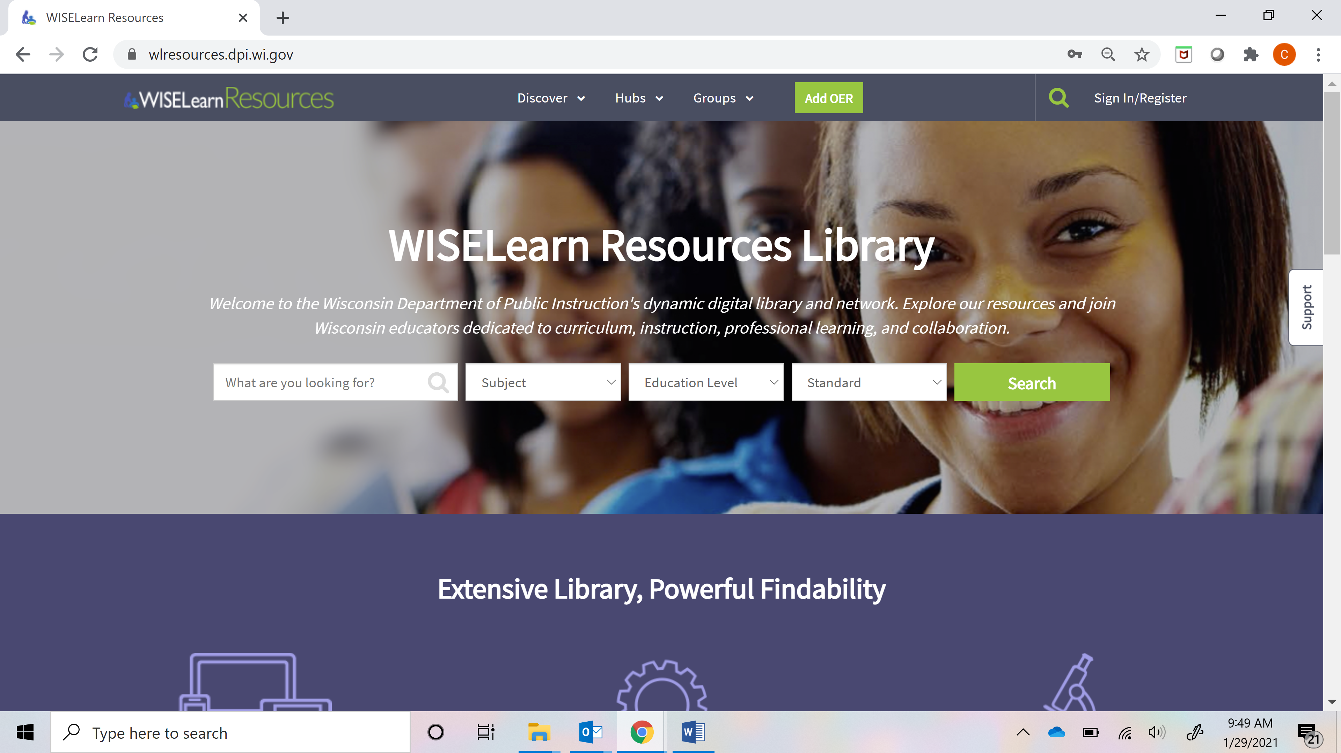
Access on WISELearn
https://wlresources.dpi.wi.gov/

Slide 14
Searching for Materials

Slide 15
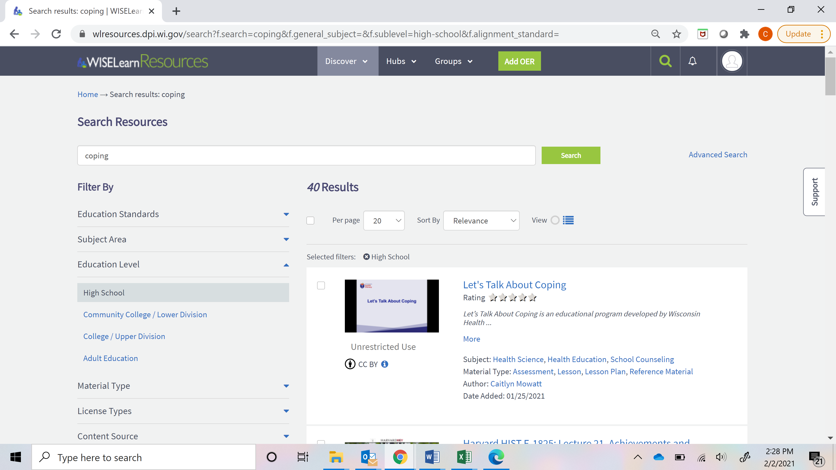
Selecting Materials

Slide 16
Viewing Materials

Slide 17
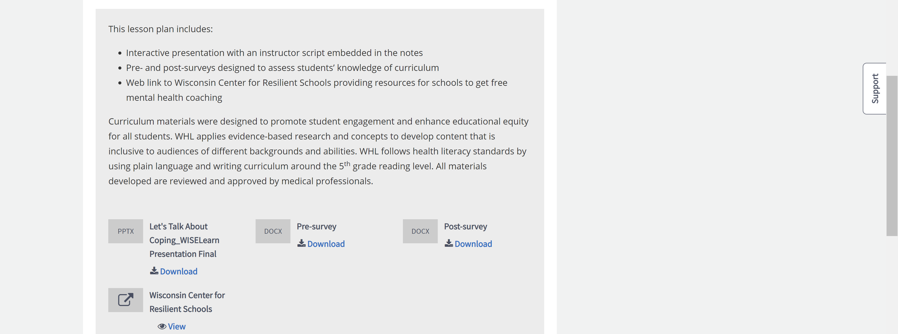
Downloading Materials

Slide 18
Health Literacy 101 Standard HSF2 and HSF3
The importance and impact of health literacy
Strategies for better communication
How health literacy can help students as a patient

Slide 19
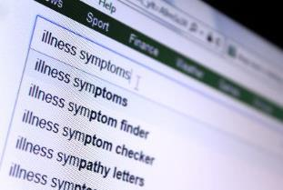
Health Online: Finding Information You Can Trust Standard HSF11
Searching for trusted health information
How to read a webpage – quick facts and key points
How to tell if the information you found is from a good source
Finding websites in other languages
Local places to use the internet

Slide 20
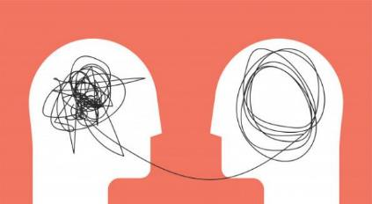
Let’s Talk About Coping Standard HSF9
Difference between mental health and mental illness
Why mental health is important
Stigmas and myths of mental health
Coping strategies for mental health

Slide 21
Let’s Talk About Medicines Standard HSF9
Different types of medications
Taking prescription medication safely
How to read and understand prescription medicine labels
Questions to ask your doctor
Take one tablet two times a day

Slide 22
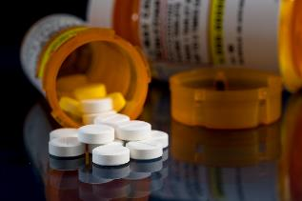
Let’s Talk About Pain Medicines Standard HSF9
Differences between opioids and other pain medicines
History of the opioid epidemic
Common terms and dosage instructions
Signs of an overdose and information about Naloxone
The risks of taking opioids with other medicine/drugs
How to store opioids in a safe place and get rid of unused opioids

Slide 23
Health Literacy Resources
Health Insurance
Standard HSF3
Health Equity
Standard HSF2 and HSF6
Diversity and Inclusion
Standard HSF2 and HSF6
Health Communication
Standard HSF2
Notes:
Show example from Diversity and Inclusion - a YouTube video created by high school students

Slide 24
Engagement for Special Populations
Notes:
WHL applies evidence-based research and concepts to develop content that is inclusive to audiences of different backgrounds and abilities.
WHL follows health literacy standards by using plain language and writing curriculum around the 5th grade reading level.
All materials developed are reviewed and approved by medical professionals.
WHL facilitated focus groups to review all materials - including student participants from the University of Wisconsin School of Medicine Community Health Engagement Program and high school students from rural and suburban school districts in Wisconsin.

Slide 25
Questions?
Kari LaScala Associate Director of Health Literacy
kari@wisconsinliteracy.org
Caitlyn Mowatt
Project Manager
caitlyn@wisconsinliteracy.org

