Slide 1
The Roundtable on Health Literacy
A Resource for Implementing Health Literacy
Melissa G. French
Program Officer
Roundtable on Health Literacy
500 Fifth St, NW, K813
Washington, DC 20001

Slide 2
I have no financial interests to disclose.

Slide 3
The Roundtable on Health Literacy
Our mission is to inform, inspire, and activate a wide variety of stakeholders to implement and share evidence-based health literacy practices and policies with the goal of improving health and well-being.

Slide 4
Our Activities
3-5 public workshops a year
Workshop Proceedings
Workshop Proceedings – in Brief
National Academy of Medicine Perspectives
Commissioned Papers

Slide 5
Organizational Health Literacy
“Health Literacy is the product of the interaction between individuals’ capacities and the health literacy-related demands and complexities of the health care system. System changes are needed to better align health care demands with the public’s skills and abilities.”
Organizational Change to Improve Health Literacy (IOM, 2013)

Slide 6
Organizational Health Literacy
Resources available from the Roundtable:
Measures of Health Literacy: Workshop Summary
Institute of Medicine (2009)
How Can Health Care Organizations Become More Health Literate? – Workshop Summary
Institute of Medicine (2012)
Attributes of a Health Literate Organization
Cindy Brach, Benard Dreyer, Paul Schyve, Lyla M. Hernandez, Cynthia Baur, Andrew J. Lemerise, and Ruth Parker (2012)
Ten Attributes of Health Literate Health Care Organizations
Cindy Brach, Debra Keller, Lyla M. Hernandez, Cynthia Baur, Ruth Parker, Benard Dreyer, Paul Schyve, Andrew J. Lemerise, and Dean Schillinger (2012)
Organizational Change to Improve Health Literacy: Workshop Summary
Institute of Medicine (2013)

Slide 7
Organizational Health Literacy
Effective Bidirectional Communication
Features of a health-literate health care organization.
Embedded Policies and Practices
Augmented Workforce
Accessible Educational Technology Infrastructure
Organizational Commitment
The Other Side of the Coin: Attributes of a Health-Literate Health Care Organization, Schillinger and Keller, 2011

Slide 9
Leadership Promotes
Has leadership that makes health literacy integral to its mission, structure, and operations
Plans, evaluates, and improves
Integrates health literacy into planning, evaluation measures, patient safety, and quality improvement
Prepares Workforce
Prepares the workforce to be health literate and monitors progress

Slide 10
Includes Consumers
Includes populations served in the design, implementation, and evaluation of health information and services
Ensures Easy Access
Provides easy access to health information and services and navigation assistance
Communicates Effectively
Uses health literacy strategies in interpersonal communications and confirms understanding at all points of contact
Meets Needs of All
Meets needs of population with a ranges of health literacy skills while avoiding stigmatization

Slide 11
Targets High Risk
Addresses health literacy in high-risk situations, including care transitions and communications about medicines
Designs Easy to Use Materials
Designs and distributes print, audiovisual, and social media content that is easy to understand and act on
Explains Coverage and Costs
Communicates clearly what health plans cover and what individuals will have to pay for services

Slide 12
Numeracy
“Numbers are used to instruct, inform, and give meaning to information in order to help us make better judgments and healthier choices in our everyday lives.”
Numeracy and the Affordable Care Act: Opportunities and Challenges (Peters, Meilleur, and Tompkins, 2014)

Slide 13
Numeracy
Resources available from the Roundtable:
Numeracy and the Affordable Care Act: Opportunities and Challenges
Ellen Peters, Louise Meilleur, and Mary Kate Tompkins (2013)
Health Literacy and Numeracy: Workshop Summary
Institute of Medicine (2014)
Strategies to Enhance Numeracy Skills
Andrew Pleasant, Megan Rooney, Catina O’Leary, Laurie Myers, and Rima Rudd (2016)
Numbers Get in the Way
Rima Rudd (2016)

Slide 14
Numeracy
Question 1:
What does research show about people’s numeracy skill levels?

Slide 15
Numeracy
Quantitative Literacy Level | % of adults in each level (NAAL findings) | Estimated % of uninsured adults in each | Estimated % of insured adults in each
Below Basic | 22% | 28.8% (9,169,063) | 18.2% (30,596,144)
Basic | 33% | 33.4% (10,656,748) | 31.9% (53,702,419
Intermediate | 33% | 29.3% (9,339,640) | 35.3% (59,508,631)
Proficient | 13% | 8.6% (2,749,954) | 14.6% (24,505,031)
Adapted from Numeracy and the Affordable Care Act: Opportunities and Challenges (Peters, Meilleur, and Tompkins, 2014)

Slide 16
Numeracy
This may be OVER-estimating numeracy skills in health care settings because of the increased cognitive load of stress, illness, or time pressure.

Slide 17
Numeracy
Question 2:
What kinds of numeracy skills are needed to select a health plan, choose treatments, and understand medication instructions?

Slide 18
Numeracy
Quantitative Literacy Level | % of adults (uninsured/insured) | Example Task: Health Plan Selection
Below Basic | 28.8%/18.2% | Compare and calculate the difference between monthly premiums of two plans
Basic | 33.4%/31.9% | Select the health plan with the lowest cost based on the annual premium and annual deducible for a family
Intermediate | 29.3%/35.3% | Calculate the co-insurance cost of an emergency rom visit bill for $500 from a table of difference co-insurance rates
Proficient | 8.6%/14.6% | Estimate total annual cost of the health plan including premiums, copays, and deductibles based on expected health care needs (e.g., estimating costs due to chronic illnesses such as diabetes or asthma)
Adapted from Numeracy and the Affordable Care Act: Opportunities and Challenges (Peters, Meilleur, and Tompkins, 2014)

Slide 19
Numeracy
Question 3:
What do we know about how providers should communicate with those with low numeracy skills?

Slide 20
Numeracy
Communicators should:
Provide numeric information (as opposed to not provide it)
Reduce the cognitive effort required from the patient or consumer and require fewer inferences (i.e., do the math for them)
Provide evaluative meaning, particularly when numeric information is unfamiliar
Draw attention to important information
Set up appropriate systems to assist consumers and patients

Slide 21
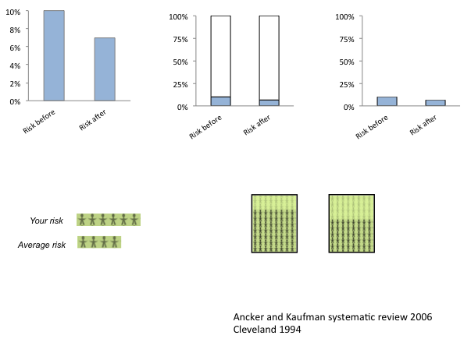
Numeracy
Examples of graphics where the part-to-whole relationship is not clear.
Presented by Jessica Ancker to the Roundtable on Health Literacy, July 18, 2013. Available in Health Literacy and Numeracy (IOM, 2014)

Slide 22
Numeracy
Two ways of expressing risk where the part-to-whole relationship is visible, one showing blue figures scattered throughout yellow figures and one showing blue figures consolidated.
Presented by Jessica Ancker to the Roundtable on Health Literacy, July 18, 2013. Available in Health Literacy and Numeracy (IOM, 2014)

Slide 23
Numeracy
Why is it so hard to take medication?
Presented by Michael Wolf to the Roundtable on Health Literacy, July 18, 2013. Available in Health Literacy and Numeracy (IOM, 2014)

Slide 24
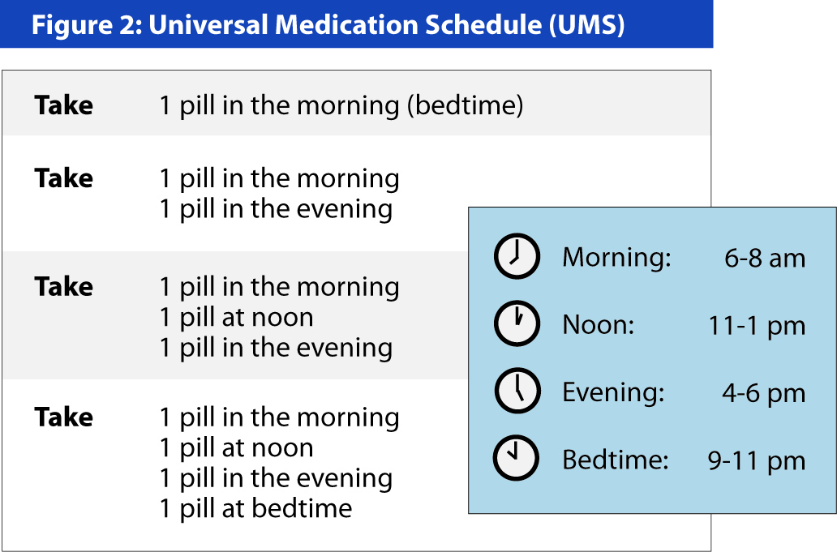
Numeracy
Presented by Michael Wolf to the Roundtable on Health Literacy, July 18, 2013. Available in Health Literacy and Numeracy (IOM, 2014)

Slide 25
Numeracy
Marry words and numbers to provide a complete understanding
Do the math
Be consistent
Present only the most necessary information, but enough to fully understand
Be visual – use images and shapes to reflect the meaning of the numbers
Be aware of how you present or describe a risk
Check in early and often
Strategies to Enhance Numeracy Skills (Pleasant et al., 2016)

Slide 26
Informed Consent and Shared Decision-Making
Resources available from the Roundtable:
Best Practices and New Models of Health Literacy for Informed Consent: Review of the Impact of Informed Consent Regulations of Health Literate Communications
Linda Aldoory, Katherine Emperatriz Barrett Ryan, and Ayma Martha Rouhani (2014)
Informed Consent and Health Literacy: Workshop Summary
Institute of Medicine (2015)
Health Literacy and Palliative Care: Workshop Summary
National Academies of Sciences, Engineering, and Medicine (2016)
Integrating Health Literacy, Cultural Competence, and Language Access Services: Workshop Summary
National Academies of Sciences, Engineering, and Medicine (2016)

Slide 27
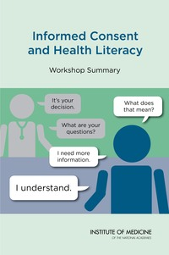
Informed Consent and Shared Decision-Making
Aldoory et al. (2014) analyzed of 120 research studies, government reports, videos, toolkits and presentations and interview 8 experts in informed consent.
The paper:
Summarizes themes found in the literature review
Describes lessons learned
Lists 30 best practice suggestions.
Presented by Linda Aldoory to the Roundtable on Health Literacy, July 28, 2014. Available in Informed Consent and Health Literacy (IOM, 2015)

Slide 28
Informed Consent and Shared Decision-Making
Eight Steps to Health Literate
Informed Consent:
Know the setting and the risks
Train Staff
Know your participants
Simplify written forms
Consider alternate formats
Dialogue
Assess comprehension
Document and evaluate
Presented by Linda Aldoory to the Roundtable on Health Literacy, July 28, 2014. Available in Informed Consent and Health Literacy (IOM, 2015)

Slide 29
Informed Consent and Shared Decision-Making
Presented by Linda Aldoory to the Roundtable on Health Literacy, July 28, 2014. Available in Informed Consent and Health Literacy (IOM, 2015)

Slide 30
Informed Consent and Shared Decision-Making
Example of a simplified health care directive form.
Presented by Rebecca Sudore to the Roundtable on Health Literacy, July 28, 2014. Available in Informed Consent and Health Literacy (IOM, 2015)

Slide 31
Informed Consent and Shared Decision-Making
Example of a simplified informed consent form.
Presented by Chris Trudeau to the Roundtable on Health Literacy, July 28, 2014. Available in Informed Consent and Health Literacy (IOM, 2015)

Slide 32
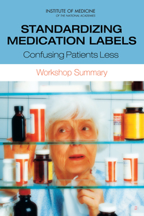
Other Topics:
After Visit Summaries and Discharge Instructions
Medication Labeling and Instructions
Oral Health
Health Insurance Literacy
Health Literacy and Technology

Slide 33
2017 Workshops
March 15, 2017:
Facilitating Health Communication with Immigrant, Refugee, and Migrant Populations
May 4, 2017:
Integrating Quality Measures for Health Literacy, Cultural Competence, and Language Access
July 19, 2017:
Community-Based Health Literacy Interventions
November 15, 2017:
Building the Case for Health Literacy

Slide 34
Our Sponsors
AbbVie Inc.
Health Resources and Services Administration
Aetna Foundation
Agency for Healthcare Research and Quality
Humana
Institute for Healthcare Advancement
American Dental Association
Merck Sharp & Dohme Corp.
Bristol-Myers Squibb
National Institutes of Health
East Bay Community Foundation (Kaiser Permanente)
National Library of Medicine
Eli Lilly and Company
Northwell Health
Health Literacy Media
Office of Disease Prevention and Health Promotion
Health Literacy Partners
UnitedHealth Group

Slide 35
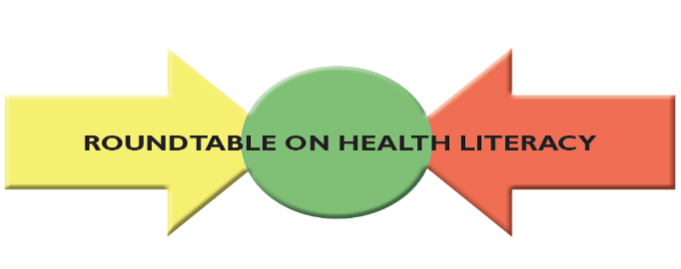
All of our publications are available free on our website:
www.nationalacademies.org/healthliteracyRT

Slide 36
Or you can contact me at:
mfrench@nas.edu
Melissa G. French
Program Officer
Roundtable on Health Literacy
500 Fifth St, NW, K813
Washington, DC 20001

