Slide 1
Wisconsin Literacy
Wisconsin Literacy is a nonprofit, statewide coalition of 70 literacy agencies.
In partnership with our members, we strengthen literacy through professional development opportunities, personalized consultations, health literacy, workforce connections, networking and advocacy.

Slide 2
Digital Resilience: A Framework for Reducing Tech Anxiety
Presented by Jamie Kobs
Tutor Training & Digital Literacy Project Manager,
Wisconsin Literacy

Slide 3
In the chat...
What are the emotional barriers
to digital skill building?

Slide 4
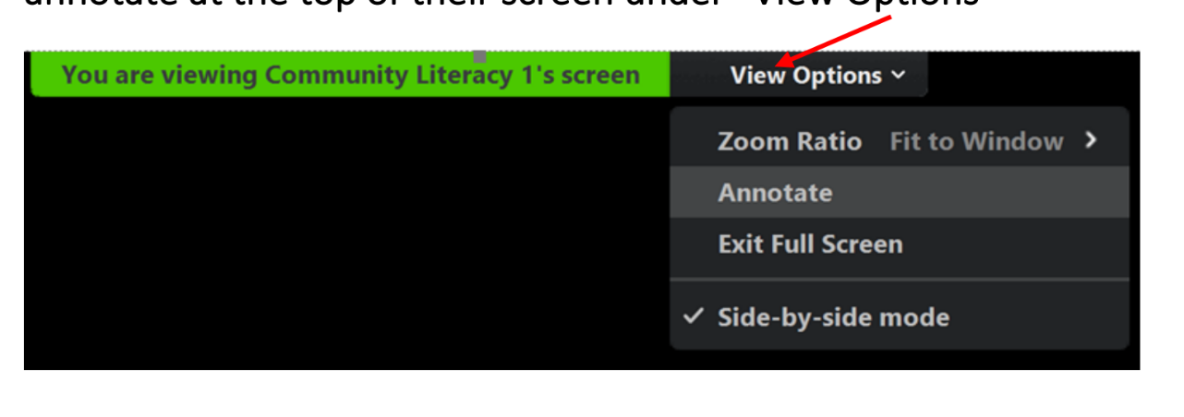
Wisconsin Literacy

Slide 5
YES
NO
Notes:
Participants click View Options then Annotate
If you started the shared screen, click More ... in the screen share controls for these annotation settings:
Enable/Disable Annotation for Others: Allow or prevent the participants from annotating on your shared screen.
Show/Hide Names of Annotators: Show or hide the participants' names when they are annotating.
I can...statements. Participants place themselves on the continuum.
Digital skill building is a continuum. Sometimes using the term "digital literacy" implies a destination or a false binary "we are literate or not literate."
But we are always learning because technology is always evolving.
The goal of today's presentation is to shine a light on that mindset so that it helps lower our affective barriers.

Slide 6
Problem:
The sound on the TV is too loud.
What can I do?

Slide 7
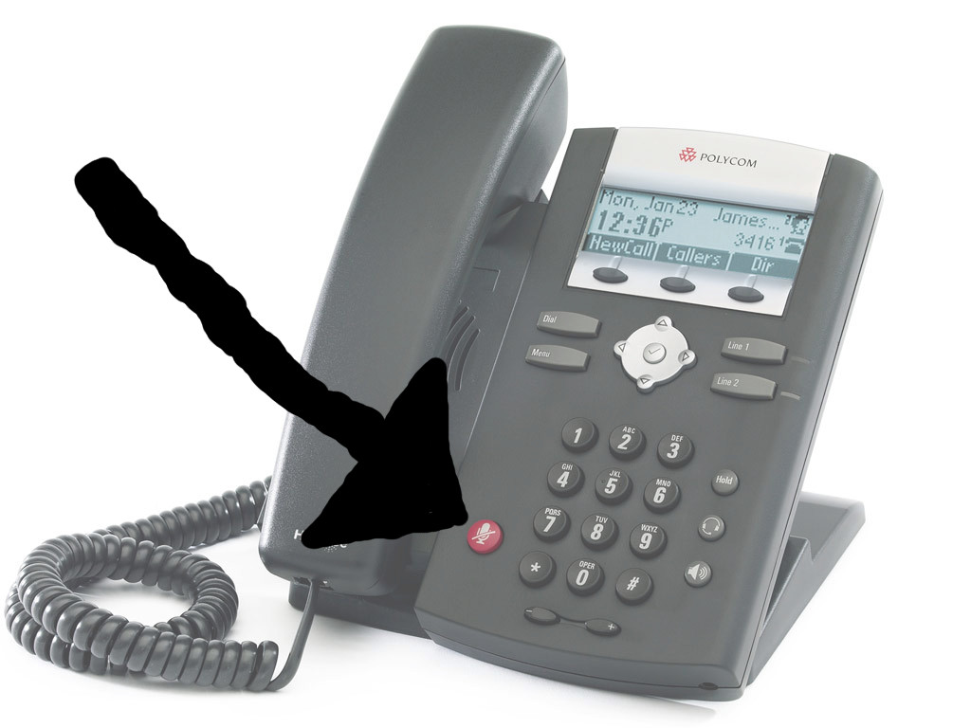
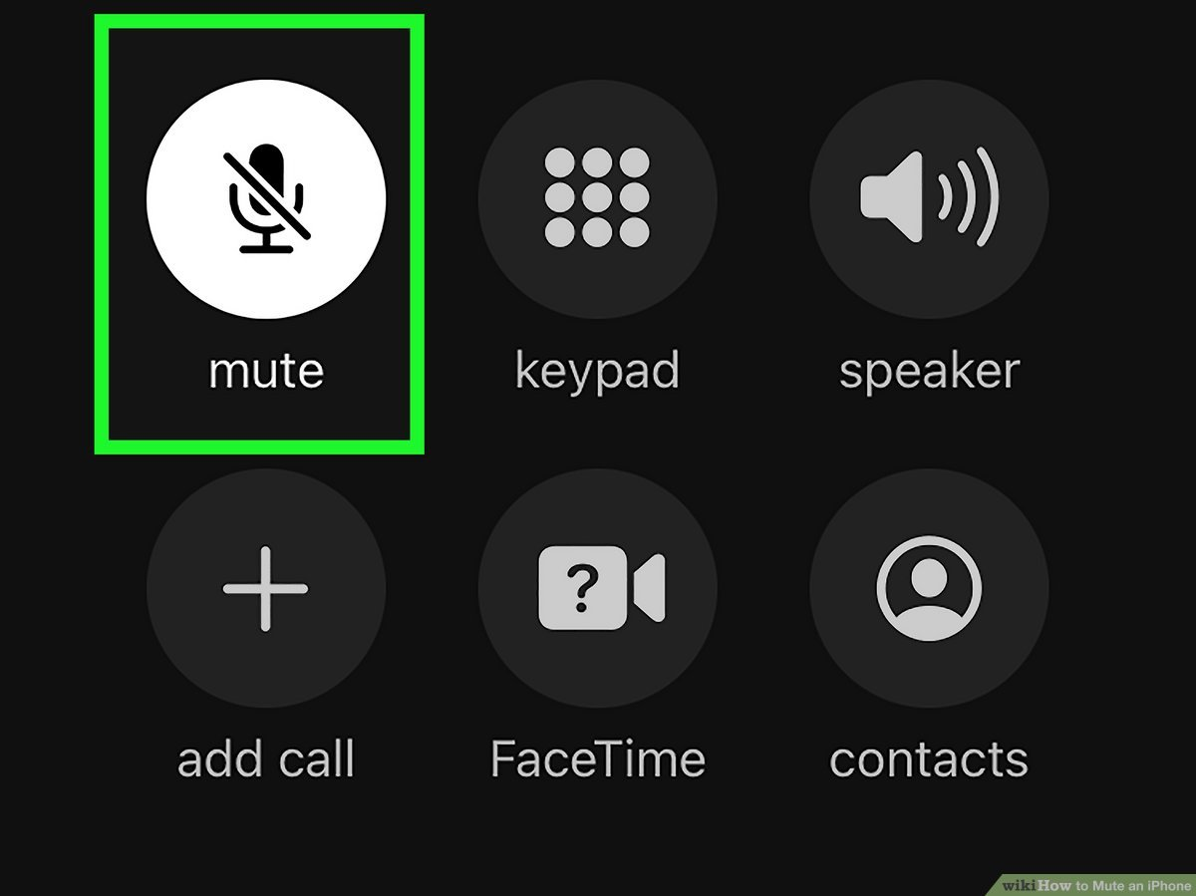

Slide 8
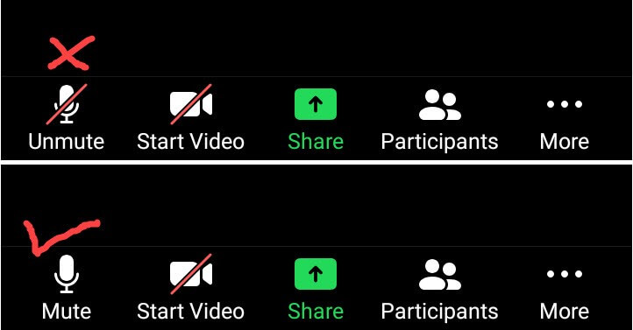

Slide 10
Problem:
I need to talk to my doctor.
What can I do?

Slide 11
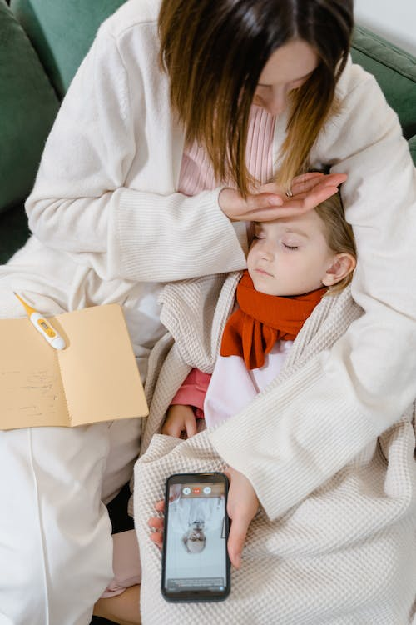
Problem:
I need to talk to my doctor.
What can I do?

Slide 12
Digital resilience
Patience
Confidence
Curiosity
Flexibility
Adaptability
Problem Solving
Self-Efficacy
Empowerment

Slide 13
Digital Resilience
Notes:
Like attitude about math…you don’t need to know it all. It’s how you behave when you don’t know.

Slide 14
Everyone is a tech person.
Change the narrative.

Slide 15
5 Strategies for building digital resilience

Slide 16
1. Model a calm, curious, collaborative attitude
Co-learning (no experts)
“What happens if…?”
Plan time for exploration

Slide 17
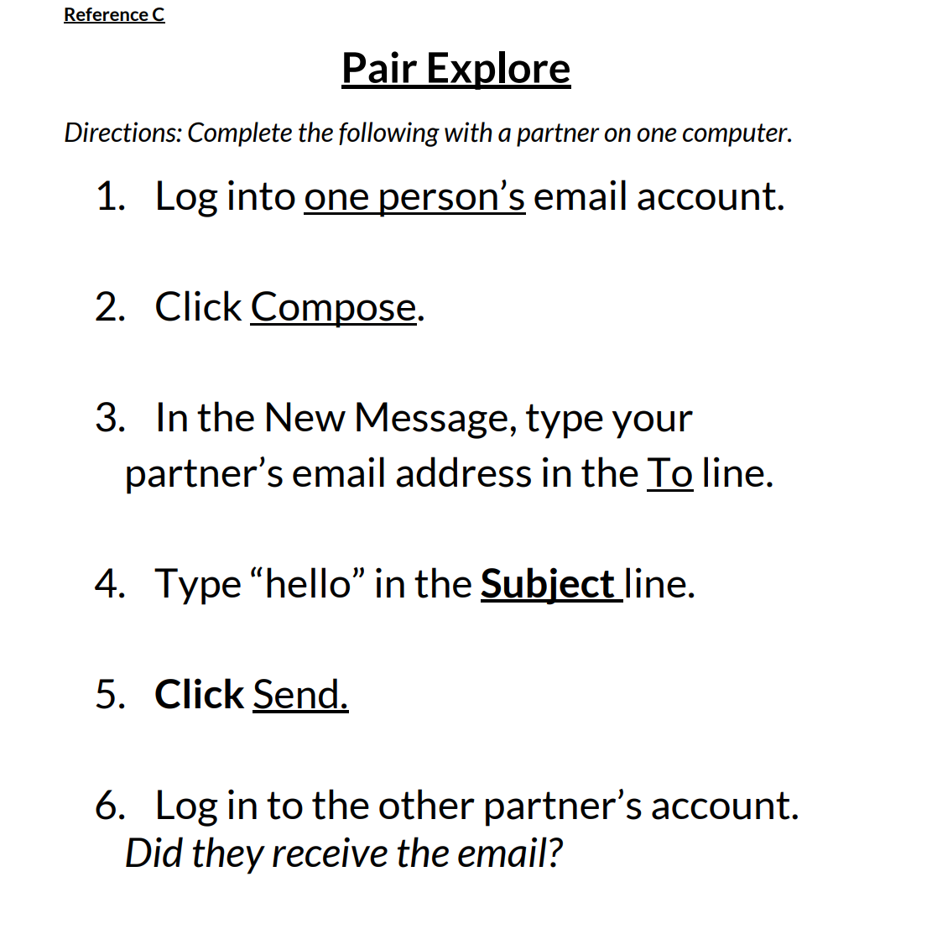

Slide 18
2. Make sure digital learning is hands-on
Adults seek opportunities for immediate application
We learn by doing

Slide 19
3. Teach skills across contexts
“Content needs to be developed...to not only teach the how of the skills but the why and when of the skill.” (DRAW study)
Notes:
When do you send a text vs. an email
Across Contexts and Devices
3 lines vs. 3 dots (menu vs. more)
Copy/paste
Mouse clicks example
What are common features of health portals (so you’re not teaching MyChart, you’re teaching context)

Slide 20
Transfer across contexts and devices

Slide 21
4. Teach problem-solving
What are your problem-solving strategies?
GCF Global "YouTube:Searching for Videos" Lesson
What problems can you predict?
Creating a password
Sending and receiving email
Setting up online health portal
Notes:
https://edu.gcfglobal.org/en/youtube/searching-for-videos/1/
Have audience identify potential problems with each skill

Slide 22
Sounds like...
What else could you try?
Do you see anything here that might help solve this problem?
What if you try to ______________? Do you think that strategy could help here?
Try for _____ minutes. If you still need help, I’ll come back.

Slide 23
5. Celebrate success!
Reflect often on the journey and how far you’ve come.
This builds self-efficacy.

Slide 24
Sounds like...
I have noticed you are now able to __________.
Remember when you couldn’t ______, and now you can.
I noticed that when you got stuck, you tried another way. That’s a great digital learning strategy. Can you explain to me what you did to overcome the challenge?

Slide 25
Digital Resilience in Action
Notes:
"I'm tech savvy" "I'm tech challenged" goes against our first strategy, but what I like is the role reversal...just to prove that we all have something to learn.
Plenty of confident, curious, hands-on learning. Not worried that they're going to break anything.
Lots of celebrating.
In the end, we get the idea of how skills transfer to different contexts: the smartphone does everything those devices do.

Slide 26
5 Strategies for building digital resilience
Model a calm, curious, collaborative attitude
Make sure digital learning is hands-on
Teach skills across contexts
Teach problem-solving
Celebrate success!

Slide 27
Digital Resilience in Action
Note where and how you see the tutor modeling digital resilience.

Slide 28
Resources
Building a Digitally Resilient Workforce: Creating On-Ramps to Opportunity
https://digitalus.org/
Digital Resilience in the American Workforce (DRAW)
https://edtech.worlded.org/our-work/draw/
Promoting Digital Literacy for Adult Learners: A Resource Guide
https://www.barbarabush.org/wp-content/uploads/2022/04/Digital-Literacy-Resource-Guide-for-Adult-Learners-.pdf

