Slide 1
Getting Started with Health Literacy
Improvement Using the Revised
AHRQ Health Literacy Universal Precautions Toolkit
Cindy Brach
Center for Delivery, Organization, & Markets
April 4, 2017

Slide 2
Disclosure
I have no relevant financial interests

Slide 3

Overview
Health Literacy Universal Precautions
AHRQ Toolkit and Quick Start Option
Conducting a Health Literacy Assessment
Creating a Health Literacy Improvement Plan

Slide 4
Learning About You
How familiar are you with:
  Health literacy improvement in general?
  AHRQ Health Literacy Precautions Toolkit?
What do you hope to learn in the next hour?

Slide 5
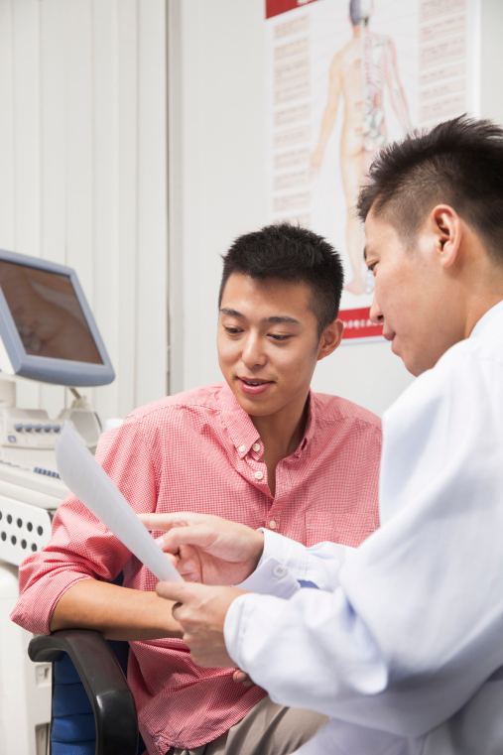



Health Literacy Equation
X
=
Skills/Abilities x Difficulty/Complexity = Health Literacy

Slide 6
Health Literacy Demands
Find the office
Fill out forms
Give medical history and describe symptoms
Ask questions and share in decision making
Notes:
Does your office routinely give directions? Is there good signage to lead a patient to your office?
Patients with literacy challenges report that being asked to fill out forms as soon as they get in the door is the worst thing about going to the doctor’s. Sometimes it’s enough to make them avoid the doctor’s office.
We ask patients to be articulate, to know what’s important to share with the doctor and what’s irrelevant.

Slide 7
More Health Literacy Demands
Understand and act on anticipatory guidance
Follow-up on screenings, lab tests, referrals
Take medicines as directed
Self manage conditions
Process insurance and pay bills
Notes:
We tell patients a lot of do’s and don’ts. Telling them they should exercise to improve their cardio-vascular health doesn’t tell them what risk they take by not exercising, what kind of exercise to do, or how often and how long. We leave it to patients to figure out where to find a safe place to exercise, or how they can exercise within the constraints of work, caregiving, or other responsibilities.

Slide 8
Health Literacy
Universal Precautions
Structuring the delivery of care in the practice as if everyone may have difficulty understanding health information and accessing health services

Slide 9
Why Health Literacy
Universal Precautions
You can’t tell by looking
Even people with higher literacy skills have trouble understanding medical care
No screening instrument can tell you if people will understand what they need to know
Most interventions designed for people with low literacy help those with higher literacy
Notes:
Some patients with limited health literacy:
Have completed high school or college
Are well spoken
Look over written materials and say they understand
Hold white collar or health care jobs
Function well when not under stress

Slide 10

AHRQ Health Literacy
Universal Precautions
21 Tools to improve:
Spoken communication
Written communication
Self-management & empowerment
Supportive systems
https://www.ahrq.gov/professionals/quality-patient-safety/quality-resources/tools/literacy-toolkit/index.html

Slide 11
Quick Start Option

Slide 12
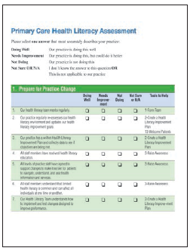
Primary Care Health
Literacy Assessment
Identify:
  Strengths and opportunities for improvement
  Variation within the organization
Build consensus on improvement goals

Slide 13
Options for Fielding
Assessment Questions
Health Literacy Team completes
  Review items ahead of time together
  Complete individually
Everyone in the practice completes
  Educate on purpose: to gain multiple perspective on practice activities
  Assure confidentiality
  Validate “not sure” option
  Importance of completing – get leadership to reinforce

Slide 14
Analysis Options
Individual questions, e.g.,
  # of “Needs Improvement”/# of responses - # of “Not Sure or NA” responses
By domain, e.g.,
  # scored “Needs Improvement” or “Not Done”/# questions in the domain
Flag agreement and disagreement, e.g.,
  Items for which 85% chose the same answer
  Items for which <50% chose the same answer

Slide 15
Discussion Questions
What interesting things did you notice in the results? Were there any surprises?
In which areas did you find agreement, and in which areas is there disagreement?
Which are areas of strength, and which areas need improvement?
Which areas for improvement are most important to your practice?

Slide 16
Augmenting Assessments
Patient tracers
Rounding
Patient surveys

Slide 17
Reactions
“We liked the assessment process, and when we looked at our answers, our priorities just lit up.”
“Before doing the assessment, we had an idea about what tool we wanted to try. But after discussing our assessment questions, we completely changed our selection.”
“The assessment increased our attention to areas not previously identified as concerns”

Slide 18
Checking In
Have you conducted a health literacy assessment?
What happened?

Slide 19
Choosing Improvement Goals
Easy Wins
Stretch Goals
Mission Critical
Leadership Priorities
Staff Empowerment
Building Momentum
Catching the Moving Train
Notes:
Catch the moving train:
Person-centered care
Disparities reduction
Patient safety
Emergency preparedness
Readmission reduction
Prevention and wellness

Slide 20
Creating a Health Literacy Improvement Plan
Vision statement
For each goal:
  What actions will be taken
  Who will be responsible
  What resources will be allocated
  How progress will be measured
  Timeline
Recognize the plan is a living document

Slide 21
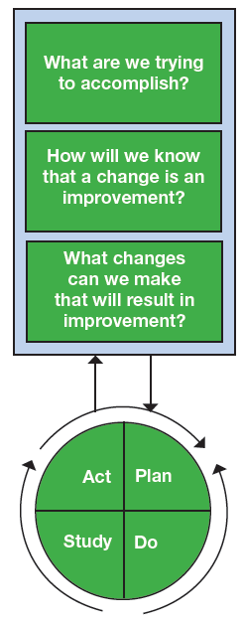
Model for Improvement
Identify improvement targets
Test changes on small scale before scaling up

Slide 22
Example
Assessment item targeted for improvement:
Our practice creates an environment that encourages our patients to ask questions
Targeted improvement:

Slide 23
Example
Assessment item targeted for improvement:
Our practice creates an environment that encourages our patients to ask questions
Targeted improvement:
Increase % of staff who encourage questions
OR
Increase % of staff who encourage all patients to ask questions

Slide 24
SMART Objectives
Specific
Measurable
Attainable
Relevant
Timely
Objective: To (action verb + key result + target date)
Example: To increase the % of staff who encourage patients and family members to ask questions to 70% within 1 year
Notes:
Specific: What are we planning to do?
Measurable: Is it measurable?
Attainable: Can we get it done in the proposed timeframe/in this political climate/for this amount of money?
Relevant: Will this objective lead to the desired results?
Timely: What is the target date for accomplishing this objective?
The following equation may facilitate the objective-writing process:
Objective: To (action verb + key result + target date)

Slide 25
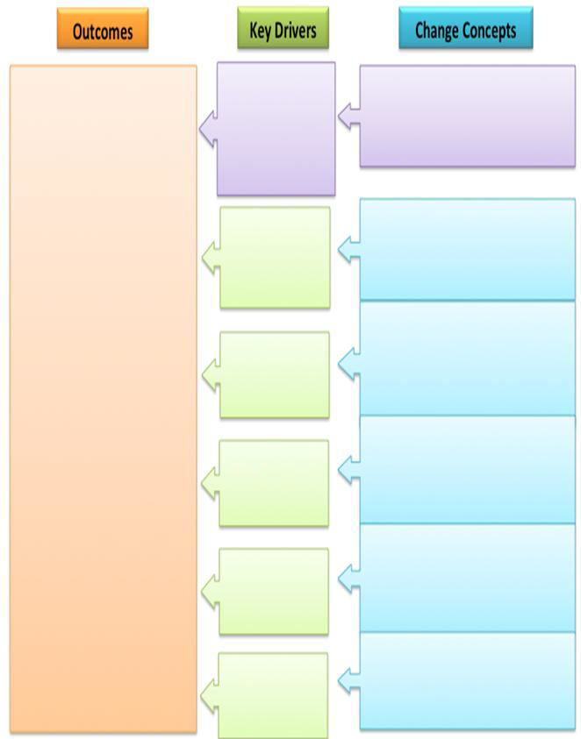
Key Driver Diagram
Notes:
Key driver models graphically display the strategies and activities needed to achieve goals and aims of the practice improvement effort

Slide 26
Change Concepts
Desired change: more staff encourage patients and family members to ask questions
Change concepts: (Hint – use corresponding tool in AHRQ Health Literacy Universal Precautions Toolkit)

Slide 27
What Will Drive Change?
Desired Change: staff encourage patients and family members to ask questions
Change concepts:
Train staff
Allow time
Establish standard operating procedures, e.g.,
  Reminder to bring questions when appt is confirmed
  Pad of paper and pens in waiting room
  At checkout ask “Did you get your questions answered?

Slide 28
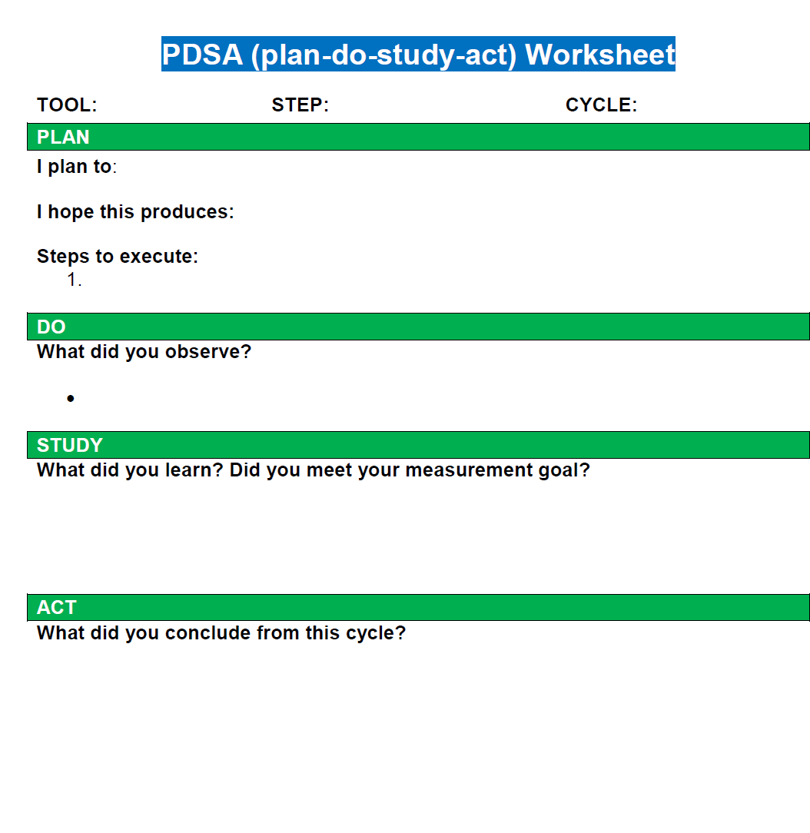

Slide 29
Communication Around Improvement Activities
Prior to testing changes
  Raise health literacy awareness
  Assessment results
  Implementation plans
After testing changes:
  Testing results
  Plan for spread

Slide 30
Additional Resources
AHRQ Practice Facilitation Curriculum
  https://www.pcmh.ahrq.gov/page/primary-care-practice-facilitation-curriculum
Building Health Literate Organizations: A Guidebook to Achieving Organizational Change
  https://www.unitypoint.org/health-literacy-guidebook.aspx
CDC Action Plan Template
  https://www.cdc.gov/healthliteracy/pdf/planning_template.pdf

Slide 31
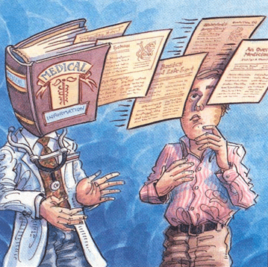
What questions do you have?
www.ahrq.gov

