Slide 1
The Health Literacy Journey: Getting to an Exceptional Health Care Experience
Cindy Brach
Center for Delivery, Organization, & Markets
April 5, 2017

Slide 2
Disclosure
I have no relevant financial interests

Slide 3
What AHRQ Does
AHRQ invests in research to understand how to make health care safer and improve quality
AHRQ creates materials to teach and train health care professionals and systems to improve care for their patients
AHRQ generates measures and data used to track and improve performance and evaluate progress of the U.S. health system
WWW.AHRQ.GOV

Slide 4

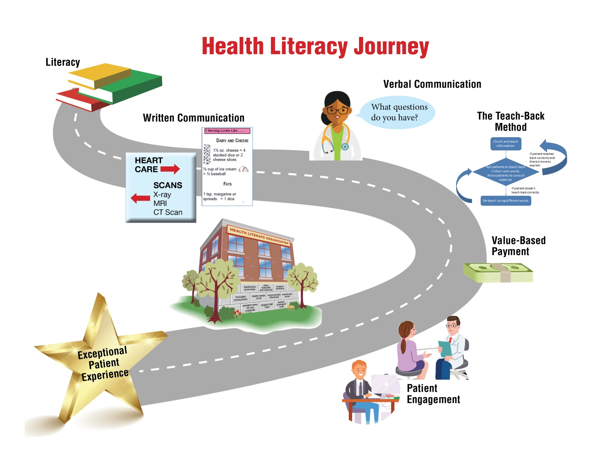
Health Literacy Journey

Slide 5



Skills/Abilities x Difficulty/Complexity = Health Literacy
Notes:
No where is it clearer than at this meeting where the health literacy movement began. The field started with concern for people with low literacy. Many people in this room have worked with adults who struggle with the written word to improve their skills and abilities.
We’ve come to recognize, however, that health literacy is not just a function of the skills and abilities of the individual.
The difficulty of the information conveyed and complexity of the tasks set also is a factor in determining health literacy – whether people can obtain, understand and use health information and services.

Slide 6

Health Literacy’s Roots in Literacy
Notes:
Health literacy roots lay in concern for people with limited literacy.

Slide 7
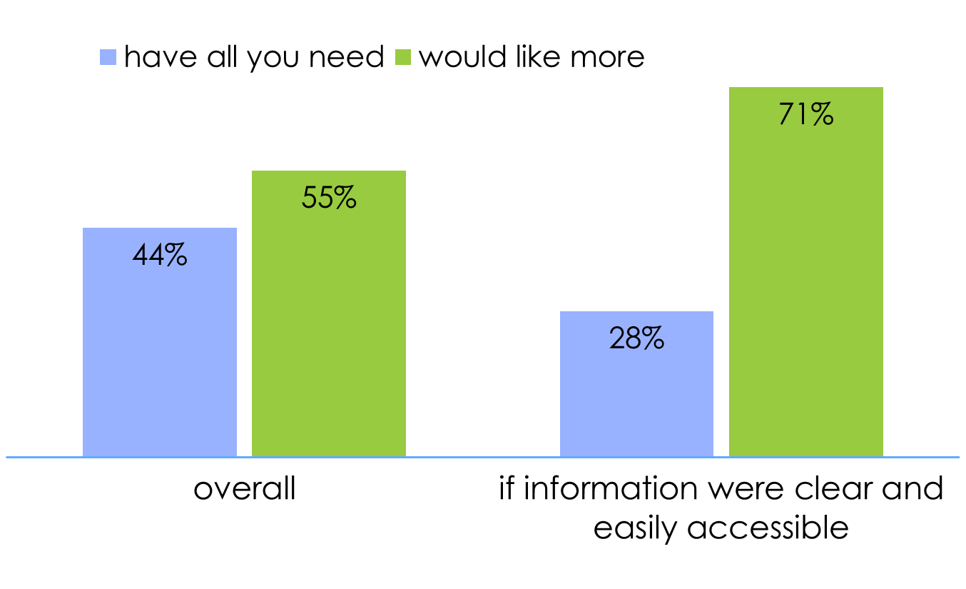
Consumers Desire Clear,
Accessible Information
Langer et al. 2012
Notes:
Data from survey of low-income Californians

Slide 8
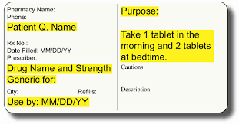
Patient-Centered
Prescription Label
Standardized instructions in 5 languages
Notes:
Chinese, Korean, Russian, Spanish, Vietnamese
Patients receiving the PCL were better able to demonstrate proper use of their multi-drug regimens at first exposure (76.9% vs. 70.1%, p=0.06) and by 9 months (85.9% vs. 77.4%, p=0.03). The effect of the PCL was significant for English-speaking patients (OR 2.21, 95% CI 1.13 – 4.31) but not for Spanish-speakers (OR 1.19, 95% CI 0.63 – 2.24). While there were no differences in adherence rates between study arms overall, certain subgroups received significant benefits from the PCL intervention.
Specifically, adherence was greater in the PCL arm by 9 months compared to standard among patients with limited literacy (OR 5.08, 95% CI 1.15 – 22.37) and for those with medications to be taken two or more times daily (OR 2.77, 95% CI 1.17 – 6.53).

Slide 9
Improved Forms
16th + Grade Level
7th – 8th Grade Level
Source: Iowa Health Systems

Slide 10
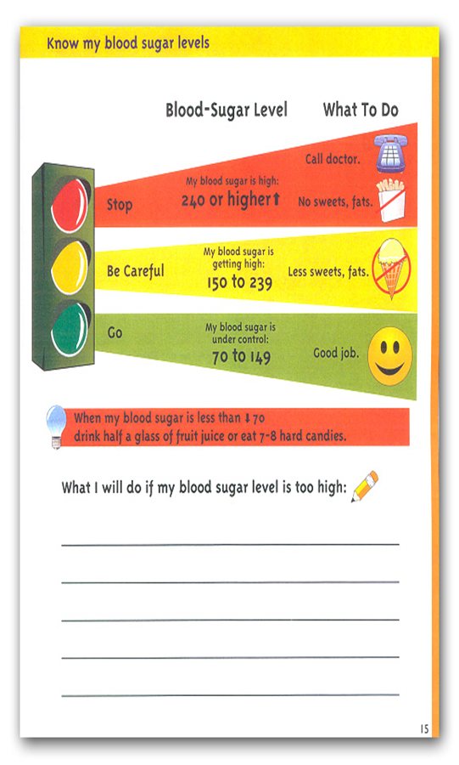
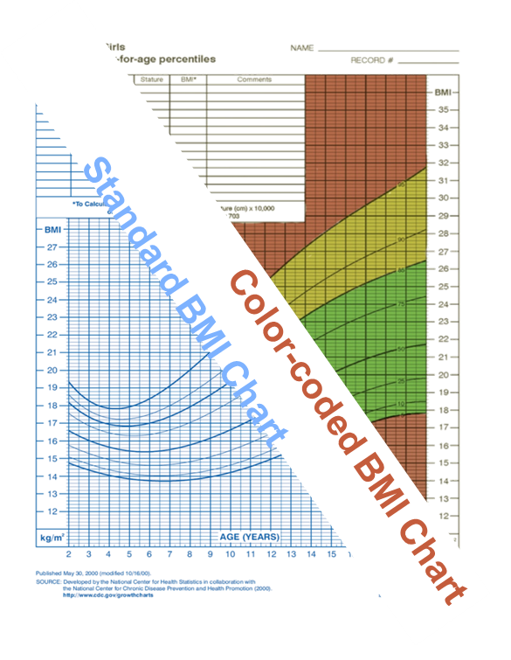
Using Color to Convey Meaning

Slide 11
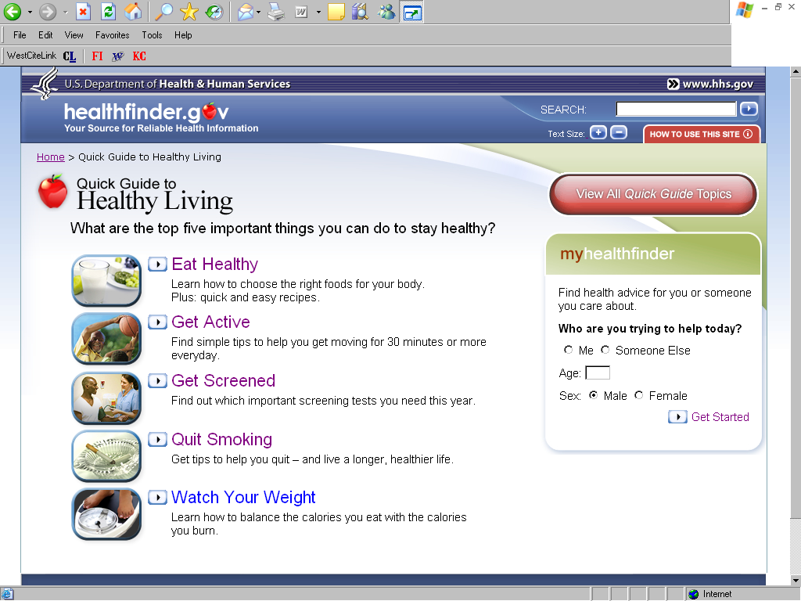
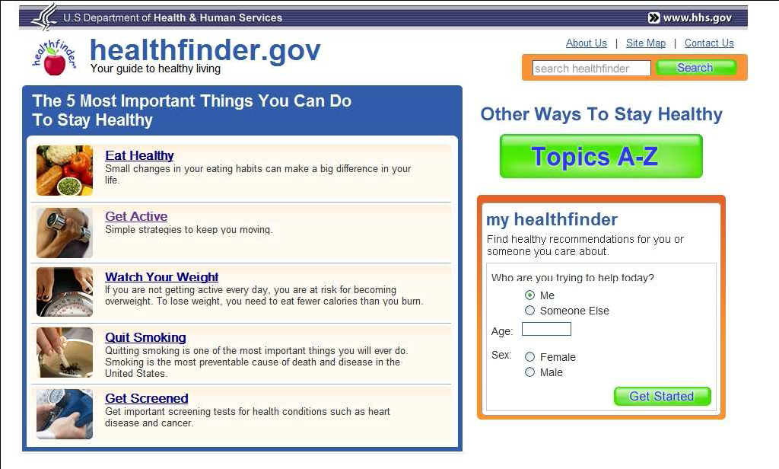
Simple Design

Slide 12
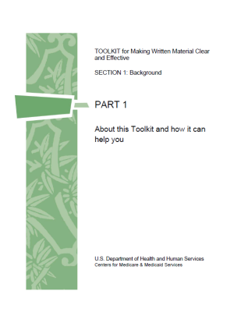

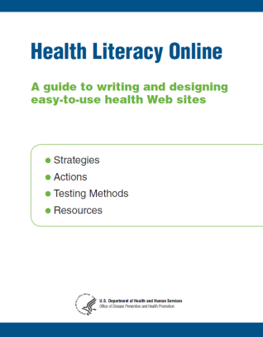
HHS Tools to Improve
Health Information
Toolkit for Making Written Material Clear and Effective
The Patient Education Materials Assessment Tool (PEMAT)
A Guide to Writing and Designing Easy-to-Use Health Web Sites
Notes:
HHS has created a number of tools to create and assess health information, both print and online.
Next slide

Slide 13

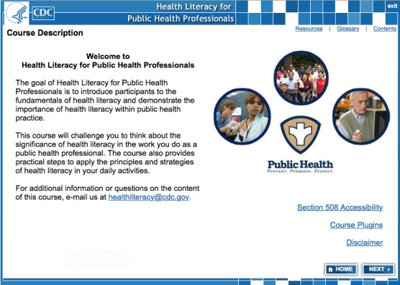
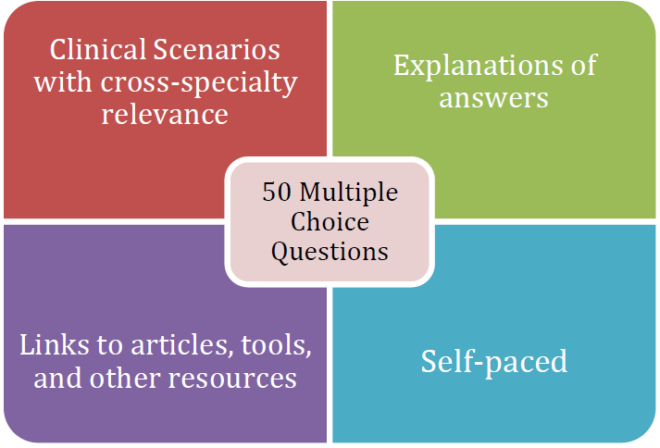
Free Online Training
NIH Plain Language: Getting Started or Brushing Up
CDC Health Literacy for Public Health Professionals
AHRQ Health Literacy Knowledge Self-Assessment for CME and MOC credit
Notes:
HHS has also created several free online training programs. Continuing education credit is available for the last training on this list, the CDC’s course “Health Literacy for Public Health Professionals.”

Slide 14
Health Literacy Has Branched Out
Notes:
Health literacy has branched out from our literacy roots. We’ve come to recognize that health literacy includes verbal communication.
And that everyone, including those with excellent literacy skills, face health literacy challenges, and therefore we need to take universal precautions.

Slide 15
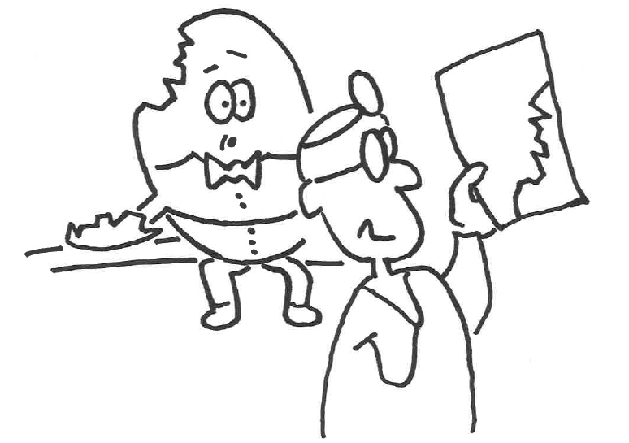


Slide 16
Clear Communication
Warm Greeting
Eye Contact
Listen
Use Plain, Non-medical Language
Slow Down
Limit Content
Repeat Key Points
Show How It’s Done
Use Graphics
Invite Patient Participation
Source: AHRQ Health Literacy Universal Precautions Toolkit, Tool 4

Slide 17

The greatest problem with communication is the illusion it has occurred.
- Attributed to George Bernard Shaw

Slide 18
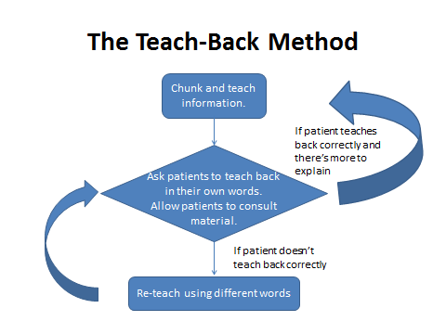
An Always Event
Notes:
Teach-back is a widely used technique to check for understanding. Research has shown that teach-back has been associated with better control of blood sugar by people with diabetes. Schillinger et al. 2003
You use teach-back by asking patients to explain in their own words what they were told. It’s a chance to check the patient’s understanding and re-teach information if needed.
Ask for a volunteer to conduct teach-back

Slide 19
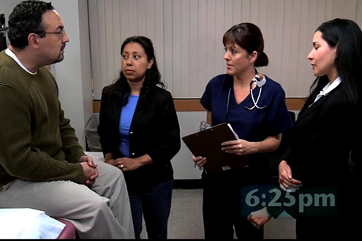
Address Language Differences
Assess language preferences and language assistance needs
Use ONLY acceptable language assistance services
Interpreter
Source: AHRQ Health Literacy Universal Precautions Toolkit, Tool 9 and TeamSTEPPS® limited English proficiency (LEP) module

Slide 20
Health Literacy
Universal Precautions
Structuring the delivery of care as if everyone may have limited health literacy
  You can’t tell by looking
  Higher literacy skills ≠ understanding
  Health literacy is a state not a trait
  Everyone benefits from clear communication
Notes:
Tell personal story about Isabel’s strokes

Slide 21
AHRQ Health Literacy
Universal Precautions Toolkit
2nd edition with 21 tools
New companion guide for practice facilitators
http://ahrq.gov/qual/literacy

Slide 22
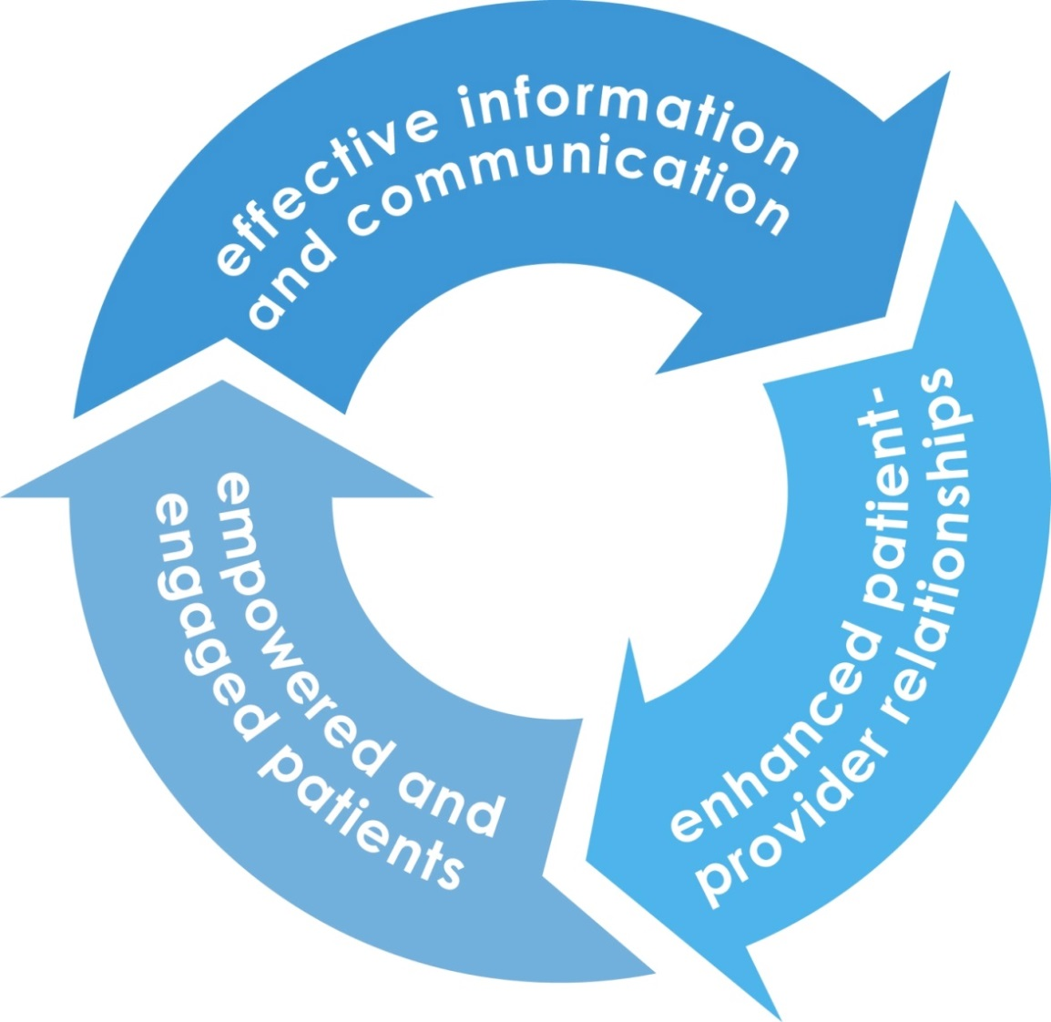
Health Literacy and Patient Engagement

Slide 23

Patient engagement is the next blockbuster drug!
Patients who are more actively involved in their health care experience better health outcomes and incur lower costs.
What’s the fuss all about?
Notes:
Heath Affairs Health Policy Brief on Patient Engagement.
Who want to take a crack at defining patient engagement?

Slide 24
Two Sides of
Patient Engagement
Provider Actions
Provider Actions
Patient Actions
Consumer Actions
Notes:
Definitions of patient engagement include those that talk about it as something consumers/patients do, and those that talk about it as something that providers/delivery systems do.
Provider side: Making sure patients understand, are active participants in their care, and are prepared to take care of their health
Patient side: Actions individuals must take to obtain the greatest benefit from the health care services available and to improve or maintain their health.

Slide 25
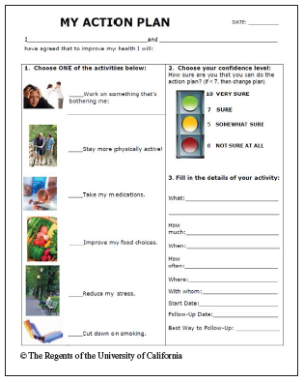
Self-Management Support
Motivational Interviewing
Action Planning
Ask
Advise
Assess readiness to change
Assist with brief counseling or materials
Arrange for follow-up
Applaud
Notes:
Clinician asks the patient about weight, nutrition, and exercise.
Clinician provides the patient with clear, strong advice
Clinician verbally assesses patient's readiness to change.
Clinician assists by providing brief counseling or self-help materials
Clinician arranges for follow-up with health care professional or community-based resource
Clinicians applauds even small changes in patient behavior and to acknowledge these changes

Slide 26
What Do Engaged Patients Do?
Become Health Literate
Seek knowledge
Use Technology
Advocate for Themselves
Tell providers what’s important
Use patient portals
Ask questions
Plan for the future
Partner with providers
Develop skills and confidence
Take responsibility
Use health Apps
Use home health devices
Notes:
Who here has a fit bit?

Slide 27
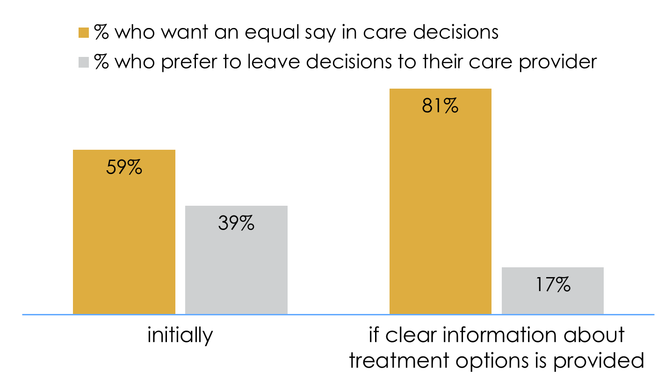
Desire for Shared
Decision Making
Langer et al. 2012

Slide 28
Clear Information Reduces
Disparities in Desire for SDM
Notes:
Interest in shared decision making rises particularly among lower-SES groups when accompanied by clear information. For example, the 25 point education gap shrinks to an n.s. 7 points.

Slide 29
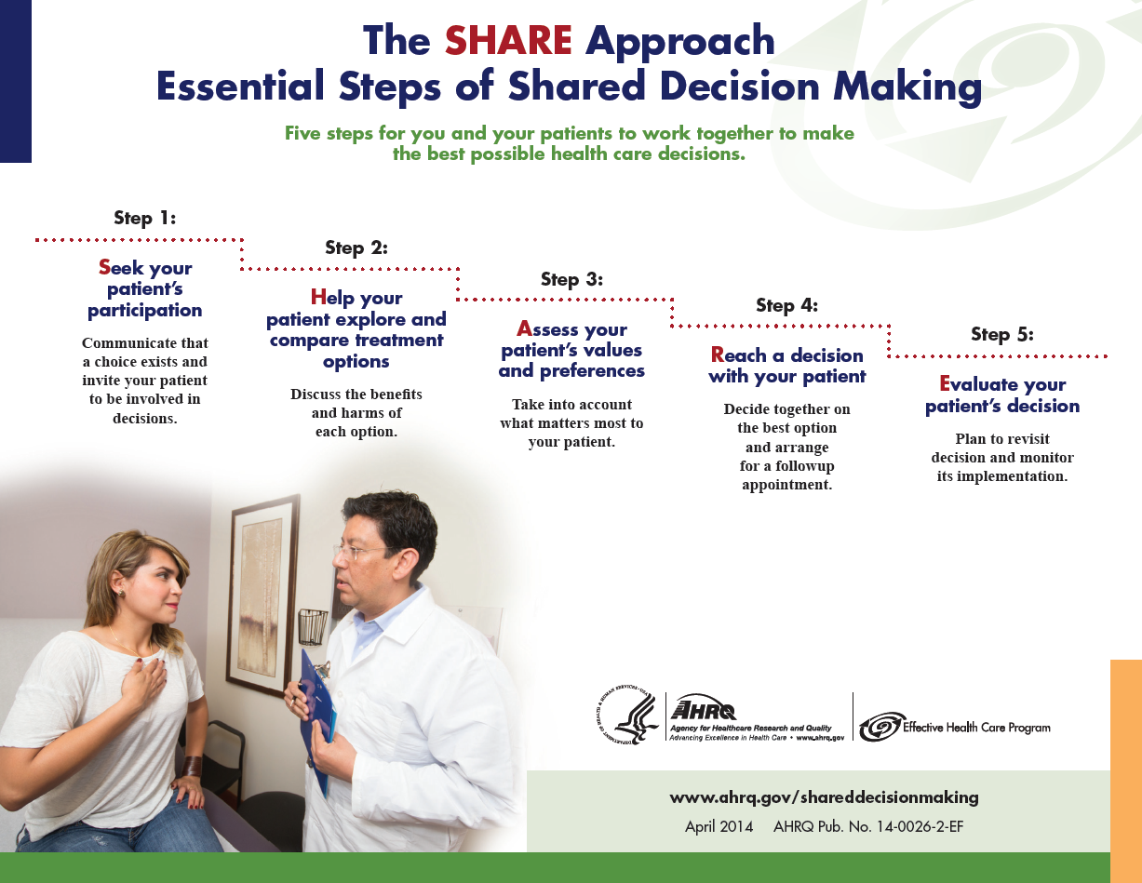
SHARE Approach Tools
Notes:
Here are the essential steps to assist health care providers in working with their patients to make the best possible health care decisions… together.
Step 1: Seek your patient’s participation. Communicate that a choice exists and invite your patient to be involved in a decision.
Step 2: Help your patient explore and compare treatment options. In other words, discuss the benefits and harms of each option.
Step 3: Assess your patient’s values and preferences. Take into account what matters most to your patient.
Step 4: Reach a decision with your patient. Decide together on the best option and arrange for a follow-up appointment.
Step 5: Evaluate your patient’s decision. Plan to revisit the decision in the future and monitor its implementation.

Slide 30

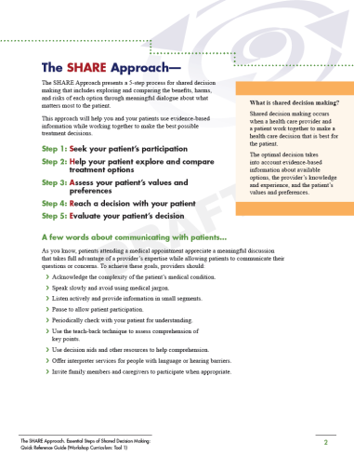
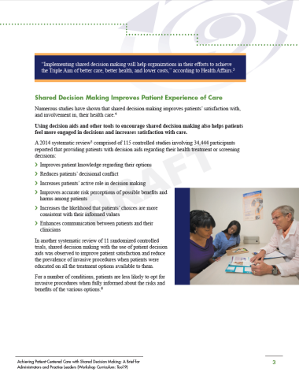

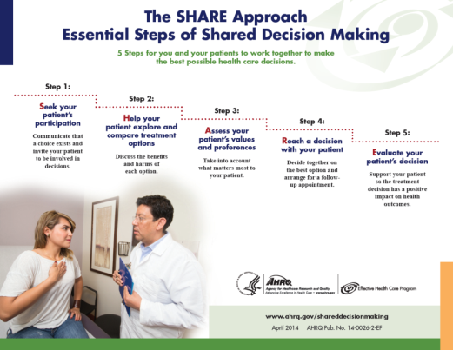
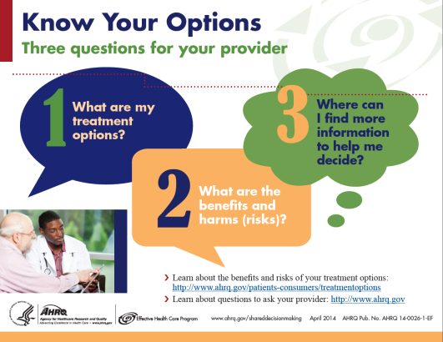
The SHARE Approach Tools
Communication tools addressing health literacy and cultural competence
Resources such as conversation starters, a video, and posters
Implementation guides for clinicians, teams, and administrators
Notes:
AHRQ has developed a large number of tools to help healthcare providers implement the SHARE Approach. These tools include:
SHARE Approach tools, including conversation starters, a video, and posters
Tools that address common communication barriers
Tools to help gain buy-in and implement Shared Decision Making in practice
Some of these tools are shown on the slide.

Slide 31
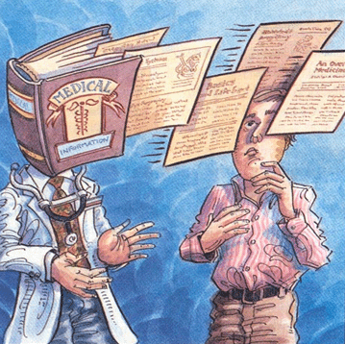
What questions do you have?

Slide 32
Patient Engagement
Health Literate Systems
Exceptional Patient Experience
Systems Change is Key to Achieving the Exceptional Patient Experience

Slide 33
Exceptional Patient Experience
Making a human connection
  Being mindful of our patients
  Creating an atmosphere of respect and courtesy
  Listening and responding to their concerns
  Providing clear explanation of care delivery and care planning
All reinforced through standard work to ensure everyone on the care team is on the same page.
University of Utah course

Slide 34
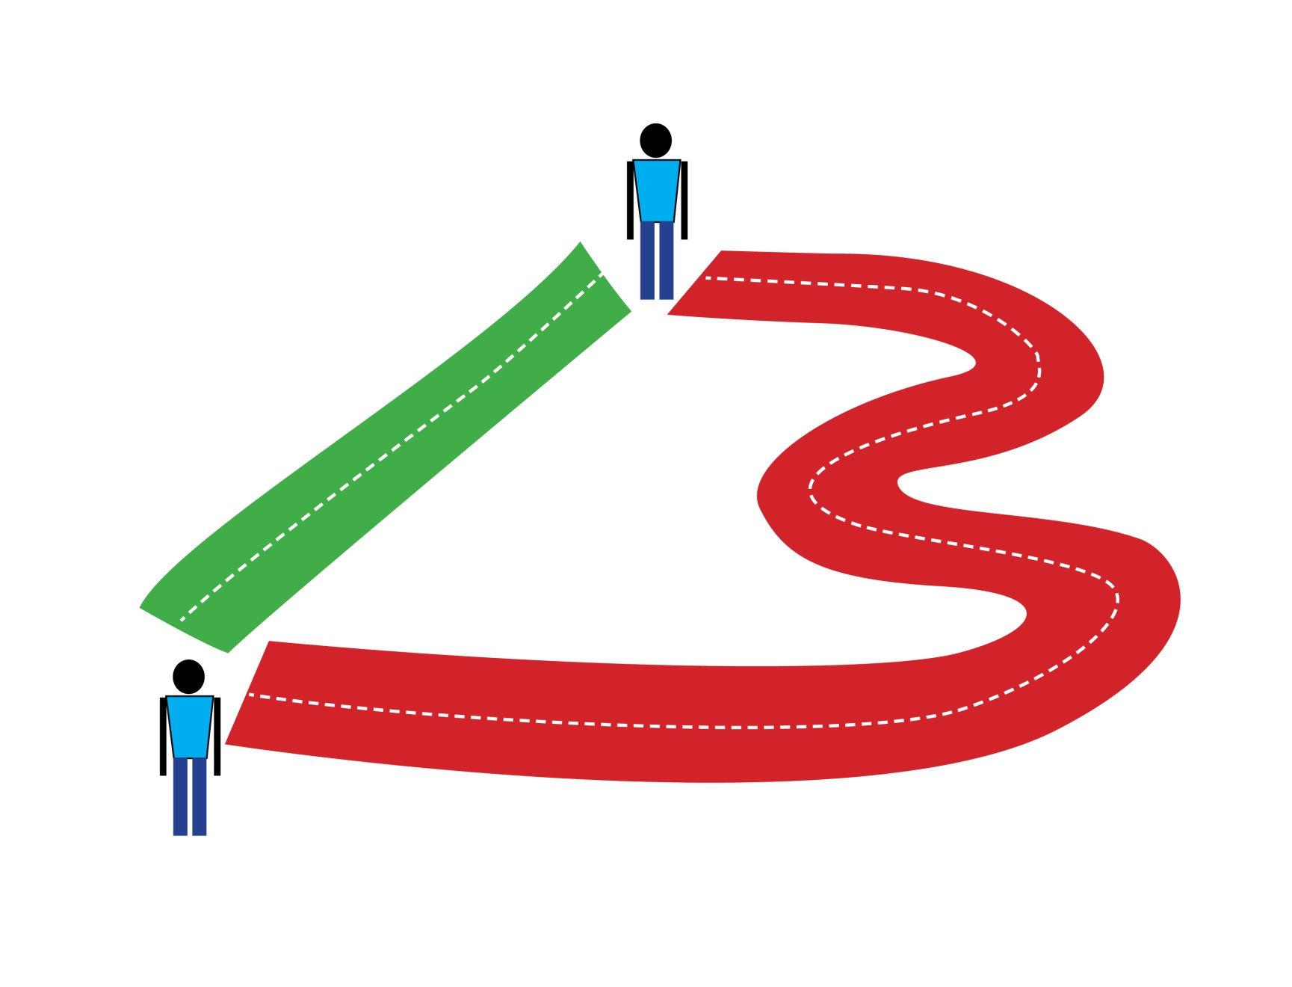
Why Do We Care About the
Patient Experience?

Slide 35

My Dad
Notes:
88-year old father with Stage 4 prostate cancer, responded well to hormone treatment.
couldn’t pee, had surgery
Surgery went well, but during while trying to empty his bladder he began searching for words
Stroke team called, assessed him, and started wheeling him out of the room
“Where are you taking him?”
“To the ER to give him tPA.”
“But I haven’t consented.”
“This is an emergency.”
“I’m his health care proxy. You’re NOT giving him anything without my consent.”
They admitted I was right and invited me to walk with them.
During the next hour the residents kept repeating the same thing:
My father had a stroke
The medicine would dissolve the clot,
But there was a very small window of time in which the medicine had to be given.
In the name of evidence-based medicine, the residents pressured me to consent
I refused to give consent until after I called my mother.
She wanted my dad to get the medicine. So he got the tPA just within the 3-hour window.
Shortly after the gave my dad tPA, he had two seizures.
He had bled into the right side of his brain.
All night he shook uncontrollable, didn’t appear to understand us, and couldn’t communicate at all.
I asked myself, what had I done – was it not consenting to the medicine quickly, or giving him the tPA at all.
My father recovered from the bleeding in his brain, though his mobility was impaired. The doctors thought he was a huge success story – this was a good outcome.
How do you think I felt about the experience?

Slide 36
Building Engagement into Protocols
Frenzy to minimize door-to-needle time
Find time for engagement
  During stroke assessment
  During CT scan
  After CT scan
Bad outcomes are inevitable
How patients and families feel about them matters
Notes:
The reason that none of that happened is because of the frenzy to administer tPA to stroke victims quickly. Hospitals have campaigns to reduce door-to-needle times with protocols to shave off the minutes.
The residents thought they were doing the right thing – getting my father the medicine they thought he should have as quickly as possible.
They thought there was no time to engage us. But they were wrong.
There was time during the stroke assessment – when they could have prepared me for the upcoming decision and asked me if there were other family members that should be involved in the decision.
There was time during the CT scan they did to make sure that my dad wasn’t already bleeding into this brain. They could have talked to me about the results of the assessment and showed me an unbiased decision aid to help me understand the risks and benefits of treatment versus no treatment.
And there was time after the CT scan to confer with my mother and me and weigh the options.
What I needed to make the experience exceptional was:
Someone to serve as the unbiased interpreter of the evidence
To recognize my knowledge about this particular patient
To ask about our values and goals
I needed someone to acknowledge that we faced a hard decision
That there were no guarantees
And that it was ultimately our choice.
After all, we’re the ones that have to live with the consequences.

Slide 37
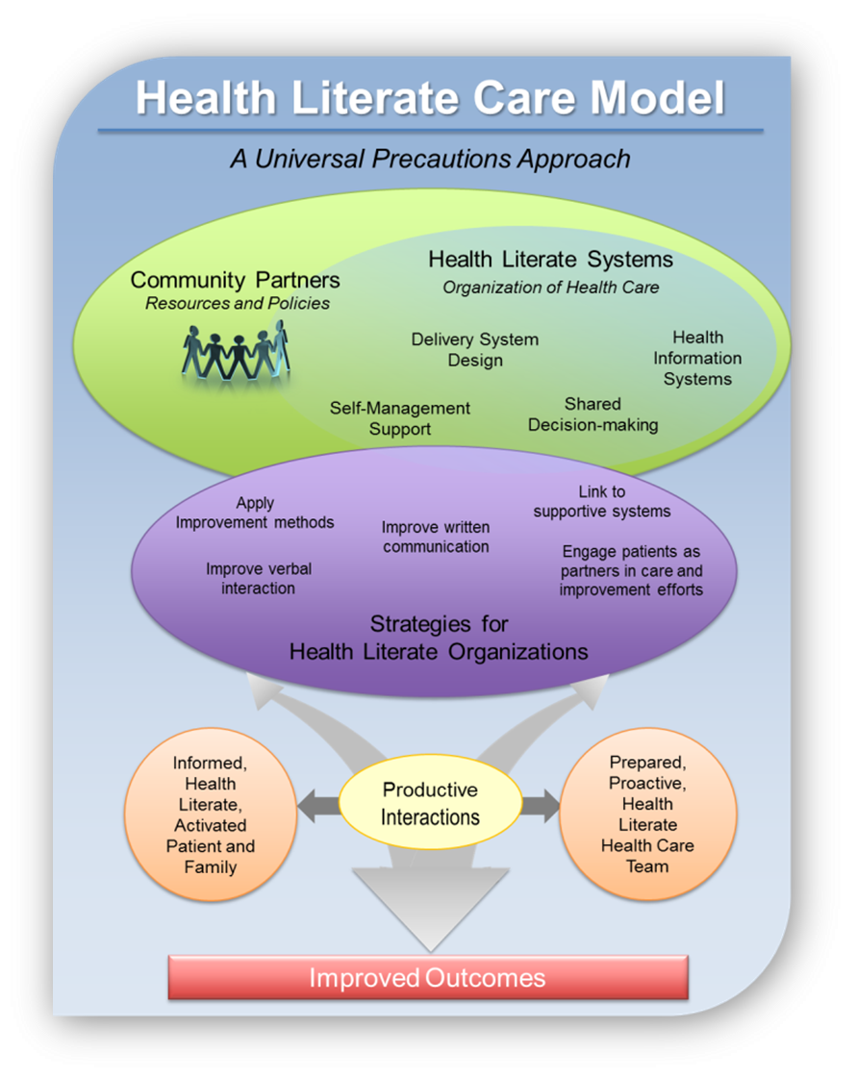
Koh, Brach, Harris, & Parchman 2013
Notes:
To get to the exceptional patient experience, we have to remember that the patient-provider exchange happens in the context of a health care organizations.

Slide 38
Health Literate Organizations
A health literate organization makes it easy for people to navigate, understand, and use information and services to take care of their health.
Brach et al. 2012
Notes:
A health literate organization makes it easy for people to navigate, understand, and use information and services to take care of their health. The term “health literate organization” was coined by members of the Institute of Medicine Roundtable on Health Literacy.
http://iom.edu/~/media/Files/Perspectives-Files/2012/Discussion-Papers/BPH_Ten_HLit_Attributes.pdf

Slide 39
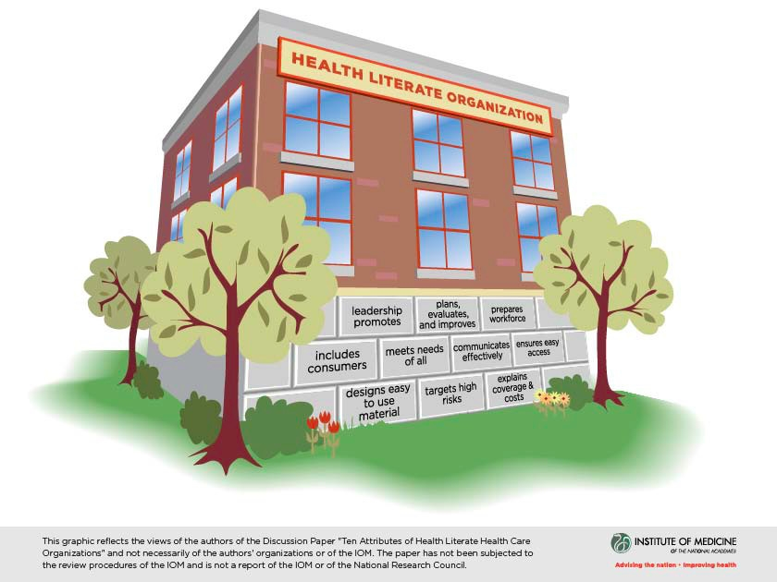
Brach et al. 2012
Notes:
So let’s figure out how organizations can become health literate? My colleagues from the IOM Roundtable on Health Literacy build upon work done by Dean Schillinger and Debra Keller to define attributes of a health literate organization. We’ve suggested what an organization has to do to be health literate.

Slide 40
Drivers of Health Literate Organizations
Accreditation standards (The Joint Commission, NCQA, URAC )
  Communication and access
  Patient education
  Team-based care
  Population health
  Coordination, care management, & transitions
  Quality improvement

Slide 41
Drivers of Health Literate Organizations Cont’d
Value-based Purchasing: financial rewards for clinical and patient satisfaction outcomes
  Affordable Care Act (2010): Accountable Care Organizations, Medicare Hospital Value-Based Purchasing (HVBP) Program
    CAHPS® CXO
  MACRA (2015): Merit-based Incentive Payment System (MIPS)
  Being health literate can affect both:
    Population health
    Patient experiences
Notes:
Shift from fee-for-service to value-based payments in the United States has buoyed health literacy as an organizational priority.
ACA: alternative payment – ACOs give incentive for attending to population health outcomes and HVBP gave hospitals incentive to pay attention to readmission rates and CAHPS scores. The institutional incentives to improve CAHPS scores have given rise to a new member of the C-suite – the Chief Experience Officer.
Medicare Access and CHIP Reauthorization Act – MIPS gives physicians the same incentives that HVBP gave hospitals

Slide 42
Using Patient Experience Surveys
CAHPS® scores affect payment
Serve as red flags for problems
CAHPS health literacy supplemental items let you further diagnose
Can train people to be better communicators, more empathetic
Can redesign systems to improve the patient experience
Notes:
In a 2016 environmental scan of organizations undertaking organizational health literacy improvement, the most common form of monitoring was found to be tracking patient experience data, either through CAHPS® or other surveys

Slide 43
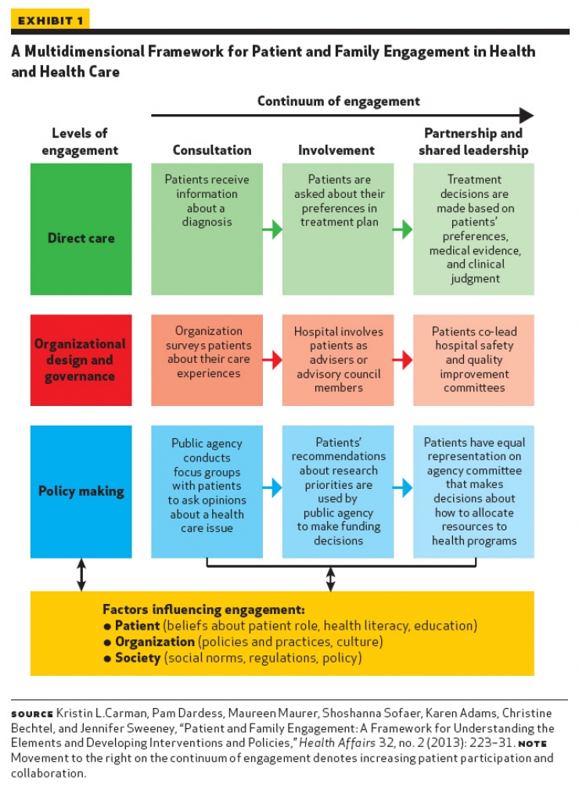
Notes:
While I talked before about patient engagement at the direct care level earlier, now I want to talk about patient engagement at the organizational level. Organizations can get input from patients from patient experience surveys, but they can also take patient engagement to another level.

Slide 44
Patient Engagement at the Organizational Level
Obtain patient feedback
Engage patients as partners
Surveys
Patient shadowing
Observed use (e.g., patient portal)
Suggestion boxes
Advisors
Co-creators
Trainers
Improvers
Source: AHRQ Health Literacy Precautions Toolkit, Tool 17

Slide 45
Health Literacy
Sponsors and Allies
C-Suite
Health Education
Quality & Safety
Patient & Family Experience & Engagement
Population Health
Risk Management & Compliance
Organizational Development
Policy & Research
Marketing

Slide 46
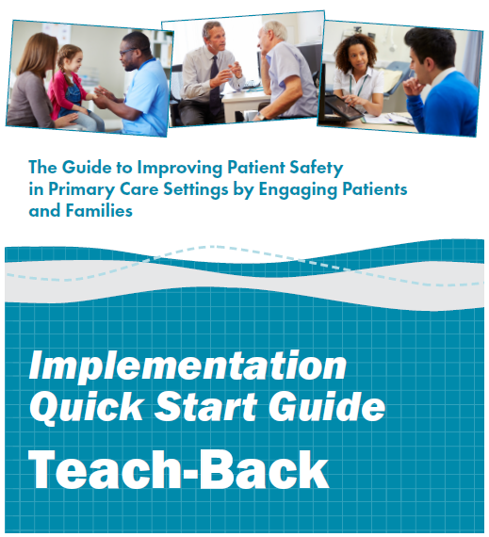

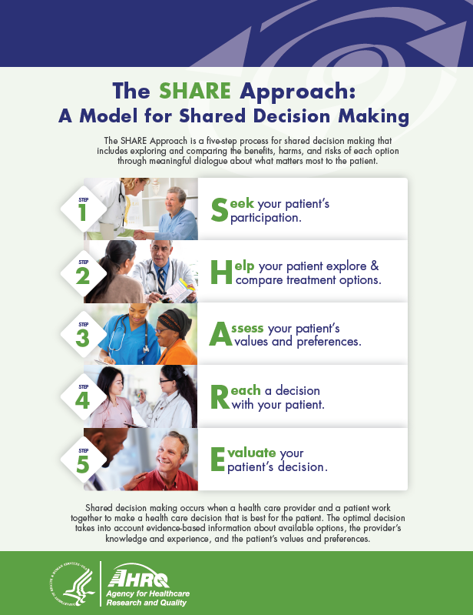

AHRQ Tools to Become Health Literate & Boost Patient Experience
Notes:
Abrams

Slide 47
Conclusion
Health literacy strategies can improve patient engagement and the patient experience
There are many strategies and implementation tools
Exceptional patient experience can only be achieved when health literacy is addressed at the systems level

Slide 48
What questions do you have?
www.AHRQ.gov/healthliteracy

