Slide 1
Convince & Convert:
Making the Case for Health Literacy & Implementing it in Your Organization
Kim Parson
Chris Trudeau, JD
Strategic Consultant, Humana
Professor of Law, Western Michigan University - Thomas M. Cooley Law School

Slide 2
We have no relevant financial interests to disclose.

Slide 3
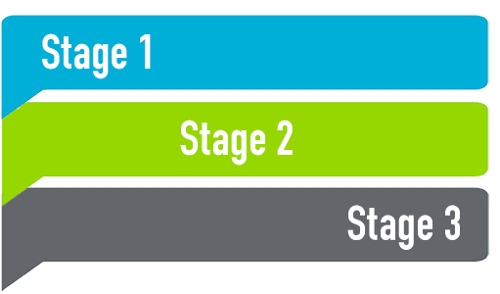
Three Stages of HL Integration
System-based policy changes
Implementation
Outcome measurement

Slide 4
Do (at least) these three things when advocating for system-wide changes:
Underscore the importance of HL
Make the business & regulatory case for integrating HL
Provide some actionable steps
Notes:
The key here is to do all three of these things. Remember, this is an advocacy session. You need to lay the foundation and give some calls to action.

Slide 5
Start by showing the importance of health literacy
(even if you think they already know it)
Notes:
You can vary how much time you take on this section based on the audience’s suspected knowledge of HL. Maybe even show the video.

Slide 6
Which of the following is the best predictor of an individual’s health status?
Age
Income
Race/ethnicity
Education Level
Literacy Skills
75% of patients who reported being in poor health also tested in the below-basic HL category
Source: Weiss BD. Health Literacy: A Manual for Clinicians. American Medical Association / American Medical Association Foundation, 2003. p. 7.
Notes:
This is one of my favorite things to do – it creates more interaction, and it’s very impactful.

Slide 7
Scary data we all need to know
In one of the largest studies conducted on health literacy, researchers using patients from two public hospitals found that:
Source: http://www.ncbi.nlm.nih.gov/pubmed/7474271
Notes:
From my experience, these stats seem to really resonate with administrators.

Slide 8
Show them videos – they act like a hammer to help drive in your points
AMA Health Literacy Video (short version):
https://www.youtube.com/watch?v=ubPkdpGHWAQ
This is bad enough Youtube video:
https://www.youtube.com/watch?v=R3tJ-MXqPmk
Source: AMA Health Literacy Video (Short Version)
Notes:
Again, these are impactful, but it depends on how much time you have in front of this audience.

Slide 9
Make the business & regulatory case for health literacy
Notes:
Onto the next section…

Slide 10
Think of some avoidable problems in health settings
Hospital readmissions
Low adherence rates
Insurance issues
Medical errors
Patient dissatisfaction
Low health literacy & poor organizational communication are key factors in all of these.
Source: National Action Plan for the Improvement of Health Literacy:
https://health.gov/communication/initiatives/health-literacy-action-plan.asp

Slide 11
Use the Org’s Strategic Goals to Make Your Case (Here are some I’ve used)
Optimal Health
Reduce unnecessary variation in care through the development of patient-centered, value-based pathways.
Exceptional Experience
Provide consumer-centric and patient-centric access to services and care.
Deliver personalized, integrated, and equitable health care that meets and anticipates the needs of individual members of our diverse community.
Organizational Vitality – integrating health literacy will help you save money and meet your financial goals.
Notes:
For optimal health: Health literacy research demonstrates that improved understanding leads to improved outcomes for chronic diseases.
For Exceptional Experience: Patient-centered care isn’t really patient centered if patients can’t act on the information we give to them to improve their health.
For organizational vitality: Creating a HL organization will not only improve health outcomes, but it will help streamline your organizational processes, which will reduce waste and increase value-based payments and improve margins.

Slide 12
Integrating health literacy will help with your care- improvement goals
Patient Safety: Research has shown that using health-literate practices “during medication reconciliation with patients helps reduce medication errors and increase adherence.”
Patient-centered care: “Making sure patients understand their options and involving them in decision-making helps ensure they get the care they need and want. Understanding patients’ lifestyles is important to making self-care information usable and helping them set personal action plans.”
Health equity: “Clear communication is key to efforts to eliminate health disparities and build cultural and linguistic competence. This includes understanding and responding to cultural and language differences through interpretation and translation services.”
Source: Building Health-Literate Organizations (Unity Health):
https://www.unitypoint.org/filesimages/Literacy/Health%20Literacy%20Guidebook.pdf

Slide 13
Happy Patients, Healthy Margins (Accenture study)
“A superior customer experience doesn’t just strengthen patient engagement — it also correlates to 50 percent higher hospital margins.”
“[A] hospital system earning $2B in revenue would have to cut 460 jobs (assuming a loaded salary of $100K) to achieve the same 2.3 percent margin benefit that improving the consumer experience might bring through revenue growth.”
https://www.accenture.com/t20151003T033201__w__/us-en/_acnmedia/Accenture/Conversion-Assets/DotCom/Documents/Global/PDF/Industries_17/Accenture-Happy-Patients-Healthy-Margins.pdf

Slide 14
The SCAN Foundation Report on Patient-Centered Care (June 2016)
“For the person receiving care, PCC results in a greater sense of empowerment, a focus on wellness and quality of life, and a better care experience. There is also evidence that it improves the job satisfaction of health care providers, who enjoy connecting meaningfully with patients and working as a team.”
“[For older adults], Medicare pays the hospital a certain amount for a hospitalization based on the person’s diagnosis, regardless of length of stay. . . . [W]hen the PCC program shortens stays, the hospital receives the same compensation but has lower costs and it realizes a return on its investment in PCC.”
http://www.thescanfoundation.org/person-centered-care-todays-health-care-environment-business-case-stronger-ever-issue-brief

Slide 15
Health-literate communications will also help you save money in other ways
Los Angeles County – revised documents & phone messages; conducted training on clear communication
30% reduction in customer assistance calls
Cleveland Clinic – revised billing statements back in the 90s
80% increase in patient payments because they knew where to pay, how to pay, when to pay, etc.
Veteran’s Benefits Administration – revised beneficiary letter
Saved $4,430,000 by improving response rate from 43% to 65%.
Joe Kimble, Writing for Dollars; Writing to Please

Slide 16
Laws, regulations, & accrediting standards encourage integrating health literacy
Notes:
Onto the next section…

Slide 17
HHS, CDC, and FDA care about improving health literacy:
Strategic Goal #1 from HHS’s 2011-2015 Strategic Plan:
“Engage individuals and families as partners in their care by incorporating patient and caregiver preferences; using clear and productive communication strategies; improving the experience of care for patients, caregivers, and families; integrating health literacy principles; and promoting patient self-management.”

Slide 18
The MACRA Final Rule Provides Incentive Payments for…
“Improvement activities . . . that support broad aims within healthcare delivery, including care coordination, beneficiary engagement, population management, and health equity.”
https://qpp.cms.gov/docs/QPP_Executive_Summary_of_Final_Rule.pdf
One of the specific initial improvement goals in the final rule is to “[e]ngage patients, family and caregivers in developing a plan of care and prioritizing their goals for action, documented in the CEHRT.”
See Table 8, p 786 of the Final Rule for MACRA https://qpp.cms.gov/docs/CMS-5517-FC.pdf
Notes:
MACRA = Medicare Access & CHIP Reauthorization Act

Slide 19
CMS’s Conditions of Participation (tag C-0320) says this about patient understanding of consent:
“Informed consent requires that a patient have a full understanding of that to which he or she has consented. An authorization from a patient who does not understand what he/she is consenting to is not informed consent.”
Ctr. for Medicare & Medicaid Serv., State Operations Manual, Appendix W, at C-0320 (2015).

Slide 20
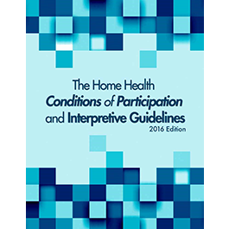
For home healthcare organizations, CMS’s new final rules require:
A Patient Rights Notice that includes patients’ right to actively participate, to develop and update their plan of care and discharge and transfer plans.
This notice must written in a language and manner that patients can understand.
https://www.cms.gov/Regulations-and-Guidance/Legislation/CFCsAndCoPs/homehealth.html

Slide 21
The liability risk of poor health communication
4 of the top 10 reasons for malpractice:
No informed consent
No informed refusal
Communication problems
Weak patient education
“The Top 10 Reasons Physicians are Sued for Malpractice” ProAssurance Corp
Notes:
[Click 4x]

Slide 22
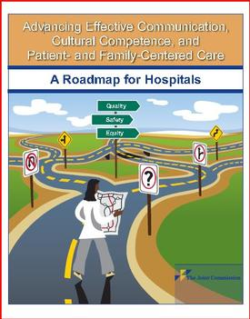
The Joint Commission cares about clear communication
“Informed consent forms that are written by lawyers for lawyers do not increase the knowledge of those who, with their signature, are committing to allow the performance of treatments and procedures that may be associated with significant risks. The typical informed consent form is unreadable for any level of reader.”
The Joint Comm’n, What did the Doctor Say? Improving Health Literacy to Protect Patient Safety, p. 34 (2007).

Slide 23
Provisions mandating clear patient communication are increasingly becoming a feature of healthcare regulations
The Final Rule on Section 1557 of the ACA (discussing non-discrimination) requires health providers to provide language assistance for those with low English proficiency, nearly all of whom have low health literacy.
81 F.R. 31375, 31390-91 (May 18, 2016).
The CARE Act, which the AARP has been helping to pass in numerous states, requires that caregivers be explained options in “non-technical language.” For example, Michigan’s CARE Act specifically states that
“training or instructions provided to a designated caregiver shall be provided in nontechnical language, [and] in a culturally competent manner . . . .”
Mich. Comp. Laws Ann § 333.26289 (2016).

Slide 24
The Delaware CARE Act has some great language for HL purposes – check to see if your state has passed it.
http://legis.delaware.gov/LIS/lis148.nsf/48224c9dab6a374a852568f70050ed2c/26a56bc4813cebb785257f9d00530eb3?OpenDocument

Slide 25
After making the case, show them the path to implementation
Notes:
Onto the next section…

Slide 26
Be sure to bring up this resource to raise awareness

Slide 27
But how does this relate to my specific division?
(Answer this question before they ask it. They are thinking it.)
Notes:
Self-Reflection Question: How does my division relate to the patient experience at my health system?
Answer: Anything from the way we speak patients, to the signs they read, to access tools we provide is related to health literacy. So if you influence that process, then HL relates to your department and you should consider how to integrate HL into those processes.

Slide 28
Three Stages of Integration
System-based changes
Implementation
Outcome measurement
These stages apply to integration with pilot projects, within divisions, and at an organizational level.

Slide 29
Give them some key tips (action steps) to get them started on the path
Notes:
Onto the next section…

Slide 30
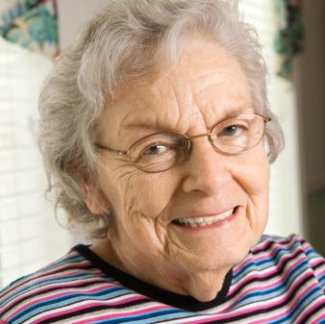
Action #1: Universal precautions for health communication
Use clear communication strategies with everyone. Treat everyone as though they have low health literacy. You can’t tell by looking.
Notes:
So how do you tell if someone you’re treating has low health literacy? The beauty of it is you don’t have to. One of the hallmarks of health literacy best practices is applying universal precautions in your health communications.
Why? We know that everyone is at risk for misunderstanding. How many of you know about Universal Precautions for Clinical Care?
Universal Precautions for clinical care were implemented when medical professionals realized they couldn’t look at someone and tell whether they had an infectious disease. They started using certain safety precautions with everyone with the goal to reduce risk and control infection rates, such as:
Hand washing
Using gowns, gloves, and masks
Handling needles safely
Cleaning the environment and tools
Similarly, health literacy professionals have realized that they can’t look at someone and tell whether they are at risk for misunderstanding the information they receive, so the goal is to communicate in ways everyone can understand. Studies show that even those who can read at higher levels, or have more knowledge of health, still prefer simple health information.

Slide 31
Action step #2: Create (or better use) a Patient Advisory Council to help integrate health literacy
Use the PAC to conduct a HL/Clear Communication Assessment of your existing practices – the PAC is your home-grown focus group, so use it.
A sub-group of this council should review all widely used patient-facing material – they can be used to user test and as independent reviewers.
Members will need to be trained on HL & PCC, but it will allow you a chance to design an organizational process to vet all material and gain input for patient-centered decisions.

Slide 32
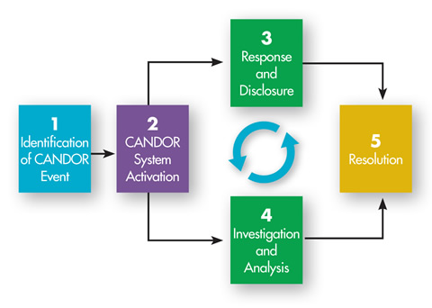
Action Step #3: Integrate health literacy into the CANDOR System
Communication and Optimal Resolution
(CANDOR) process
A patient-centered approach to handling adverse events.
Also reduces litigation costs for adverse events
Developed at the Univ of Mich, who helped develop AHRQ toolkit
http://www.ahrq.gov/professionals/quality-patient-safety/patient-safety-resources/resources/candor/introduction.html

Slide 33
But to implement CANDOR effectively, HL is a must
Redesign your consent processes to facilitate patient understanding – outline and predict all interactions patients will have.
Design the consent forms (and all written material) to be easily understood by those with low HL – shoot for the 5th or 6th grade reading level.
Design the complaint resolution process to be easy to follow – it shouldn’t be a procedural nightmare for patients.

Slide 34
Action Step #4: Train EVERYONE to use teachback
Anyone who has any patient contact whatsoever should be trained to use teachback (and, generally, to be empathetic).
Integrate measurement and feedback regarding teachback into evaluations – for those who routinely see patients.
http://www.teachbacktraining.org/

Slide 35
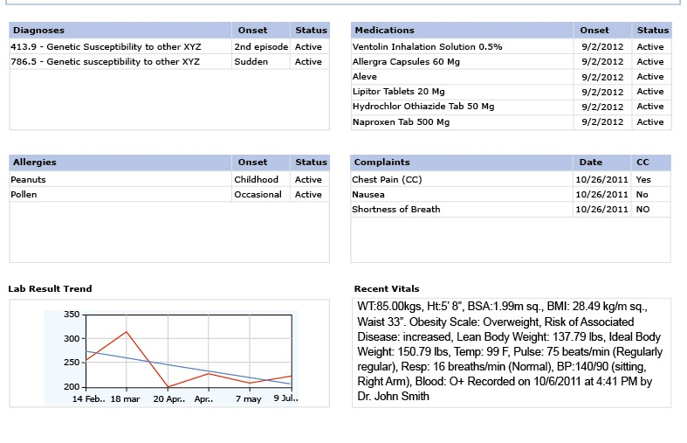
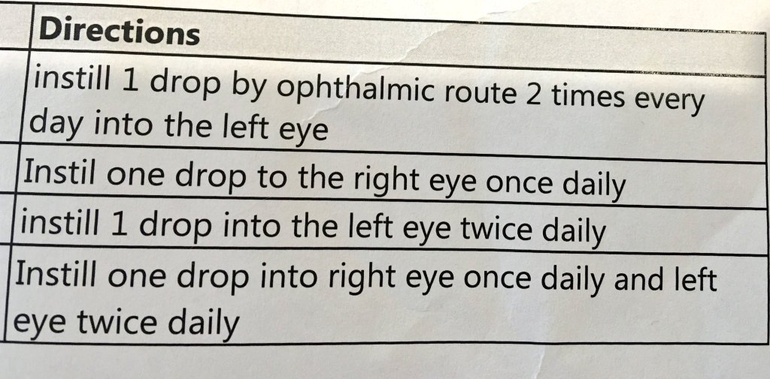
Action step # 5: Consider HL when working with any process or vendor that is “patient facing”

Slide 36
Still skeptical? Then develop & measure pilot projects that relate to your goals
Want to reducing hospital readmissions?
System-wide integration should be the goal. But using AHRQ’s Project Red Toolkit (Re-Engineered Discharge) to help develop and measure a pilot project in the acute service line would be a good start.
Want to improve adherence rates?
Design a pilot project that targets a specialty or patient pop.
(1) Train providers & staff to use teach back when dealing with patients.
(2) Include a patient-education program to increase HL levels for patients using these specialty services.
(3) Measure the outcomes along the way.

Slide 37
Then sum it up for them so they can remember some of the key points
Notes:
Onto the next section…

Slide 38
The case for health lit:
Better health outcomes
Better patient satisfaction & higher “ratings”
Lower risk of litigation
Better compliance with laws and regulations
Steps to implement:
System-based changes
Effective implementation
Outcome measurement

Slide 39
Now let’s find out how Humana has integrated HL…
Bailey E. 86511132566. [Creative Commons]. Startup Stock Photos. http://startupstockphotos.com/post/86511132566/download

Slide 40
Kim Parson, Strategic Consultant, Humana

Slide 41
What I’m going to cover
How I discovered health literacy
Path taken to introduce in my organization
Best practices that I learned from others that you can use too

Slide 42
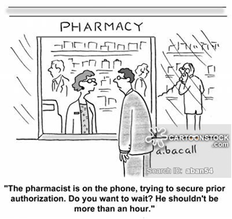
My ah-ha moment

Slide 44
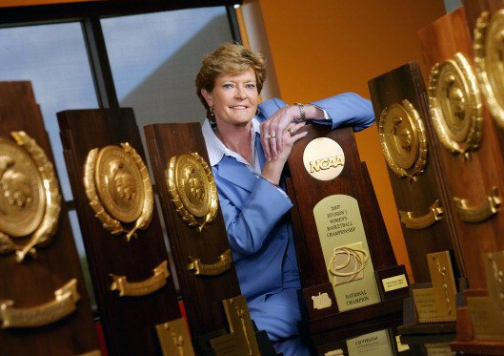
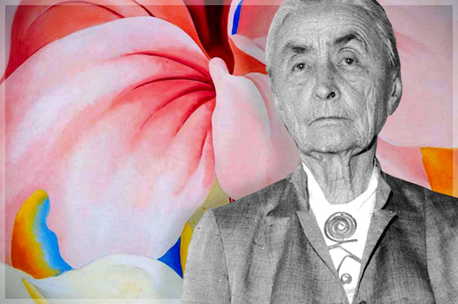
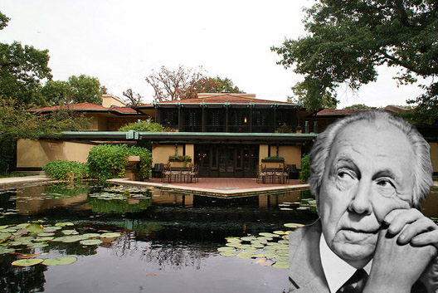

Slide 45
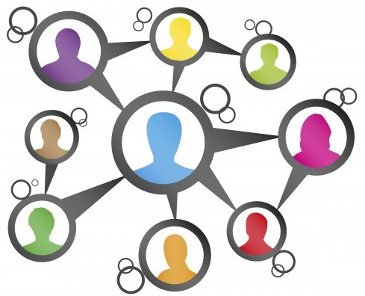
Can improved health literacy lower rates of return hospital visits?
Can it help with medication adherence?
What’s the impact on people choosing and using health insurance?

Slide 46
Building blocks
Identified influencers
Communications expert – chief of staff for Chief Information Technology Officer
Representative from Humana Foundation
Physician in Humana Resources organization
Created Health Literacy Roundtable
Group meetings every 6 weeks to share information on HL efforts going on around the company, share best practices
140 on meeting invite, average 60-70 on the call
Activated a team of Health Literacy Champions to:
Gather input / ideas for key HL information to share with Humana associates
Share weekly Hi! articles & Buzz posts throughout National Health Literacy Month
Launch an educational toolkit to socialize learning activities through these Well-being Champions/Advocates and other trusted resources
Notes:
That got people listening, and I started building champions in those organizations.
One of the biggest champions is the Chief of Staff to the head of the IT organization at Humana
She does communications and strategy for Health Literacy through the company.
IT Chief of Staff requested promotion of toolkit among the area’s 3000+ associates through IT’s Share What You Know program
At Humana we are all consumers of health and all have stories of our health and the health of loved ones.
Kim – Never undiagnosed
Amy – Family of health providers with a husband who is an ER doc who did not triage his own heart condition like he would have a patient in the ER. Despite delaying he did seek help and had the “widowmaker” but survived.
These stories make people think of their own health stories and how they see it operate in their own lives.
Humana associates may not see the Health Literacy impacts at Humana, but they can recognize it in their personal situations and make corrections and apply it to the organization.
The goal is to build interest.
We created a Health Literacy Roundtable with participants from throughout Humana.
We meet every six months and share info on what’s happening in the organization.
We also cascade information from other Health Literacy conferences, meetings, etc.
Currently we have about 120 Humana associates on the distribution list – from analysts in customer care up to an enterprise vice president.
About 60 have attended each time depending on topics, etc.

Slide 47
Toolkit Highlights
What was done:
The “briefcase” concept was designed to meet WB Champions’ request to make it easy to socialize tools & learning activities by pre-packaging everything needed; make each tool usable by teams or individuals in 10 minutes or less.
An overview presentation + seven short learning presentations including user guides & introductory messaging were introduced to WB Champions on their Sep 22 monthly call. Call to action: Begin sharing 1/week during National Health Literacy Month. Article in their newsletter followed.
Notes:
From that group we recruited Health Literacy champions modeled after wellbeing champions.
(((might give an example here of what a wellbeing champion does – encourages others, etc.))
We just wanted people who were familiar with the process. They included people who did dissertations on Health Literacy to others just introduced to it.
We also created a Health Literacy Toolkit that was designed by talking with wellbeing champions to see how they got their message out.
The toolkits include Briefcases – 5-10 minute presentations that include activities on best practices, awareness and influencers ((are these on the web?))
They are tools people can easily cascade throughout the organization.

Slide 48
Toolkit Highlights
Tools and activities have been selected by members of Humana’s Health Literacy Roundtable for their impact, value to associates and simplicity. Each provides a learning experience in 10 minutes or less!
Notes:
From that group we recruited Health Literacy champions modeled after wellbeing champions.
(((might give an example here of what a wellbeing champion does – encourages others, etc.))
We just wanted people who were familiar with the process. They included people who did dissertations on Health Literacy to others just introduced to it.
We also created a Health Literacy Toolkit that was designed by talking with wellbeing champions to see how they got their message out.
The toolkits include Briefcases – 5-10 minute presentations that include activities on best practices, awareness and influencers ((are these on the web?))
They are tools people can easily cascade throughout the organization.

Slide 49
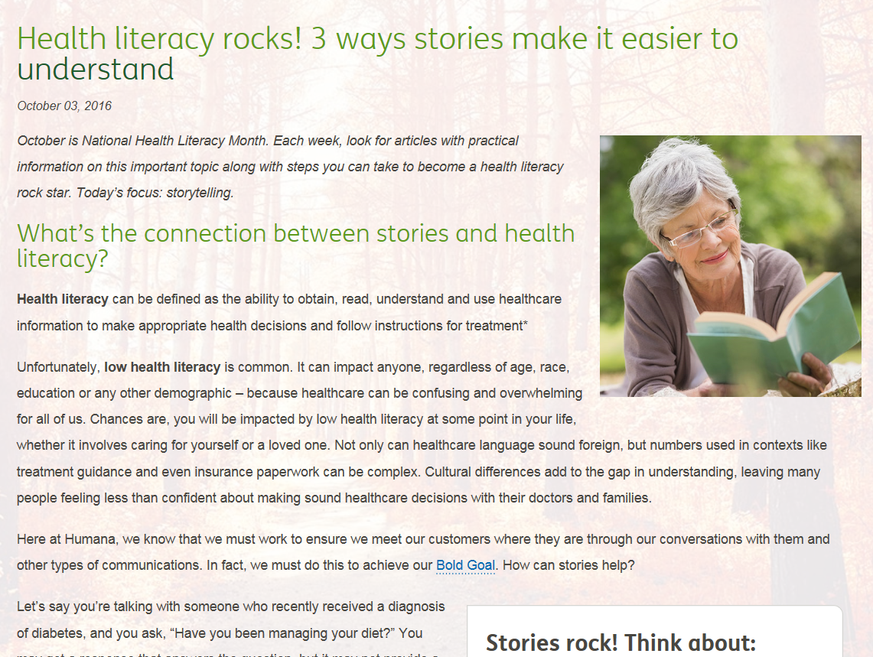
Articles & Buzz Highlights
What was done:
Four weekly articles were published on Hi! during October / National Health Literacy Month to increase awareness about the issue and share information on some key topics.
Each article directed associates to the toolkit and other learning options.
Buzz posts amplified each article, and some additional short format content was also posted.
Week 1 article: Using stories in communication
https://hi.humana.com/article/health-literacy-rocks-3-ways-stories-make-it-easier-to-understand/
Week 2 article: Health numeracy
https://hi.humana.com/article/health-literacy-rocks-3-keys-to-making-numbers-easier-to-understand/
Notes:
At Humana we have focus on Health Literacy with:
A month-long awareness campaign in October for Health Literacy Month
Internet ((training??)
Department newsletters
Department meetings ((show up and discuss Health Literacy??))
We tell the story of Health Literacy and use personal stories.

Slide 50
Bold Goal
Improve the health of those we serve by 20%
Notes:
Now we’re drinking from a fire hose.
I showed kits to the wellbeing champs. Many departments saw how Health Literacy could make a difference.
That includes our Bold Goal Team, which has the goal of increasing health?? By 20 percent in 2020.
Health Literacy is a recognized barrier to attaining that goal.
Now the toolkits created to be used internally are being shared with community organizations, local governments and groups Humana partners with to improve the health of people in the community.

Slide 51
Cultivating partners

Slide 52
Wins
External version of Health Literacy toolkits requested for sharing with communities in our markets
IT Chief of Staff requested promotion of toolkit among the area’s 3000+ associates through IT’s Share What You Know program
Invited to share overview of HL and tools as part of DevelopMe personal development program – hundreds attended
National Academies of Sciences, Engineering and Medicine Roundtable on Health Literacy – since 2012

