Slide 1
Helping Consumers Become More Engaged with Their Health Care and Health Insurance
Wisconsin Health Literacy Summit
Stephanie Severs
Health Insurance Literacy Specialist
Covering Wisconsin
Kari LaScala
Health Communications Specialist
Wisconsin Health Literacy

Slide 2
We have no relevant financial interests

Slide 3
Agenda
Project Goals
Activities
Results
Implications for engaging consumers

Slide 4
Background
Funded by the State of Wisconsin and
Wisconsin Health Information Organization
Timeline: June 2014 – May 2016
Collaborating organizations:
  Covering Wisconsin (formerly Covering Kids & Families WI)
    Education and assistance with health coverage; office at UW-Madison and in Milwaukee, affiliated with UW-Ext., hosts annual Wisconsin Enrollment Conference
  Wisconsin Health Literacy
    Training, organizational planning, outreach, and advocacy for health literacy

Slide 5
WHIO’s Three Priority Messages
You have a role to play in getting good health care and good health.
The quality of health care varies in important ways that will affect your health.
Your choice of primary care provider is very important to your health care experience and your health.

Slide 6
Project Goals
Assist consumers in:
Understanding of health care quality and value
Engaging in health care decision-making
Enhancing ability to obtain and effectively use health insurance and health services
Assist health organizations in:
Raising awareness of importance of effective communication on use of coverage and care
Supporting consumers as active partners in health care

Slide 7
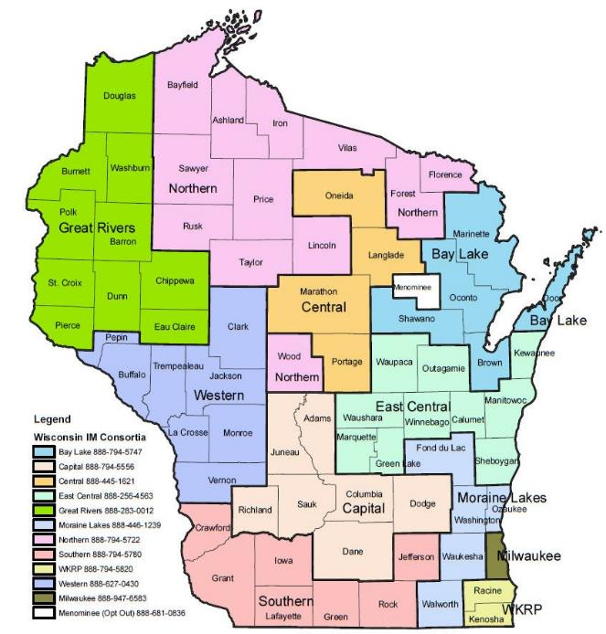
Target Regions
Target 2 regions - 13 counties
Compare to 8-county control regions
Work within existing DHS Regional Enrollment Networks (RENs)

Slide 8
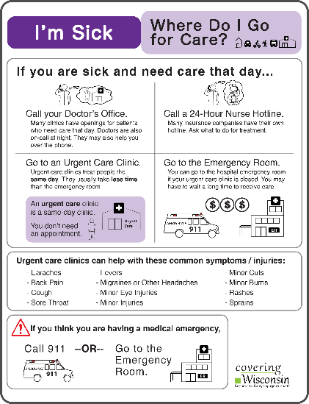

Project Activities
Consumer materials
Training on materials dissemination
MyHealthWI.org
Health literacy assessments:
Hospital and Insurer
Workshops for consumers

Slide 9
Focus Groups
90 minute sessions to learn about consumers’ perspectives, targeting those with low literacy
Provided framework for project activities
Consumers gave their thoughts on health care quality-Many showed low interest in topic until they realized how quality has affected them personally
Consumers were engaged with format: active listening and validation of experience

Slide 10
Research to Create Materials
Interviews with organizations revealed:
Professionals needed materials to help explain how to enroll and use insurance that were accessible for low literacy consumers
Materials from health insurance companies were overwhelming and not accessible
Consumers needed materials that told them what to do and how to do it

Slide 11
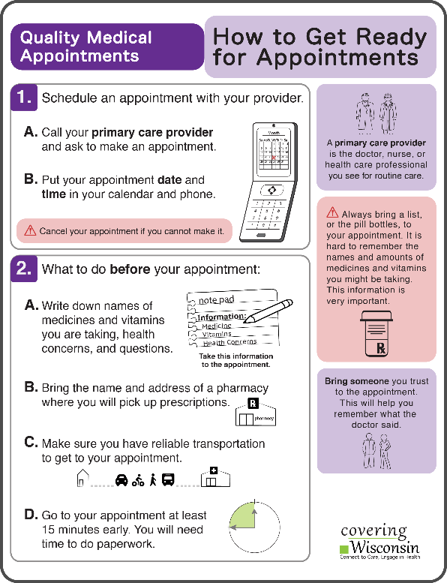
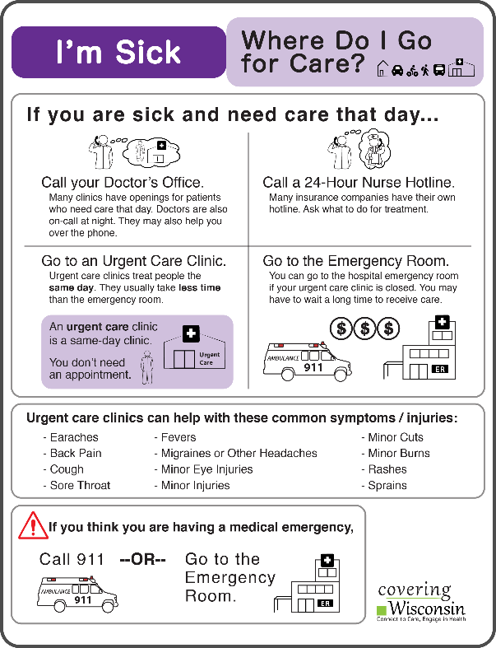
Engaging Consumer Materials
Plain, everyday language
White space, color
Graphics to support text
Action steps
1-3 key messages
Consumer reviewed
Organization: key message pops out, reason for reading is clear

Slide 12
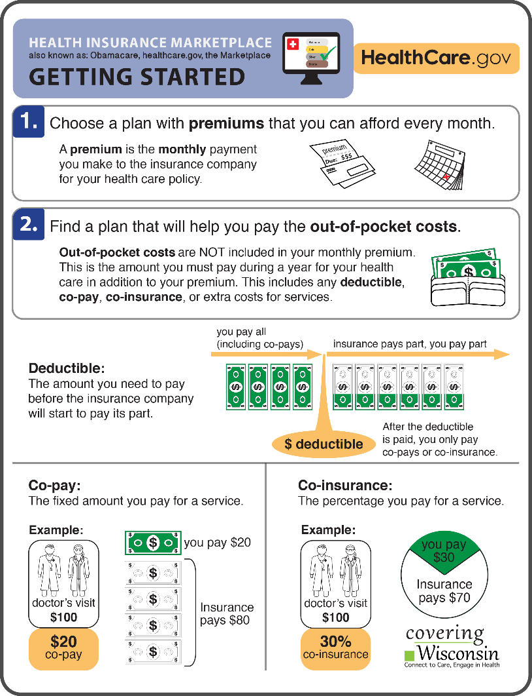
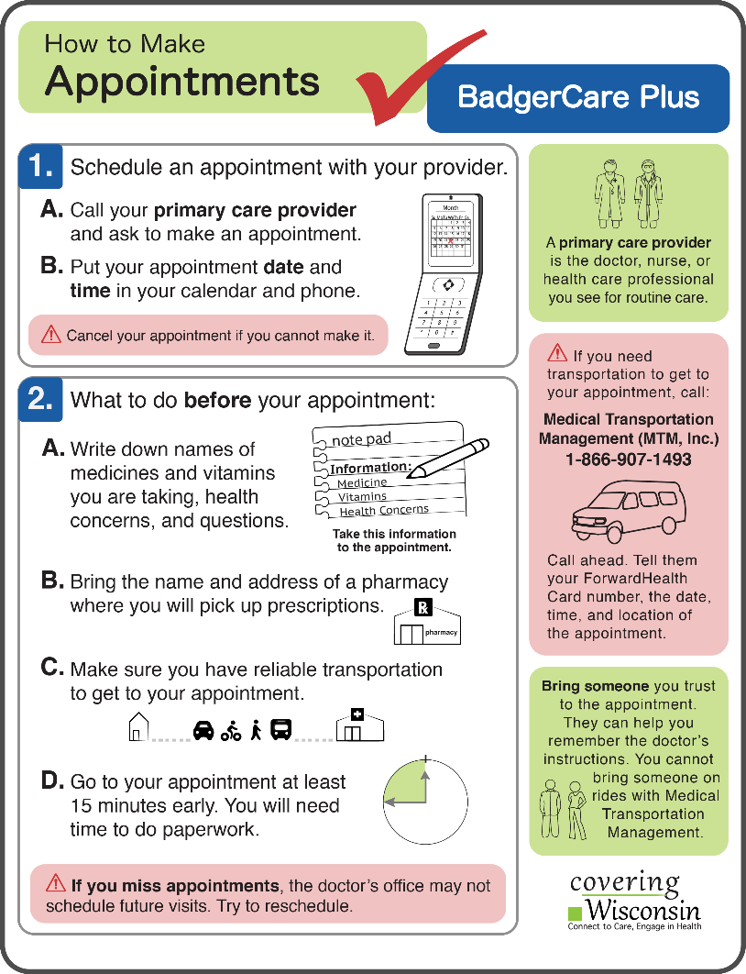
Materials Topics
Health Insurance Marketplace (Obamacare)
BadgerCare Plus (WI Medicaid)

Slide 13

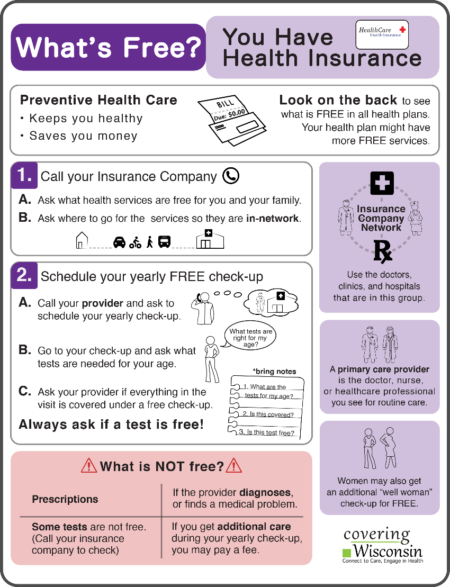
Materials Topics
Using Health Insurance-coveringwi.org/learn
Free resource you can use with consumers coveringwi.org

Slide 14
Training on Materials Dissemination
Engaged variety of agencies
  Enrollment assisters
  Health care providers
  Insurance agents and brokers
  Federally Qualified Health Centers and free clinics
  Indian Health Centers
  UW Extension

Slide 15
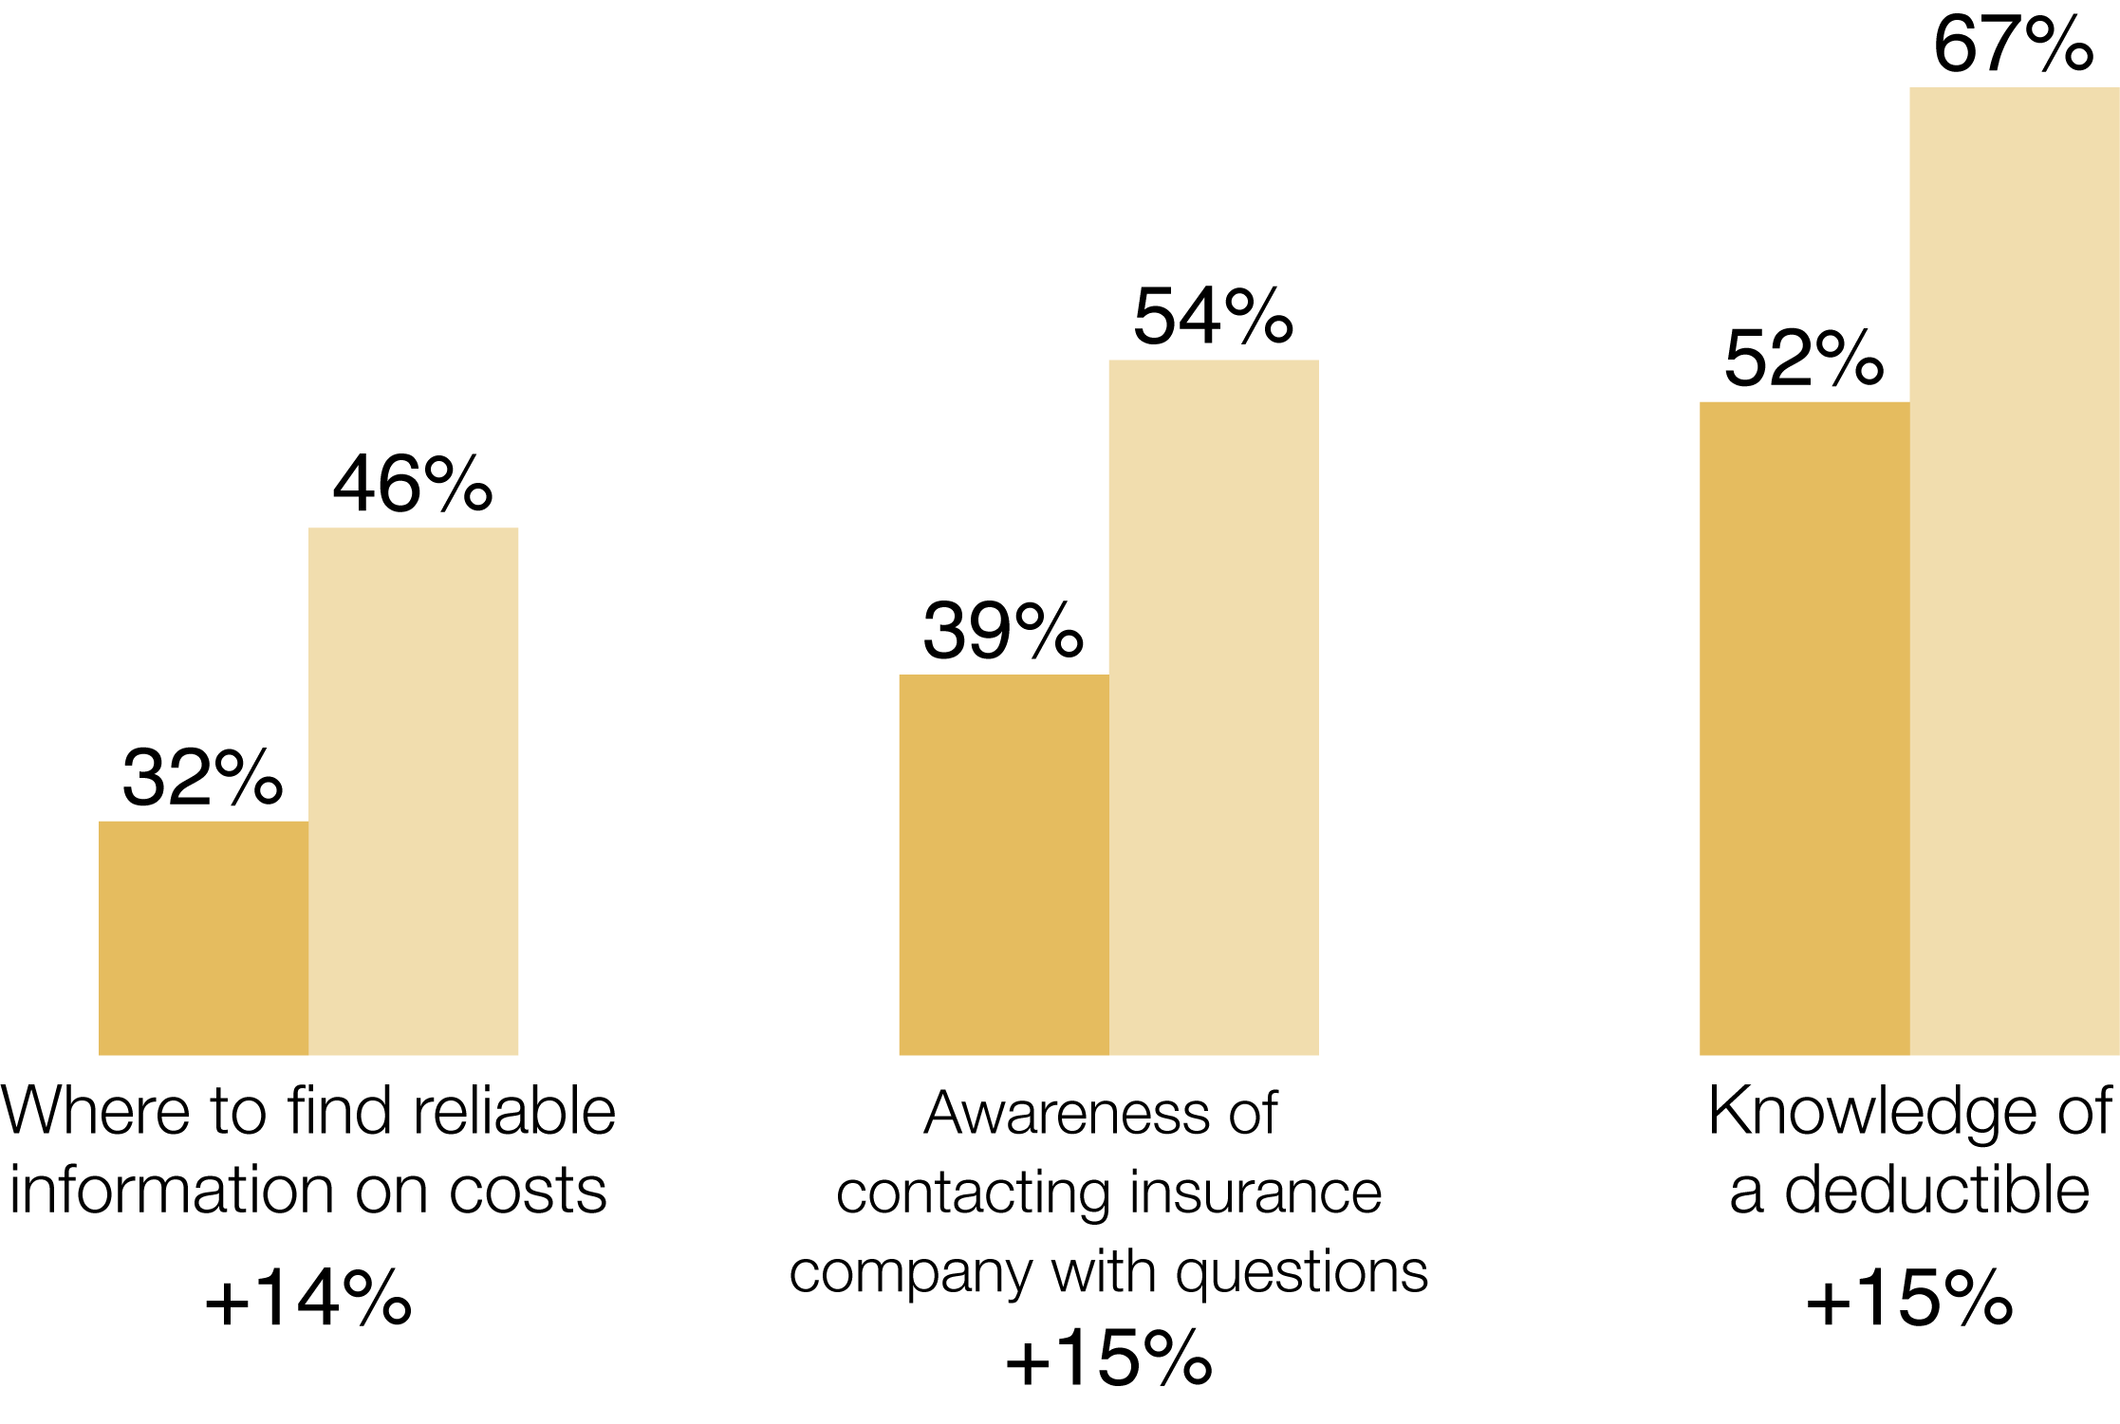
Testing Materials with Consumers
Consumer Pre- & Post-test responses: Agencies used materials with their clients and collected surveys
Increases in consumer knowledge:
300 pre-test
237 post-test

Slide 16
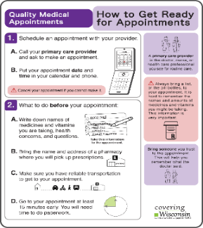
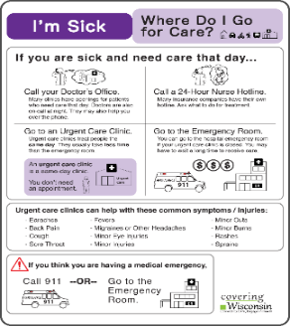
Interviews and Observations with Professionals
Enrollment Assisters:
  May use complicated language, and rely on verbal explanations with consumers
  May lack expertise in how to choose the best plan for health needs and budget
  Benefit from training in how to teach consumers about healthcare and include materials in their routine

Slide 17
Train-the-Trainer
  Training topics:
  What is health insurance literacy
  Tips to engage with consumers (visual aids, examples, personalize and limit information, plain language, Teach Back)
  Including materials in their routine to explain consumers’ options and how to use their insurance
  How to effectively explain health insurance terminology

Slide 18
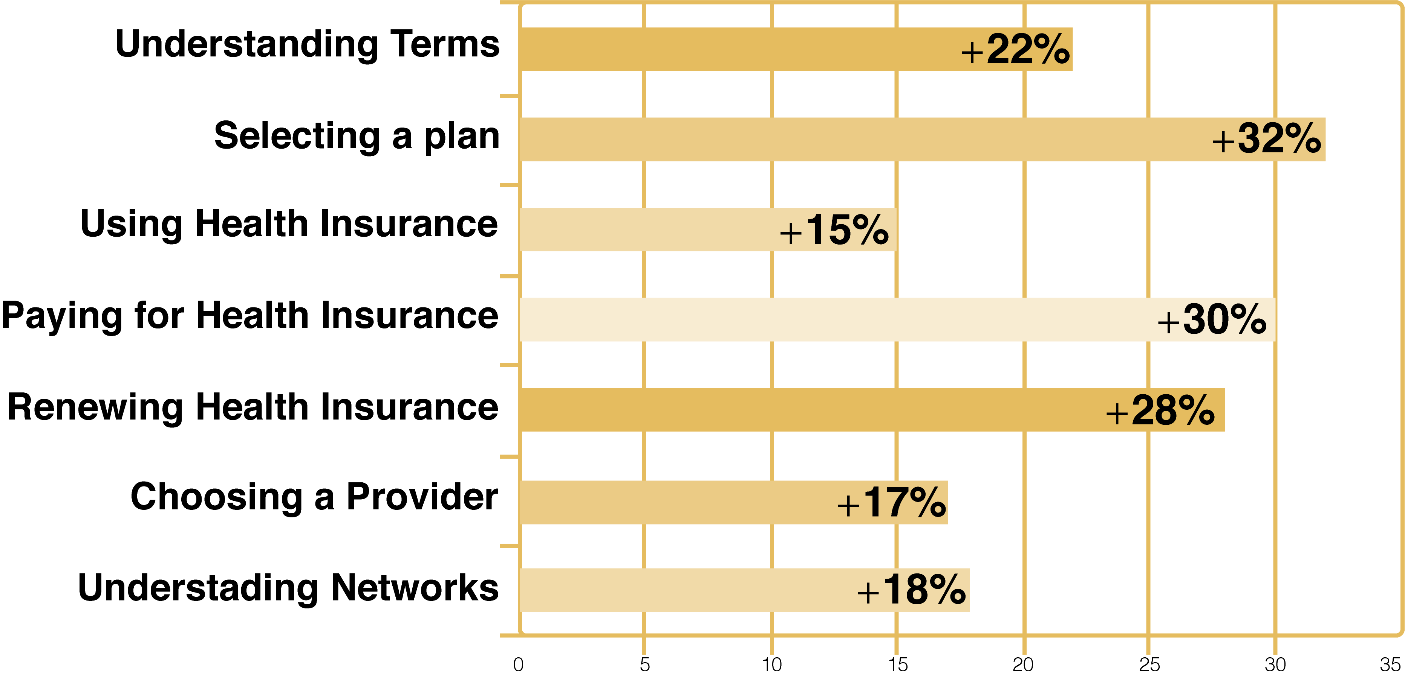
Results for Professional Trainings
Survey Results-Professionals trained with materials, as compared to those not trained, are more confident than untrained professionals (Total N=120, trained N=41)

Slide 19
Evaluations from Trainings
Train-the-Trainer Evaluations
Would like to learn more about materials, additional resources, or health insurance literacy: 69%
Change in overall understanding of health insurance concepts: + 36%
“Keep providing the trainings!”
“I will use this to teach patients to be good consumers of health care.”

Slide 20
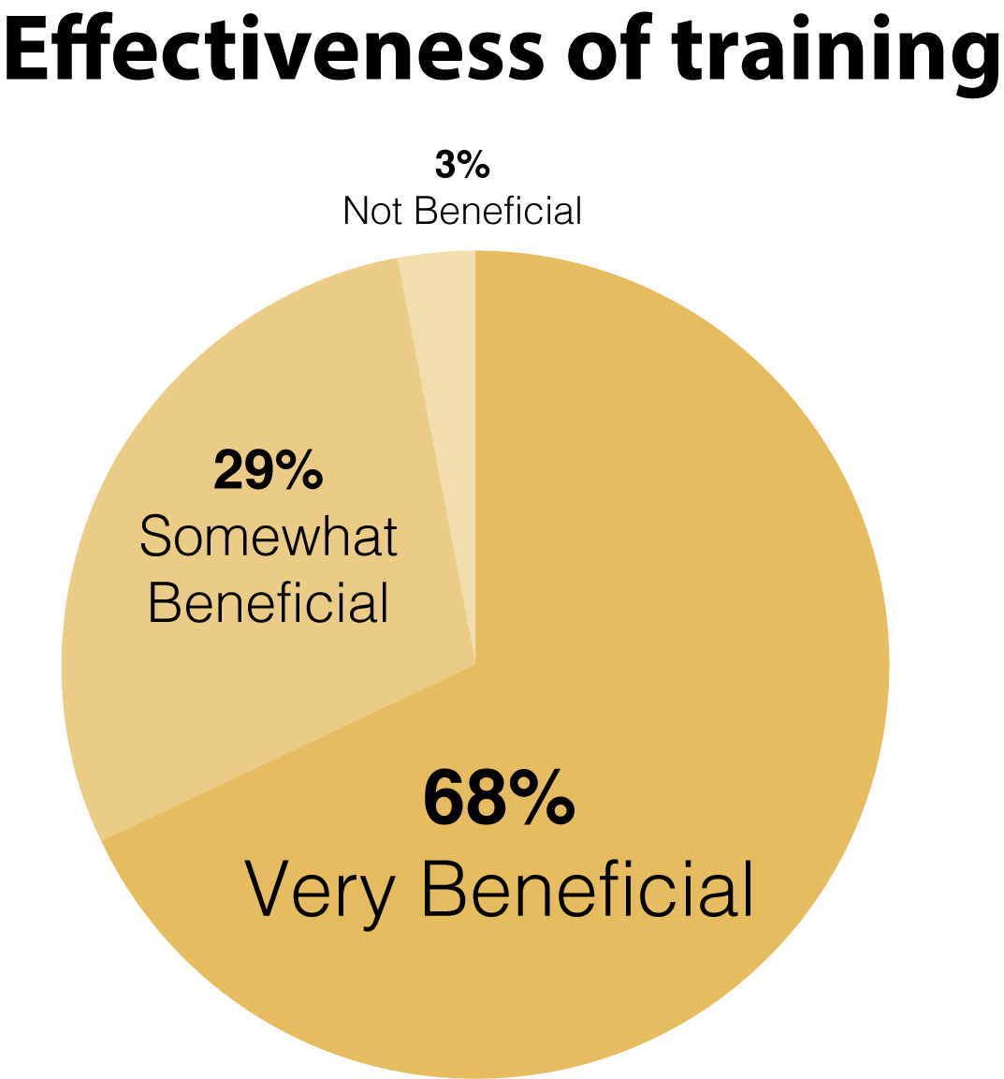
Evaluations from Trainings

Slide 21
Consumer Engagement Implications
Support to agencies:
Recognizing importance organizations play in sharing information-we need to engage staff of agencies as well as consumers
Trainings need to target all the professionals working with consumers in the organization
Trainings need to incorporate specific ways professionals can integrate literacy techniques into their routines

Slide 22
Consumer Engagement Implications
Consumers learn best when someone teaches the material verbally, incorporates visuals aids, has them repeat back what they understood, and offers easy to understand materials
Use materials that engage and motivate your audience:
    Action steps or stories
    Telling readers why information is important to them
    1-3 key messages, important information pops out
    Visually engaging, instructional or iconic images

Slide 23

MyHealthWI.org: An Introduction

Slide 24
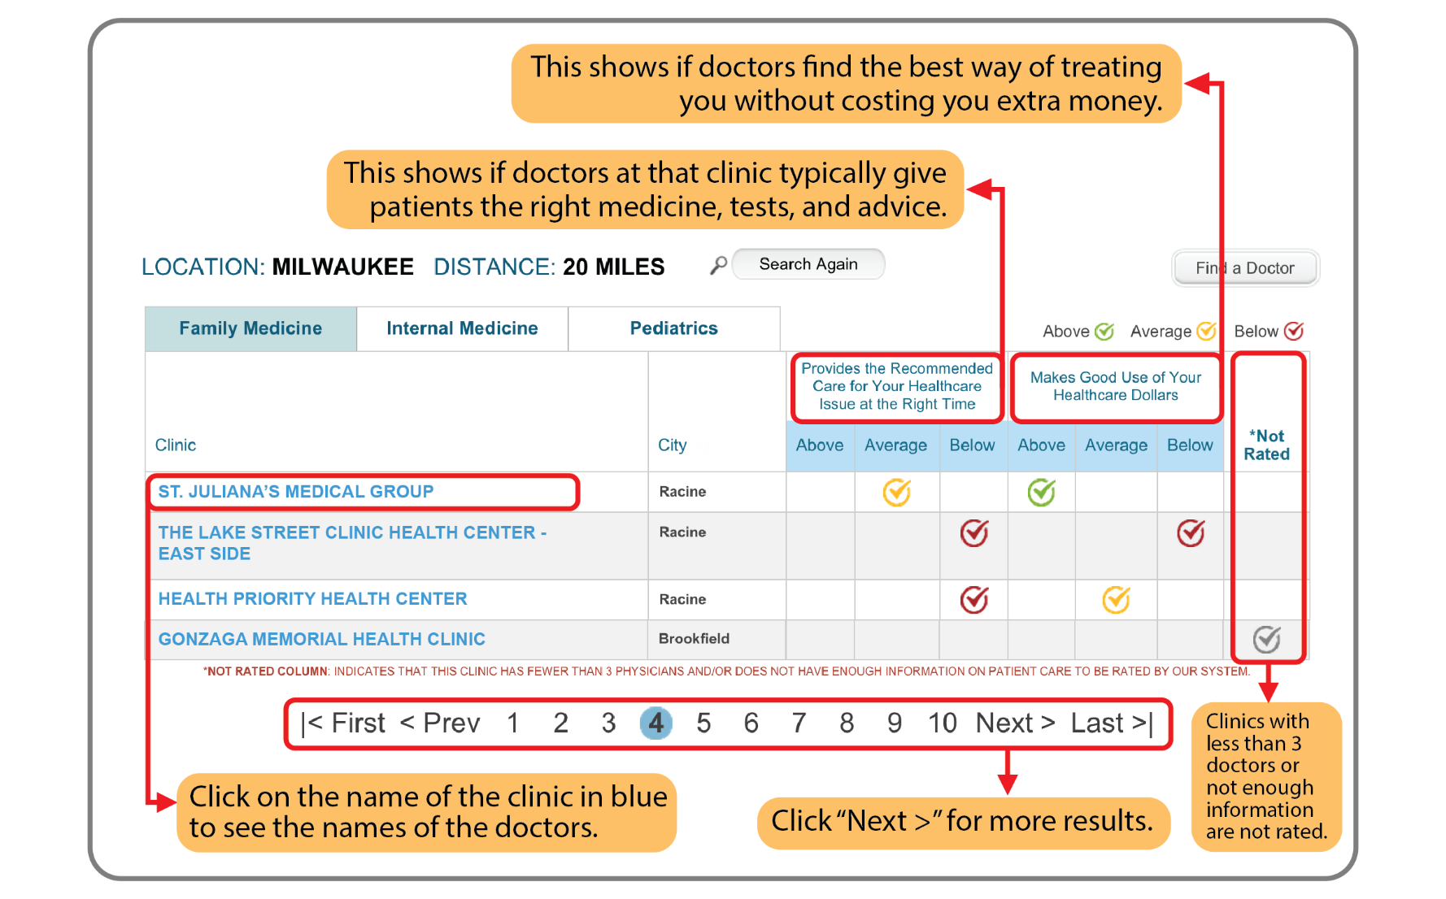
MyHealthWI.org

Slide 25
Health Literacy Assessments
Health Plan Health Literacy Assessment
  Opportunity to improve printed and oral communication and improve effectiveness of health care use
Hospital Assessment (C-CAT)
  Opportunities for patient, provider and executive leader communication on quality and value

Slide 26
Health Insurer Assessment Results
Members could benefit from more “how to use the plan and services” information
Printed materials need readability and user testing
LEP members need extra assistance and resources
Call staff need training in how to verify understanding

Slide 27
Hospital Assessment Results
Hospital opportunities for improvement:
    Perception of welcoming environment for patients
    Use of interpreters
    Diversity awareness
    Collection of race/ethnicity information
    Staff encouragement of shared decision-making
    Internal communications (email overload)

Slide 28
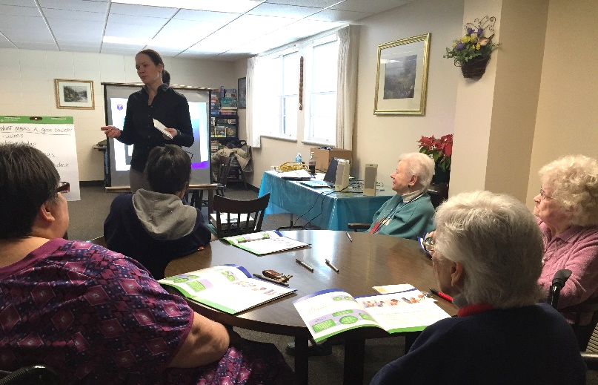
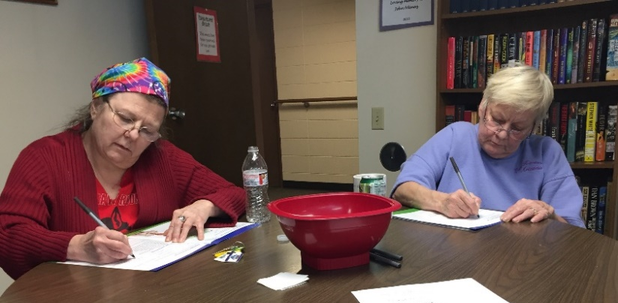
Consumer Workshops
20 workshops with community partners for those needing assistance to understand and apply WHIO’s 3 key messages.
253 participants

Slide 29

Consumer Workshops
Content:
  Confusing terms: provider, PCP
  Why have a primary care provider
  Evaluating quality
  Preparing for doctor visit

Slide 30
Consumer Workshops
Content:
  Going to PCP or to Emergency Dept.

Slide 31
Consumer Workshops
Content: Using card activity
  Going to PCP or to Emergency Dept.

Slide 32
Keeping workshops engaging
90-minutes
Interactive – role play & card activity
Active listening
Use of videos

Slide 33
Results
Participant Pre- & Post-test responses
  Ability to judge quality of health care: up 23%
  Likely to prepare more for doctor visit: 77%
“After the program, I finally made an appointment with my doctor and wrote out a list of questions…”

Slide 34
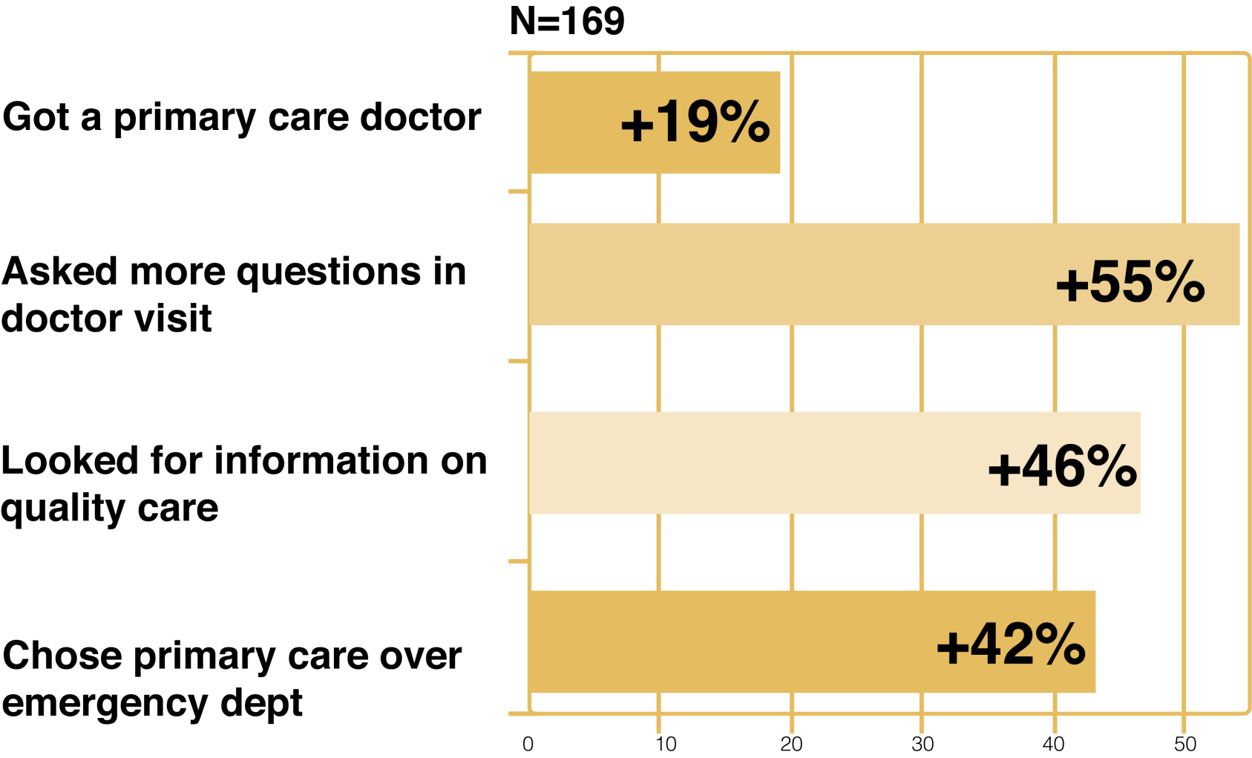
Results
Participant 60-Day Survey

Slide 35
Consumer Engagement Implications
Can be challenging to schedule & organize
Must have special considerations for ELLs
Need to be engaging, fun and interactive
Should be held in a familiar environment
Simple greeting/smile goes a long ways
Comfort level at the beginning v. the end

Slide 36
Consumer Engagement Implications
  Health care professionals play key role in helping navigate health care
Be prepared to explain quality in health care
Consumers need help with:
  What “provider” means and the value
  Distinguishing when to go to ER vs. PCP
  Quality = more than listening or wait time
  Importance of participating in their care
  Believing they deserve high quality care
  Encouragement to ask questions
  Preparation for provider visit

Slide 37
Future Directions
Distribution of materials statewide
Partnering with health care organizations on professional trainings
Development of health literacy recognition opportunities for provider and insurer organizations

Slide 38
Questions?
Stephanie Severs
Covering Wisconsin
ssevers@wisc.edu
Kari LaScala
Wisconsin Health Literacy
kari@wisconsinliteracy.org

