Slide 1
Wisconsin Health Literacy Summit
April 4, 2017
www.exceptionallives.org
© 2017 Exceptional Lives, Inc.

Slide 2
Disclaimer
I have no relevant financial interests.

Slide 3
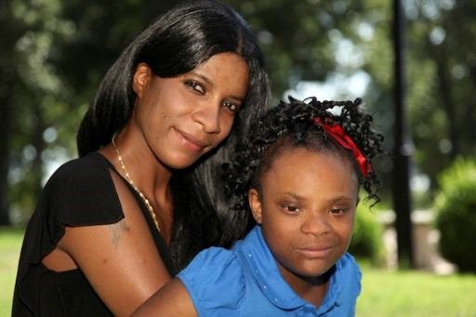

To empower and support families caring for children with disabilities by providing the information they need to access resources and services.
Our Mission
© 2017 Exceptional Lives, Inc.

Slide 4
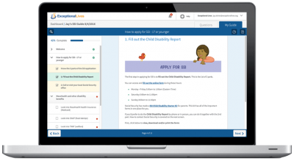

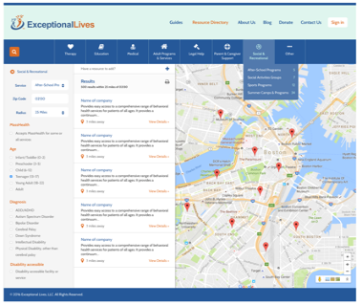
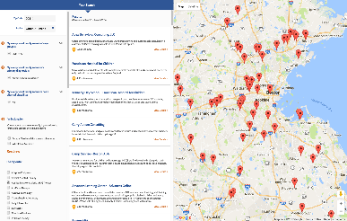
What is Exceptional Lives?
A customized and trustworthy disability information platform for families, caregivers, and professionals
Resource Directory
of disability services & providers
Personalized Guides
on how to navigate processes
Expert Support
to answer individual questions
© 2017 Exceptional Lives, Inc.
Notes:
SHOW VIDEO!

Slide 5
Here’s what we’ll cover:
Need for health literate information about disabilities
The Exceptional Lives Guides and Resource Directory
Unique features of this resource to serve as an example of good Health Literacy principles
Capturing data to improve how we fill people’s needs for information
© 2017 Exceptional Lives, Inc.

Slide 6
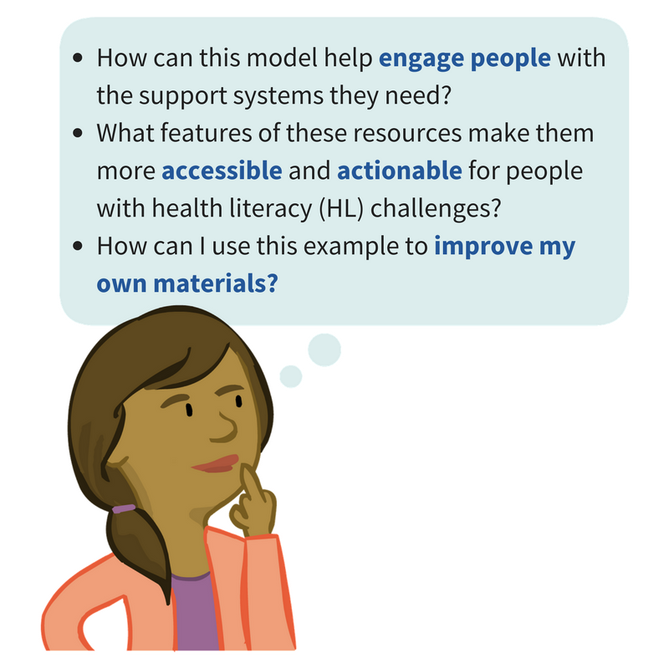
Questions to consider during our talk
© 2017 Exceptional Lives, Inc.
Notes:
We hope to do more than tell you about this resource
We’ll highlight features that help to engage people who are not connected with the systems they need, that help them go beyond understanding the information, and walk them through taking action
Maybe these features can help you when you’re creating materials

Slide 7
Need for good disability resources
Not much out there
Disabilities more prevalent in poor families
Families touched by disability are emotional and stressed (lower HL)
© 2017 Exceptional Lives, Inc.
Notes:
The point is: amount of good info is especially lacking, but the need is especially large!
Anne’s story: go get a book
Stats on DD and poverty
Story of how the stress and financial burden can affect a family
Developmental issues are more prevalent in families with lower income (and education?) STATS!
Families touched by disability are more stressed, HL capacity is already lowered
Story: mom needs to quit work, $ tight, etc. Can’t find info, but services are vital to helping the family survive
Need for resources to access on your own at any time

Slide 8
Problems with current disability information
To make informed decisions, parents and caregivers must sift through large amounts of information to find anything useful to their situation. (Timberlake et al., 2014)
The time required to locate and interpret relevant information is difficult, and increased choices can lead to increased anxiety. (Timberlake et al., 2014)
Children in low-income families with less-educated parents are “less likely to access health services because their parents didn’t recognize the need for those services or did not know what services were available.” (Porterfield, 2007)
© 2017 Exceptional Lives, Inc.
Notes:
We should have said this before at slide 7. Skip through this quickly.

Slide 9
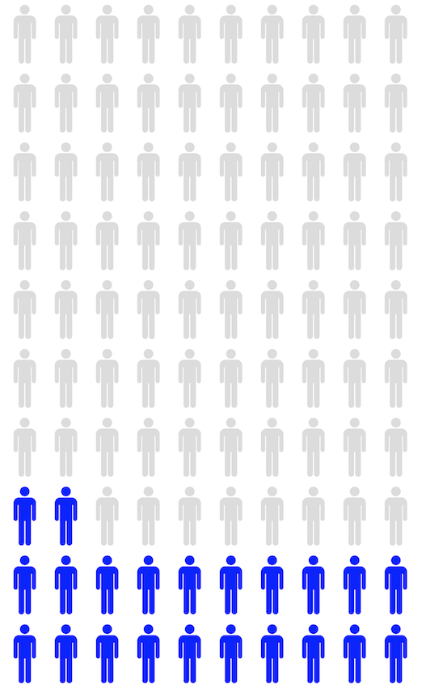
Disabilities and Low Income Families
Approximately 22% of people in the U.S. have a disability (CDC)
Low income families are more likely to have a child with a disability (Children’s Defense Fund)
  Nearly 50% higher than the rates for higher-income families
Caring for a disabled family member is a strain on finances
  “40% of U.S. families of children with special needs experience a financial burden due to their child’s condition.” (Maternal and Child Health, 2005)
© 2017 Exceptional Lives, Inc.
Notes:
Parents may have DD too, as it may genetic.
Unique because we help access systems
Systems are fragmented: not directly connected to health or ed systems

Slide 10
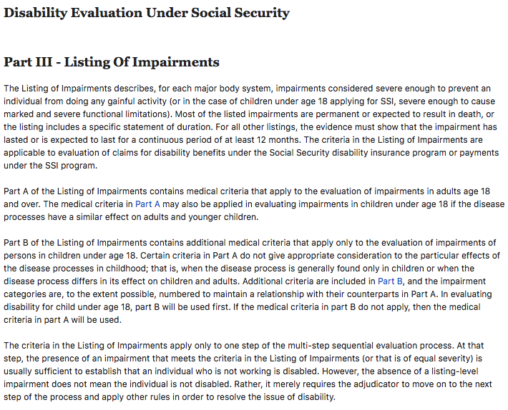
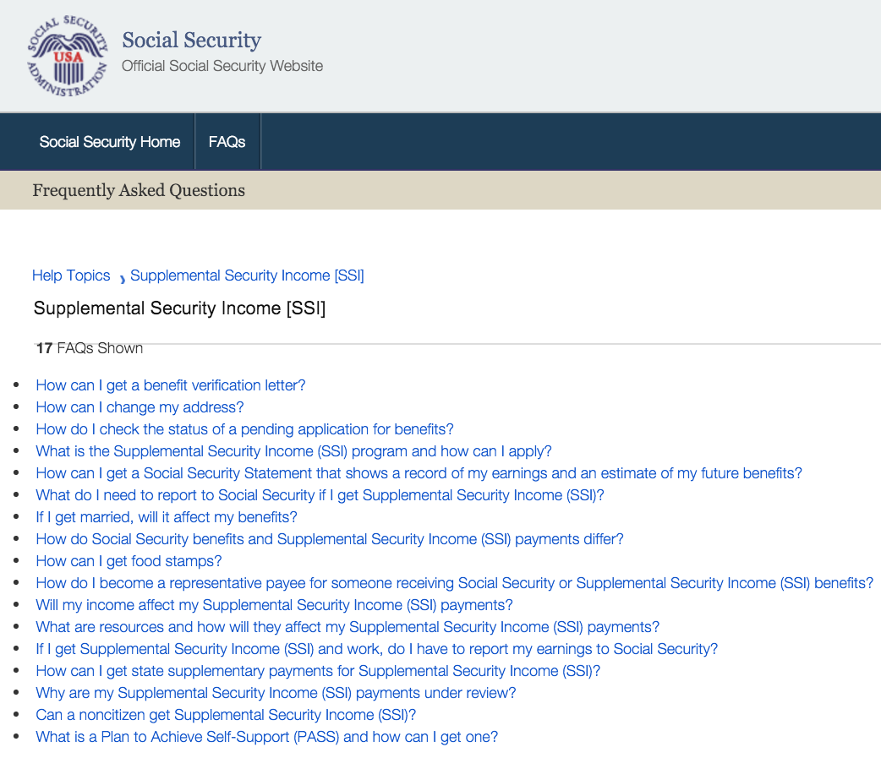
Problem: Current information is inaccessible
Long, confusing websites
Generic lists of FAQ’s
Leads to confusion, anxiety, and frustration
© 2017 Exceptional Lives, Inc.
Notes:
Sift through large amounts of info to find what you need
Hard to understand
Already stressed and this leads to more
Children of low income or less educated parents end up not accessing services they need

Slide 11
Exceptional Lives and Health Literacy
Normal health literate principles:
  Plain language writing
  Plain language design
  Actionable
  Tested with intended audience
  Accurate, up-to-date
How do we go beyond these principles?
© 2017 Exceptional Lives, Inc.
Notes:
We’ll show you the Guides and RD in a minute, but let’s preview the points we want to highlight…
Tested with 3 audiences!
Parents
Parent support staff
Official offices (SSA, Dept of Health, School system)

Slide 12
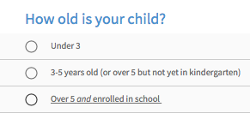
1. User engagement and personalized information
Users answer questions and engage with interactive software
Answers generate information personalized to each user
Example:
© 2017 Exceptional Lives, Inc.
Notes:
It’s hard to engage people with a print or web-based resource. This is how we do it.

Slide 13
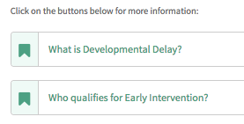
2. Small chunks and option to learn more
Information appears in small chunks of need-to-know facts and action steps
If you want to learn more, you can choose to read more detail
Example:
© 2017 Exceptional Lives, Inc.
Notes:
Information appears in small chunks to maintain user’s attention and systematically introduce next steps
After each chunk is a section to go further and learn more than what has been presented on the slide
UNIVERSAL DESIGN!

Slide 14
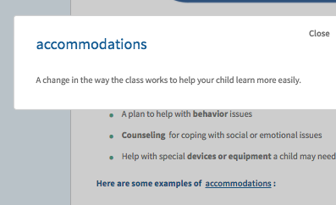
3. Help with new terminology and web navigation
New terms are underlined and in a different color
Users can click on the term for a short definition
Example:
© 2017 Exceptional Lives, Inc.
Notes:
Lots of terms and acronyms that people have to learn
We support that with features like this
Also explains how windows open in new tabs
Video to help people learn to use site

Slide 15
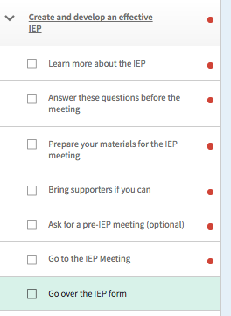
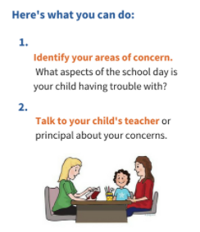
4. Focus on action steps, not just information
Each slide presents action steps: what should you do?
Printable checklist to record what you’ve done
Examples:
© 2017 Exceptional Lives, Inc.
Notes:
Also mention form filler

Slide 16
The hardest health literacy component…
Finding health information
Understanding it
Evaluating it
Communicating it
Using it…acting on it…to live healthier!
© 2017 Exceptional Lives, Inc.
Notes:
This guides people through processes one step at a time—the whole focus is on applying for or connecting with services

Slide 17

5. Personal support: Expert Helpline
Toll-free helpline & online support for parents or professionals who have a question while using our platform.
  Free phone & email support at
  1-844-354-1212 or
  info@exceptionallives.org
  All questions responded to within
  24 hours
  More than 500 requests resolved
  in the past 12 months
© 2017 Exceptional Lives, Inc.

Slide 18
Let’s look at the online platform!
© 2017 Exceptional Lives, Inc.
Notes:
Here we could either go to the real site and show them, or go through the next 3 slides first.
Make sure to highlight how we used these
Normal health literate principles:
Plain language writing and design
Tested with intended audience (before, during and after development)
Accurate up-to-date

Slide 19
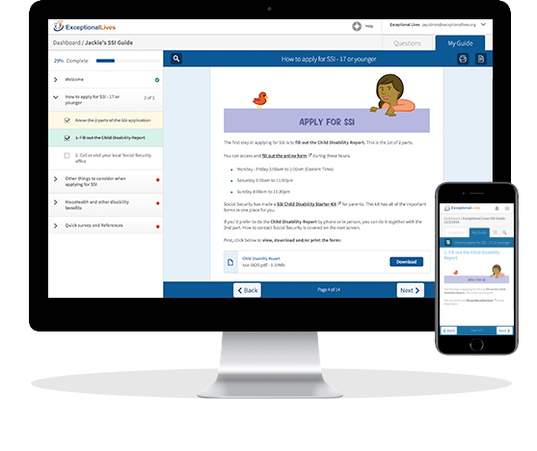
Plain Language Guides
Exceptional Lives provides free, interactive, step-by-step Guides to help families care for their exceptional children, such as how to:
  Apply for SSI and other disability benefits
  Find out if your child qualifies
  for special education
  Create an effective IEP
  Optimize health insurance
  Explore guardianship
  and its alternatives
© 2017 Exceptional Lives, Inc.

Slide 20
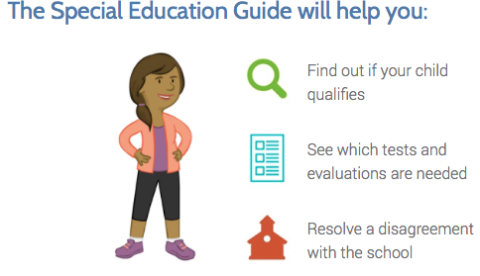
A Closer Look: Special Education Guide
© 2017 Exceptional Lives, Inc.

Slide 21
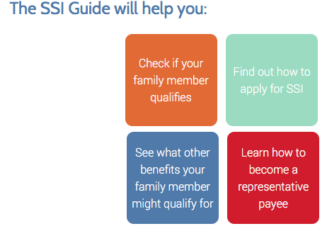
A Closer Look: SSI Guide
© 2017 Exceptional Lives, Inc.

Slide 22
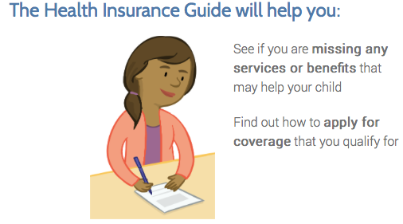
A Closer Look: Health Insurance Guide
© 2017 Exceptional Lives, Inc.

Slide 23
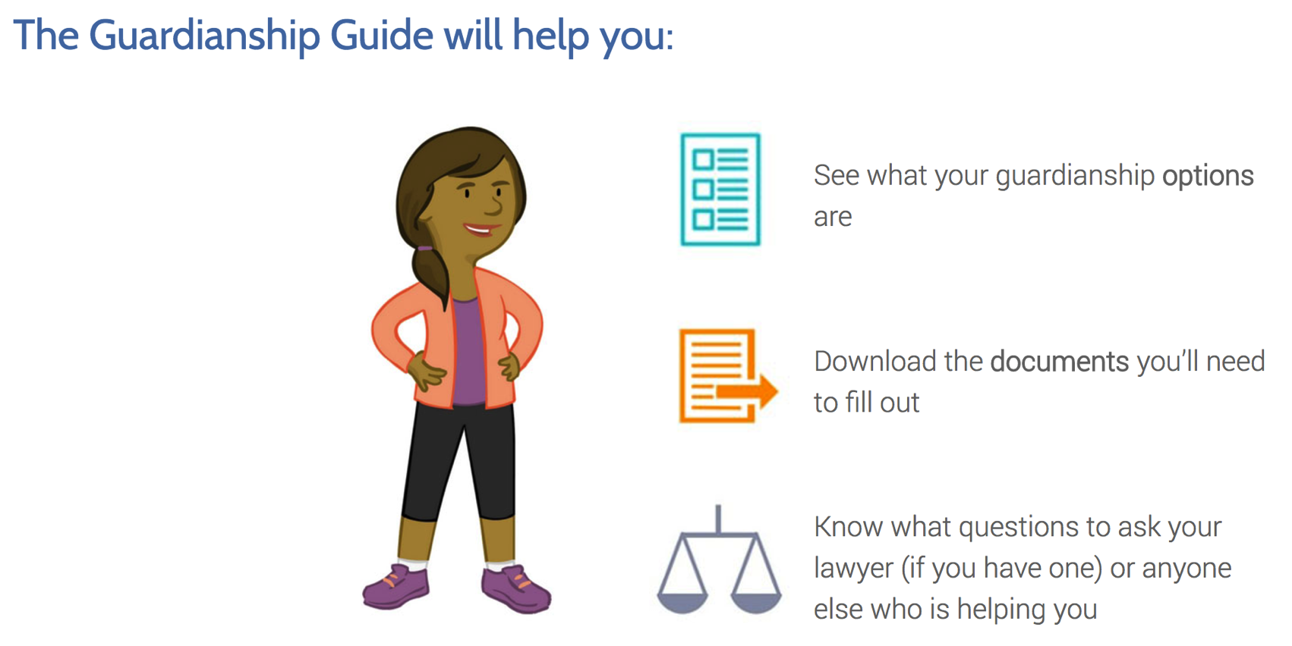
A Closer Look: Guardianship Guide
© 2017 Exceptional Lives, Inc.

Slide 24
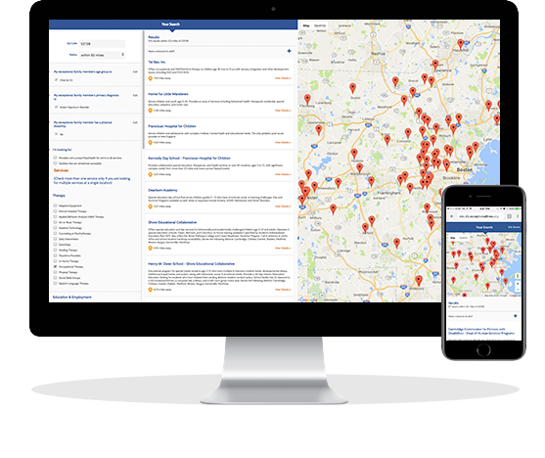
Curated Resource Directory
User-friendly Directory parents & professionals can search by zip, age, disability, service type, accepts Medicaid, wheelchair-accessibility
  Simple to search & navigate from any device
  Visual mapping & directions
  Plain language descriptions
  Launching in Massachusetts April 2017, Louisiana July 2017
© 2017 Exceptional Lives, Inc.

Slide 25
Group Activity
Explore the site and think about these questions
1. Using these resources in your community
  What’s the need in your setting?
  How could this be useful to your audience?
  What organizations could you partner with to help families find and use this?
2. Using this platform as a model for your own resources
  What have you seen here that can help you to improve your own materials?
  How might the features highlighted here help as you develop and disseminate your own resources?
3. How can we make this better? (we’d love your input!)
© 2017 Exceptional Lives, Inc.

Slide 26
Data and Analytics: Beyond Evaluation
We use analytics in our software and user surveys embedded in our guides and resource directory to do more than evaluate our product.
  What we capture:
    How many visitors to each guide
    Level of user satisfaction with their experience
    How well guides help users take action
  How we use data to improve:
    Identify gaps in filling resource needs
    Identify potential guide topics to address areas of need
We hope to share this data with policymakers to influence resource allocation.
© 2017 Exceptional Lives, Inc.
Notes:
Anne, can you give an example of how this helped us to fill gaps?

Slide 27
Our Impact
Tens of thousands of families helped
33,700
1 in 5
Parents, professionals, and persons with disabilities have used one or more free Guides at www.exceptionallives.org since Nov. 2015
>50%
Website visitors choose to access a Guide
of Guide users took action as a result of using the Guide
Users love the experience
90% would recommend
90% of parents (and 95% of disability professionals) say they would recommend our Guides to another parent or caregiver
½
Average user rating
© 2017 Exceptional Lives, Inc.
Notes:
Any other stats we should include?

Slide 28
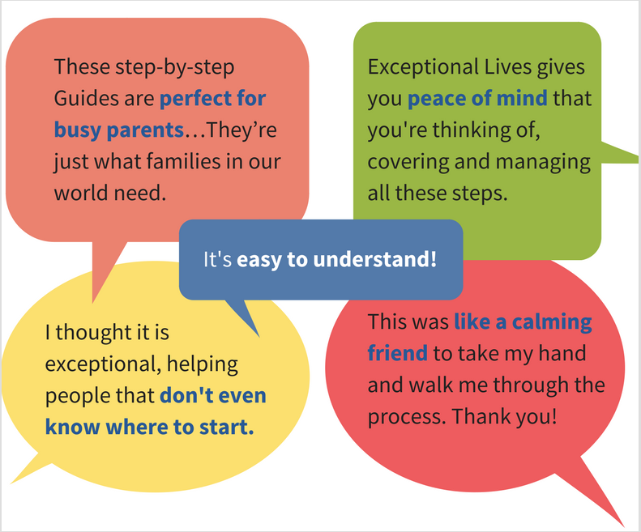
Parent Testimonials
© 2017 Exceptional Lives, Inc.
Notes:
I can’t get rid of the line around this box. -RM

Slide 29
Thank You!
Julie McKinney
julie.mckinney@exceptionallives.org
Anne Punzak Marcus
anne.punzakmarcus@exceptionallives.org

Slide 30
References
Centers for Disease Control and Prevention (2015). Prevalence of Disability and Disability Type Among Adults — United States, 2013. Available at https://www.cdc.gov/mmwr/preview/mmwrhtml/mm6429a2.htm?s_cid=mm6429a2_w
Children’s Defense Fund (2003). Children with Disabilities and Other Special Needs: Opportunities Must Be Expanded. Available at http://www.childrensdefense.org/library/data/children-disabilities-special-needs-opportunities-participate-quality-programs-expanded.pdf.
Kuhlthau, K., Hill, K.S., Yucel, R. et al. Financial Burden for Families of Children with Special Health Care Needs. Matern Child Health J (2005) 9: 207. doi:10.1007/s10995-005-4870-x.
Porterfield, S. & McBridge, T. The Effect of Poverty and Caregiver Education on Perceived Need and Access to Health Services Among Children with Special Health Care Needs. Am J Public Health (2007) 97(2):323-329.
Timberlake, M., Leutz, W., Warfield, M., & Chiri, G. (2014). “In the driver's seat’: Parent perceptions of choice in a participant-directed Medicaid waiver program for young children with autism. Journal of Autism & Developmental Disorders, 44(4), 903–914. http://doi.org/10.1007/s10803-013-1942-4

