Slide 1




Cancer Clear & Simple: A Health Literate, Community-Driven Cancer Education Program
Wisconsin Health Literacy Summit
April 4th – 5th, 2017
Madison, Wisconsin

Slide 2
Introductions
Cody Fredrick, MPH
Community Health Educator and Rural Project Coordinator
Cancer Health Disparities Initiative
UW Carbone Cancer Center
Mary Ann Schilling, M.Ed.
Family Living Educator, Associate Professor
UW-Extension, Waushara County
We have no relevant financial interests
Notes:
Please feel free to jump in with any questions. I’m hoping to have some time at the end as well

Slide 3
Learning Objectives
Understand how Cancer Clear & Simple (CC&S) was adapted to enhance education using a participatory approach founded on health literacy principles
Verbalize how interactive activities compliment health literate materials to create a supportive learning environment, breaking the silence that can surround cancer and limit community awareness and support
Describe how a community driven, health literate, cancer education program can serve as a springboard for statewide dissemination and community-based participatory research

Slide 4
What is Cancer Clear & Simple (CC&S)?

Slide 5
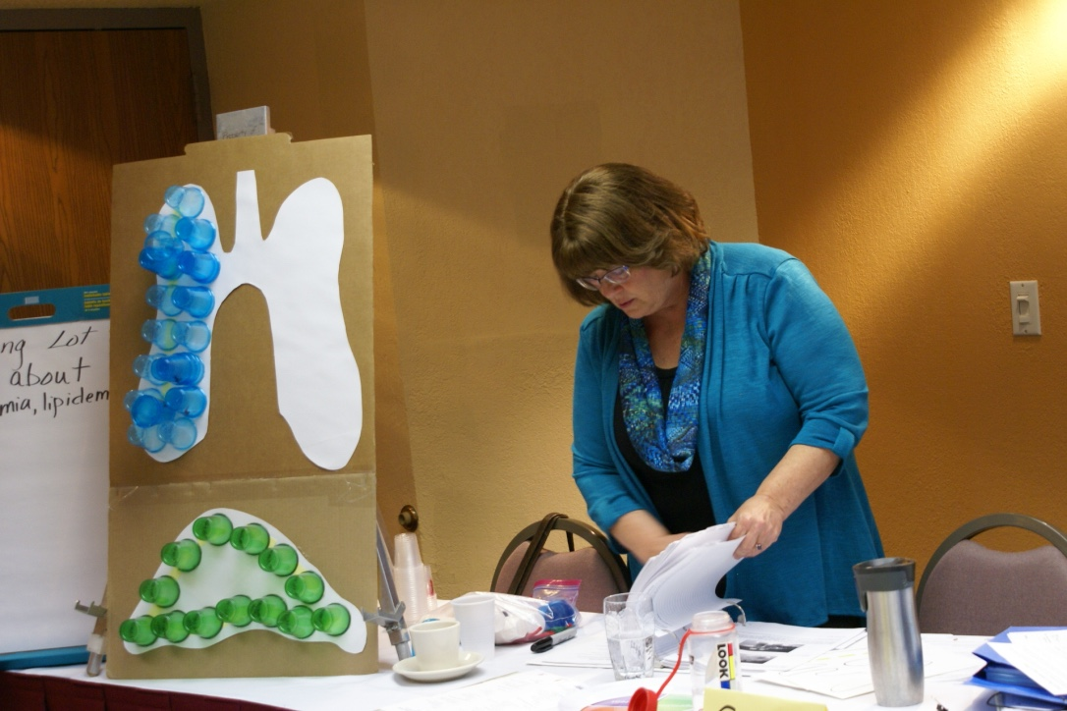
What is CC&S?
Set of educational materials adapted in Wisconsin for a rural audience
Three related but distinct topics
Facilitators use a learner-centered approach
Define cancer and identify information to improve health
Interactive activities to apply information
Notes:
Cancer, Clear & Simple (CC&S) is a set of educational materials about cancer. CC&S includes a curriculum, Facilitator Guide and educational handouts. All CC&S materials incorporate health literacy principles and are designed to build knowledge and improve health-related decision-making. CC&S was originally developed for use in rural communities. CC&S has also been adapted for use with other populations and is currently available for both Rural, African American, and Latino populations.

Slide 6
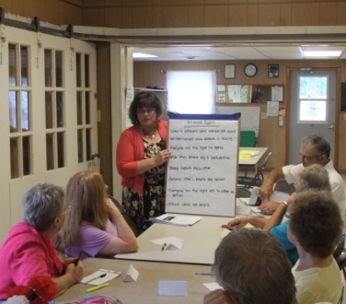
History of Cancer Clear & Simple
2010 NCI Pilot Project
  Select an evidence-based cancer education resource
  Adapt cancer education
  Test adapted resource
  Develop a plan for implementing new resource
Notes:
CHDI and Rebecca Linskens were awarded an NCI pilot.

Slide 7
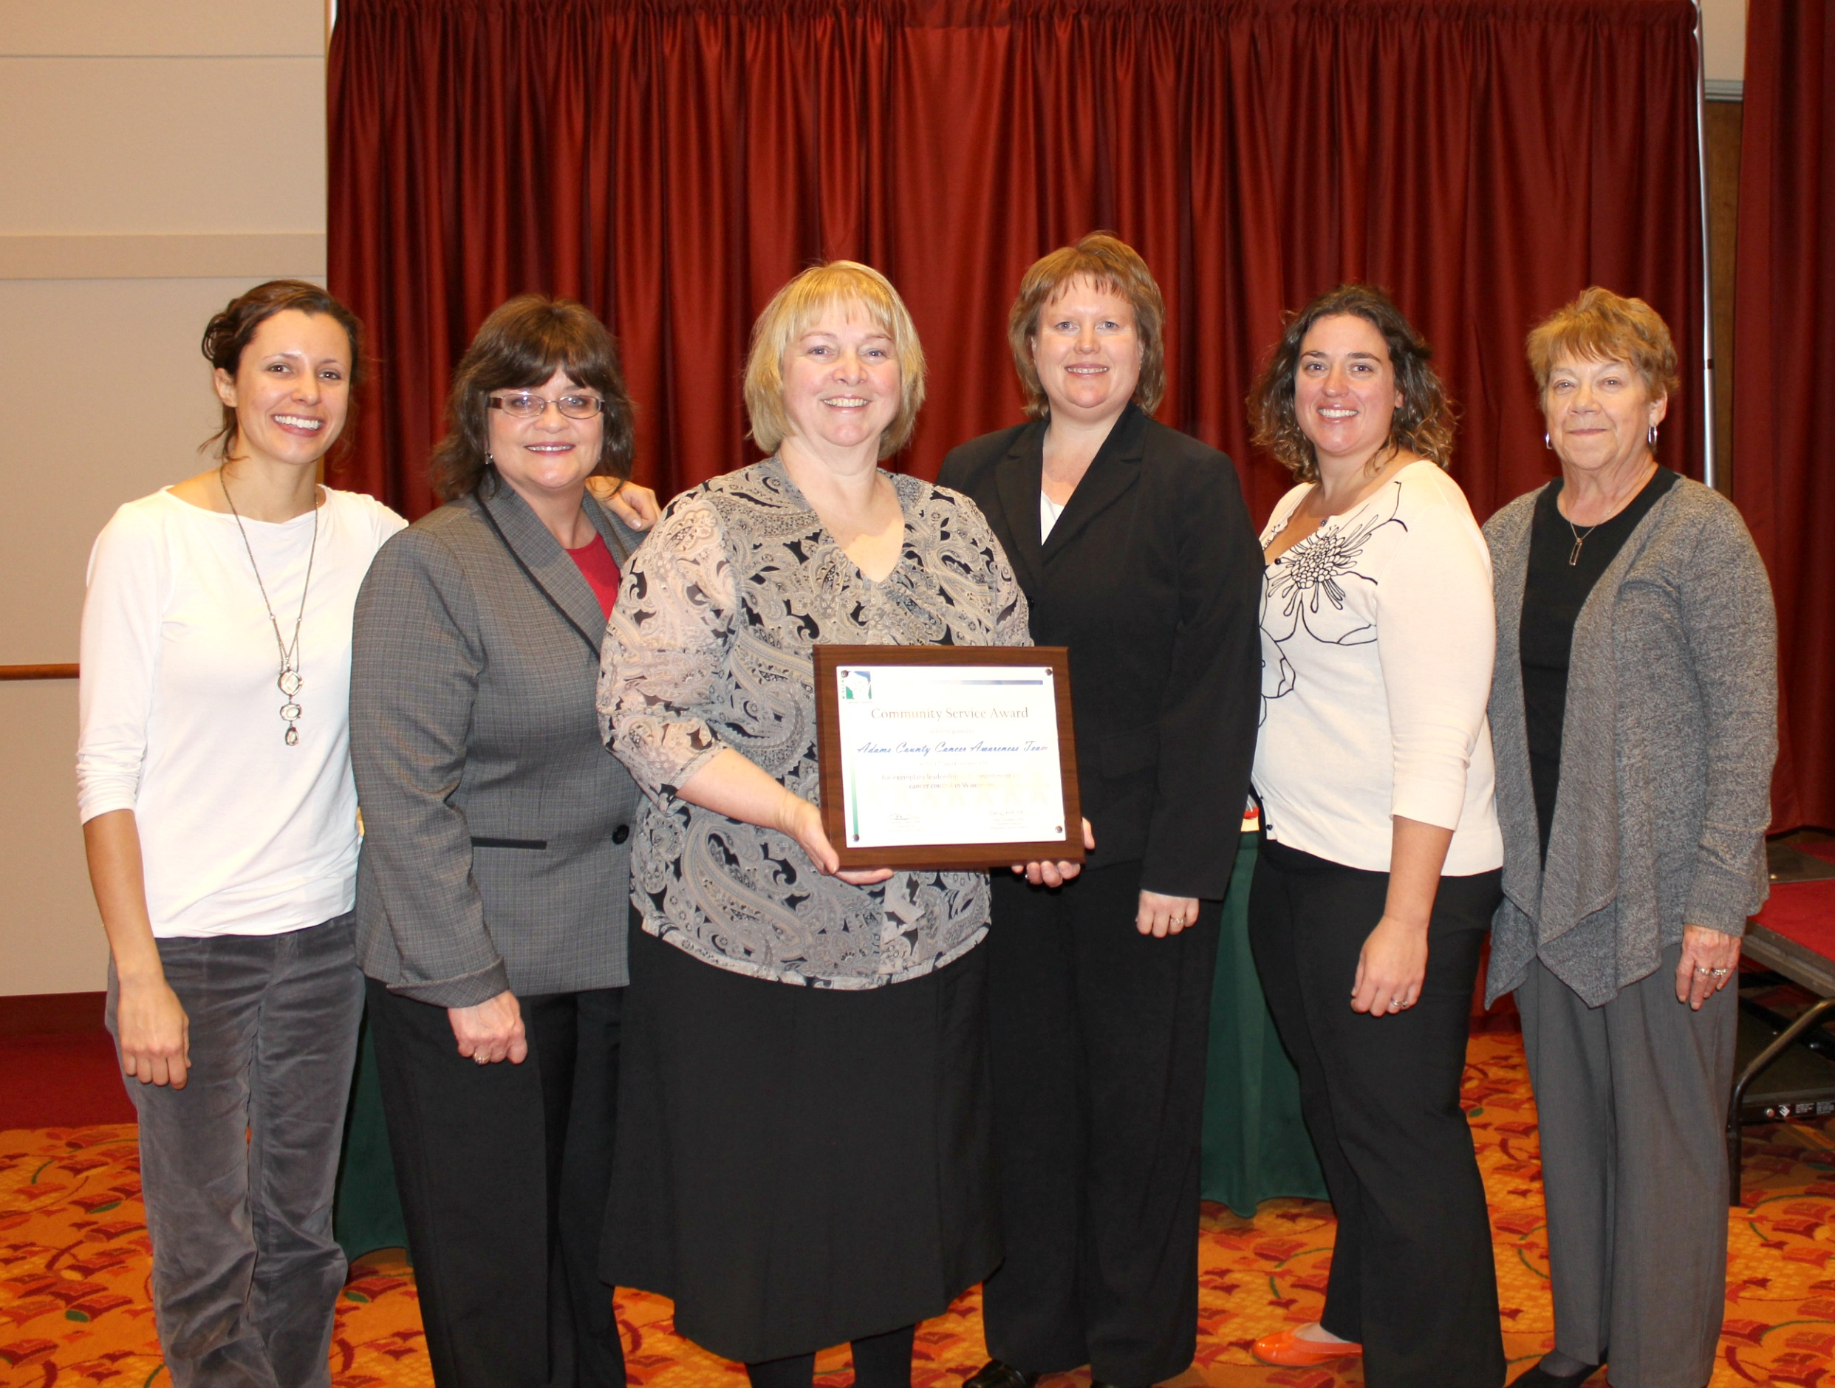
History of Cancer Clear & Simple
Becca conducted a need assessment in 16 county region
Adams County was identified
Understanding Cancer was selected
Focus groups, interviews and preliminary sessions done to adapt education
Implementation plan was developed
  ACCAT was born

Slide 8
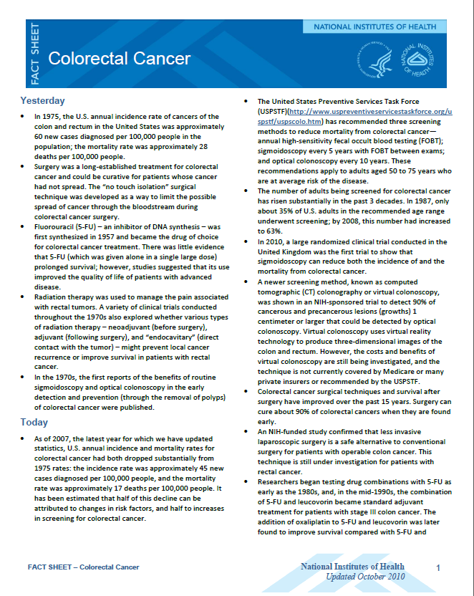
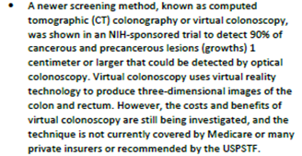
Existing Handouts
Notes:
Difficult language, complex messages, dense text
This one about Virtual Colonoscopy

Slide 9
How can we make this more health literate?
Notes:
Difficult language, complex messages, dense text
This one about Virtual Colonoscopy

Slide 10
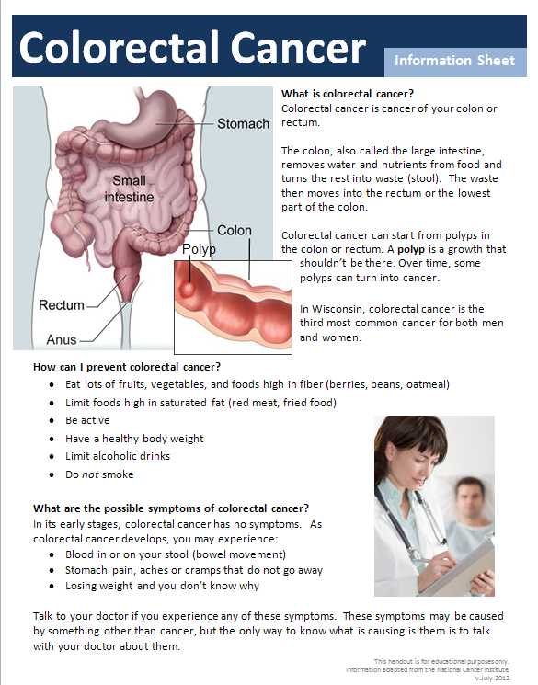
Our Example
Notes:
Created our handouts using strategies reflecting
Simple Language (reading level 8th grade)
Relevant Content – Understood and applicable to Real Life of the Audience
Graphics
Organization and White Space
This has resulted in materials which have
Simple messages
Easy to do tips
Promote action

Slide 11
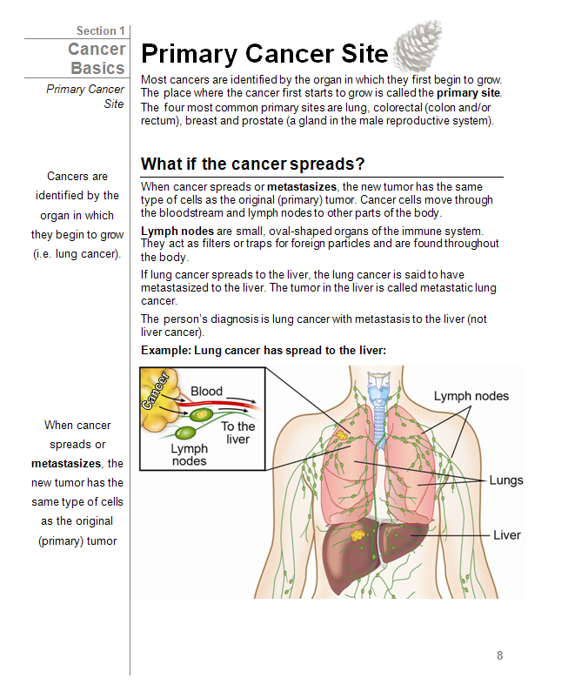
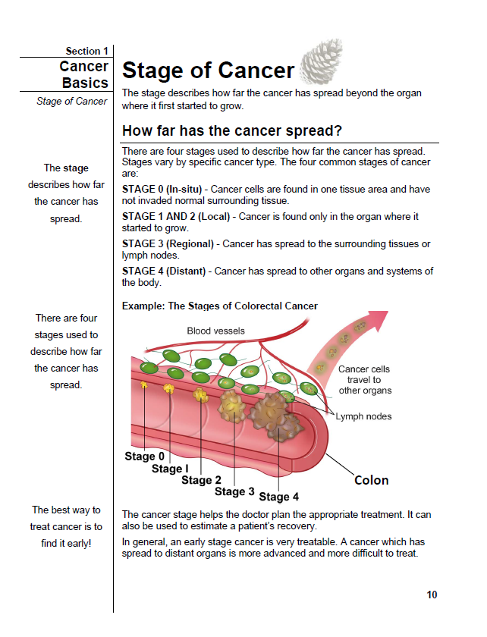
Notes:
Use pictures and visuals. Simple images. Text directly relates to images. (Story of cancer survivors not understanding the concept of staging until attending a session). Topics are understandable. Try to take away the “big C word”

Slide 12
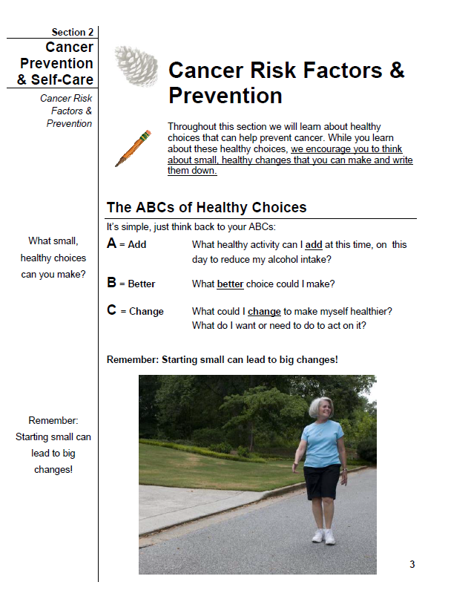
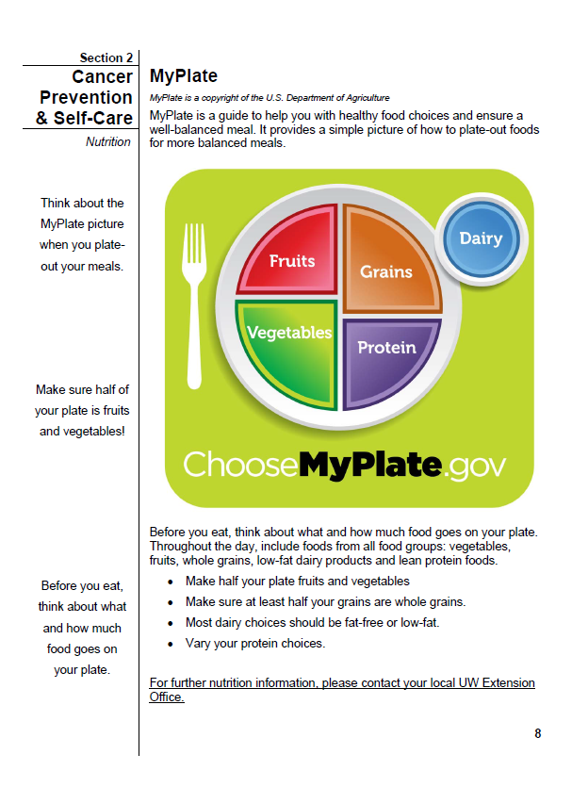
Notes:
ABC method to promote behavior change. Provide tools for individuals to own health improvements and incorporate into their lifestyle.

Slide 13
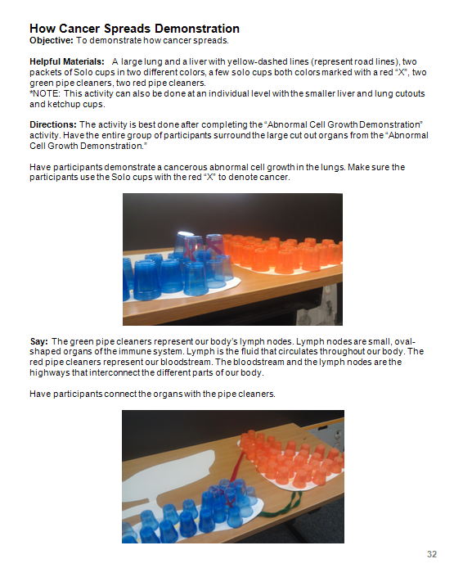
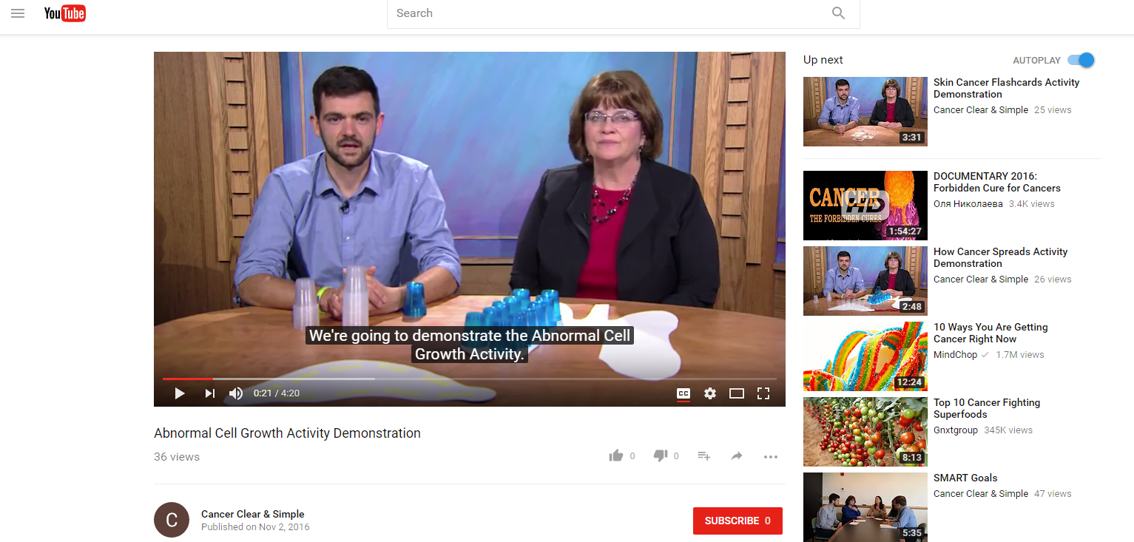
Notes:
Interactive demonstrations. Encourage participation and use teach-back methods to promote learning.

Slide 14
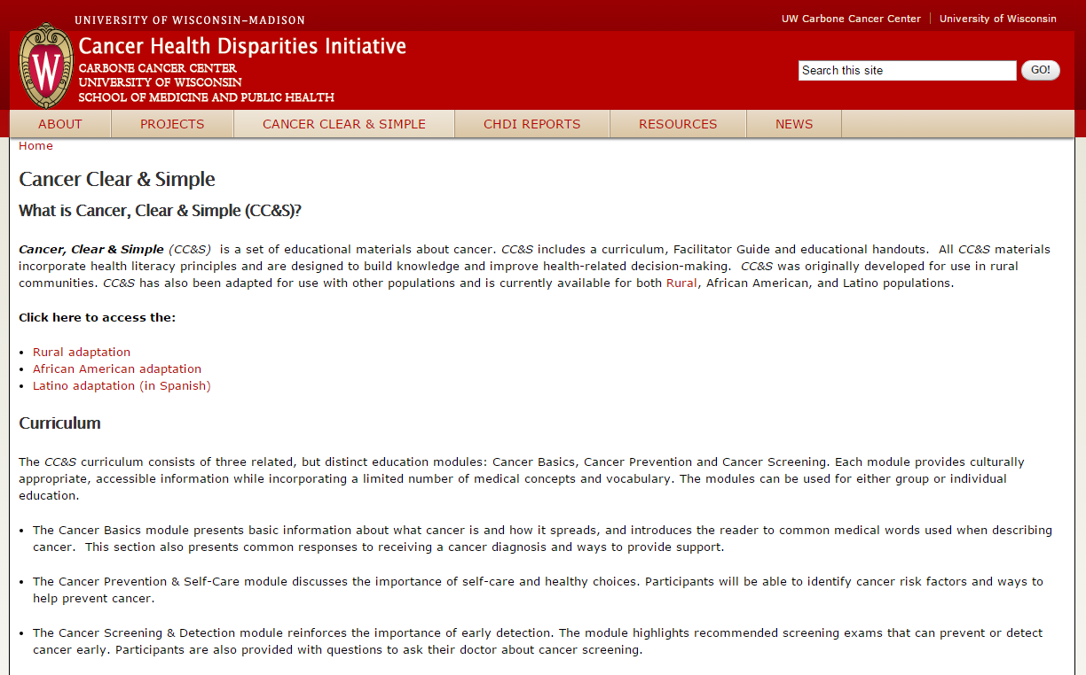
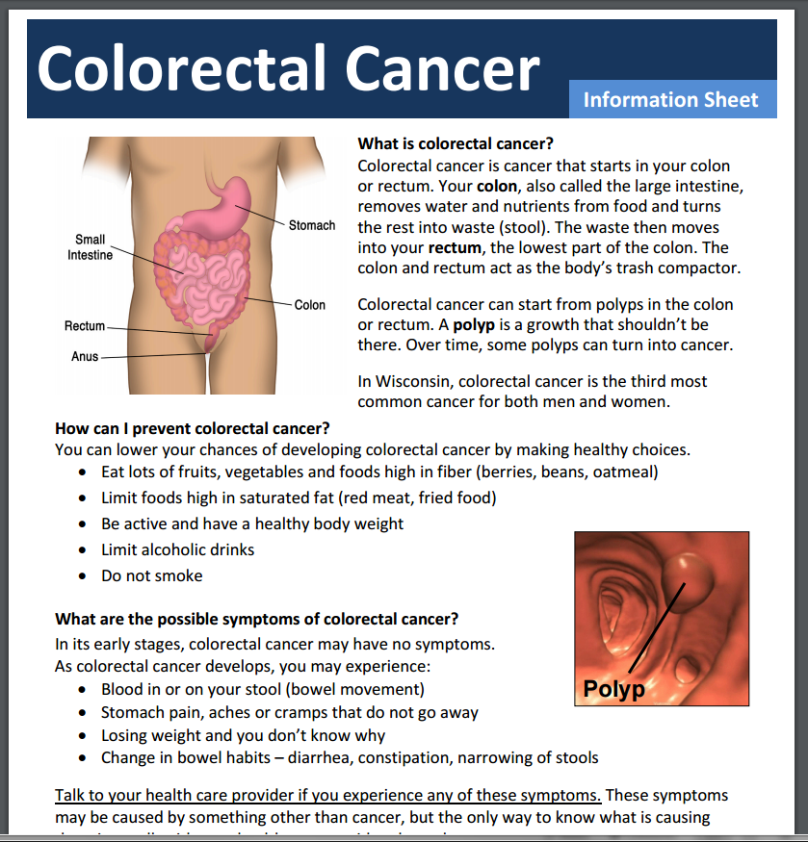
Cancer Clear & Simple
3 module curriculum
http://chdi.wisc.edu/cancer-clear-simple
45+ topical handouts
  Information sheets
  Questions to ask your doctor
  Healthy tips & ideas
Notes:
(if time, why CRC here)

Slide 15
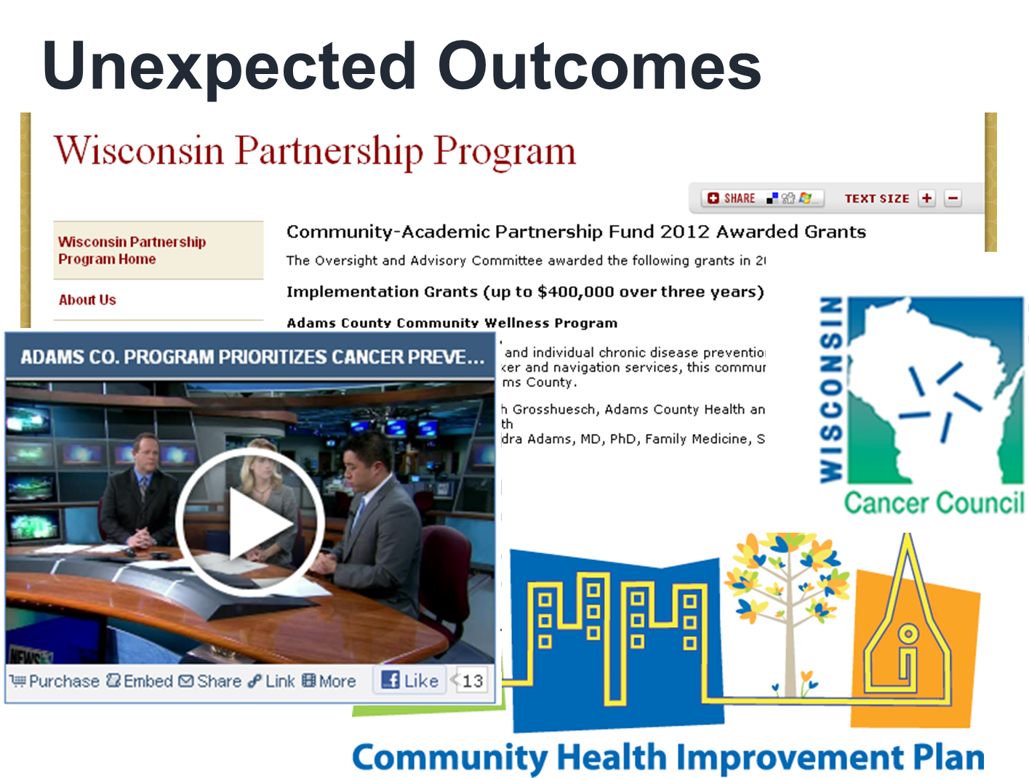
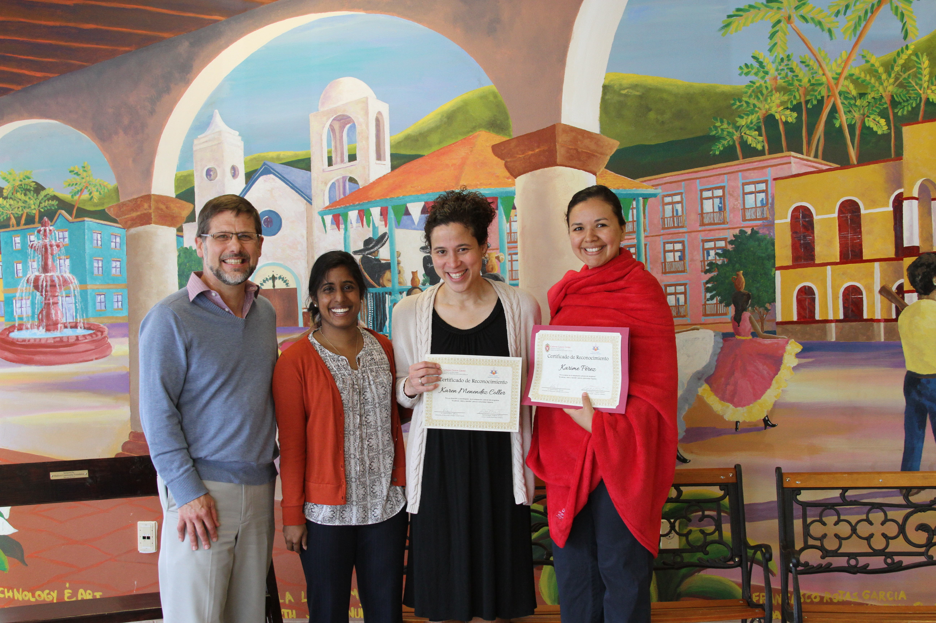
Since CC&S was developed
Implemented CC&S in 3 additional counties
  Over 14 facilitators trained
  New expansion statewide
Over 10,000 rural residents reached
Continued support from NCI
African American adaptation
Newly released Latino adaptation
Multiple research projects

Slide 16
What do participants experience during educational sessions?

Slide 17
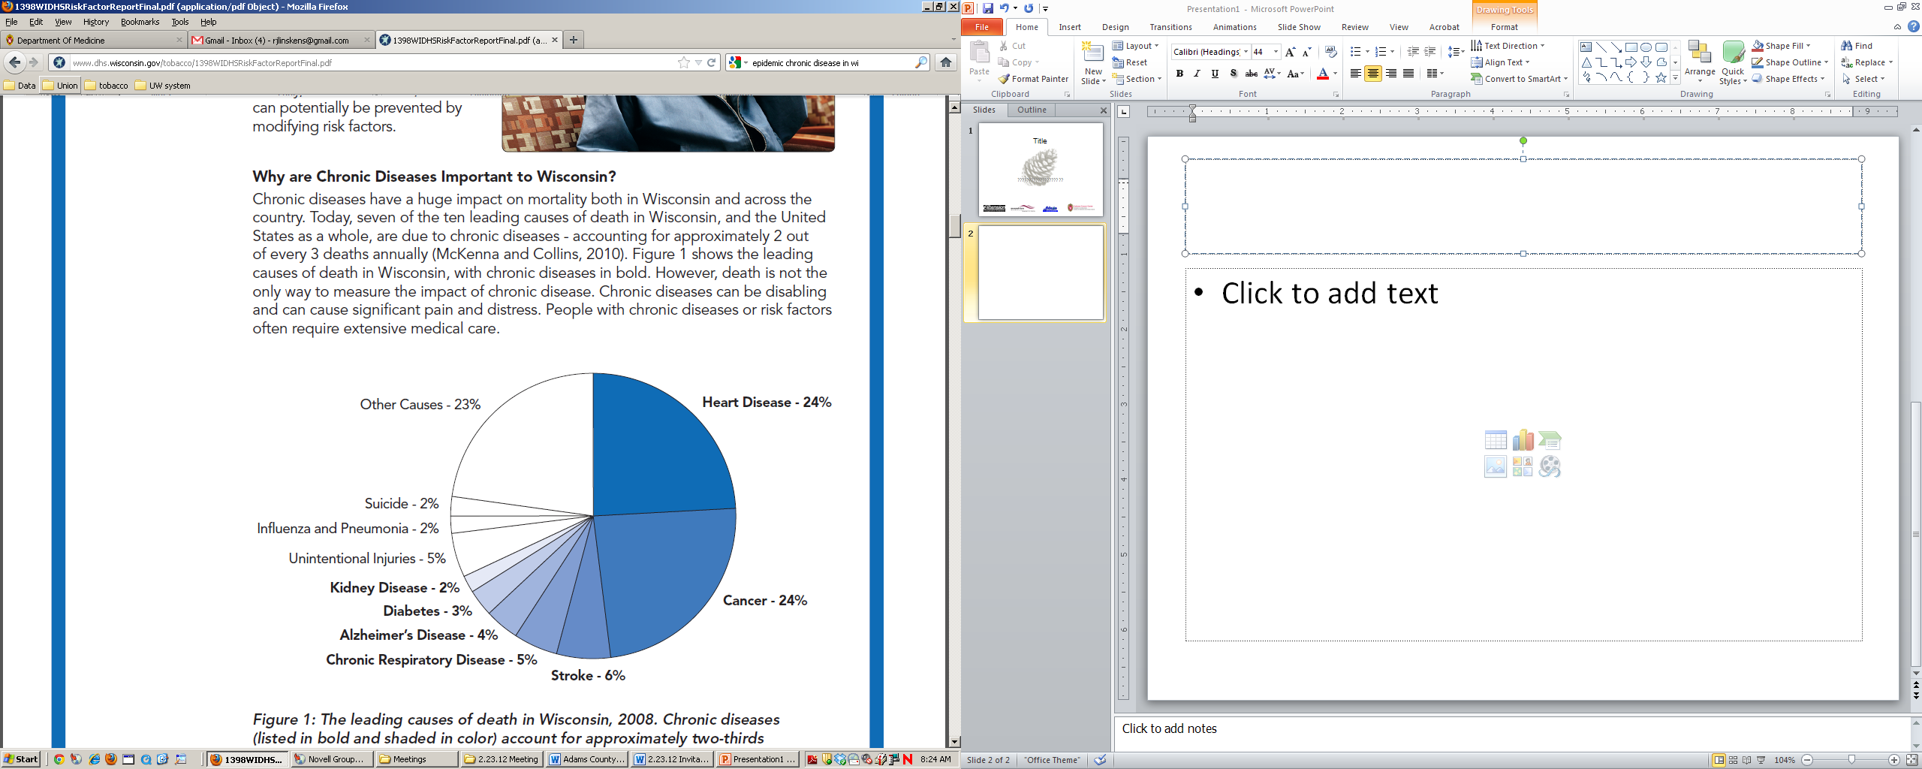
Why Cancer Education is Needed
Cancer is a leading cause of death in Wisconsin
Wisconsin Department of Health Services, 2011
Notes:
Concepts in CC&S have a positive effect on all of the ailments in bold.

Slide 18
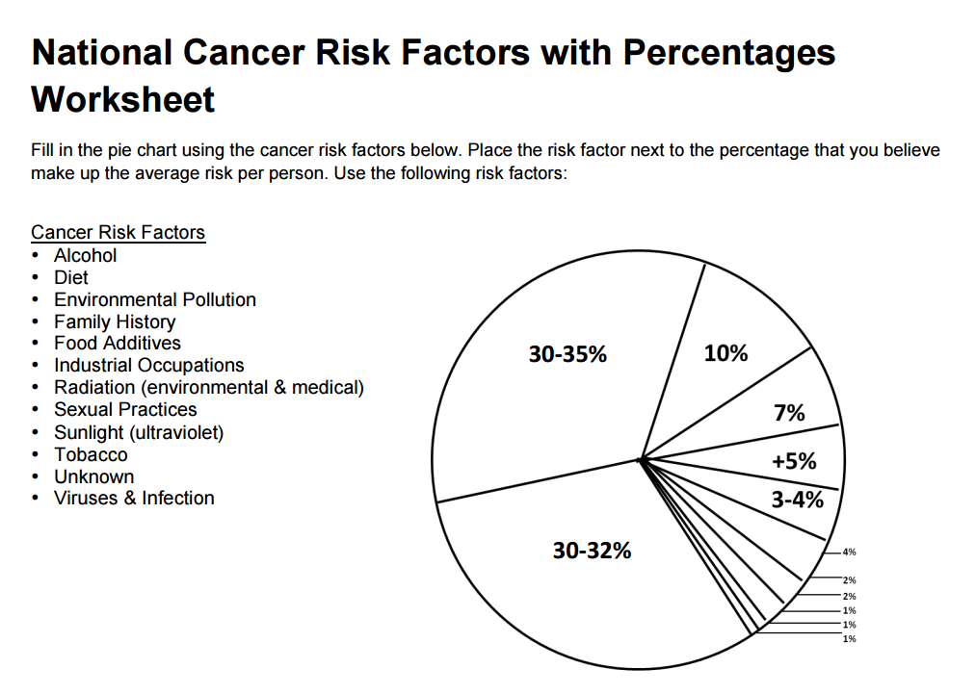

Slide 20
Key Concepts within CC&S
Participant driven and interactive
Tools to empower and encourage behavior change
Health improvement effects much more than cancer
Notes:
Our behaviors have an effect on roughly 60% of cancer risk! (Chart disclaimer) (how CC&S addressed these risk factors)

Slide 21
Key Concepts within CC&S
Supportive learning environment
Develop comfort with “cancer”
Continued community focus and involvement
Notes:
Our behaviors have an effect on roughly 60% of cancer risk! (Chart disclaimer) (how CC&S addressed these risk factors)

Slide 22
How is CC&S currently being used?
Notes:
Glimpse into CC&S basics session to see how CC&S works and why it goes beyond cancer

Slide 23
Reducing Rural Cancer Disparities Together
Douglas
Bayfield
Iron
  Funded by USDA
  Partnership with UW Extension
  Statewide expansion of CC&S
  Coalition coaching to select counties to shape policy, systems and environmental change
  Strengthen CC&S evaluation components
Ashland
Vilas
Burnett
Washburn
Sawyer
Florence
Price
Oneida
Forest
Marinette
Polk
Barron
Rusk
Lincoln
Langlade
Taylor
St. Croix
Chippewa
Menominee
Dunn
Marathon
Oconto
Pierce
Eau Claire
Clark
Shawano
Door
Pepin
Wood
Portage
Waupaca
Outagamie
Brown
Kewaunee
Buffalo
Jackson
Trempealeau
Waushara
Calumet
La
Crosse
Adams
Winnebago
Manitowoc
Monroe
Green
Lake
Juneau
Marquette
Fond du Lac
Sheboygan
Vernon
Richland
Sauk
Columbia
Dodge
Washington
Crawford
Ozaukee
Iowa
Dane
Jefferson
Waukesha
Milwaukee
Grant
Lafayette
Green
Rock
Walworth
Racine
Kenosha
Notes:
3 goals

Slide 24
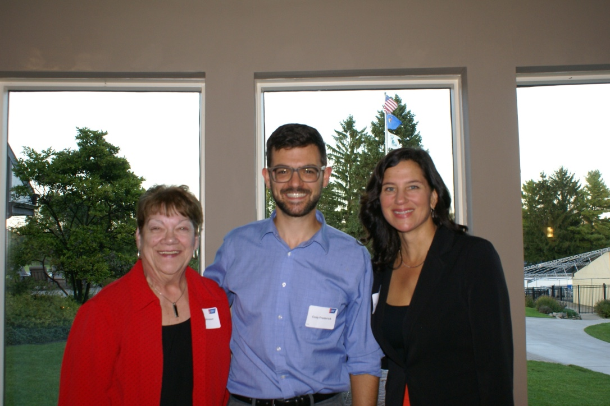
Adams County Research Pilot Project
Funded by the American Cancer Society (ACS)
Modify CC&S to reach broader audience
Evaluate participant likelihood to pursue cancer screening
Continued work with ACCAT and new partners (ACEC)
Notes:
2 aims of the project Thus far audience reached is mostly retired women. This aims to change that.

Slide 25
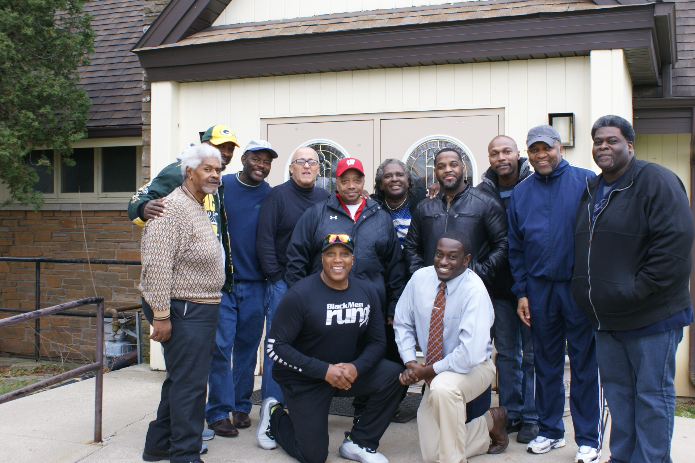
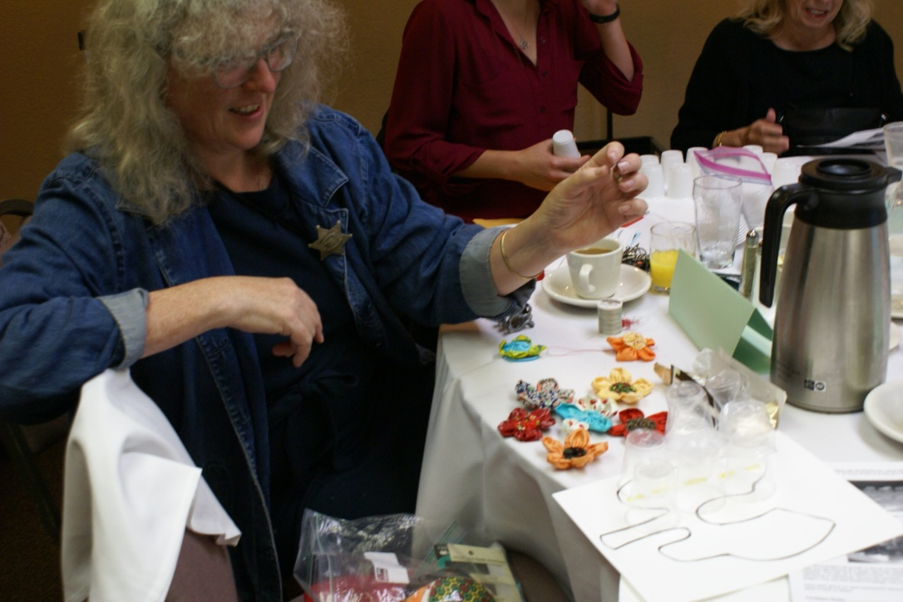
Community Focus
Local facilitators trained
Partnership with UW Extension
Community driven boards and project ownership
Notes:
Train-the-trainer method. (Examples of USDA, Juneau County?)

Slide 26
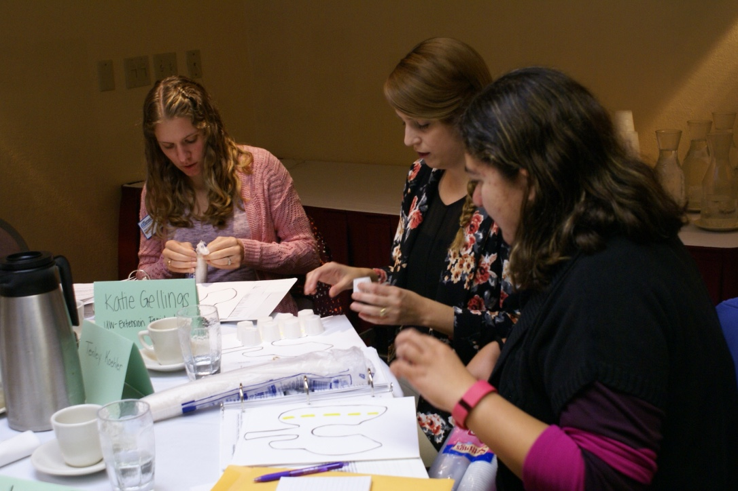
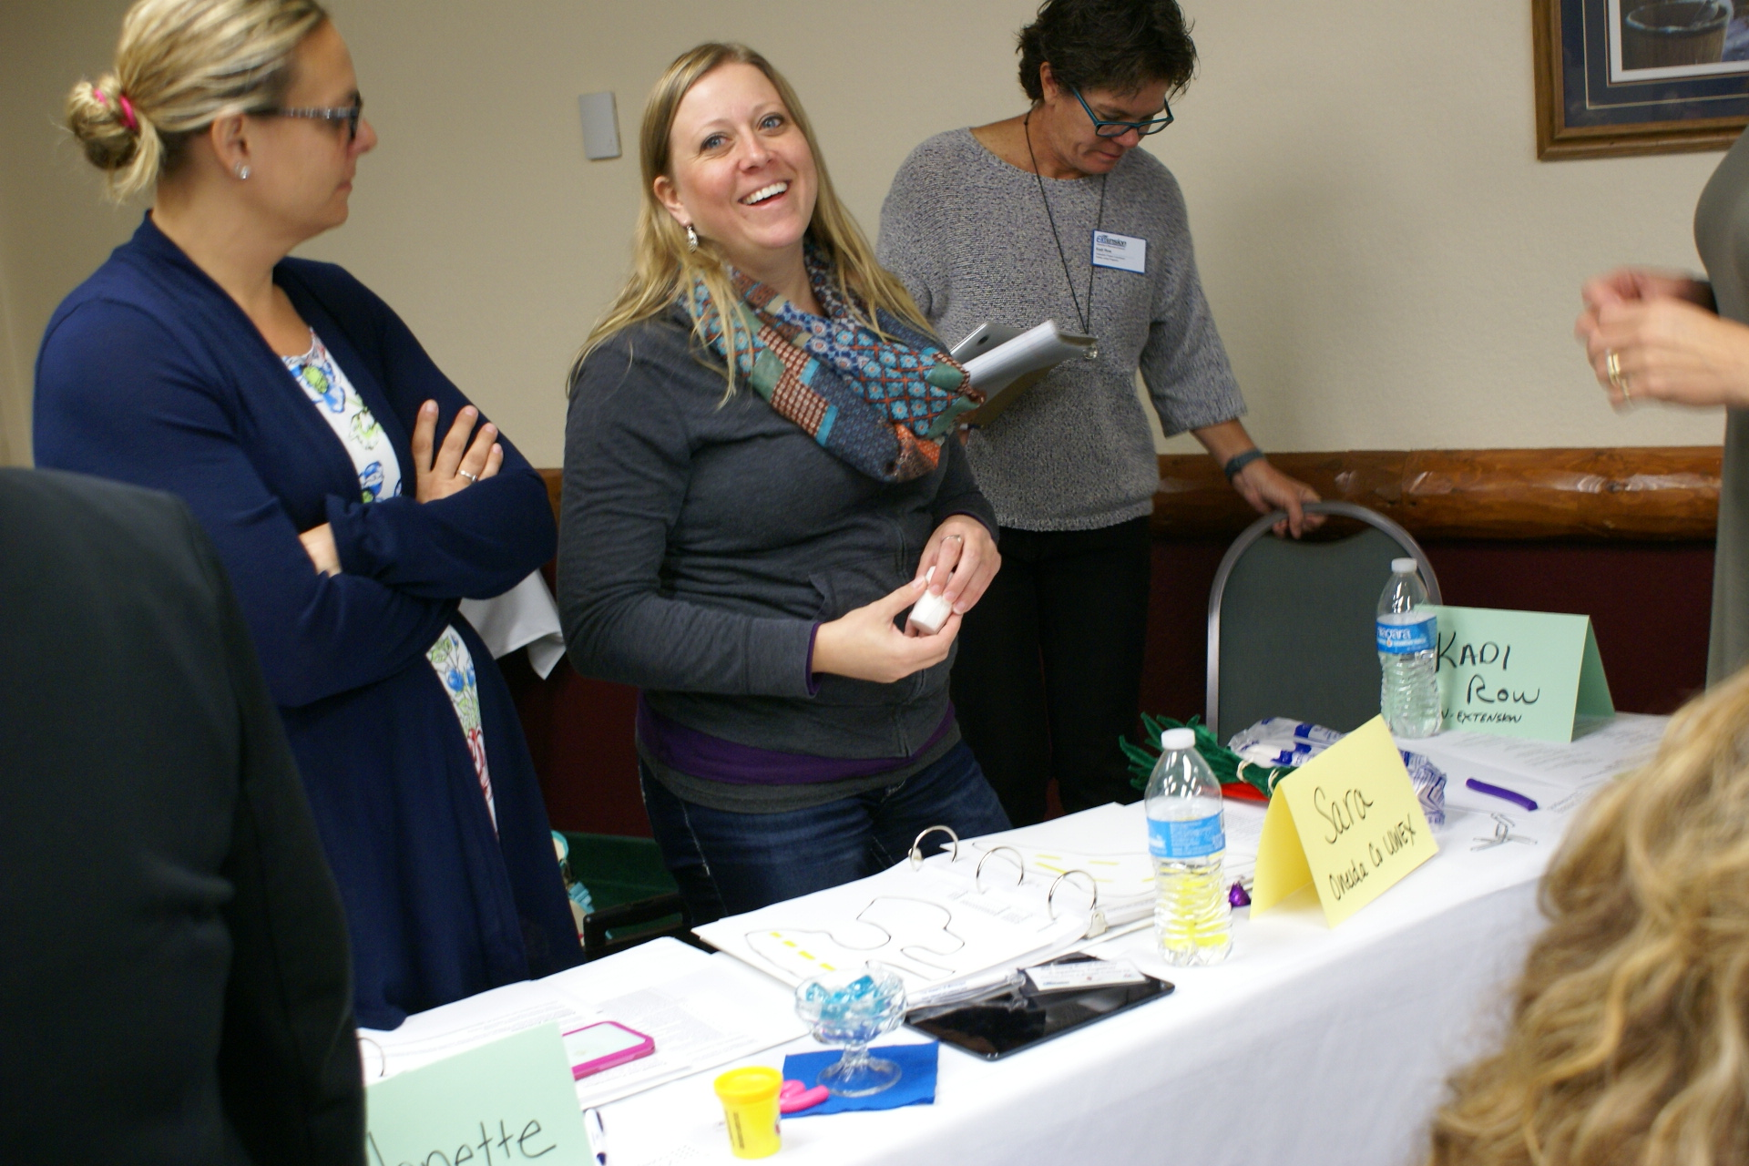
Summary
CC&S was developed with community engagement and cultural tailoring
Has served as a platform for expansion and research
Continued efforts to promote health literacy, cancer awareness, and community support
Notes:
Train-the-trainer method. (Examples of USDA, Juneau County?)

Slide 27
Thank you!
Questions?

