Slide 1

Moving from Education to Engagement – Using Hands on Activities to Assess and Build People’s Knowledge, Attitudes, Beliefs and Values about Health
Susan Reid
Health Literacy NZ
sreid@healthliteracy.co.nz

Slide 2

Learning outcomes
Participants will be able to
Situate health education within adult learning principles and schema theory
Learn how to use hands on activities with patients and families
Develop a hands on activity for their context
I have no relevant financial interest
Financial statement

Slide 3
Dr Lisa Elsinger 2015 presentation
Learning is a complex process, strongly influenced by environment & prior experience
We can help people become more self-directed as learners and have a greater sense of self-efficacy
Include opportunities for people to
  Increase their self-knowledge
  Define what well-being means to them (as individuals)
  Understand where their own thinking & beliefs inhibited their learning or accomplishment
  Determine when and how their environment is affecting their actions & thoughts
And when their actions & thoughts are affecting their environment
  Improve their health and sense of well-being through small successes and incremental progress
People are “creatures of habit” - schemas – actions - habits - self-efficacy -self-direction

Slide 4
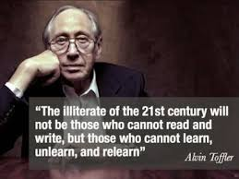


Slide 5
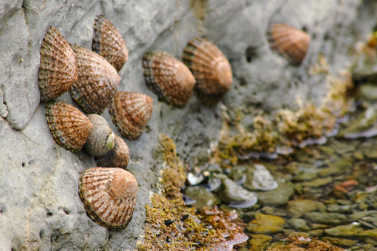
Analogies - limpets and cholesterol

Slide 6
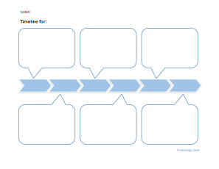
Timelines

Slide 7
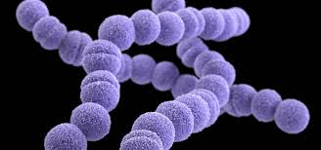
Group A Strep bacteria

Slide 8
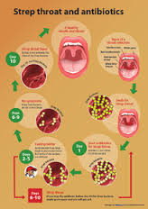

Antibiotic adherence

Slide 9
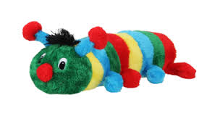
Group A Strep A bacteria and caterpillars

Slide 10
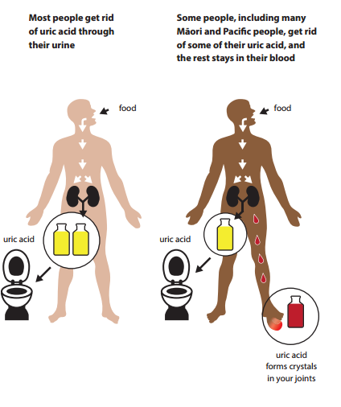

Gout and uric acid

Slide 11
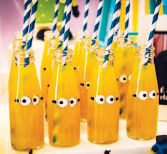
Gout bottles

Slide 12
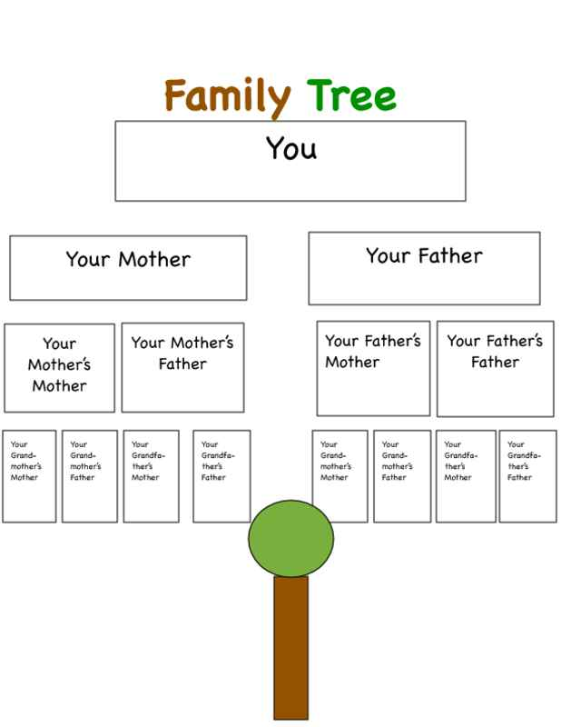
Family trees

Slide 13
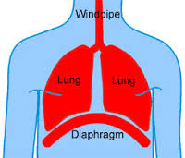
Asthma - pump my lungs

