Slide 1
UW-Extension and WI Literacy Organization : Working Together for Digital Equity
February 24, 2022
Gail Huycke, Professor
Christopher Stark, Associate Professor
Community Development Institute
Division of Extension
University of Wisconsin-Madison

Slide 2
UW-Extension and WI Literacy Organization: Working Together for Digital Equity
The 3A’s of Broadband: Access, Affordability and Adoption
Of these 3 A’s the majority of our time to date has been focused on: Access
Spending more time on Affordability and Adoption

Slide 3
What do we mean by Access?
High-speed internet access
Infrastructure deployment:
Cable
Fiber optic*
Wireless
Satellite
DSL
FCC defines high speed broadband as 25 Mbps down and 3 Mbps up
But emphasis is now on 100 Mbps/100 Mbpsx

Slide 4
What do we mean by Affordability?
At what price can low to moderate income people afford internet service? What is Sustainable?
The non-profit Everyone On has surveyed LMI households (only households under $50K per year were surveyed:
40% cannot afford to pay anything for internet
22% can pay $25 per month
38% can pay in the range of $55-$70 per month

Slide 5
Affordable Connectivity Program
Am I eligible?
You can get ACP if your income is 200% or less than the Federal Poverty Guidelines. The guideline is based on your household size and state.
https://acpbenefit.org/do-i-qualify/
(Formerly the Emergency Broadband Benefit, now ACP ($14 billion))

Slide 6
Affordable Connectivity Program
“The benefit provides a discount of up to $30 per month toward internet service for eligible households and up to $75 per month for households on qualifying Tribal lands – if the provider participates.
Eligible households can receive a one-time discount of up to $100 to purchase a laptop, desktop computer, or tablet from participating providers if they contribute more than $10 and less than $50 toward the purchase price.”
https://acpbenefit.org/

Slide 7
Adoption
Broadband adoption is daily access to the Internet:
at speeds, quality and capacity necessary to accomplish common tasks,
with the digital skills necessary to participate online, and
on a personal device and secure convenient network.
Source: National Digital Inclusion Alliance

Slide 8
Barriers to Broadband Adoption
No Access or limited reliability
Costs
Lack of digital devices
Lack of digital skills to use those digital devices
Fear of unknown and cyber security concerns
Lack of desire to learn or utilize the internet
This list is not comprehensive

Slide 9
Motivational Factors to Learn Digital Skills
Staying connected to friends and family
Ability to remain independent
Employment
Access to health care
Apply for benefits – unemployment, veteran’s, etc.
Online shopping
Education
Banking
Entertainment – Netflix, online articles, games, research, planning vacation

Slide 10
How Specifically Can Wisconsin Literacy and UW-Extension Best Partner to Develop Digital Literacy?
Help people develop partnerships
Identify curriculum to teach digital skills
Help identify tutors
Teach digital skills
Identify resources (for facilities, equipment, etc.)

Slide 11
Potential Partners in YOUR Community
Where is the greatest need in your community?
Who do clients already have trust relationships with?
Who else would benefit in your community from working on this issue?
Look for the win-win relationships?
Who gains customers?
Who gains workers?
Who gains support?

Slide 12
Trusted Partners in YOUR Community
Libraries - #1 most trusted
Economic/workforce development groups
Churches
Schools
Senior Centers
Health care providers
Housing centers
Financial Institutions
Internet service providers
Businesses

Slide 13
Potential Regional Partners
Economic development organizations
Department of Public Instruction
Department of Workforce Development
Foundations
Non-profits (Digital Bridge, Everyone On, etc. Wisconsin Mujer)
Wisconsin Hospital Association
WSTA – Wisconsin State Telecommunications Association

Slide 14
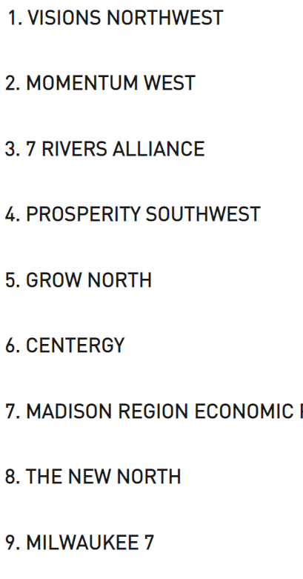
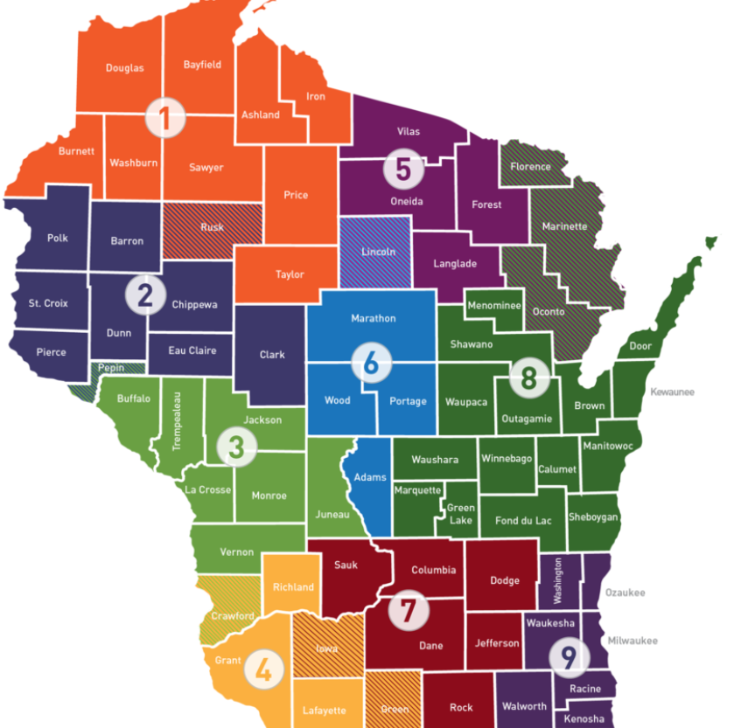
Regional Economic Development Organizations

Slide 15
Governor’s Task Force on Broadband
“Advise the Governor and Wisconsin State Legislature on broadband actions and policy, including strategies for successfully expanding high speed internet access to every residence, business and institution in the state: initiatives for digital inclusion; and pathways to unlocking and optimizing the benefits of statewide, affordable access to all communities in Wisconsin” https://psc.wi.gov/Documents/broadband/2021%20Governors%20Task%20Force%20on%20Broadband%20Access.pdf

Slide 16
Governor’s Task Force Recommendations
Access
Hybrid models, increased permitting coordination, increased funding, increased data collection
Affordability
Increase consumer protections, establish Internet Assistance Program,
Adoption
Establish Statewide digital equity fund (nonprofit operated), develop and fund digital navigator program, understand reason for none adoption

Slide 17
Governor’s Task Force 2022 Emphasis
Active Network Building and Community Alignment
Local –communities, counties, anchor institutions, business, organization, internet providers, end users
Regional – economic development, anchor institutions, Internet Providers, Organizations, etc.
Statewide – State Agencies, State Associations, Philanthropic Foundations, etc.

Slide 18
Wisconsin Digital Equity and Inclusion Stakeholder's Group
The Wisconsin Digital Equity and Inclusion Stakeholder Group’s purpose is to grow and strengthen the digital inclusion ecosystem in Wisconsin and develop and inform Wisconsin’s Digital Equity and Inclusion Plan
A Digital Inclusion Ecosystem is a combination of programs and policies that meet a geographic community’s unique and diverse needs. Coordinating entities work together in an ecosystem to address all aspects of the digital divide, including affordable broadband, devices, and skills

Slide 19
Digital Literacy Curriculum
Need to be flexible
Content is based on audience – menu of things to choose from
Need a “hook” to attract the audience. Signing up for the ACP?
Keep formal sessions short with limited concepts

Slide 20
Tutors and Teaching
Tutors can come from a variety of sources
Lessons need to be short
Hands on experience is essential
Individualized training and practice is essential
Participants benefit from written support materials (cheat sheets)
Homework supports lessons learned
Participants need an avenue for additional support

Slide 21
Additional Resources and Questions
Gail Huycke, Professor
gail.huycke@wisc.edu
Community Development Institute
Division of Extension
University of Wisconsin-Madison
Christopher Stark, Associate Professor
christopher.stark@wisc.edu
Community Development Institute
Division of Extension
University of Wisconsin-Madison

Slide 22
Community Development Institute
Division of Extension
University of Wisconsin-Madison

Slide 23
Today’s meeting was made possible by a grant from the
United States Department of Commerce Economic Development Administration
in support of the
Economic Development Administration University Center
at the
Community Development Institute
Division of Extension
University of Wisconsin-Madison.
Any opinions, findings, conclusions or recommendations are those of the presenters
and do not necessarily reflect the views of the
U.S. Department of Commerce Economic Development Administration

