Slide 1
Integrating Health Literacy into Practice: A Public Health Approach
Krystal Rafenstein, BSN RN
Katie Lepak, MS

Slide 2
I have no relevant financial interest

Slide 3
Learning Objectives
Participant will be able to identify/describe three tools to assess health literacy for integration into practice
Participant will be able to articulate the need/advocate for implementation into their practice
Participant will be able to navigate potential barriers to implementation of tool into practice

Slide 4
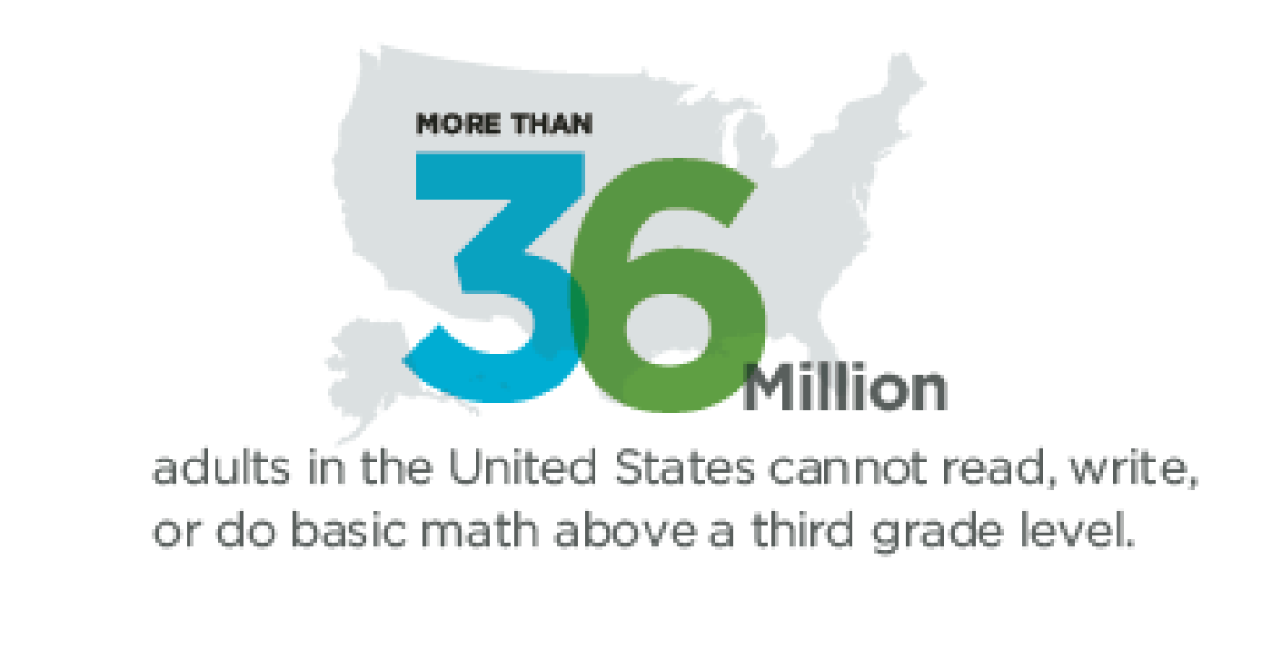
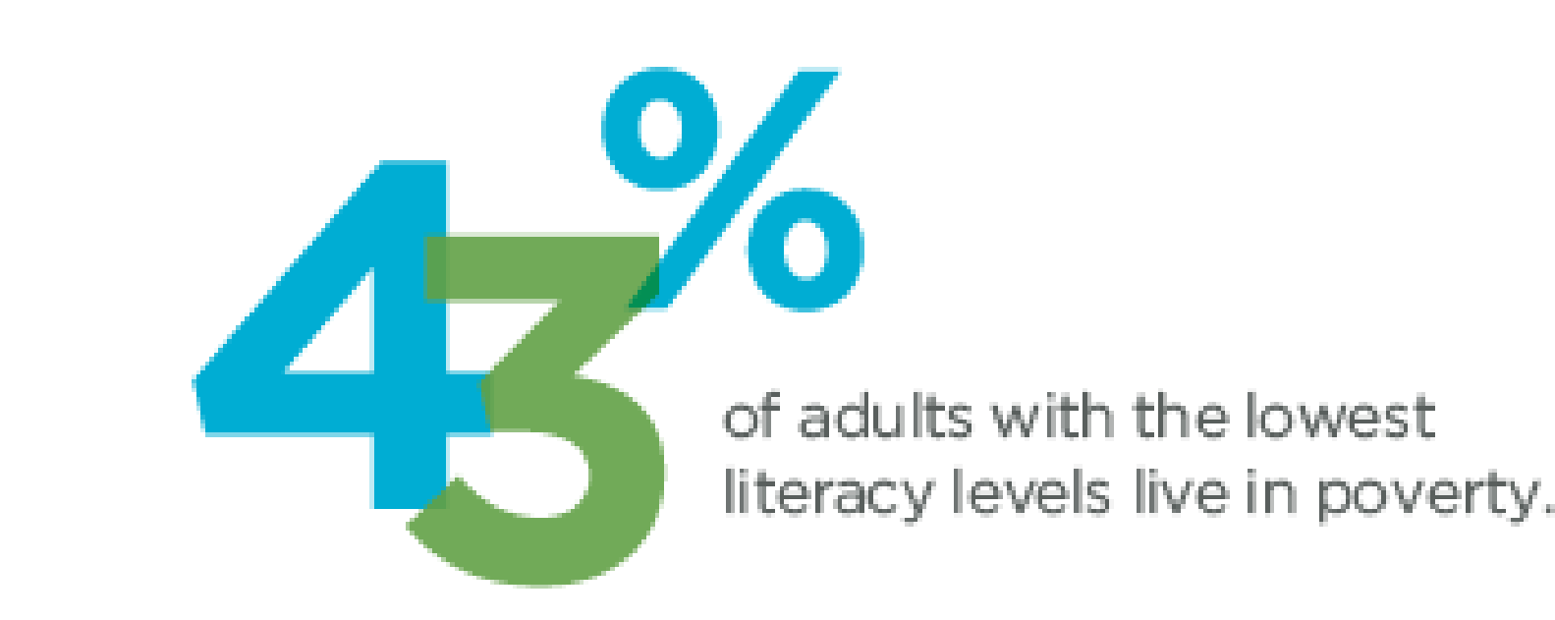
Literacy in America
(Proliteracy.org, 2016)

Slide 5
Health Literacy
“The degree to which individuals are able to obtain, process and understand basic health information…” (para. 1)
(Office of Disease Prevention and Health Promotion, 2017)

Slide 6
Health Literacy and Health Outcomes
Lower health literacy is associated with:
Increased hospitalizations
Increased use of emergency care
Lower receipt of vaccines
Lower use of mammography
Higher mortality for seniors
Lower self-reported health and quality of life
Children have a lower likelihood of having medical insurance
(Agency for Healthcare Research and Quality, 2011)

Slide 7
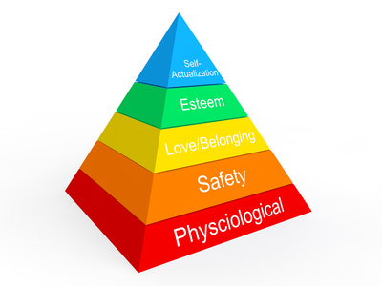
Why the focus on health literacy?
Why are we as an agency unable to create a change in behavior?
Non-Compliance?
Perceived health risk?
Lack of understanding?

Slide 8
IOWA Model of Research-Based Practice to Promote Quality Care
Serves as a guide for nurses and other health professionals to use research in order to improve health outcomes
Identify the trigger
Determine the clinical relevance
Form a team to locate and analyze research
Design and implement pilot practice change
Implement and evaluate test pilot
Integrate and maintain
(Melnyk & Fineout-Overholt, 2015)

Slide 9
Research Review
How does Health Literacy Impact Health Outcomes?
How many people understand medical information?
What types of tools are available to assess health literacy?
What information does the assessment of health literacy provide to the practitioner?
Can implementing a health literacy assessment improve health outcomes in our practice?

Slide 10
Clinical Relevance
Health literacy assessment is relevant within our practice
Individualize patient care
Health Equity
Provide understandable information to the people we serve so they can make the best decisions for themselves
Promote greater independence in individuals throughout the community
Low risk, low resource utilization

Slide 11
Health Literacy Tools
Health Literacy Tool Shed:
Short Assessment of Health Literacy (SAHL)
Rapid Assessment of Adult Literacy in Medicine (REALM)
The Newest Vital Sign

Slide 12
The Newest Vital Sign
Assesses Prose literacy, numeracy and document literacy
Ease of staff training and use
Timeframe for conducting the assessment
Provides results that are comparable to more complex assessments
Research indicates low reports of shame or stigma related to this assessment
Research indicates that patients report this assessment would be helpful to the care provider
(Shah, West, Bremmeyr, & Savoy-Moore, 2010)
(VanGeest, Welch, & Weiner, 2010)

Slide 13
Let’s Look at the Tool
https://www.pfizer.com/files/health/nvs_flipbook_english_final.pdf

Slide 14
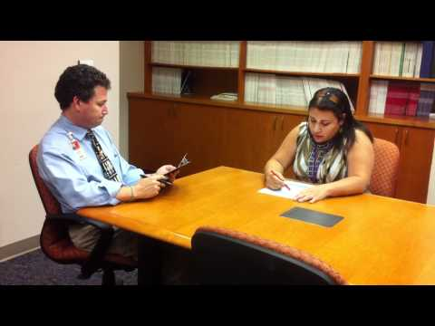
Let’s take a moment to talk about the tool and practice

Slide 15
Design and Implement a Pilot
The team decided that it would be best to start small
All clients that we spend “more” time with
All clients that receive more than average education and information
Home Visitation Clients
PNCC, CCC and Care Coordination for elderly
Reproductive Health Clients

Slide 16
AND Then…. We Implemented

Slide 17
Barriers & Limitations
Fear of offending the client
Staff refusal to complete assessment
Limited to English and Spanish
Limited information on the consistent use of the tools available

Slide 18
Data Collected
5% high likelihood (50% or more) of limited literacy
25% possibility of limited literacy
70% adequate literacy

Slide 19
Changes within Our Agency
Allowed the nursing staff to be more aware of the needs of the client
As an agency we needed to change the way we present information
Always review readability
Working to integrate more language options into our materials
Use of iconology in educational materials
Developed an agency communications plan
Created a broader awareness of the needs of the clients we serve

Slide 20
Review Education Materials
A LOT of our educational materials were written at a 12th grade or greater reading level
YIKES!

Slide 21
How has this changed our practice?
Patient education
Skill building and teach back
Meaningful Use vs Purposeful Use
Integration of newer technologies
Notes:
UpToDate

Slide 22
Next Steps
Determine if there is a way to implement this assessment into all client encounters
Establish a way to complete the assessment more frequently than initial encounter
Establish measurements to test health literacy improvement

Slide 23
Thank You
Thoughts
or
Questions

Slide 24
References
Beauchamp A, Batterham RW, Dodson S, Astbury B, Elsworth GR, McPhee C, Jacobson J, Buchbinder R, Osborne RH. BMC Public Health. 2017 Mar 3;17(1):230. doi: 10.1186/s12889-017-4147-5.
Mazurek Melnyk, B. & Fine-Overholt, E. (2015). Evidence-based practice in nursing and healthcare. A Guide to Best Practice, 3rd ed. Philadelphia: Wolters Kluwer/Lippincott, Williams & Wilkins
Office of Disease Prevention and Health Promotion. (2017). Evidenced-Based Resources Summary. Retrieved from https://www.healthypeople.gov/2020/tools-resources/evidence-based-resource/national-action-plan-improve-health-literacy
Shah, L., West, P., Bremmeyr, K., & Savoy-Moore, R. (2010). Health literacy instrument in family medicine: the 'newest vital sign' ease of use and correlates. Journal Of The American Board Of Family Medicine, 23(2), 195-203. doi:10.3122/jabfm.2010.02.070278
VanGeest, J., Welch, V., & Weiner, S. (2010). Patients' perceptions of screening for health literacy: reactions to the newest vital sign. Journal Of Health Communication, 15(4), 402-412. doi:10.1080/10810731003753117
Welch, V., Vangeest, J., & Caskey, R. (2011). Time, Costs, and Clinical Utilization of Screening for Health Literacy: A Case Study Using the Newest Vital Sign (NVS) Instrument. Journal Of The American Board Of Family Medicine, 24(3), 281-289. doi:10.3122/jabfm.2011.03.100212

Slide 25
Research Review References
Pleasant, A., McKinney, J., & Rikard, R. V. (2011). Health literacy measurement: a proposed research agenda. Journal of Health Communication, 16(3), 11-21.
Nutbeam, D. (2000). Health literacy as a public health goal: a challenge for contemporary health education and communication strategies into the 21st century. Health Promotion International, 15(3), 259-267.
Agency for Healthcare Research and Quality. (2011). Health literacy interventions and outcomes an updated systematic review (Vol. 199). Rockville, MD

