Slide 1
Graphic Medicine: A Visual Narrative Approach to Health Literacy
Matthew Noe
Lamar Soutter Library, Fellow
NNLM/NER, Graphic Medicine Specialist
Acknowledgements
This project is funded (in part) by a Mapping the Landscape, Journeying Together grant from the Arnold P. Gold Foundation Research Institute.
This project is funded (in part) by the National Library of Medicine, National Institutes of Health, Department of Health and Human Services, under Cooperative Agreement Number UG4LM012347 with the University of Massachusetts Medical School, Worcester.

Slide 2
Disclosure
I have no relevant financial interests.

Slide 3
A Story

Slide 4
A Story
http://www.graphicmedicine.org/about

Slide 5
Definitions
“Graphic Medicine is the intersection of the medium of comics and the discourse of healthcare.” – Ian Williams, MD
Comics are comprised of… “juxtaposed pictorial and other images in deliberate sequence, intended to convey information and/or to produce an aesthetic response in the viewer.” – Scott McCloud
Notes:
Neither are clean, clear definitions and both are only one of several possible ones. Consider Will Eisner or other comic scholar definitions. The GM Manifesto also includes several interpretations of Ian’s initial definition.

Slide 6
Problems with these definitions?

Slide 7
Problems with these definitions?
Broad
Notes:
What counts as healthcare? Is animation a comic?

Slide 8
Problems with these definitions?
Broad
Narrow
Notes:
Single panels, wordless comics, WHAT IS A COMIC??

Slide 9
Problems with these definitions?
Broad
Narrow
Subjective
Notes:
Ultimately these definitions leave us with questions of subjectively defining what is/is not GM and raises questions of cannon (don’t dwell on this).
Discuss what is excluded in review later

Slide 10
Roles for Graphic Medicine
Health Literacy
Consumer Health
Medical Education
Research and Discovery

Slide 11
Background: Health Literacy
Only 12% of US adults are considered proficiently health literate
Minority groups, the elderly, and those with less education are disproportionately impacted
Poor health literacy is tied to all manner of healthcare problems:
4 times higher healthcare costs…
6% more hospital visits…
2 day-longer hospital stays…
And more
Medical education needs to give special attention to ensuring future physicians can communicate clearly
“Most complaints about doctors are related to issues of communication, not clinical competency.” (Ha & Longnecker, 2010)

Slide 12
Background: Visual Literacy
Definitions are often subject specific, but focus is always on ability to accurately interpret visual images.
Recognizing the increasingly visual world, in 2011, ACRL approved the Visual Literacy Competency Standards for Higher Education.
Numerous studies have found a positive relationship with comics readership and increased visual literacy competency.
Studies have similarly found comics to be a valuable tool in print literacy development.
Notes:
Believe it or not, not everyone can read images. It is a specialized skill set. Consider “comics” literacy.

Slide 13
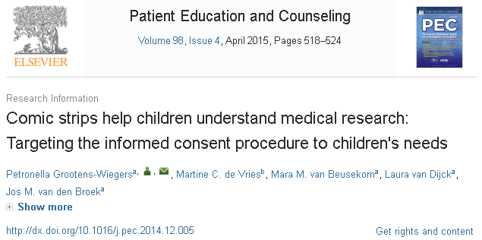
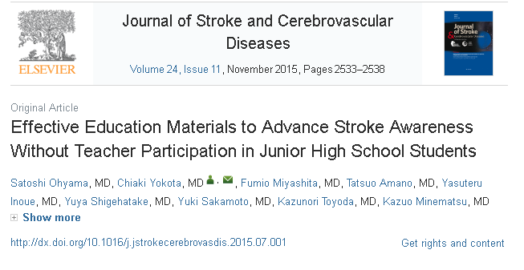
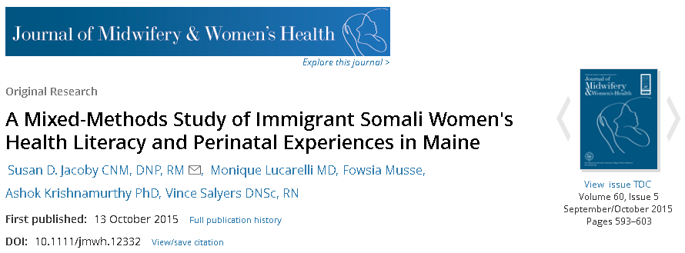
Comics and (Health) Literacy
Notes:
Some studies on comics and health literacy. We pride ourselves on being advocates for better health literacy – we owe it to our patrons to know about these options.

Slide 14
“I don’t know how to read a comic!”
Find the full comic here: http://dw-wp.com/resources/what-is-a-graphic-novel.
Notes:
You’d be surprised how often I hear some variation of this concern. I’m here to tell you that it isn’t a huge worry. If you have nervous patrons or people who simply don’t understand what comics are all about, I highly recommend this short strip by Jessica Abel. I’ve shown the first page here. She’s even been kind enough to make it CCBY so you can put it up and make it easily available to all your patrons!

Slide 15
Consumer Health
We are regularly engaged in providing timely, evidence-based medical information. Few patrons can understand jargon-filled scholarly work however…
People like narratives. Stories make things relatable.
MedlinePlus is fantastic for factual knowledge. Graphic Medicine can meld that knowledge together with human experience.
For some, reading about another person’s experience with illness can be therapeutic.
This is one aspect of Bibliotherapy – a field unto itself that Graphic Medicine may play a role in. Sarah McNicol’s research provides a good introduction: doi: 10.1136/medhum-2013-010469.

Slide 17
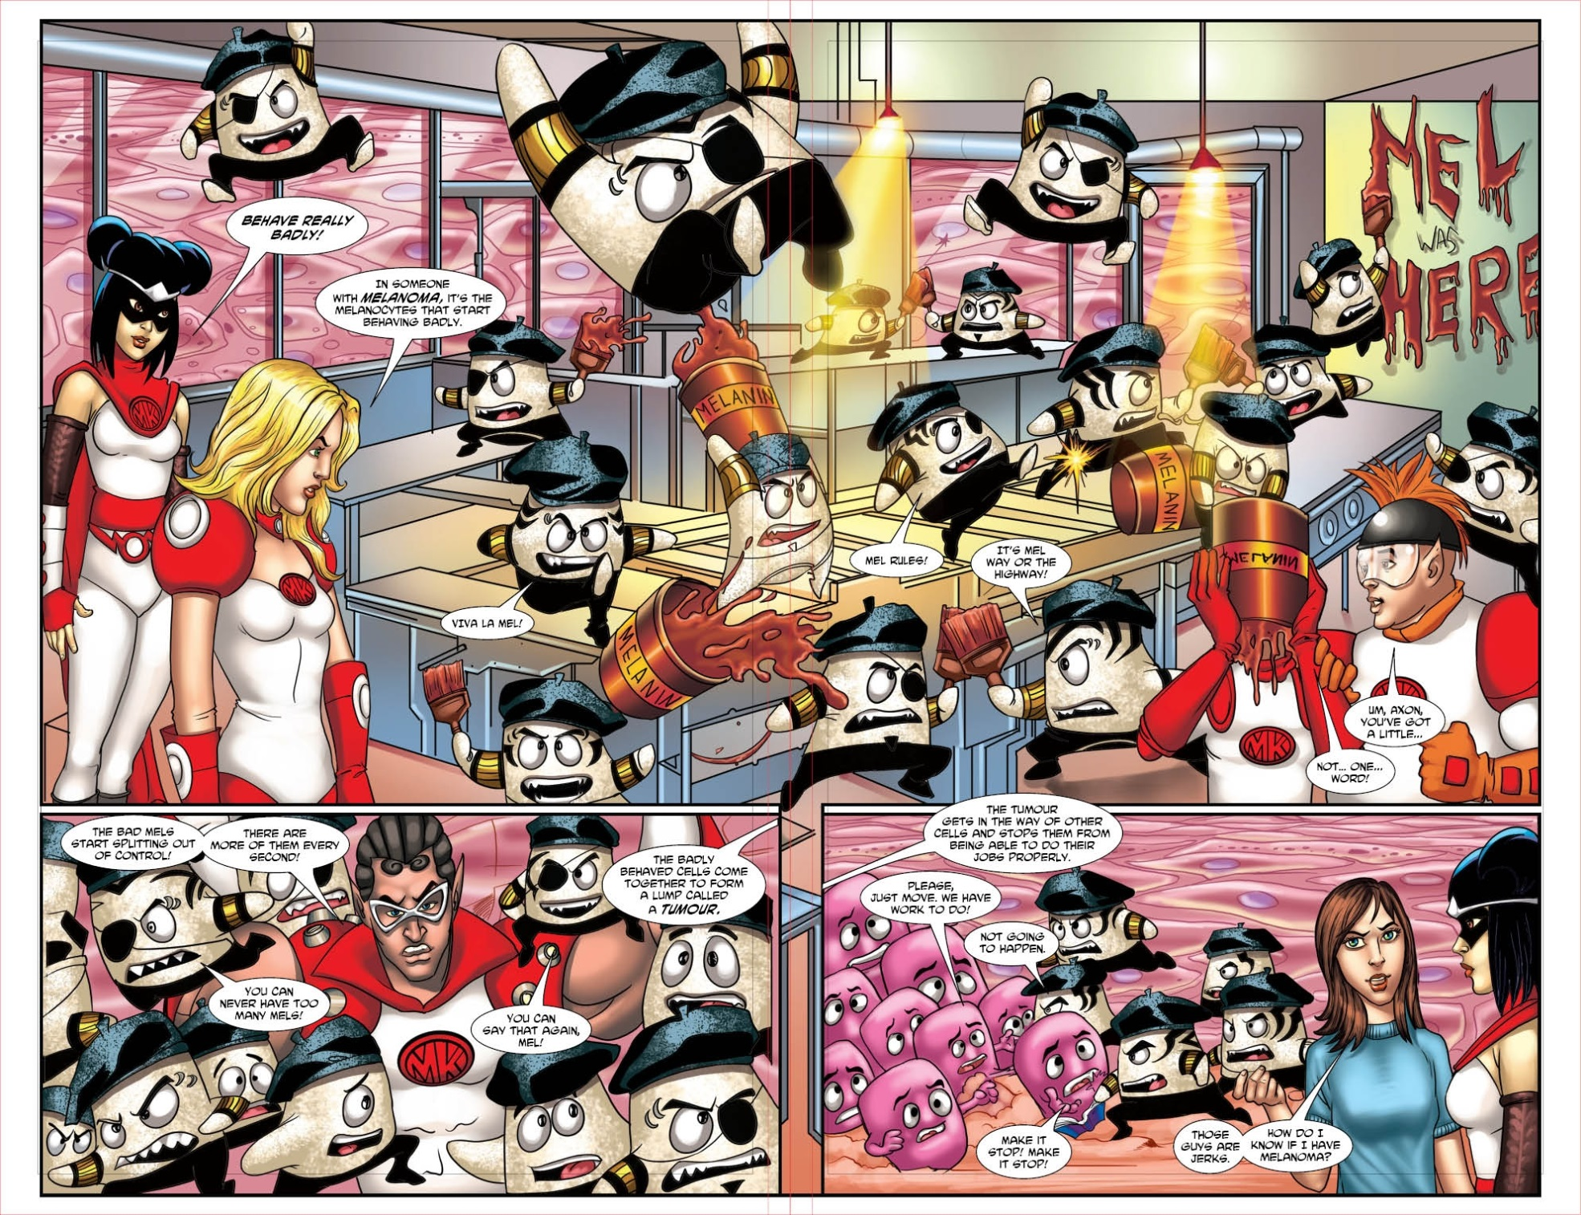
Melanoma, Medikidz Comics

Slide 18
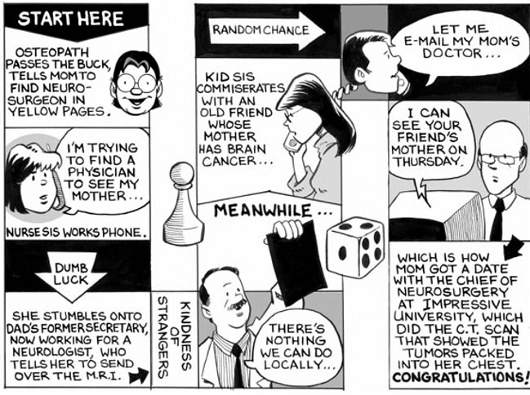
Mom’s Cancer by Brian Fies

Slide 19
Pain is Really Strange by Steve Haines
Notes:
Personal experience: I would have loved to have this comic when I was a teenager. Now, I offer it to people when I can. It isn’t perfect, but some explanation about chronic pain is a powerful tool

Slide 20
Medical Education
Empathy
Identity Formation
Illustrating Physician Experience
Value of Comics as Educational Tool

Slide 21
Empathy
Mom’s Cancer by Brian Fies
Notes:
Despite the recognized importance of empathy, studies show a decline in medical student empathy throughout training. A review of 18 studies on changes in empathy in medical school and residency showed a significant decrease in empathy, particularly in the third year

Slide 22
Identity Formation
https://sites.psu.edu/graphicnarratives
Notes:
Value in creating something (Green, MK)

Slide 23
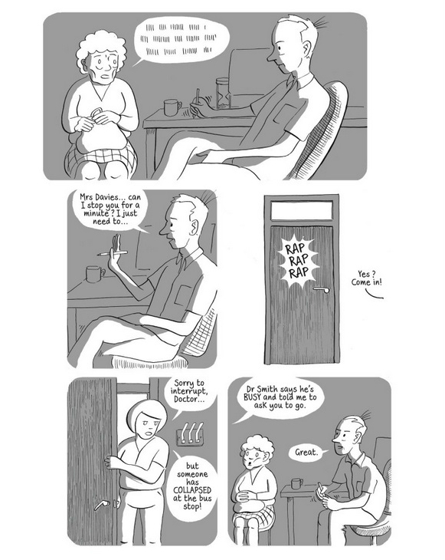
Illustrating Physician Experience
Left: From The Bad Doctor by Ian Williams Above: MK Czerwiec’s exploration of her experience as a nurse for HIV/AIDS patients

Slide 24
Educational Tool
Using comics for pre-class preparation
https://dx.doi.org/10.1111/medu.12868
A Potential Use for Manga in Medical Education
https://dx.doi.org/10.1097/ACM.0000000000001063
Memory for biopsychology material presented in comic book format
http://dx.doi.org/10.1080/21504857.2016.1219957
Notes:
Comics have been shown to be a valuable tool in a variety of educational settings, including public school, college, and medical school. The benefits being replicated across all three stages of a US-based physician’s education strikes me as powerful evidence of the role comics can play in education.

Slide 25
Research and Discovery
Graphic Medicine is still an emerging field.
There is more that we don’t know (in the scientific sense) than we do.
Most studies are small and/or narrow
Opportunities to get involved in research:
Our skills and knowledge make us ideal for exploring graphic medicine.
Example: P.F. Anderson (Taubman Health Sciences Library) led this study on building empathetic communication: http://dx.doi.org/10.1016/j.jacr.2016.09.015.
Notes:
We are experts in searching, health literacy, patron/patient needs, information seeking, and on and on. We can be the conduit.

Slide 26
Research and Discovery
Research into comics and medicine is minimal. What does exist can be unduly difficult to find.
MeSH terminology for comics is faulty (Cartoon-as-Topic is far too broad, misses the mark)
Numerous ways of saying comics make keyword searching problematic.
How can we improve findability of studies?
Comics created for research studies on medical comics often disappear.
Difficult to replicate research without access to the exact comics being tested.
Perhaps a role for LIS in graphic medicine is to collect, store, and make these comics available? Consider our emerging role in dataset curation.
Collections – both in public and medical libraries – are sorely lacking in medical comics
If comics on medical topics do exist, how are we helping patrons find them?
Notes:
These section is far more… free flowing. What do we know?
What do we not now?
What roles might we play?
These are all spoken rhetorically. Topics for discussion. Note that these questions have arisen as a result of my scoping review

Slide 27
A Research-Focused Graphic Memoir
Raised on Ritalin by Tyler Page
Unique in that it is both a personal account of life with ADHD and a well-researched, historical account of ADHD and the pharmaceuticals industry surrounding it.
Tyler’s graphic novel includes an extensive bibliography, made available online here: http://raisedonritalincomic.blogspot.com/p/raised-on-ritalin-research-bibliography.html.

Slide 28
Keeping Up-to-Date
Graphic Medicine website – www.graphicmedicine.org
Social Media:
GM Twitter List: https://twitter.com/NoetheMatt/lists/graphmed-graphlib-list
Graphic Medicine Facebook page: https://www.facebook.com/Graphic-Medicine-118202494896480/?ref=page_internal
Graphic Librarian Blog – www.graphiclibrarian.wordpress.com

Slide 29
2017 Comics & Medicine Conference: Access Points
June 15th – 17th
Seattle Public Library Central Branch
Registration Opens March 18th
Special Librarian Brown Bag session on March 16th
Conference Art by E.T. Russian

Slide 30
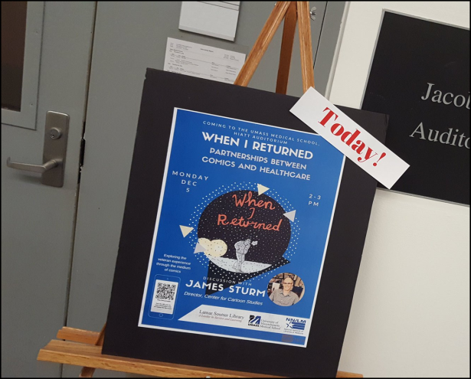
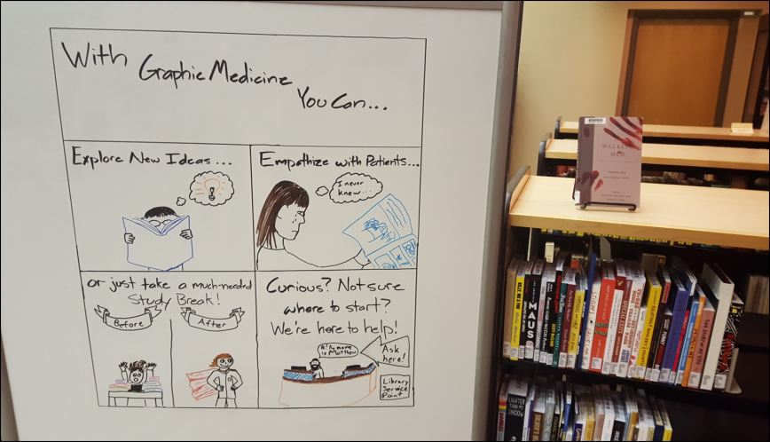
Our Efforts
Created in August 2016, the Lamar Soutter Library’s Graphic Medicine Collection now holds 65+ titles.
Holdings in WorldCat
Last December, we hosted James Sturm, Director of the Center for Cartoon Studies for a talk on applied comics and their partnership with White River Junction VA.
Beginning this academic year, 3rd-year UMass Medical Students will have the option of taking a 1-week course on Graphic Medicine
And…

Slide 31
Graphic Medicine Book Club Kits!
https://nnlm.gov/ner/guides/graphic-medicine-book-club-kits

Slide 32
Question
What other ways might we make use of comics in healthcare?

Slide 33
Thank You!
Questions? Comments?
Suggestions?
Feel free to contact me any time at:
Matthew.Noe@umassmed.edu
@NoetheMatt on Twitter
A full bibliography for this presentation can be found here: www.graphiclibrarian.wordpress.com/graphic-medicine-in-the-academy

