Slide 1
Making Informed Consent an Informed Choice: Tools from AHRQ
Cindy Brach
Center for Delivery, Organization, & Markets
April 5, 2017

Slide 2
Disclosure
I have no relevant financial interests

Slide 3

Overview
Problems with Informed Consent
Training Modules
Leaders Module
Health Care Professionals Module
Pilot Test Findings

Slide 4
Learning About You
Where do you work and in what capacity?
What do you hope to learn in the next hour?

Slide 5
Informed Consent: The Problem
Patients
Clinicians
Misunderstanding
  Benefits, harms, risks, alternatives
Don’t know they can say no
Just a form
Don’t offer choices
Malpractice top 10
Notes:
Many patients don’t understand the basic information about benefits, harms, and risks of proposed treatment even after signing an informed consent form.
Many clinicians and patients treat informed consent as a nuisance and think it’s just signing a form.
Sometimes clinicians don’t offer choices and patients don’t know they can say no.
Informed consent is one of the top 10 reasons for malpractice

Slide 6
To what extent do clinicians obtaining consent in your hospital/unit agree with the following statements?

Slide 7
How frequently do clinicians do the following when obtaining informed consent?

Slide 8
Why Two Modules?
Ingredients for successful quality improvement:
  Leadership support
  Prepared workforce
Leaders module – for C-suite and other execs
Health care professionals module – teach skills to clinical teams
Health literacy relevance: informed consent requires clear communication about choices
Both modules are available to Joint Commission-accredited Institutions for free continuing medical education credit

Slide 9


Notes:
What’s wrong with this scenario?

Slide 10
Approach: Enduring and Interactive Modules
Video recordings
Provider illustrations
Knowledge checks
Illustrative scenarios
Patient friendly forms
Model conversation
Multiple resources
Patient stories
Notes:
Notes for slide 3
The HCP module is designed to be interactive to keep the learner engaged
Presents several patient stories that allow the providers taking the module to “hear” patient conversations about their experiences and see various aspects of the informed consent process and challenges from the patient perspective.
Illustrations of how to enhance informed choice in practical circumstances. Many of these are presented as healthcare provider illustrations which makes the module relatable to the provider audience.
The module also carries several resources many of which are downloadable for use at a later time

Slide 11


Making Informed Consent an Informed Choice:
Training for Health Care Leaders
Sponsored by:
Agency for Healthcare Research and Quality (AHRQ)
Contract No. HHSA290201000031I, Task Order #3
The development and production of this course was a joint effort by
AHRQ, Abt Associates, and The Joint Commission.
The authors of this module are responsible for its content. No statement may be construed as the official position of the Agency for Healthcare Research and Quality or the U.S. Department of Health and Human Services.

Slide 12
Leaders Module Components
Three Components
  Principles of informed consent
  Policy
  Supportive Systems
Worksheets throughout
34 new and existing resources – e.g., Championing Change, AHRQ Health Literacy Universal Precautions Toolkit.

Slide 13
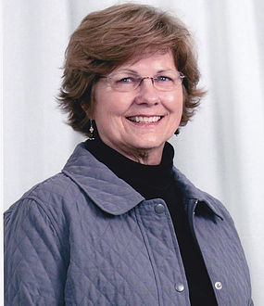
Principles of Informed Consent
Clarify patients’ rights
Legal and patient safety implica-tions
Patient capacity for decision making
Toni Cordell
Notes:
Cases like Toni Cordell still happen – breast cancer patient who didn’t understand that when she gave consent for a double mastectomy that it meant that both her breasts were being removed.
Clarify patients’ rights
Make care decisions, including refusing treatment
Receive adequate disclosure and choose from among options
Withdraw consent
Legal and patient safety implications
Patient capacity for decision making

Slide 14
Policy
Purpose
Who can obtain IC
When
Content
Documentation
Exceptions
Clear communications policy (plain language, using teach-back, accommodating communication needs)
Compliance
Enforcement
Dissemination
Review
Notes:
Joint Commission staff conducted an analysis of de-identified informed consent audit data. They found that the most common audit citations were for hospitals that did not have a written informed consent policy, or whose policy was unclear and ambiguous. The module goes through each topic that an informed consent policy should address and gives examples from a fictional hospital of what that part of the policy could look like. The module also address how to monitor compliance and enforce the module, how to disseminate it, and review it on a regular schedule.

Slide 15
Informed Consent
Policy Worksheet

Slide 16
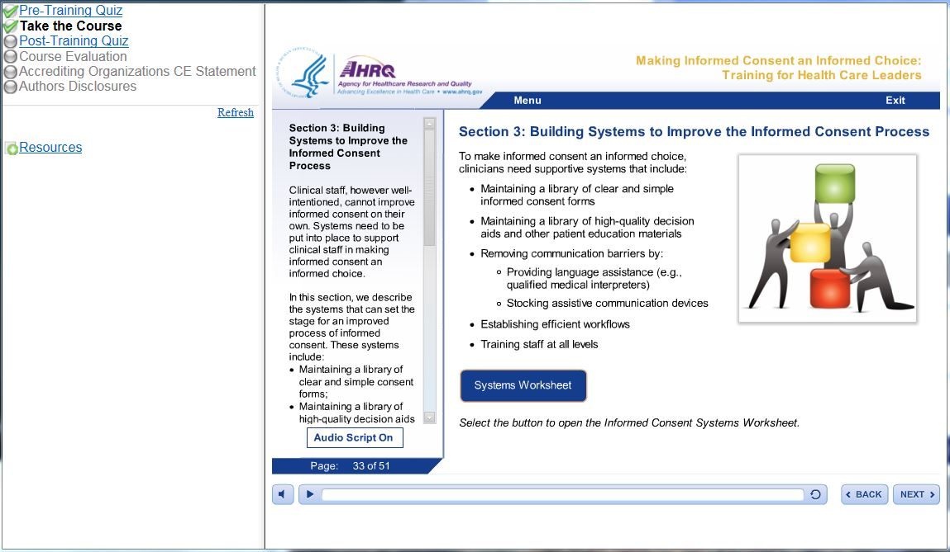
Picture of slide 42 Building Systems to Improve the Informed Consent Process
Notes:
Library of forms
Library of decision aids
Remove communication barriers
Improve workflows
Address staff training needs

Slide 17
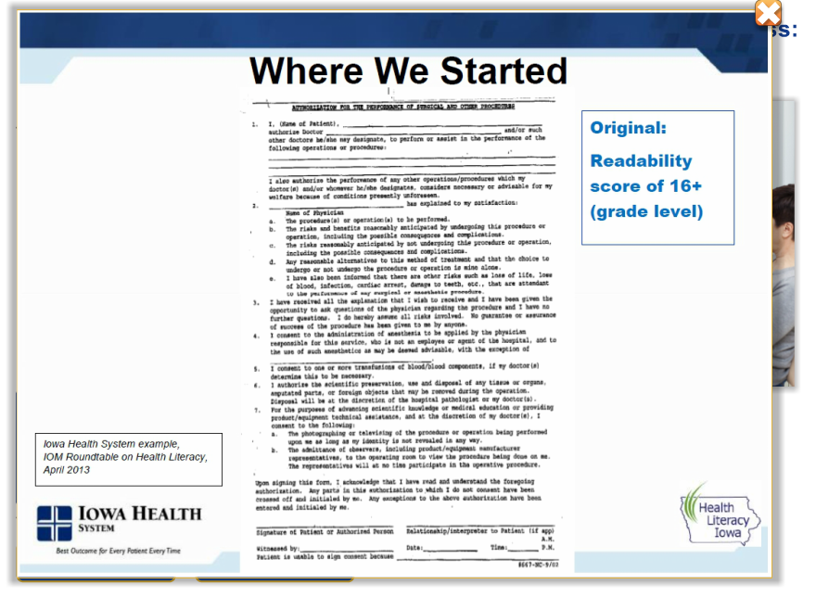
Notes:
A “Before” example from the Iowa Health system is shown that is a document with a high amount of text and readability score of over 16. The text is tightly packed in the document and the words are therefore hard to read.

Slide 19
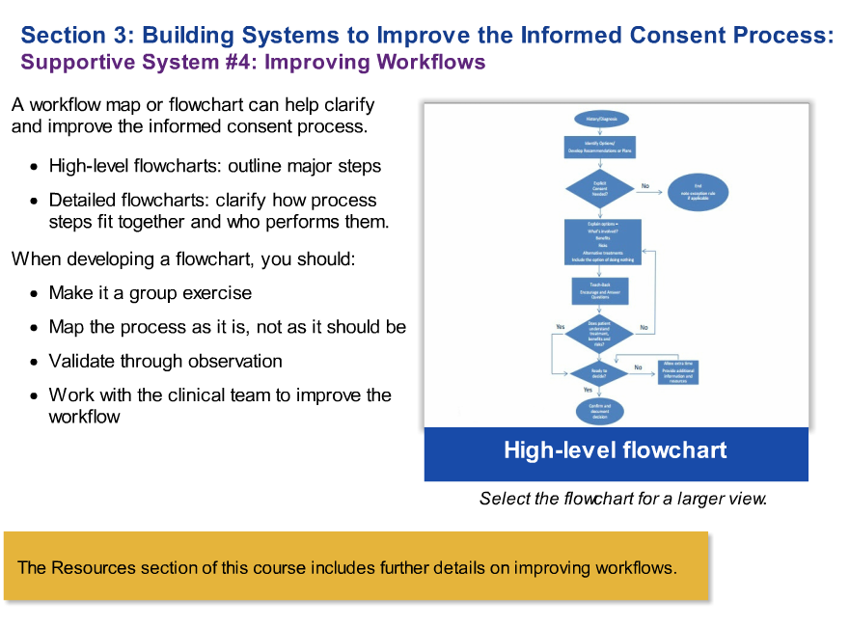
Notes:
Improving workflows is our fourth supportive strategy.
A workflow map or flowchart can help to clarify and improve the informed consent process. A high-level flowchart can be developed as part of the hospital’s informed consent policy to outline the major steps in the informed consent process. Detailed flowcharts can be developed at the unit level to clarify how the process steps fit together and who is responsible for what.
Developing a flowchart is most beneficial when you do it as a group exercise with the people who are involved in the process such as physicians, independent nurse practitioners or independent physician assistants and nurses. First step is to observe the process and to develop your initial flowchart, map the process as it is, not as you think it should be. This mapping will help you to see what needs to be improved. Once you have a flowchart developed, observe the process again and check that the flowchart matches what actually happens; edit the flowchart until it matches what actually happens. Once you’ve done this, you can work with your diverse clinical team to improve the workflow.
Select the flowchart for a larger view.
The Resources section of this course includes further details on improving workflows.

Slide 20

Making Informed Consent an Informed Choice:
Training for Health Care Professionals
Sponsored by:
Agency for Healthcare Research and Quality (AHRQ)
Contract No. HHSA290201000031I, Task Order #3
The development and production of this course was a joint effort by
AHRQ, Abt Associates, and The Joint Commission.
The authors of this module are responsible for its content. No statement may be construed as the official position of the Agency for Healthcare Research and Quality or the U.S. Department of Health and Human Services.

Slide 21
Health Care Professionals Module: 10 Strategies
Clear Communication
Presenting Choices
Prepare for the Informed Consent Discussion
Use Health Literacy Universal Precautions
Remove Language Barriers
Use Teach-Back
Offer Choices
Engage Patients, Families and Friends
Elicit Goals and Values
Show High Quality Decision Aids
Explain Benefits, Harms, and Risks of All Options
Help Patients Choose

Slide 22
The Teach-Back Process
Chunk and teach information.
If patient teaches back correctly and there’s more to explain
Ask patients to teach back
in their own words.
Allow patients to consult material.
If patient doesn’t teach back correctly
Re-teach using different words

Slide 23
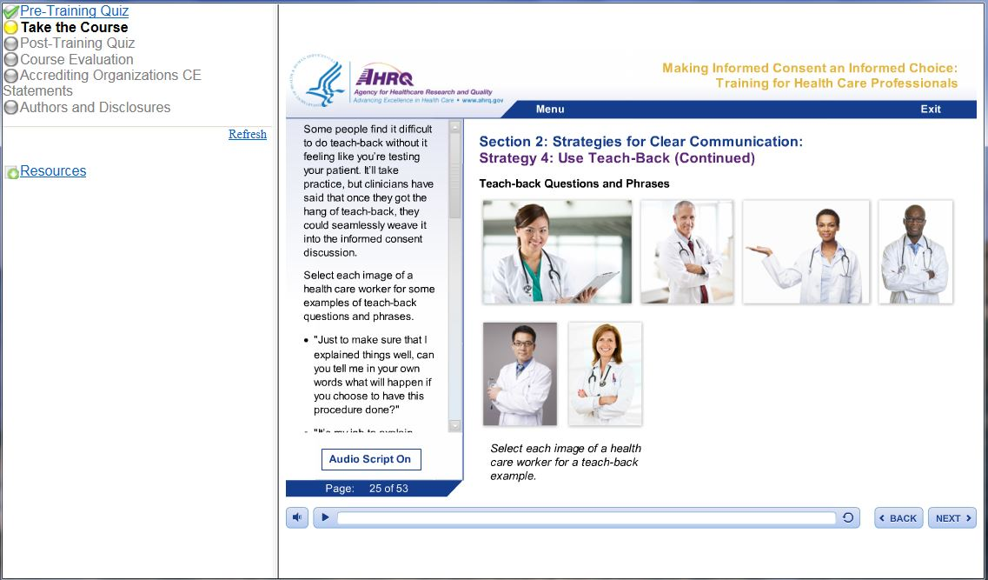

Teach-Back Examples

Slide 24
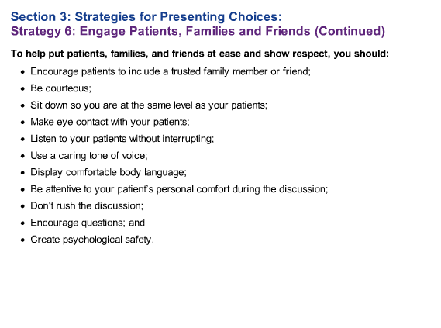
Notes:
Part of engaging the patient, and their family and friends, includes putting everyone at ease and showing respect. You can start doing this by encouraging your patients to have a trusted family member or friend with them during the informed consent discussion to support them as they get information and make decisions. A patient who is stressed about their condition is more likely to misunderstand the information given. A support person can lower the stress, help the patient to process the information, and ask questions.
There are other things you can do to put patients and their family and friends at ease. To show them that they are important and respected, you should:
Be courteous;
Sit down so you are at the same level as your patients;
Make eye contact with your patients;
Always listen to your patients, and try not to interrupt them;
Use a caring tone of voice;
Display comfortable body language;
Be attentive to your patient’s personal comfort during the discussion;
Don’t rush the discussion. Let your patients know that you have time to make sure they have the information they need and to discuss their concerns. And don’t rush them to make a decision. Rarely will taking a little extra time make a clinical difference; and
Be sure to encourage the patient to ask questions.
You can also create an environment of psychological safety by encouraging questions and signaling your openness. Psychological safety means that patients are not afraid to share what they think, wonder, and feel, because they feel accepted and respected.

Slide 25
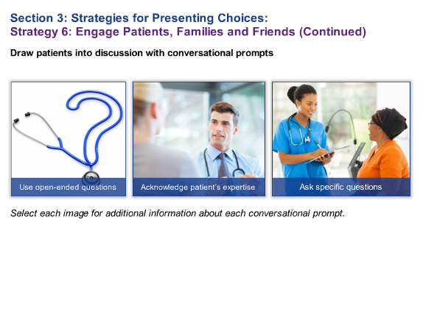
Notes:
Many patients and their families and friends will need your encouragement to become active participants in the informed consent discussion. To draw them into the conversation, try starting with their areas of expertise - their experience with their health problem.
Select each image to learn about using open-ended questions, acknowledging patients' expertise, and asking specific questions as ways of stimulating a conversation.

Slide 26
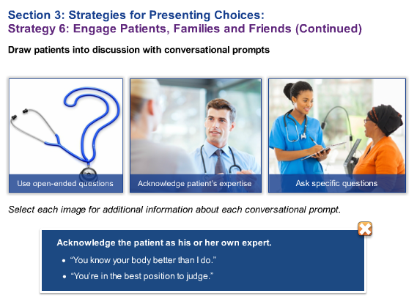
Notes:
Always acknowledge that the patient is an expert about himself or herself and encourage them to ask and share information about their treatment expectations, concerns, and understanding of their condition. For example, you might politely say,
“You know your body better than I do,” or,
“You’re in the best position to judge.”

Slide 27
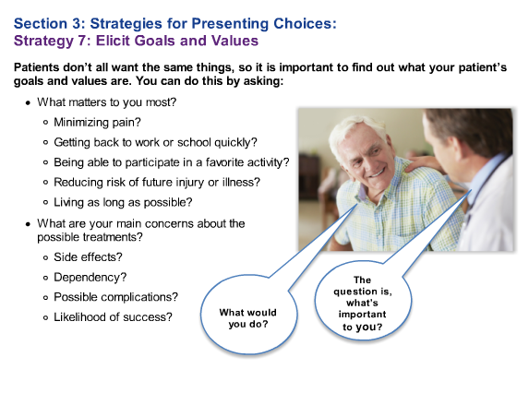
Notes:
Strategy 7 is to elicit goals and values. Patients don’t all want the same things. Treatments have different consequences, and some will matter more to one patient than another. By using Strategy 7, you will help your patient figure out what is important to him or to her.
To get at your patients’ treatment goals and values, you might try asking this: “What matters to you most?” You may need to probe a bit further, by asking about specific outcomes such as minimizing pain, getting back to work or school quickly, and being able to participate in a favorite activity. Some goals may be long-term, such as reducing the risk of future injury or illness or living as long as possible.
Treatment choices may be influenced by concerns about the treatments themselves. Again, you may have to probe to find out what is really on your patients’ minds. Is it the side effects? Or are they worried about being dependent on others, or on medicines? Or about possible complications? Or perhaps they are concerned about whether the treatment is likely to be successful.
Patients may ask you, “What would you do?” Remember that what a person chooses depends on their goals and values, and your patient’s goals and values may be different from your own. It’s tempting to jump in with your recommendation, but try to help your patients to think about what is important to them.

Slide 28
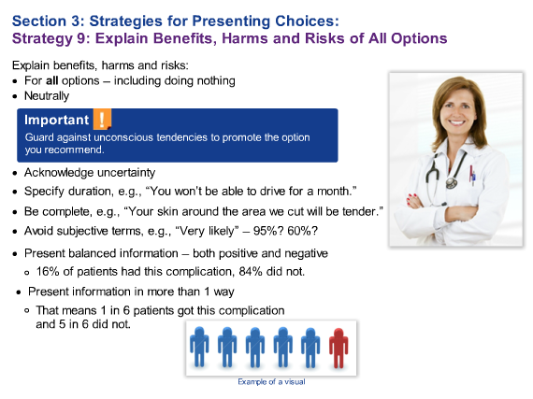
Notes:
Strategy 9 is explaining benefits, harms, and risks of all options.
Don’t just describe the option you recommend. And remember, “all options” includes the option of doing nothing.
For informed consent to be an informed choice, your explanation must be neutral.
This takes a certain effort, because there’s often an unconscious tendency to lead the patient towards the option you recommend.
You also want to acknowledge that there’s often uncertainty regarding the outcomes of the options. Don’t be afraid to share the limitations for the evidence.
For example, you might say, “Some research shows this treatment is effective, and some show’s it’s not effective. We don't know how effective it will be for you.”
Some benefits and harms will be time limited. Be specific about how long you expect a benefit or harm to last. For example, you might say, “You won’t be able to drive for a month.”
You also want to be complete. Don’t leave out little things. For example, you might tell your patient, “Your skin around the area we cut will be tender.”
When there’s a risk of harm rather than a virtual certainty, it can be challenging to explain.
Try to avoid subjective terms, such “very likely.” If you only say that the result is very likely, your patient may think the chances are 95%, or 60%. This may affect the patient’s decision, so it’s important to use actual numbers.
When you present numbers, frame the information in a balanced way, giving both the positive and negative consequences.
For example, you could say, “16% of patients had this complication, and 84% did not.” But not everyone will understand percentages.
People process information differently, so try presenting information in more than one way.
For example, in addition to giving percentages, you could give the same information as the frequency, saying “That means 1 in 6 patients got this complication and 5 in 6 did not.”
It’s also helpful to show a visual. helpful to show a visual.

Slide 29
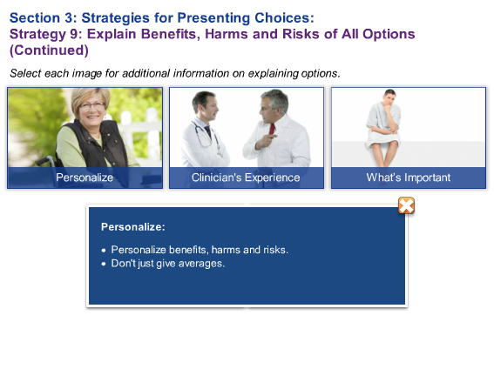
Notes:
It is important to state clearly when your patient is more or less likely than the average patient to experience particular benefits, harms, or risks. For example, if your patient has diabetes, she needs to know that her healing time may be longer than that of the average patient.

Slide 30
Informed Consent as a
Team Process
Confirming Understanding
Ensuring Appropriate Documentation
Team Roles and Responsibilities
Notes:
Notes for slide 8
Module emphasizes informed consent confirmation and documentation as a safety practice – not a check and done action. Confirming understanding of informed consent that took place earlier including verifying the patient’s understanding of the care they consented to right before a procedure is a safety precaution
Presents different ways to document informed consent based on nature of the treatment and urgency of care
How to ensure complete documentation, examples of a patient friendly consent form and a patient chart form
Module puts a spotlight on Informed consent as a team process that includes several team members hence it is important for each team member to understand his/ her role and the roles of other care team members.
(Key finding in analysis of provider queries to Joint Commission’s Standards Interpretations Group…)

Slide 31
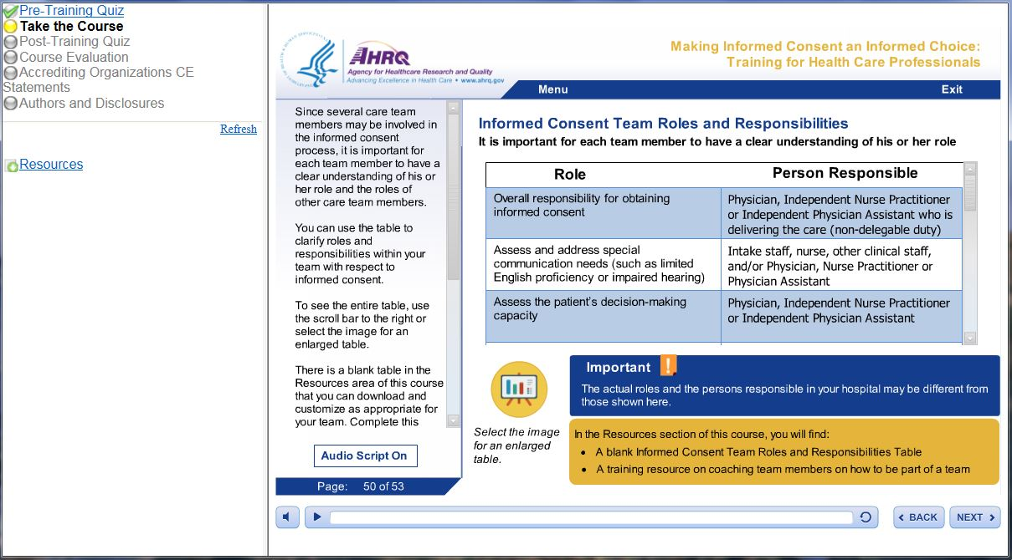
Team Roles and Responsibilities

Slide 32
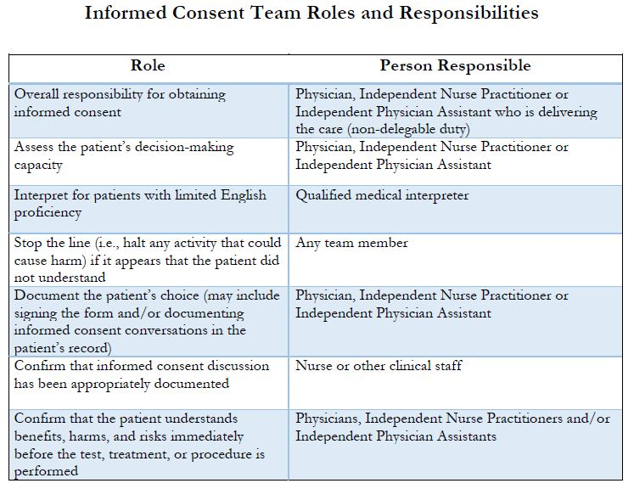

Slide 33
Learning from Training Modules
Training modules improved knowledge
  Leaders (p < 0.05)
  Health care professionals/ staff (p < 0.001)

Slide 34
Effect of Training Modules and Strategies*
Increased awareness & fostered dialogue
Pointed out discrepancies in interpretation of policies (e.g., who can obtain consent)
Assessed workflow and processes
Revealed documentation issues
Reinforced existing interpreter services
Identified many opportunities for improvement
*Potentially a result of pilot test participation, too

Slide 35

What questions do you have?
www.ahrq.gov

