Slide 1
Communicating with Refugee and Immigrant Populations on Health
Kari LaScala, J.D.
Health Communications Specialist
Wisconsin Health Literacy
Omar Eliwa, RPh
Compounding Pharmacist
Clinical Services Manager
Hayat Pharmacy

Slide 2
Disclosure Statement
We have no relevant financial interest

Slide 3
Today’s Agenda
A community project – challenges to think about when working with and communicating with refugee and immigrant populations
In the words of a pharmacist – tips for better communication with refugee and immigrant populations

Slide 4
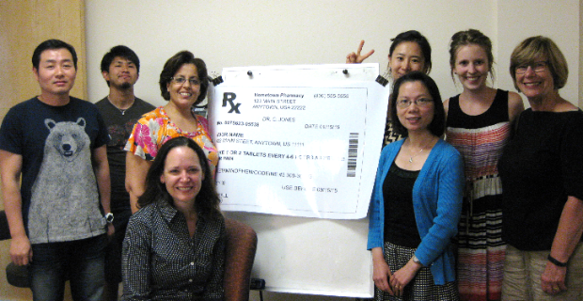
Let’s Talk About Medicines Project
Why this project?
Grant: Wisconsin DHS – Minority Health Program
Project goals:
  Refugees & immigrants gain a better understanding of how to more safely and effectively use medicine
  Develop a comfort level to ask questions of their pharmacist or doctor

Slide 5
Project – Workshop Design
Two-year project (July 2015 – June 2017)
Partner with refugee & other community organizations
20 workshops/year
90-minute interactive workshop
Interpreters/translations
15-30 participants/workshop
Pre- and post-tests & 60-day post survey
Pill box to each participant

Slide 6
Workshop Topics
The main parts of a medication label
Dosage instructions: determining how much medicine to take and when
Basic storage techniques
Over-the-counter medicines & potential interaction with other medicines
Strategies to remember to take medications
Discuss importance of asking pharmacist questions

Slide 7
Workshop Topics/Content Modified for Refugees & Immigrants
Met with community health educators
Multiple translations used
Keep it as interactive as possible
Sample medications for demonstration

Slide 8
What went well – Year 1
Over 350 participants
13 different community organizations participated
Knowledge and behavior increases (a few examples):
  Pre- and post-test results:
    Percentage of those who could correctly respond to a question on label content increased from 56% to 77%.
  60-day survey results:
    76% of those who saw a doctor or pharmacist since attending the workshop said they had asked more questions about their medicine
    49% of those who used OTC medicine said they had asked their doctor or pharmacist if it was safe to take with other medicine

Slide 9
In their own words:
Also, I wanted to let you know, a client came in today who attended the workshop. He has a lot of medication to manage and I asked him if he felt like he could do it. He said that of course he knew how, he has been trained and he has a pill box now that he can organize all his medicines in and knows how to keep track of everything because he went to the workshop. I was very happy to hear this and wanted to pass along that we are so happy we have projects like this because it is a huge need in the community. - Refugee Medical Liaison

Slide 10
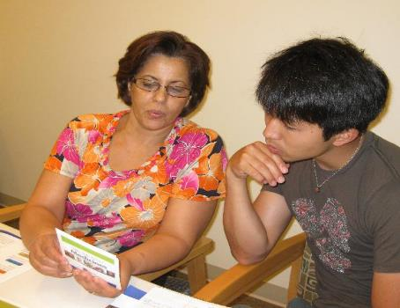
Challenges - Language
Written translations – difficulty with less common languages
Multiple languages and interpreters at some workshops
English Language Learners – different levels of English skills

Slide 11
Languages in Year 1
  Arabic
  Burmese
  English
  French
  Hmong
  Sgaw Karen
  Spanish
  Somali
  Swahili

Slide 12
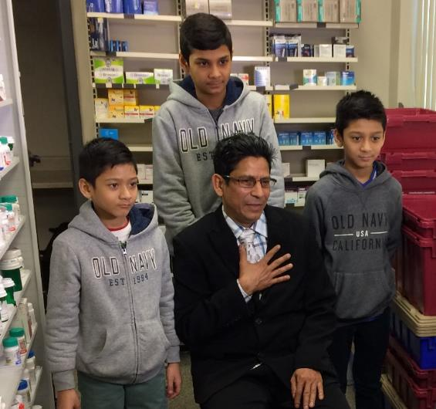
Challenges – Refugee & Immigrants’ Diverse Backgrounds
Differences in:
  Culture
  Language
  Background
  Level of Education
  Prior medicine use
(Photo courtesy of Grassland Media, Inc.)

Slide 13
Race/Ethnic Breakdown Year 1
Bhutanese Indonesian
Black Iraqi
Burmese Karen
Caucasian Latino
Chin Rohingya
Hmong Somali

Slide 14
Challenges – Organizations
Some reluctance to renew in Year 2 (time constraints)
Number and language of participants not always known (sometimes very large groups)
Follow-up surveys can be challenging to obtain

Slide 15
What we learned
Keep explanations as simple as possible
Remain flexible
A simple smile and hello go a long way
Have fun
Keep it interactive
Your work is important

Slide 16
In the Words of a Pharmacist
Tips for Better Communication with Refugees

Slide 17
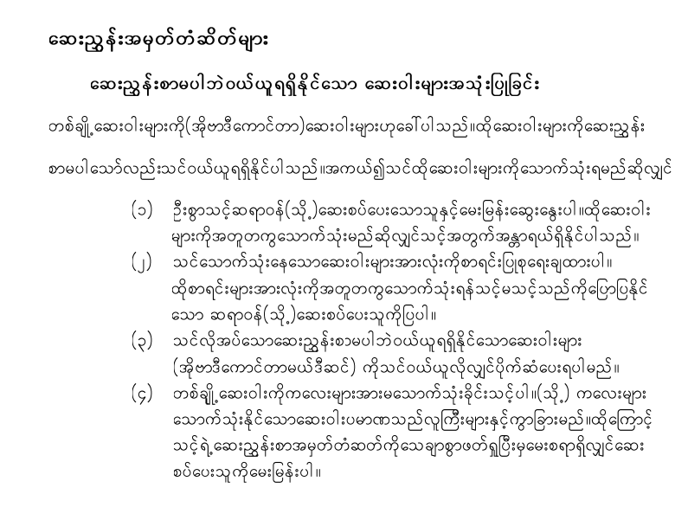
Language considerations
Be creative
Interpreters
The simpler the better
Show & tell technique
Working with other healthcare professionals
Your software provider – can it print instructions in other languages?

Slide 18

Cultural Considerations
Refugees & immigrants may be:
  Reluctant to ask questions
  Not know they need to go to a doctor to get a prescription
  May have used different medicines than are available here
  Have different gender norms

Slide 19

Time considerations
Enough time must be allocated to counsel the patient no matter how busy you are
This will go a long way in helping to meet potential language and cultural barriers

Slide 20

Trust Considerations
There are many messages a healthcare provider can convey
Treat patient as you would a family member
Show compassion
Ask questions about them or their families
Be the one who made the extra effort to communicate

Slide 21
Communicating with Refugee and Immigrant Populations on Health
https://vimeo.com/208175198
Kari LaScala, J.D.
Health Communications Specialist
Wisconsin Health Literacy
Omar Eliwa, RPh
Compounding Pharmacist
Clinical Services Manager
Hayat Pharmacy

