Slide 1
Smart Actions for Using Your Health Insurance
Wisconsin Health Literacy Summit 2017
Notes:
Hello!
Welcome to Smart Use Health Insurance: Smart Actions for Using Your Health Insurance. Regardless of how long you’ve had health insurance, you will leave today with either new ideas about using your health insurance or with the assurance you are making smart use of your health insurance. Today’s session will explore many actions that help you be a Smart User of Health Insurance.
NOTE TO EDUCATOR: For complete list, see file Materials List for Smart Actions.docx
PARTICIPANT PROGRAM FOLDER CONTENTS :
Consent form
Smart Use Pretest and Posttest
Health Insurance Important Words to Know
Saving for Health & Medical Expenses: Flexible Spending Accounts and Health Savings Accounts factsheet
Helping You Make a Good Guess for Out-of-Pocket Health Costs factsheet
How to choose a doctor
Reliable Resources from the Internet (resources/links provided on Slide 25)
Spending Plan (Optional handout for reference on Slides 17-19: include in folders and reference as the next step after estimating costs or offer to provide to interested participants)
Suggested File Categories for Health Care Records (Optional handout for reference on Slide 16 - print file categories as labels and distribute with folders or offer to provide to interested participants)
Program Materials
Terms to Know Puzzle Pieces
Sample Insurance Cards
Smart User Pledge
Sample Explanation of Benefits

Slide 2
This session will help you::
Discuss the impact health insurance literacy has on people’s health
Describe the process of creating Smart Actions for Using Your Health Insurance
Understand how to partner and bring the program to your community

Slide 3
Health Insurance Literacy
The degree to which individuals have the knowledge, ability, and confidence to:
a) Find and evaluate information about
health plans;
Select the best plan for his or her
family’s financial and health
circumstances, and
c) Use the plan once enrolled.
Measuring health insurance literacy: A call to action and report from the health
insurance literacy expert roundtable. (2011), Washington, D.C.: Consumers Union. Available at: http://www.consumersunion.org/pub/Health_Insurance_Literacy_Roundtable_rpt.pdf
Notes:
Virginia
Health literacy is a way to build up people’s skills so they can better find, understand, evaluate and communicate and use information to make informed decisions. They can use their knowledge to inform their behavior choices.
To improve any kind of literacy, definitions of terms are vital. That is true for consumers trying to understand health insurance plan terms and for professionals conducting research or creating curriculum. Consumers Union, the University of Maryland Extension and American Institutes for Research assembled experts in health insurance, financial literacy and health literacy for a Roundtable in the fall of 2011. We produced a working definition. AIR conducted the development work to create and test items that measure health insurance literacy. The University of Maryland Extension began to create a curriculum that would increase health insurance literacy and use the AIR measures to determine the curriculum’s effectiveness.

Slide 4
Have You Ever Felt Like This?
Notes:
To really understand health insurance and to be a good health insurance consumer, it is necessary to understand health insurance terminology. Knowing important health insurance terms helps you understand how your insurance plan works. Let’s watch a quick video that demonstrates the importance of knowing and understanding health insurance terms.
Note to Educator: Video is embedded in presentation. Center of slide will be black until you click on the play button along the bottom. Hover mouse over lower edge of black box to show play button. Click on play button, video will begin. Stop playing video at 26 seconds.
ZocDoc “Insurance” 30 sec TV spot retrieved from https://www.youtube.com/watch?v=HW-JcaOtV5I&feature=player_embedded

Slide 5
Health Insurance Literacy Education Requires Financial & Health Knowledge and Skills and Measurement Tools
Financial Literacy
Knowledge and
Skills (Multiple measures)
Health Literacy
Knowledge
and Skills
(Multiple measures)
Health
Insurance
Literacy
Notes:
Virginia
The definition makes clear that health insurance literacy is a combination of financial and health literacy. Having adequate financial literacy leads to the wise purchase of health insurance. Having adequate health literacy leads to the understanding that health insurance increases access to early and preventive care and helps to cover the risk of higher cost health problems when they arise.

Slide 6
Assessing Need for Smart Use
Focus groups with navigators and assisters
Consumer survey of health insurance literacy education needs
Review of the literature

Slide 7
What Navigators Said
People need to understand the importance of a primary care doctor
Allowable expenses, differences between in and out of network coverage, referrals, formulary, cap on allowed expenses
People need to be empowered to ask for information
People may not see the value in keeping health insurance
Reading and understanding their health insurance card

Slide 8
What Consumers Said
Need help figuring out health insurance costs
What is the difference between the different plan costs
How to find in-network providers near them
What to do if your plan refuses to pay a bill

Slide 9
Notes:
Only 13% Americans understand terms; high level of health insurance illiteracy. In addition, there are many citizens who are using insurance for the first time. So health insurance literacy is not only understanding how to choose insurance but also how to use and access health care.
In our review of literature we found:
Those that don’t use health care services lead less healthy lives.
Many (insured and uninsured) Americans struggle with medical bills (debt/collections) - 52% of debt collections that appear on credit reports are health related; 1 in 3 americans struggle to pay medical bills and 70% who do so are insured
- (2014-2016): more Americans (~60%) struggle with bills from one-time or short-term medical expenses whereas 33% struggle with bills built up over time
- People will forego treatment (prescriptions to procedures) when experiencing medical debt (but foregoing other necessities)
- Consumers will have OOP costs so it's essential to plan for it (spending plan should include contributions to/for OOP max not just premium)
- Given the changes in the health care system, costs of insurance/medical care have escalated with more being pushed to consumers (whether employer-sponsored or not); consumers are having a hard time managing costs
- Calculating OOP costs is difficult (numeracy, complexity, lack of transparency - can we help consumers understand? Comparison shopping - consumerism - advocacy issue/public policy)
- Importance of health savings (using FSAs if employer offers, getting HSAs if you have a high deductible plan); take advantage of tax-advantaged health care savings options
- The consequences of medical debt can be severe. People with unaffordable medical bills report higher rates of other problems – including difficulty affording housing and other basic necessities, credit card debt, bankruptcy, and barriers accessing health care.
All this lead us to develop our smart choice and smart use programs.
Today we’re going to introduce you to the smart use health insurance – Smart actions program.
Photo retrieved from
https://www.google.com/imgres?imgurl=http%3A%2F%2Fimage.slidesharecdn.com%2Fpreszi-literaturereview-120922112911-phpapp02%2F95%2Fliterature-review-1-728.jpg%3Fcb%3D1348313426&imgrefurl=http%3A%2F%2Fwww.slideshare.net%2FAnaikaAlexander%2Fliterature-review-14395725&docid=fxbfGsEpOrhanM&tbnid=FMsOxo76j88aOM%3A&w=728&h=546&bih=667&biw=1366&ved=0ahUKEwisht_OyZXNAhWFFZQKHV9EDrMQMwhXKAIwAg&iact=mrc&uact=8

Slide 10
Smart Use Modules
1- Smart Actions for Using Your Health Insurance
2- Your Health Insurance Benefits
3- Understanding & Tracking Your Costs
4- (?) Disputing Charges

Slide 11
Smart Actions Program Characteristics
One hour informational presentation
Overview of the 7 Smart Actions
Interactive activities that engage learners in understanding terms and ways to plan for health care expenses
Pre- and post-evaluation
Notes:
Explain how the Basics permits non-Extension educators to teach. Explain how the Basics can lead to the full Smart Choice Program/workshop. [Note that eventually, it can be used to lead to the Smart Use Program.
One hour informational workshop designed to target risk reduction through insurance
Designed for extension educators and outreach workers to deliver without in-depth training
Prepares participants for the full Smart Choice program/workshop

Slide 12
The 7 Smart Actions
Review my Evidence of Coverage
Carry my health insurance card with me at all times
Use preventive services to stay healthy
Choose in-network doctors and facilities
Plan for health care costs
Track health care related expenses
Use tools to solve problems
Notes:
<Click for Animation> You now know the Smart Actions of a Smart User of health insurance. Using all of these Actions will help you become a Smart User of Health Insurance. Let’s review those smart actions .
Teaching Tip: Ask participants about the smart actions that they remember or will begin to implement immediately.
First, you need to keep and review your Evidence of Coverage to understand how your plan works and what services are covered.
Carry your health insurance card, at all time.
Use preventive services to stay healthy. The goal of the Affordable Care Act is to reduce costs by getting healthy. These services, such as the flu vaccine and health screenings, will help us reach this goal.
Choose doctors and facilities that are in network and before each visit, ask them if they still participate in the plan’s network. This will help reduce costs and save you money.
Plan for health care costs. Research shows that in general costs increase by about 5% a year. By knowing what you spend this year, you can begin to plan for many upcoming health costs.
To better plan for expenses, you need to know where your money is going. In addition to reviewing bills and statements, tracking your health care expenses will help you better plan for expenses and know where your money is going.
Finally, you can these resources to solve problems if and when they arise.
Note to Educator: Pass out Smart User Pledge
To help you remember to use each of the smart actions we have shared today I will be handing out a personal pledge – the Smart User pledge. Please sign and date it. Keep it in a safe place with your health insurance files and records as a reminder of the Smart Actions you either learned or were reminded of today.
We are excited that you are taking the Smart Actions for a Smart User of health insurance challenge, and want to know if you have any questions about your new role and responsibility as a Smart User?
Teaching Tip:- PAUSE for responses/discussion. Depending on remaining time in your session, participants could be encouraged to write down their questions and provide you contact information so you could follow up with questions on an individual basis.

Slide 13
Examples of Program Components

Slide 14
SMART USE Helps You Manage Your Health & Money
Be healthy enough to work and attend school
Prevent and manage chronic illness
Get preventive services to keep costs down
Save money
Avoid costly problems
Notes:
With your attendance today, I’m confident that you want to learn to be smart about using your health insurance. There are several reasons why it is important to be an informed health insurance consumer. Can you share some reasons that come to mind?
Teaching Tip: Pause for participants to use 1-2 minutes of thinking time before asking them to share at their tables and/or with entire group, if time permits. If not simply reveal these five reasons. Acknowledge the reasons shared by participants as you reveal these five key reasons.
Thank you - these are great reasons! Although you mentioned several of these, let’s review. <Click for Animation>
One reason is to be healthy enough to work or go to school. Research shows that when people are healthy, they are less likely to miss work or school due to injury or illness. People are usually more productive at their job and get more done. Some businesses offer employee wellness programs to help people get healthy and stay healthy.
<Click for Animation>
Another reason is to prevent or manage chronic health conditions such as diabetes. If you and your family have adequate insurance coverage and use your health insurance as it is intended to be used (meaning you take advantage of prevention visits, immunizations, etc.), this can lead to better overall health for everyone. Having and using health insurance can lead to better health outcomes.
<Click for Animation>
A third reason is to be able to access (get) services while containing costs. Many health insurance plans offer services, such as a yearly physical or check-up, and wellness programs that may include personal wellness coaching, healthy pregnancy programs, gym membership discounts, nutrition counseling, online seminars/webinars, checklists, tools and calculators to help keep you healthy, thus saving you time and money.
<Click for Animation>
If you or a family member have or develop a health problem the results can be costly in both time and money. Having and using health insurance helps reduce those risks. Being smart about using health insurance helps save you money and helps you avoid costly problems.

Slide 15
Important Words to Know
Notes:
NOTE TO EDUCATOR: Introduce Important Words to Know Activity using puzzle pieces (terms and definitions). Choose one of the four activities below (Provide approximately 3-7 minutes depending on the size of the group):
Activity Choice 1: With a partner, take a few minutes to review and discuss the Smart Choice and Smart Use Important Words to Know sheet in your folder. OR
Activity Choice 2: In the middle of the table are a group of words or definitions. Select one and then find the person that has the missing piece to your puzzle/word. Introduce yourself and review the word. After everyone has found their partner, we will review some of the words. OR
Activity Choice 3: Include the puzzle pieces in participants folders or distribute one to each participant. Ask participants to find their match or partner, introduce themselves and discuss the term. OR
Activity Choice 4: In the middle of the table are a group of words or definitions. Match the words/terms with the definition, then organize by concept such as costs, types of plans, and documents.
Suggested words to review:
Coinsurance
Copayment
Deductible
Essential Health Benefits
Evidence of coverage
Explanation of Benefits
Flexible Spending Account (FSA)
Network
Out-of-pocket costs
Premium
While this video was meant to be funny, it is possible that many of us have felt like the mother in this video. Research shows that consumers are confused about health insurance terms. There are several important health insurance words; having the definitions will help you better understand your health insurance plan, other documents and costs.
So, right now, let’s turn our attention to the puzzle pieces on your table. At your table, match the words to their definitions and share with others at your table.
Teaching Tip: PAUSE to permit time for activity. Check on time used and time remaining for presentation. Listen for quality conversations. Allow 3-5 minutes for discussion. Ask for volunteers to share/call out words and definition.
In your folder, you have a list of Health Insurance Important Words to Know (health insurance glossary) that you may want to refer to after this session. We will use many of these terms during the remainder of our session.

Slide 16
Smart Action 1: Know What Your Health Insurance Policy Covers
Why is this important?
Explains covered services and benefits
Outlines plan costs
Tells you how to find in-network doctors and facilities
Discusses how to dispute a billing error
Notes:
Today we will discuss actions that can help make you a Smart User of health insurance.
Our first Smart Action is to know what your health insurance policy covers.
Knowing what your health insurance covers is important for many reasons. These include:
<Click for Animation> Why is this important?
Explains what services and benefits are covered
Outlines plan costs
Tells you how to find in-network doctors and facilities
Discusses how to dispute a billing error
Now, I have a short story to share with you to explore this a bit further.

Slide 17
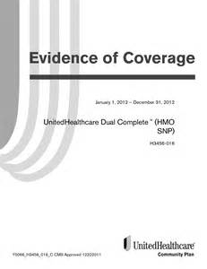
Smart Action 1: Know What Your Health Insurance Policy Covers
Where do you find this information?
Evidence of Coverage
Notes:
What the story showed us was the importance of knowing what your health insurance policy covers. In the chat box below, please tell us what you think is the main source you can turn to get this information?
Teaching Tip: - PAUSE for responses -
In order to understand your health insurance policy, you need to know where to get this information. The primary source for this information is the Evidence of Coverage.
Our first Smart Action is to learn about our health insurance policy. That means reading the Evidence of Coverage when it arrives and reviewing it before you get health services. Don’t worry; if you lose or misplace the booklet, you can get another copy by calling and requesting it from your health insurance company or accessing your online account and downloading from the website.
Now, you understand the importance of having and reading the Evidence of Coverage. Let’s go on to our second Smart Action.
Note to Educator: Some plans do not provide a booklet but refer people to the website or customer service representative for getting answers about their plans.

Slide 18
Smart Action 2: Have proof of insurance at all times
Why is this important?
Gives provider access to policy information
Lists copayments for medical services
Provides a phone number to answer questions
Where do you find the information?
On your current health insurance card
Notes:
Our second Smart Action is to have proof of insurance at all times.
Teaching Tip: Ask for 2-3 volunteers to respond with ideas about why this is important action.
It is important to carry your proof of insurance at all times because: Great.
Gives provider access to policy information
Lists copayments for medical services
Provides a phone number to answer questions
A best practice is to have your health insurance card with you at all times.

Slide 19
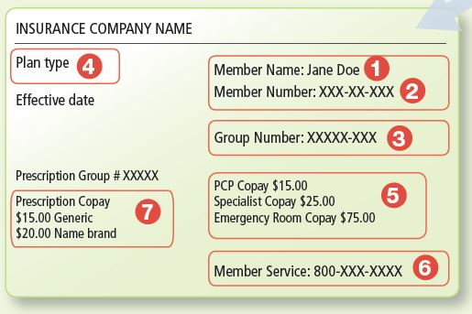
Notes:
This is a picture of a health insurance card. This is your proof of insurance for when you get health care services. Some doctors may not treat you without proof of insurance or may charge you the full amount. Therefore, it is always important to carry your insurance card at all times.
Although every card will look different, important identifying information. Let’s review the key points of information on this card.
Member name and date of birth: Every insurance card will list the member name or the person who is covered by the plan. Some cards even include the member’s birth date.
Member number: This number is used to identify you so your provider knows how to bill your health plan. If your spouse or children are also on your coverage, your member numbers may look very similar.
Group number: This number is different from the member number. This number is used to track the specific benefits of your plan. It’s also used to identify you so your provider knows how to bill your insurance.
Plan type: Your card might have a label like HMO, PPO, HSA, Open, or another word to describe the type of plan you have. These tell you what type of network your plan has and which providers you can see who are “in-network” for you.
Copayment- This is one of our words from the puzzle activity. These are the amounts that you will owe when you get health care.
Member Services- You can call your health plan if you have questions about finding a provider or what your coverage includes. Phone numbers are sometimes listed on the back of your card.
Prescription Copayment- These are the amounts that you will owe for each prescription you have filled. Depending upon how you get your insurance, you may have a separate insurance card for prescriptions.
Note to Educator- This information and visual was adapted from https://marketplace.cms.gov/outreach-and-education/downloads/c2c-sample-insurance-card.pdf

Slide 20
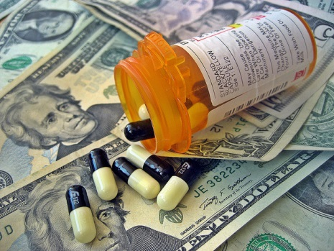
Smart Action 6: Estimate Health Care Costs
Why is this important?
Have enough money to cover out-of-pocket costs
Be able to pay for the health care services you need
Get healthy and stay healthy
Notes:
As we discussed, tracking expenses is useful for many reasons. One major reason is because health care expenses are often overlooked or underestimated; in fact, medical expenses are a primary reason cited for personal bankruptcy filing. When you track your expenses you are in control of your health and money.
As you prepare to use your health benefits, you need to plan ahead and be aware of the different health care costs.
Health care costs are a major portion of individual/family spending therefore it is important to determine how much you need to pay and save for out-of-pocket health care costs. These out-of-pocket costs are your expenses for medical care that aren't reimbursed by insurance, and include deductibles, coinsurance, and copayments for covered services as well as any costs not covered by health insurance.
<Click for Animation> By estimating costs, you can plan ahead so you will be able to:
Have enough money to cover out-of-pocket costs
Pay for health care services you need
Get the care to get healthy and stay healthy
Let’s discuss documents you can use to get this information.
Note to Educator: As you explain where this information can be found, reference definitions and examples . (CLICK TO NEXT SLIDE).

Slide 21
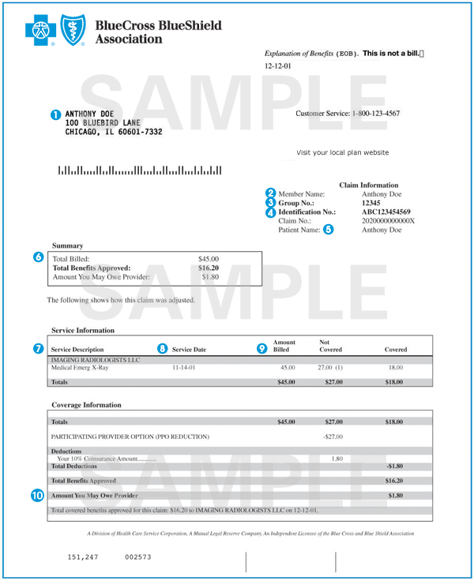
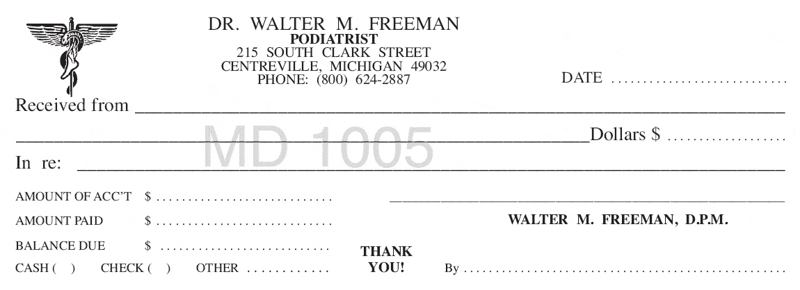
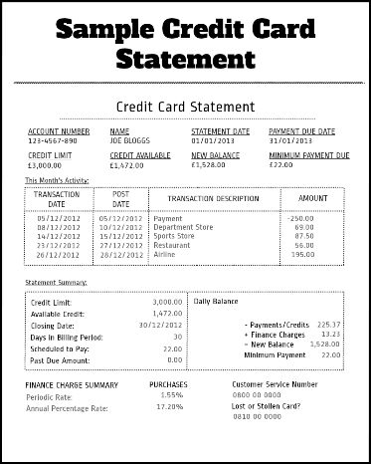
Smart Action 6: Estimate Health Care Costs
Where do you find this information?
Explanation of benefits
Medical receipts
Credit card statements
Flexible Spending Account Documents
Notes:
You can get this information from the following sources: <Click for Animation>
Explanation of benefits: Statement received after health care service which shows what services were conducted, what the insurance company paid and what you can expect to pay. As we discussed earlier, any fraudulent use and subsequent charges as a result of medical identity theft would show up on your Explanation of Benefits (or EOB).
Medical receipts: Proof of payment. These receipts should show any copayments made for the service as well as other charges you may have had to pay. You should also have similar receipts for any prescription drugs you may have purchased throughout the year.
Credit card and/or bank statements: Shows how much and when you spent money on health care expenses.
FSA or other medical savings accounts transaction receipts.
Costs are on all types of our health records. These records can be obtained from your doctor’s office and your pharmacy, for example.

Slide 22
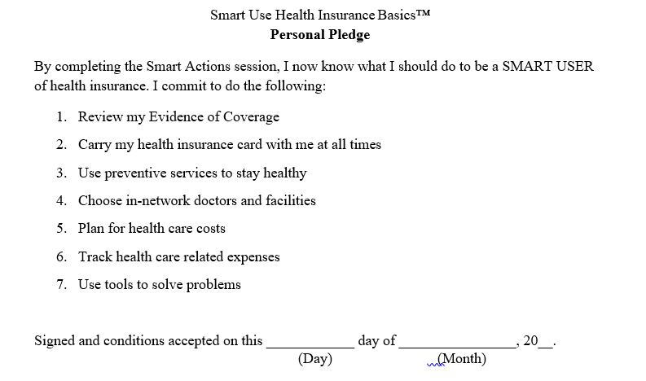
Sign Your Personal Pledge
Notes:
<Click for Animation> You now know the Smart Actions of a Smart User of health insurance. Using all of these Actions will help you become a Smart User of Health Insurance. Let’s review those smart actions .
Teaching Tip: Ask participants about the smart actions that they remember or will begin to implement immediately.
First, you need to keep and review your Evidence of Coverage to understand how your plan works and what services are covered.
Carry your health insurance card, at all time.
Use preventive services to stay healthy. The goal of the Affordable Care Act is to reduce costs by getting healthy. These services, such as the flu vaccine and health screenings, will help us reach this goal.
Choose doctors and facilities that are in network and before each visit, ask them if they still participate in the plan’s network. This will help reduce costs and save you money.
Plan for health care costs. The factsheet in your folder shows that in general costs increase by about 5% a year. By knowing what you spend this year, you can begin to plan for many upcoming health costs.
To better plan for expenses, you need to know where your money is going. In addition to reviewing bills and statements, tracking your health care expenses will help you better plan for expenses and know where your money is going.
Finally, you can these resources to solve problems if and when they arise.
Note to Educator: Pass out Smart User Pledge
To help you remember to use each of the smart actions we have shared today I will be handing out a personal pledge – the Smart User pledge. Please sign and date it. Keep it in a safe place with your health insurance files and records as a reminder of the Smart Actions you either learned or were reminded of today.
We are excited that you are taking the Smart Actions for a Smart User of health insurance challenge, and want to know if you have any questions about your new role and responsibility as a Smart User?
Teaching Tip:- PAUSE for responses/discussion. Depending on remaining time in your session, participants could be encouraged to write down their questions and provide you contact information so you could follow up with questions on an individual basis.

Slide 23
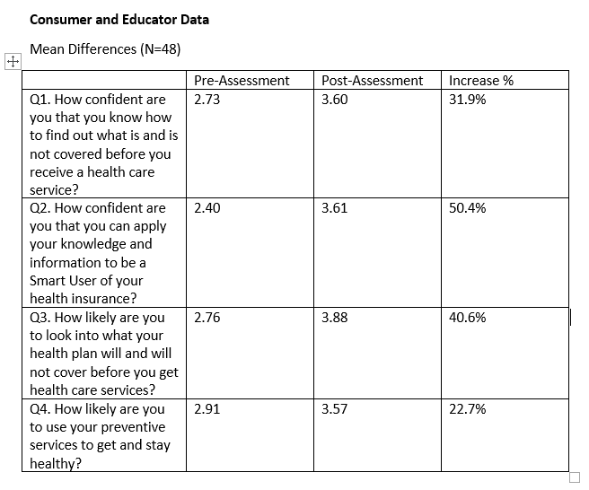
Preliminary Data
Notes:
Thank you for participating today. Smart Use is a multi-series program designed to help you better access health care, understand costs of care, track the services you receive, and keep records of health care use and costs.
NOTE to Educator: Consider sharing information about your organization as well as other programs and products that may be beneficial to your audience.
If you have any questions or concerns, please feel free to contact us.

Slide 24
Implications for Educators
Both educators and consumers learn from this program. Understanding your own health insurance and how to navigate the health care system will help your financial and health well-being.
Quality of life includes both financial and healthy life choices and they are inter-connected. So no matter what your discipline, to improve our clientele’s well-being we need to be cognizant of the connection.
Empowering consumers to take steps to access care and prevent/manage illness, as well as saving for out of pocket expenses, affects today’s and tomorrows health and financial well-being.
Notes:
Thank you for participating today. Smart Use is a multi-series program designed to help you better access health care, understand costs of care, track the services you receive, and keep records of health care use and costs.
NOTE to Educator: Consider sharing information about your organization as well as other programs and products that may be beneficial to your audience.
If you have any questions or concerns, please feel free to contact us.

Slide 25
Want to Learn More?
National initiative to increase the capacity of Extension professionals in the area of health insurance literacy
Collaborative effort to develop evidence based curriculum in this area
Opportunity to become a certified educator
Notes:
Explain how the Basics permits non-Extension educators to teach. Explain how the Basics can lead to the full Smart Choice Program/workshop. [Note that eventually, it can be used to lead to the Smart Use Program.
One hour informational workshop designed to target risk reduction through insurance
Designed for extension educators and outreach workers to deliver without in-depth training
Prepares participants for the full Smart Choice program/workshop

Slide 26
For more information, contact:
Virginia Brown
vbrown12@umd.edu
Maria Pippidis
Pippidis@udel.edu
Insuring Your Health
http://extension.umd.edu/insure
Notes:
Thank you for participating today. Smart Use is a multi-series program designed to help you better access health care, understand costs of care, track the services you receive, and keep records of health care use and costs.
NOTE to Educator: Consider sharing information about your organization as well as other programs and products that may be beneficial to your audience.
If you have any questions or concerns, please feel free to contact us.

Slide 27
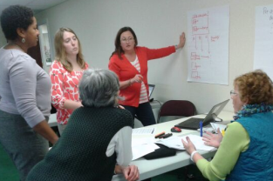
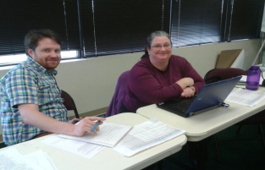
Acknowledgements
This pilot project was developed with funding from the University of Maryland Extension; College of Agriculture & Natural Resources
Program Development Team
University of Maryland Extension:
Bonnie Braun, Virginia Brown, Lynn Little, Teresa McCoy, Mia Baytop Russell
University of Maryland Residential Facilities: Christine Garcia
University of Delaware Cooperative Extension: Maria Pippidis
Notes:
This program has been created by a partnership with University of Maryland Extension and University of Delaware Cooperative Extension. Without the multiple members of our health insurance literacy initiative team and the financial support of University of Maryland Extension and the College of Agriculture and Natural Resources, the programs and curricula would not be possible.
Again, we thank you for your attendance and participation today.

Slide 28
Thanks for being part of the new Smart Actions for Your Health Insurance.
Notes:
Thanks for being part of the Smart Actions for Your Health Insurance

