Slide 1
Wisconsin Literacy Annual Meeting

Slide 2
Agenda
Introductions
Wisconsin Literacy staff
Wisconsin Literacy Board of Directors
Today’s Agenda:
Approval of 2023 Annual Meeting Minutes
Welcome: Jake Gorges, Executive Director
Board Welcome Message: Steve Mundt, Wisconsin Literacy (WL) Board Chair
Coming soon: WL Fall Succession Planning workshops
Student Success Stories
Stronger Together: Collective Achievements and WL Updates

Slide 3
Agenda (continued)
All Member Engagement Activity
What’s one thing you learned from the students you served in the past year?
Open sharing from agencies: highlight a new program, success, best practice, program expansion
Drawing for WL blanket
Closing
Questions and Gratitude

Slide 4
Succession Planning: Thinking Strategically about Sustainability
Wisconsin Literacy will present a series of virtual workshops designed to:
help small, volunteer-led literacy councils plan for sustainability
share best practices in succession planning
provide assistance in developing customized plans
We anticipate offering this series this winter and enrollment will be limited. Watch your email for details coming soon!

Slide 5
Welcome: WL's Newest Members
Joyce's House Education Center
YWCA Greater Green Bay
Catholic Charities Milwaukee
Wisconsin Workforce Transformation, Inc.
New Beginnings for Refugees
Oneida Education and Training
YWCA Rock County
COMSA
Madison International Partners
Hanan Refugees Relief Group

Slide 6
What is Health Literacy ?
Health literacy is a critical determinant of health outcomes, defined as an individual’s capacity to obtain, process, and comprehend essential health information and services (Nielsen-Bohlman, Panzer, & Kindig, 2004).

Slide 7
What is Health Literacy ?
Health literacy is measured through skills like:
Reading
Writing
Math
Communication
Using Digital tools
These skills are crucial for patients to understand the healthcare system and make informed decisions about their health (Kutner et al., 2006).

Slide 8
Wisconsin Health Literacy
Statewide nonprofit organization offering education and training on Health Literacy
Community projects
Health Literacy Summit (every other year)
WisconsinHealthLiteracy.org

Slide 9
Health Literacy Unpacked
Personal Health Literacy: The ability of individuals to find, understand, and use information to make informed health decisions.
Organizational Health Literacy: The degree to which organizations equitably enable individuals to find, understand, and use information and services to make health-related decisions.

Slide 10
Statewide Nonprofit Advancing Health Literacy Education and Training: Personal Health Literacy Focus (FY25)
Domain | Vehicle | Method | Targeted Outcome
Mental Health Literacy | Schools + Grassroots Organizations | Empowering educators and grassroots personnel through our 'train-the-trainer' Mental Health First Aid (MHFA) program. | Increase youth mental health literacy (awareness + health promotion ) as well as reduce stigma.
Digital Health Literacy | Community-based organizations + Healthcare organizations | Developing curriculum on digital health literacy for Community Health Workers and other front-line personnel. | Increase patient digital health literacy around patient portal navigation.

Slide 11
Community Projects: Enhancing Organizational Health Literacy (FY25)
Domain | Vehicle | Method | Targeted Outcome
Health Communications and Patient Engagement | 12-credit accredited Performance Improvement (PI) Continuing Medical Education (CME). | Collaborating with Wisconsin Medical Society and the Medical College of Wisconsin to develop an evidence-based PI CME, to improve health communication. | To help providers understand health literacy to better engage patients.
Organization Health Literacy Assessments | Community-based organizations + Healthcare organizations | The OHLA evaluates factors that impact patients’ Health Literacy, including information accessibility, and staff communication. | To provide organizations with solutions to improve health literacy and patient outcomes.

Slide 12
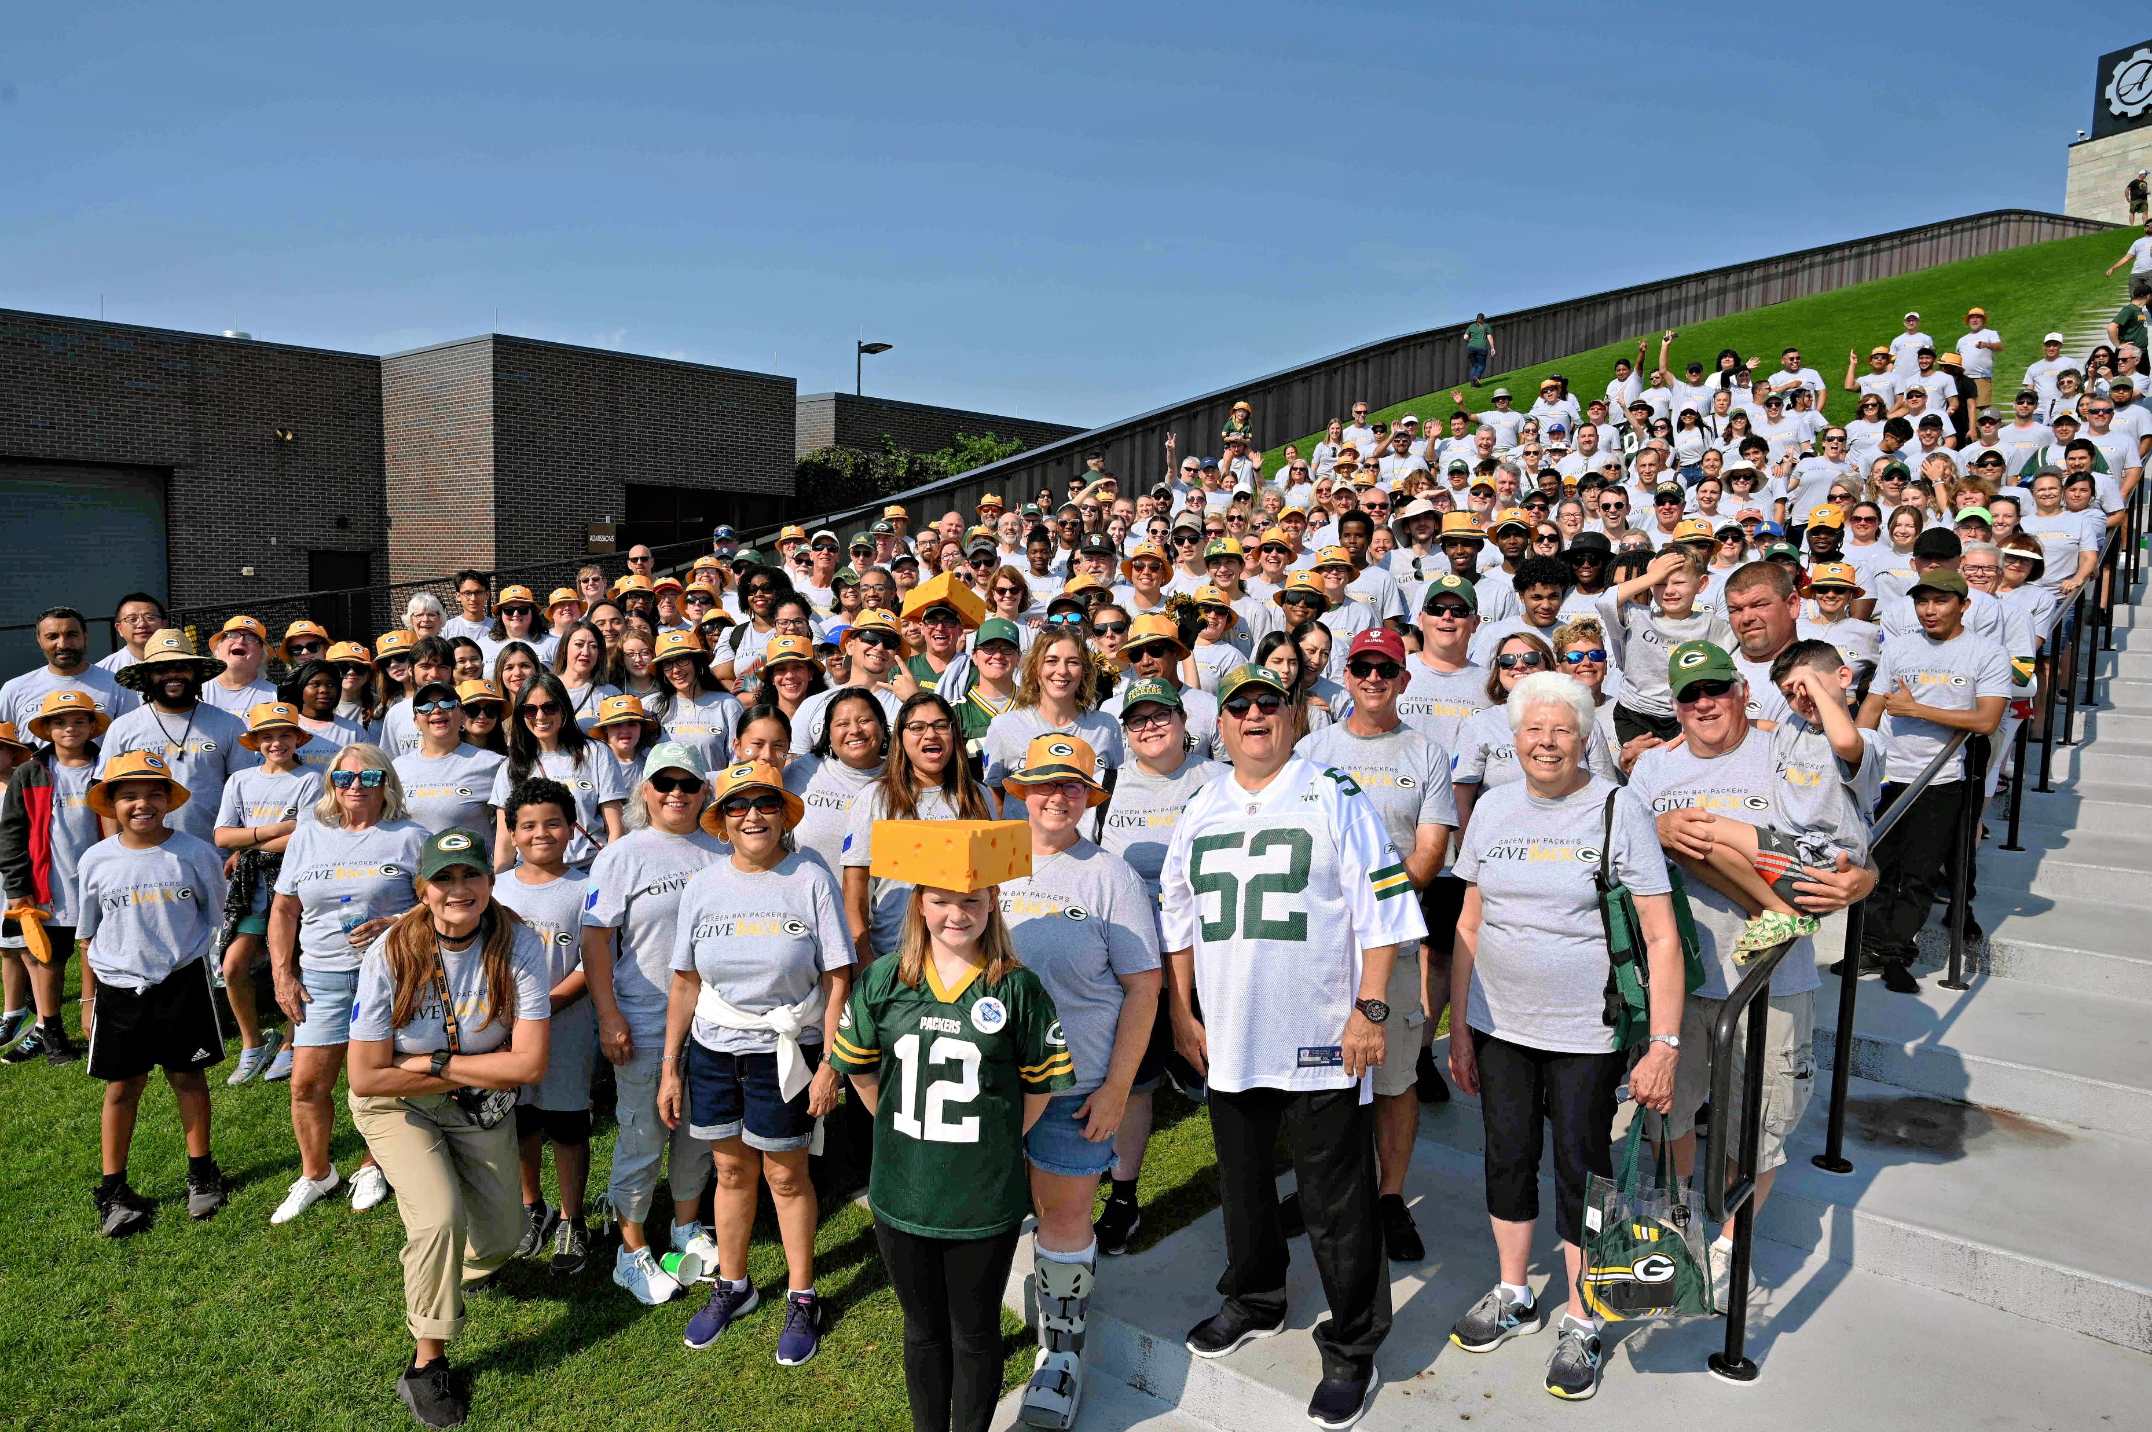
Thank You to Our Funders and Partners
Department of Administration
Bureau of Refugee Programs
Department of Children and Families
Public Service Commission
Department of Public Instruction
Department of Workforce Development (Pilot program)
Green Bay Packers
Lamar Advertising

Slide 13
All member engagement activity
What’s one thing you learned from the students you served in the past year?
Open sharing from agencies: highlight a new program, success, best practice, program expansion
Drawing for WL blanket

Slide 14
Thank you for joining us!
Fall Conference sessions continue after this meeting.

