Slide 2
Keeping up with Microsoft, Google, Zoom and more!
Tricks for technology tenacity
Presented by:
Jamie Kobs and Anna Bierer

Slide 3
What are your recent tech challenges?
Audience Survey

Slide 4
How do I get back to Zoom?
Click on the link to survey in the chat.
Zoom will minimize.
Click the Zoom icon on your computer task bar.
Zoom will maximize.

Slide 5
Digital Resilience (or Technology Tenacity)
The digital skills and confidence that people need to use new and changing technologies.
Digital resilience is important because technology is changing every
day, and we need to learn how to use it and be flexible.
~TIDE (Transforming Immigrant Digital Equity), a project of World Ed

Slide 6
Digital Resilience (or Technology Tenacity)
continuous learning
problem solving
curiosity
transfer
A lot of what I learn is because I have the attitude that something should be possible

Slide 7
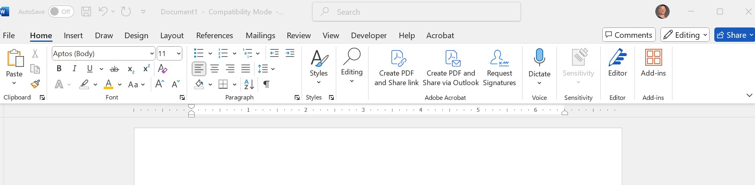
Example tech challenges
What happened to present mode in Microsoft forms?
Where in the menu?

Slide 8
4 Ways to Keep up with Technology

Slide 9
Pop-up Notifications: Google

Slide 10
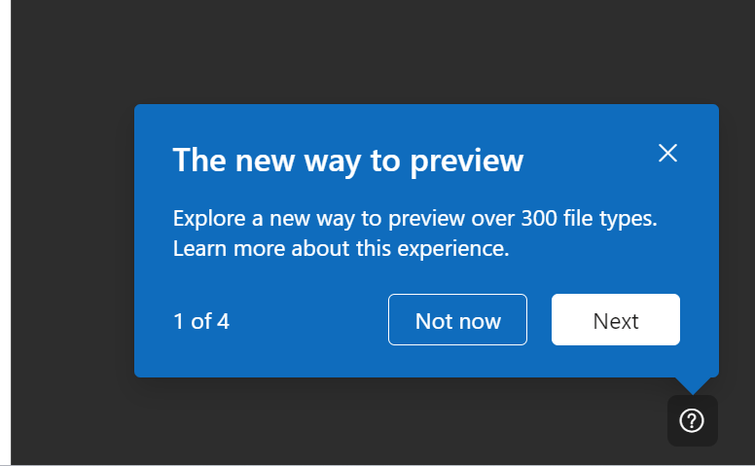
Pop-up Notifications: Microsoft

Slide 11
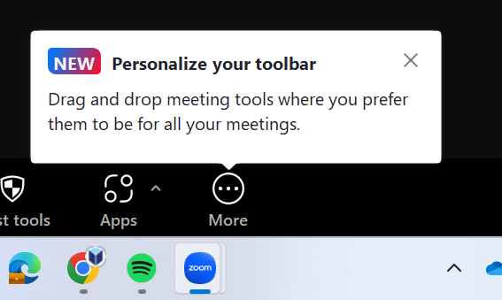
Pop-up Notifications: Zoom

Slide 12
2. Helpful Icons
Recognizable across contexts and devices

Slide 13
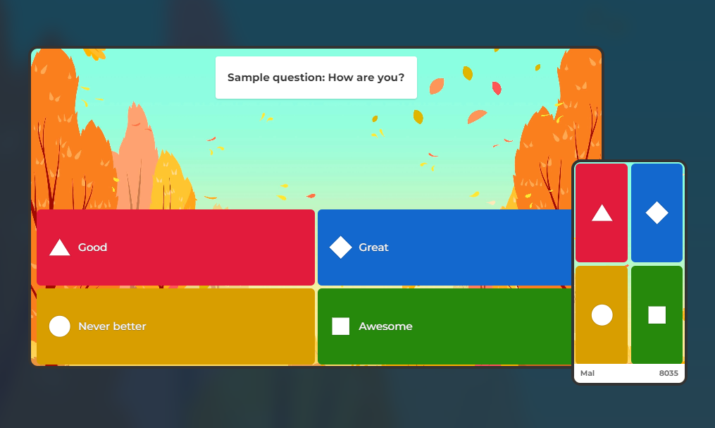

Slide 14
Using Kahoot
Same device as our Zoom call:
www.kahoot.it
Enter PIN
Phone or tablet (different device as our Zoom call):
Scan the QR code with your camera
Pick a nickname
Let's play a Kahoot!

Slide 15
3 and 4. Ask for help
Ask someone for help
Don't let them do it for you!
What did you learn for next time?
Ask the internet
Google or another search engine
YouTube

Slide 16
Tips for Searching Google
Ask your question
Look at the posting date
Consider the format and the source
Tech company tutorials (Google, Microsoft, Zoom, etc.)
Articles or blogs
User forums

Slide 17
When I Asked Google

Slide 18
Tips for Searching YouTube
Go directly to YouTube search bar
Look at video length
Look at posting date

Slide 19
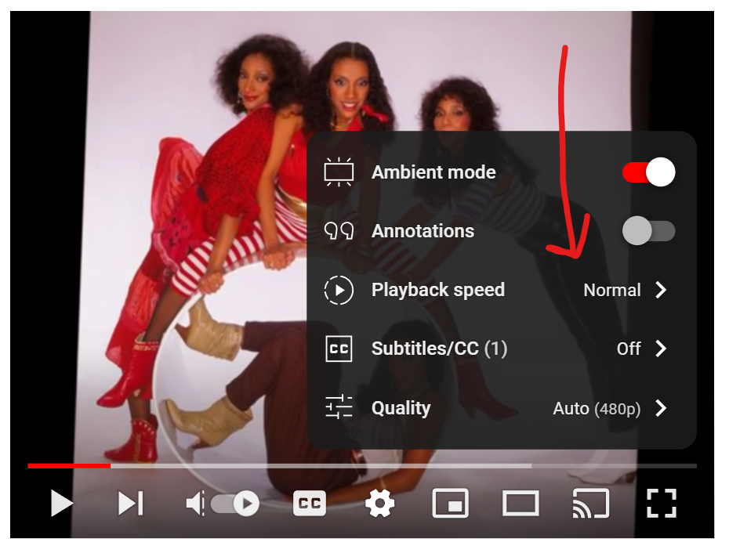
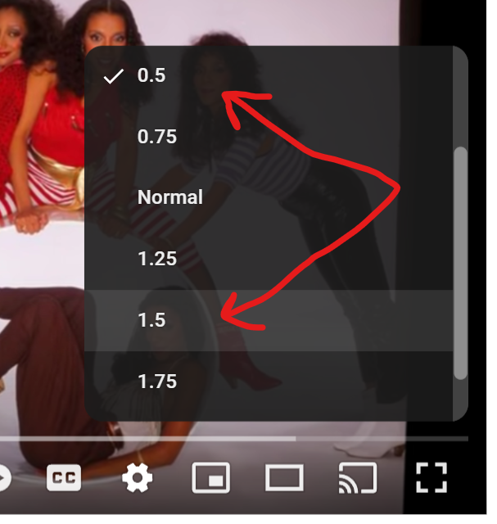
Adjusting speed
1
2
3

Slide 20
Ask YouTube
https://

Slide 21
Breakout rooms
Test your tenacity!
Explore pop-up notifications
Find and use helpful icons
Ask the internet (Google or YouTube)
Teach each other, but...
the goal is transferrable skills!

Slide 22
Breakout rooms
Join the assigned breakout room.
Choose a topic for the group to research.
If you already know how to do it, please don’t share the answer. Participate in the search with the rest of the group.
When you return, share your group's
topic
strategies for being tenacious

Slide 23
Topic Choices (choose 1)
Zoom Challenge: How do I create a recurring Zoom meeting that will be on 2 consecutive Tuesdays, then a Wednesday?
Google Challenge: How do I share a Google Doc with someone but require them to make a copy so that they can’t edit my original document?
Other Challenge: What challenge did you share in our survey?

Slide 24
Support from Wisconsin Literacy
Northstar Digital Literacy Subscription
Digital Literacy Training
How to Teach Digital Literacy (online)
Remote Instruction 101 (online)
Zoom Skills and Strategies (live)
Digital Tools for Teaching (live, monthly series)

