Slide 1
Now What? The State of the Pandemic
Ben Weston, MD, MPH, FAEMS
June 8, 2023
@BenWWeston
beweston@mcw.edu
Notes:
Good morning.
Intro
Job description
I will talk through previous pandemics and learning points from them that led to best practices and then how COVID somewhat upended many of these best practices and lastly how we as a community have responded and some of the current issues we are facing and what to expect.

Slide 2
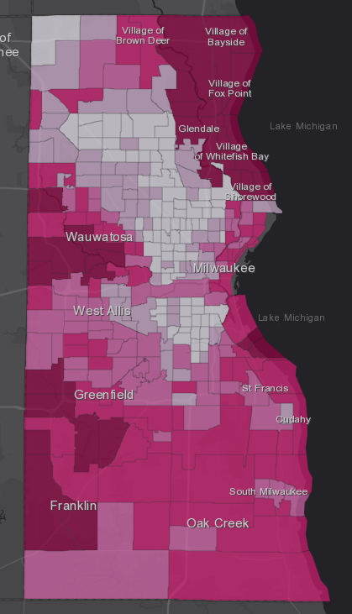
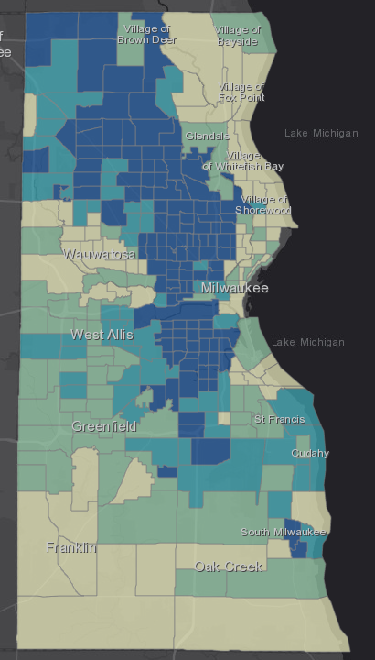
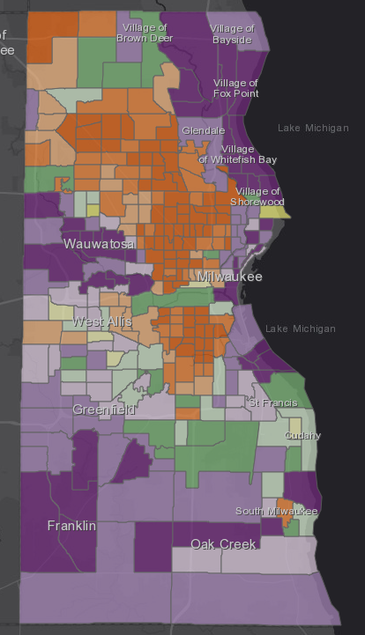
EVE Model
Evaluating Vulnerability and Equity
Vaccination Rates*
Social Vulnerability Index Scores
Equitable Distribution Model Output*
Goal: Move communities from orange to green to ensure that vaccinations are going to those most vulnerable
High Vaccination Low Vulnerability
High Vaccination High Vulnerability
Vaccination Rate
High Vax Rates
High Vulnerability
Low Vax Rates
Low Vulnerability
Low Vaccination
Low Vulnerability
Low Vaccination High Vulnerability
*Sample data were used to generate these maps. These should not be displayed outside of use as an example to further dialog
Weston BW, Swingen Z, Gramann S, and Pojar D: EVE Model: Evaluating Vulnerability and Equity. American Journal of Public Health. 2021.
SVI Score
Notes:
And to further evaluate and address equity in vaccine distribution, we have developed the EVE Model for Evaluating Vulnerability and Equity. This is an extension of the SAFER Model using the same four quadrant design, but now comparing vaccination rates by census tract with the CDC social vulnerability index or SVI score. The SVI uses 15 social factors, including poverty level, vehicle access, and crowded housing to determine vulnerability of communities to adverse events, specifically for emergency events, such as COVID.
The data in the vaccination rates is just illustrative for now and not real data– we are in the process of data use agreements with the state to get that data populated. But you can see that when you combine vaccination rates with SVI, you can develop a need based model for critical resource allocation, in this case, vaccinations. You can see from the four quadrant design that the primary goal would be shift census tracts from the orange color, representing high SVI paired with low vaccination rates, to the green category with higher vaccination rates. This model will be able to identify communities to provide targeted messaging and resource allocation. We hope to have the data for this be publicly available on the county dashboard in the near future.

Slide 3
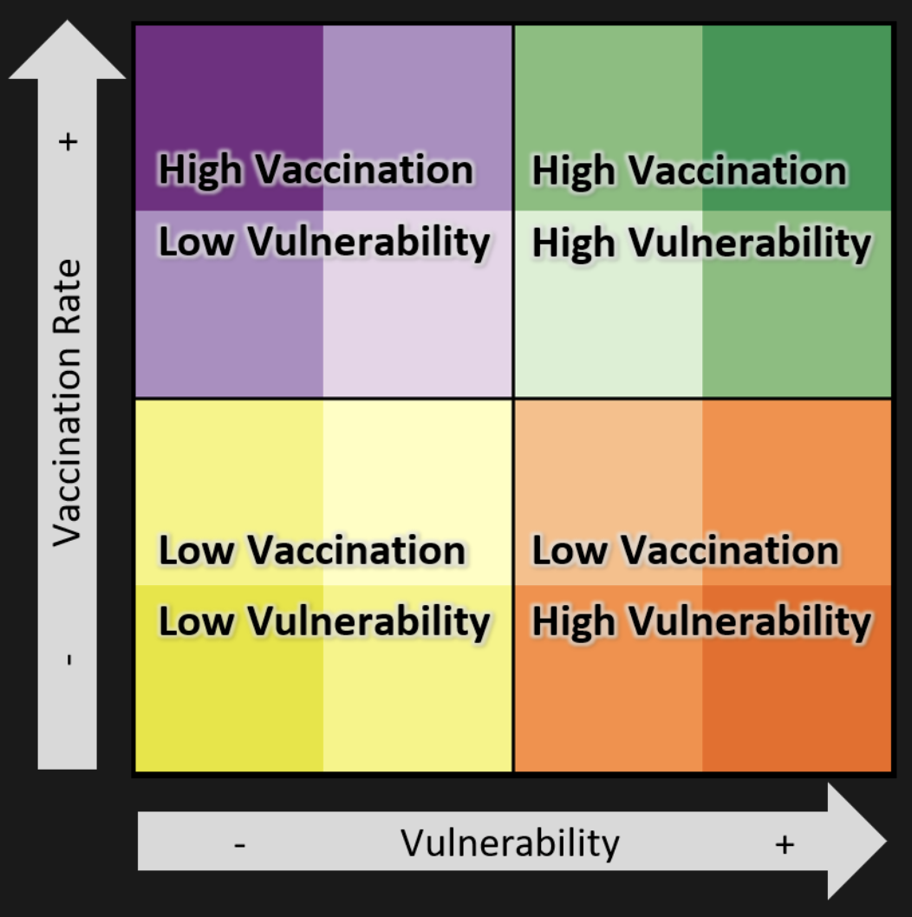
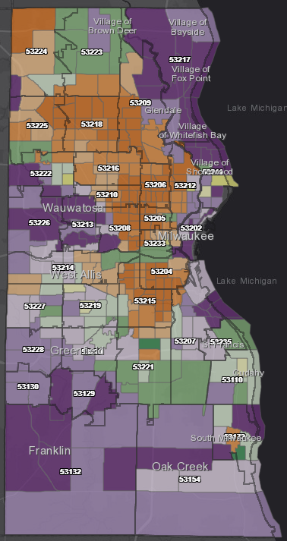
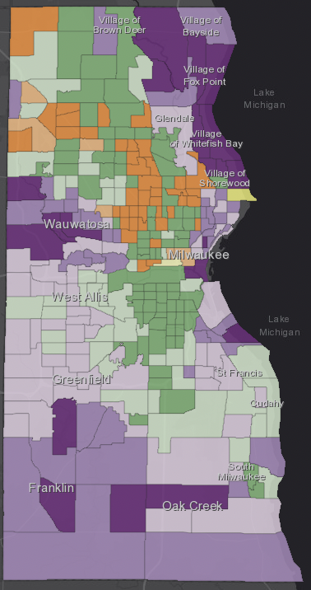
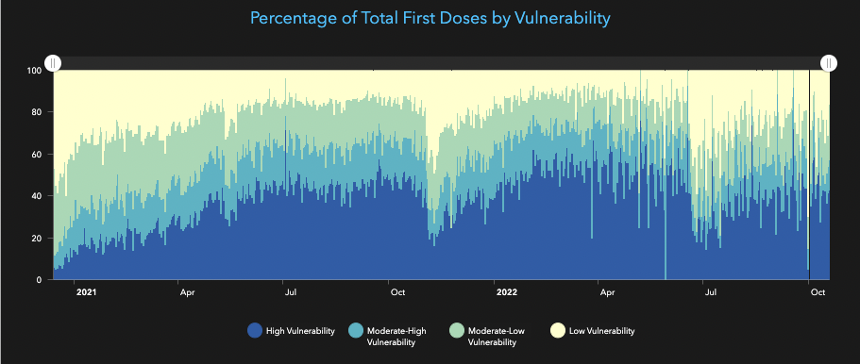
Progress
3/2021
10/2022
Notes:
We have seen a significant shift in the dynamics of the pandemic, as well as the response. One one hand– the positive view– we have seen a partial decoupling of cases from severe disease. That is largely due to immunity– most safely and effectively achieved through vaccination and boosters. So, that is good news, but it is important to remember that a large portion of our population and certainly the global population remains unvaccinated or unable to get vaccinated. Moreover, the pandemic is dynamic. New variants are emerging regularly and becoming more transmissible, though as of recently not more severe. But we can not predict the future and we must remain cautious.

Slide 4
Transitioning to a Post-pandemic Approach
Paula Tran
Division Administrator and State Health Officer
June 8, 2023
Notes:
Vaccine Community Outreach Educational Summit : COVID-19 Vaccine Community Outreach : Health Literacy Programs : Programs : Wisconsin Health Literacy : Wisconsin Literacy, Inc.

Slide 5
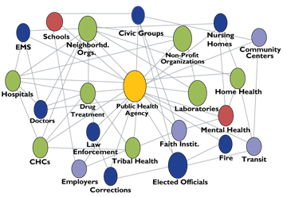
What is Public Health?
…is what we do collectively to assure the conditions in which all people can be healthy.

Slide 6
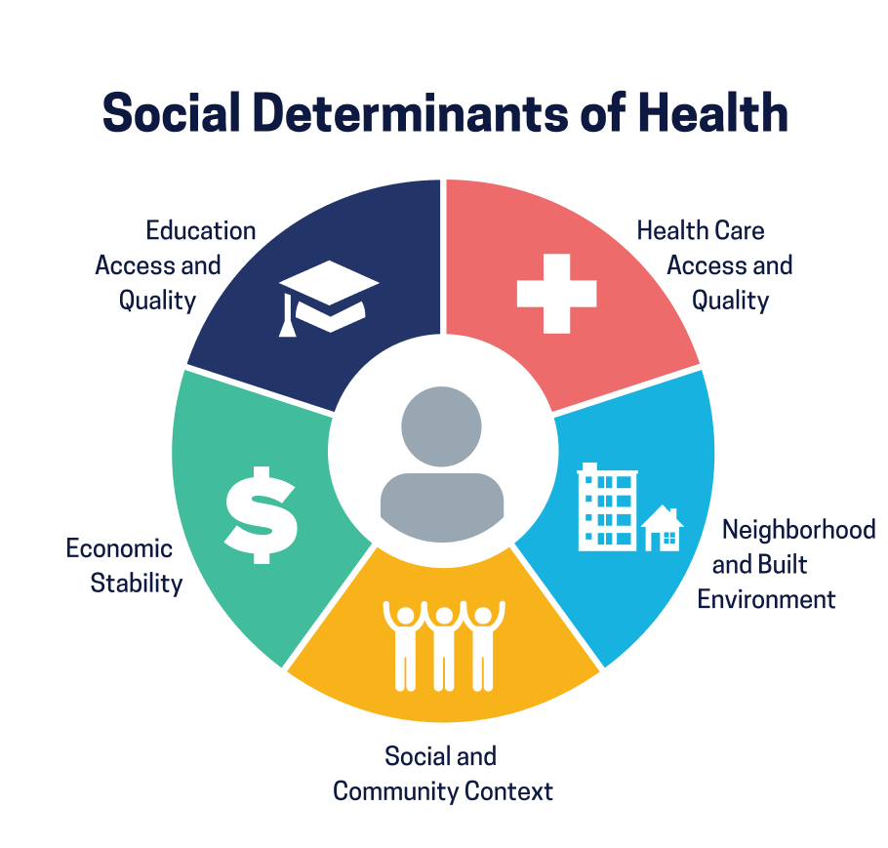
“Conditions in the environments where people are born, live, learn, work, play, worship, and age that affect a wide range of health, functioning, and quality-of-life outcomes and risks” (Healthy People 2030, 2022).
https://health.gov/healthypeople/priority-areas/social-determinants-health

Slide 7
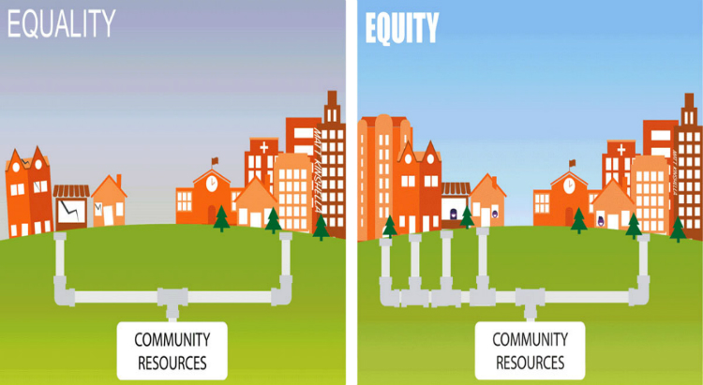
Centering Health Equity
Health equity is when every person has the opportunity to attain their “full health potential” and no one is “disadvantaged from achieving this potential because of social position or other socially determined circumstances.”
https://www.rwjf.org/en/library/infographics/visualizing-health-equity.html

Slide 8
Division of Public Health Scope
Aging and Disability Resources
Communicable Diseases
Community Health Promotion
Environmental and Occupational Health
Operations
Health Informatics
Public Health System Policy and Practice Alignment
Preparedness and Emergency Health Care

Slide 9
Pandemic State: Surge
Prevention & Mitigation
Surveillance, science & strategy
Operations
Budgeting, HR, and Finance
Engagement & Partnerships
Communications
Community grants
Disease Treatment
Testing
Vaccination
Preventive Therapeutics
Health care
Therapeutic Treatment
Test-to-Treat
Data management, infrastructure, and linkages
Logistics, Materials and Warehouse
Public health and health care partner connections
High public interest
High political will
High sense of urgency
Resource abundance
Notes:
The COVID 19 Pandemic is Winding Down, What does this mean for public health?
-Pandemic state/Surge state: What did the COVID 19 response look like
High public interest
High public desire for guidance to inform action
High political will to address issue
Sense of urgency
Top 10 public health issues in WI
Health equity
-COVID-19 as a part of routine public health practice and management
Challenges for usual work:
-less public interest and urgency
-fewer resources
What does this mean for our work
-invest in partnerships and coalitions
-invest in coordination and alignment
-support the leadership of those most impacted
-leverage diverse and creative resources and investments
-Invest in thoughtful communication and communication capacity building

Slide 10
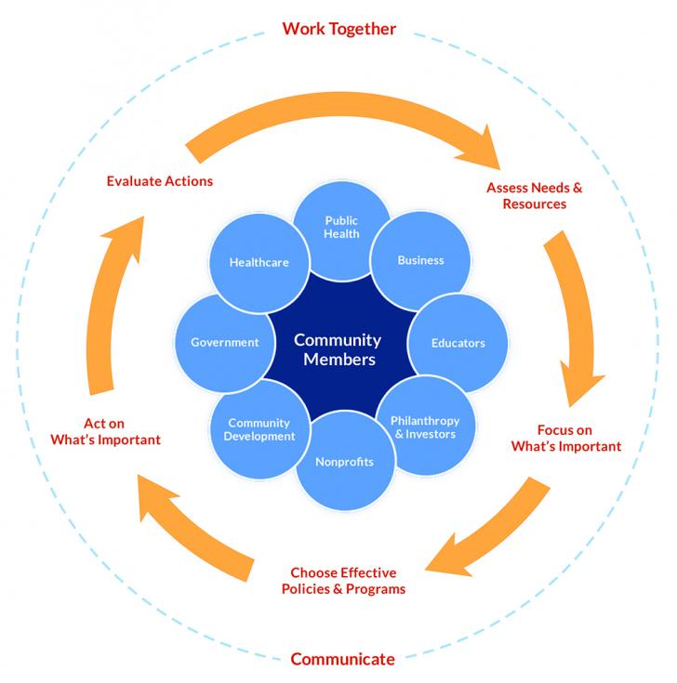
Post-Pandemic transition: What does this mean for the work?

Slide 11
What does this mean for the work?
Address equity and disparities
Partnerships and coalitions
Coordination and alignment
Building the leadership of those most impacted
Leveraging diverse and creative resources and investments
Communication and communication capacity building
Surveillance and research

Slide 12
What does this mean for those still working on COIVD-19 Outreach?
Expect the public to be less engaged in Covid-19.
Build engagement strategies around an expectation of “Covid fatigue”.
Openly acknowledge people’s barriers and reasons for vaccine hesitancy
Expect Covid-19 outreach to become absorbed into a larger set of priorities
Infuse Covid-19 prevention concepts into existing community events, activities, and initiatives.
Connect the public to local partners and resources.
Address needs that continue to exist
Continued interest/questions around: vaccines for children, what to do if you get sick with Covid-19, boosters and variants

Slide 13
The COVID 19 Pandemic is Winding Down… What does this mean for public health?
Transitioning to a Post-pandemic Approach

Slide 14
Post-pandemic transition: Education, Prevention, Surveillance, and Outbreak response
Prevention & Mitigation
Surveillance, science & strategy
Operations
Budgeting, HR, and Finance
Engagement & Partnerships
Communications
Vaccines for Children
Data management, infrastructure, and linkages
Logistics, Materials and Warehouse
Public health and health care partner connections
Decreased public interest
Decreased political will
Decreased sense of urgency
Animosity
Decreased resources
Notes:
The COVID 19 Pandemic is Winding Down, What does this mean for public health?
-Pandemic state/Surge state: What did the COVID 19 response look like
High public interest
High public desire for guidance to inform action
High political will to address issue
Sense of urgency
Top 10 public health issues in WI
Health equity
-COVID-19 as a part of routine public health practice and management
Challenges for usual work:
-less public interest and urgency
-fewer resources
What does this mean for our work
-invest in partnerships and coalitions
-invest in coordination and alignment
-support the leadership of those most impacted
-leverage diverse and creative resources and investments
-Invest in thoughtful communication and communication capacity building

Slide 15
VISION: All people and communities in Wisconsin have the opportunities and supports they need to reach their full potential
Foundational shifts
Institutional and systemic fairness (addressing the “-isms”, including structural racism)​
Representation and access to decision-making (shifting and sharing power)​
Community-centered resources and services (includes funding and community input)​
Priority areas
Social and community conditions
Economic well-being
Supportive systems of dependent care
Healthy housing
Physical, mental, and systemic safety (including trauma, violence, systemic oppression)
Person and community centered health care (including dental and other care)
Mental and emotional health and well-being (including treatment and care, substance use)
Social connectedness and belonging (including civic engagement)

Slide 16
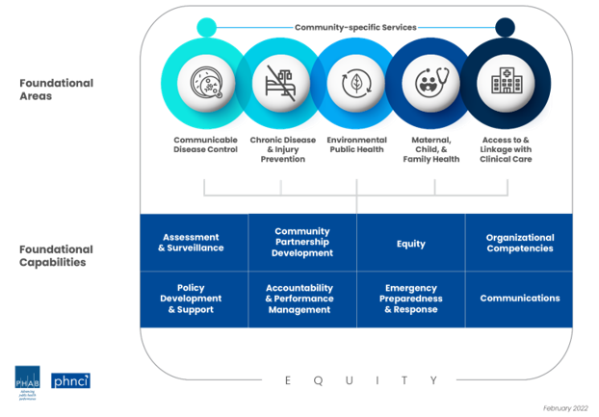
Investing in Public Health Infrastructure

Slide 17
Confronting the 'post-COVID' mentality: Strategies for effective vaccine communication and community outreach
8 June 2023
Mikhaila N. Calice, MPA
PhD Candidate
Department of Life Sciences Communication
University of Wisconsin-Madison

Slide 18
Today I will discuss with you:
What makes individuals vaccine hesitant/ resistant?
What are some communication and outreach strategies that can help overcome hesitancy?

Slide 19
How vaccine hesitant are Americans today?
31% would not
get an annual
COVID-19 vaccine
Notes:
31% of Americans would for sure not get a COVID-19 vaccine if it was offered annually

Slide 20
The science of science communication can help us contextualize why this is and what to do about it
Notes:
Science communication informed national strategies for responding to COVID-19

Slide 21
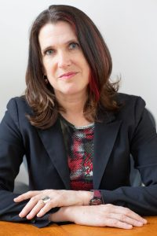
Attitudes about vaccines and other science issues depend on several factors…
Socio-political & cultural context
Information climate
Individual level characteristics
Wirz, C. D., Scheufele, D. A., & Brossard, D. (2020). Societal Debates About Emerging Genetic Technologies: Toward a Science of Public Engagement. Environmental Communication, 14(7), 859–864. https://doi.org/10.1080/17524032.2020.1811478
Notes:
From Wirz et al:
Sociopolitical & cultural: Religion, Institutions, Socio-economics, Culture
Information Climate: media coverage, marketing messages, TV & film, Educational messages
Individual characteristics: attitudes towards science, deference, perceptions of risks and benefits, trust in info providers, knowledge about the issue, interpersonal exchanges, moral considerations, personal experiences
https://lsc.wisc.edu/facstaff/brossard-dominique/

Slide 22
Debunking the “knowledge-deficit model” and rethinking science literacy
Assumption:
If people were only more informed, they would be more supportive of science…
THE BEST SCIENCE INFORMATION
≠
PUBLIC SUPPORT
(Brossard & Shanahan, 2003; Priest, 1995, 2001; MacDonald et al., 2020)
Notes:
Science literacy: Access to science—whether using knowledge or creating it—necessitates some level of familiarity with the enterprise and practice of science: we refer to this as science literacy.
What is the evidence of enhanced scientific literacy on support for, attitudes toward science, and health literacy?

Slide 23
Debunking the “knowledge-deficit model” and rethinking science literacy
Assumption:
If people were only more informed, they would be more supportive of science…
THE BEST SCIENCE INFORMATION
≠
PUBLIC SUPPORT
Information/knowledge matters in different ways for different groups
(Brossard & Shanahan, 2003; Priest, 1995, 2001; MacDonald et al., 2020)
Notes:
Science literacy: Access to science—whether using knowledge or creating it—necessitates some level of familiarity with the enterprise and practice of science: we refer to this as science literacy.
What is the evidence of enhanced scientific literacy on support for, attitudes toward science, and health literacy?

Slide 24
“Low-information publics” make sense of information through different filters
How much information do I need to decide?
What do my friends and family think?
How do the media around me define and interpret this?
How do those interpretations fit with my beliefs and other values?
It is crucial to understand the specific context is which we operate
Notes:
People are 1) cognitive misers (Fiske & Taylor, 1991) who 2) look for shortcuts in decision making (Popkin, 1991), and will 3) take a convenience sample of media nearby, and 3) check information against value predispositions, like political ideology and religiosity,

Slide 25
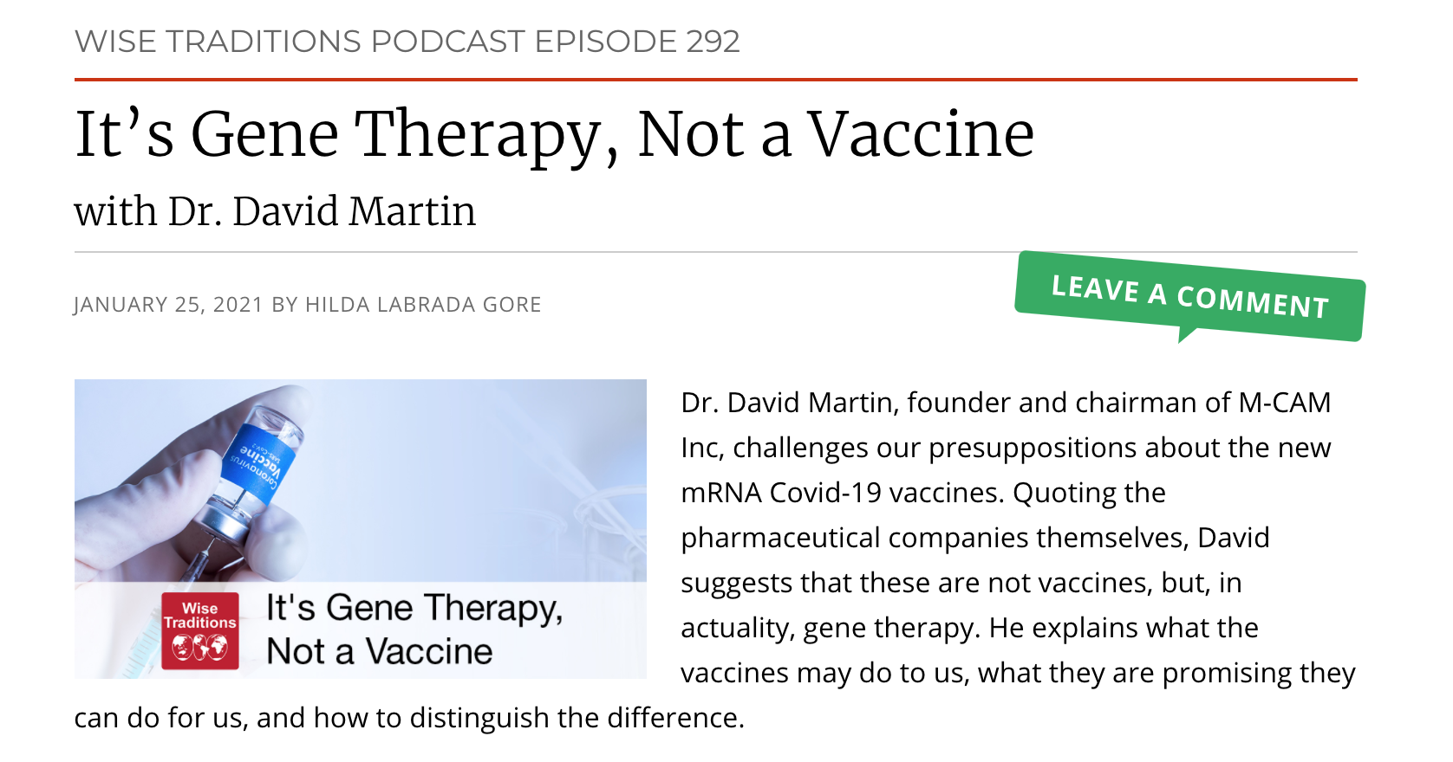
Information environments and individual characteristics shape how we understand science
Notes:
… and “media frames” do not operate in a vacuum
Audiences process frames and information through their own perceptual filters, including
Political ideology
Religious beliefs
Moral schema
Views of nature
Deference to scientific authority
Trust in information sources
Attitudes toward technology
…
As a result: Any given frame may mean different things to different people.

Slide 26
Risk communication can teach us a lot about public perceptions of vaccines
RISK = HAZARD + OUTRAGE
The risks that kill people the most and the risks that upset people the most are often unrelated
Potential impact is what people care about
Impact can be RISKS or BENEFITS
Concern is influenced more by qualitative factors rather than quantitative risk assessment
Brossard, D. (2019, Fall). LSC 625: Risk Communication. University of Wisconsin-Madison, Department of Life Sciences Communication.
Notes:
Shark attacks vs. falling down stairs/ heart disease
“potential” what ppl assume/ perceive in the hypothetical
MAGNITUDE > PROBABILITY – so even if something is unlikely to happen (nuclear disaster) the magnitude of that potential impact weighs more heavily in impacting perceptions of risk than the “actual risk” that is probabilistically likely

Slide 27
Risk communication tells us that concern is influenced more by qualitative factors rather than quantitative ones
More concern:
Less concern:
Involuntary
Controlled by others
Unclear benefits
Man-made
Unfamiliar
Affects some more than others (e.g., kids)
Voluntary
Under your control
Clear benefits
Natural
Familiar
Affects everyone equally
Brossard, D. (2021, March 18). Public Attitudes and Climate Change. Presentation with the League of Women Voters of Beloit, (virtual).
Notes:
Ok – before I introduce you to these qualitative factors, if climate change isn’t already primed in your mind. Let’s bring it there. So think about climate change – and climate change mitigation efforts or new/emerging energy technologies:

Slide 28
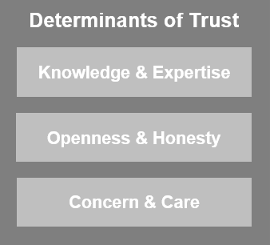
But wait! Trust also matters…
People are more receptive to information from sources that they trust
How to erode trust & credibility:
Ignoring or downplaying perceptions of risk
Trying to persuade our audiences that experts are right, their perceptions wrong
Concealing risk/ scientific uncertainty
Assuming “education” is the only answer
(Brossard, 2021)
Notes:
It is not that people do not trust the science or ignore scientific facts
They trust the “science” that supports their beliefs
“Trust” is a major predictor of risk perception (e.g. for gene techology) (Siegrist, 2000)
Acceptance of a message is often more closely related to the perceived “trustworthiness” of the messenger than the content of the message itself
Stronger correlation between “trust” and acceptance and seeing more benefits than risk, than between knowledge and acceptance (Brossard & Nisbet, 2007)
Like Priest article found that perceptions of trust varied across types of risks, also vary across social institutions
This model also incorporates the knowledge aspect as a predictor of trust in groups and institutions instead of a direct predictor of risk perceptions,
Strong correlation between perceived “trustworthiness” and frankness about scientific uncertainty.
Desire to be given the “straight facts”
Removing uncertainty raises alarms, sounds patronizing

Slide 29
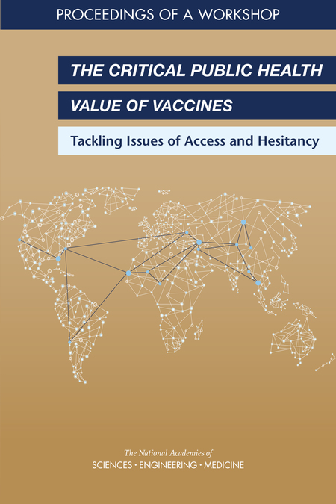
Engaging communities to effectively communicate about vaccines
YOU are the trusted messenger… what do you know about your audience?
Goal: plant a seed and promote information seeking
Strategies:
Meet audience where they are
Establishing trust requires relationship building…
…that takes more than a single 20-minute visit
Find out what their concerns are, listening is key
Is it worth trying to persuade?
Remember, established attitudes are extremely hard to change – who is on the fence?
Notes:
Find out what their concerns are, listening is key
Ponder if it is worth to try to persuade.
Established attitudes are extremely hard to change
Rely on trusted messengers (“have you heard xx talk about this?”)
Remember that often planting a seed is what is needed, as well as promoting information seeking
Kaiser Poll March 2021:
“Of those in the “wait and see” group, half said they would be more likely to get vaccinated if it were offered to them during a routine medical appointment.
37% said they would be more likely if their employer arranged for on-site vaccinations at their workplace.
37% said they would be more likely if their employer offered to pay them an extra $200 to be vaccinated.”
NASEM report shows:
Positive impact of community-based interventions
Considers how to harness cultural insights to increase vaccine uptake
The role of physicians (as trusted messengers) in building vaccine confidence and acceptance
Communicating with vaccine-hesitant parents
“Community Literacy” (explained in previous highlighted NASEM report

Slide 30
Some main takeaways…
MORE INFO ≠ ATTITUDE CHANGE
we all use heuristics to form opinions and attitudes
CONSIDER THE SOCIO-POLITICAL & CULTURAL CONTEXTS
our information environments are powerful - look for shared values
HOW WE FRAME SCIENCE ISSUES MATTERS
messages resonate differently with people
tell the stories that reflect the communities you’re working with
TRUST IS ESSENTIAL
familiarity builds trust – meet people where they are
ENGAGE COMMUNITES AND RELEVANT STAKEHOLDERS
know your audience!
what are their concerns? do cultural contexts help inform their perspective?
Notes:
Need to shorten & adjust

Slide 31
Thanks! Questions?
Mikhaila Calice
mcalice@wisc.edu
@MikhailaCalice
scimep.wisc.edu

Slide 32
Panel Discussion
Type a question for any/all presenter(s) in the chat.

